Slide 1


SafeShare
3Tier Architecture
on AWS
Capstone Portfolio / Cloud Engineer
By: Faramarz Karamizadeh Sep.2026

Slide 2
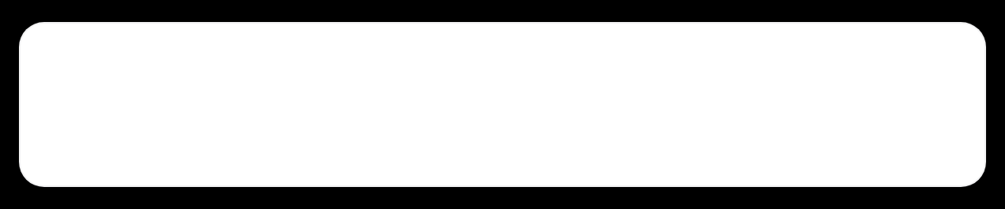




Scalable sharing without single failure
01
Problem
Single EC2, single disk = single point of failure. Files disappear on replacement, no HA across AZs, no scale.
02
Solution
3Tier with ALB → ASG → S3. Stateless Flask on private EC2, central S3 for persistence, cron bidirectional sync every 60s.
03
Key design
Public ALB in public subnets, private EC2 with no public IP. Secure access via IAM policy.
04
Monitoring
Athena+CUR
CloudTrail

Slide 3

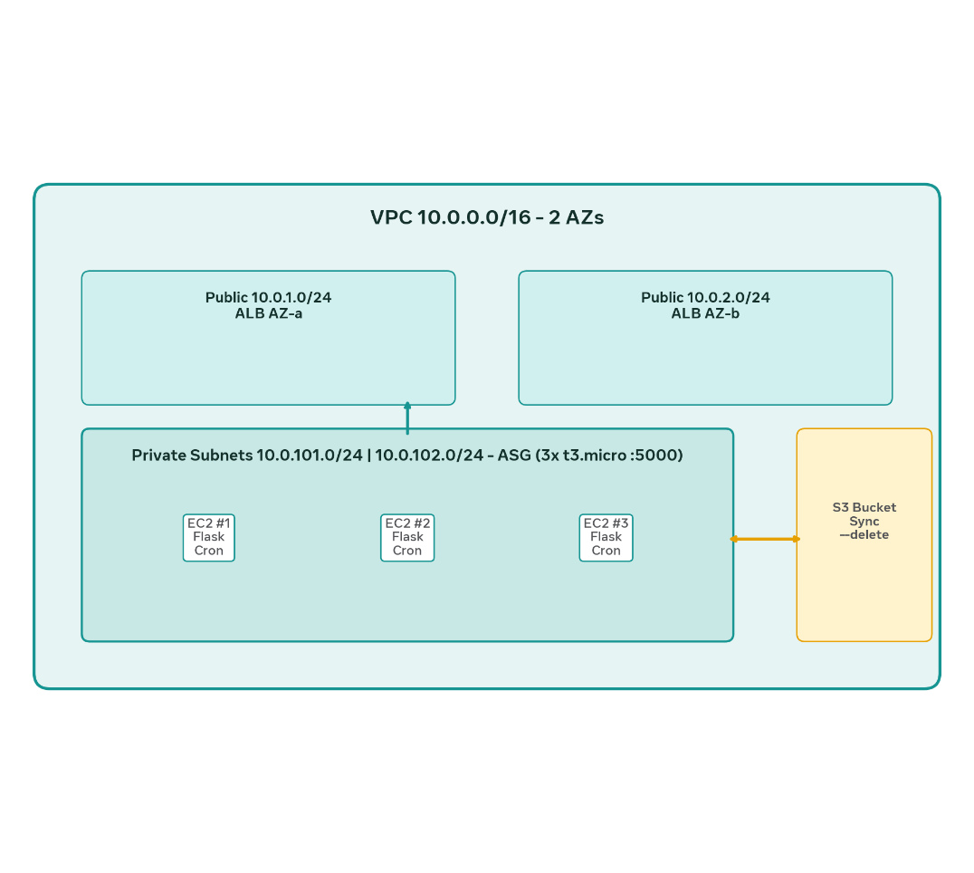




VPC 10.0.0.0/16 across 2 AZs — public for ALB, private for compute
VPC: 10.0.0.0/16
NAT → IGW
IGW → Internet
PUBLIC AZ-A
PUBLIC AZ-B
10.0.1.0/24
10.0.2.0/24
ALB subnet, route to IGW, high availability
ALB subnet second AZ, HA failover
PRIVATE AZ-A
PRIVATE AZ-B
10.0.101.0/24
10.0.102.0/24
ASG EC2, no public IP, isolated
ASG EC2, SSM only access

Slide 4


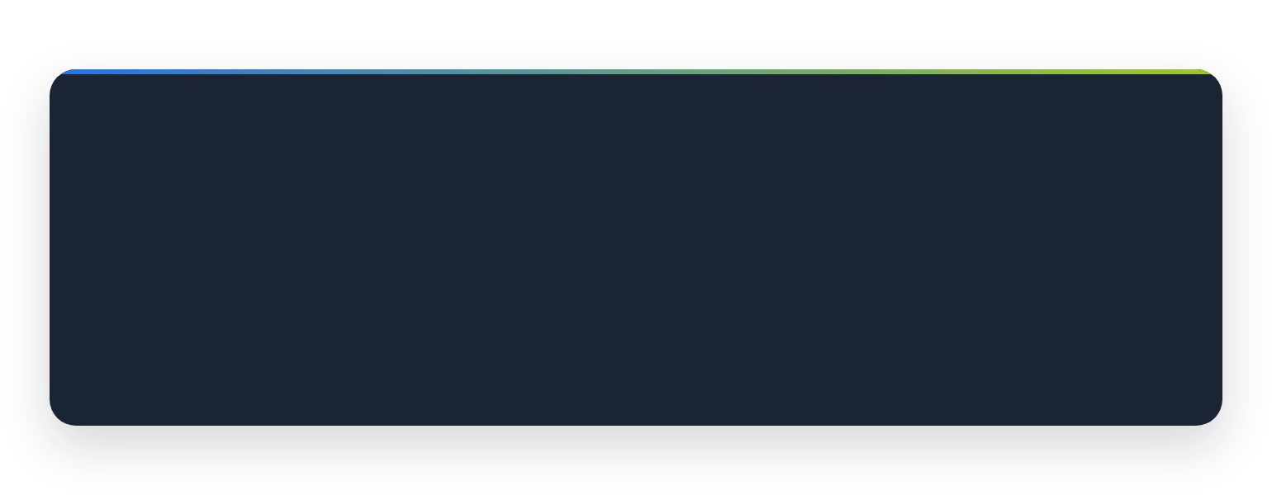






S3 is the source of truth
STORAGE TIER
#!/bin/bash — /usr/local/bin/sync-to-s3.sh
BUCKET="safeshare-files-99"
DIR="/home/ec2-user/uploads"
LOG="/var/log/s3-sync.log"
# Bidirectional — keeps all nodes in sync
aws s3 sync $DIR s3://$BUCKET/
aws s3 sync s3://$BUCKET/ $DIR
chmod -R 777 $DIR; chown -R ec2-user $DIR
safeshare-files-99 • persistent
Central persistent storage
S3 survives instance replacement. No EFS cost, native versioning.
Bidirectional sync
CRON SCHEDULE
LOG FILE
Upload on any EC2 → S3 → all EC2s. Delete propagates with --delete flag could implement.
* * * * * — every 60s
/var/log/s3-sync.log
Fix: cronie on AL2023
dnf install cronie + systemctl enable crond --now

Slide 5

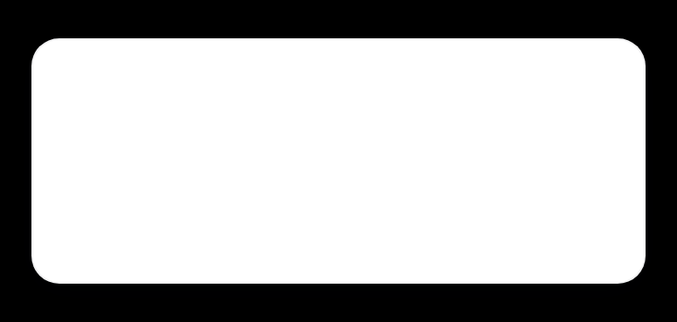
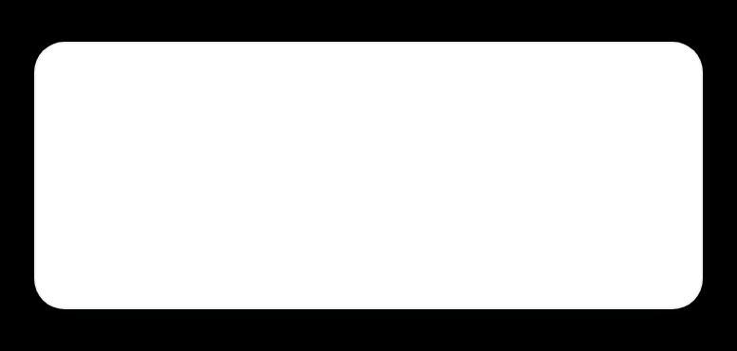
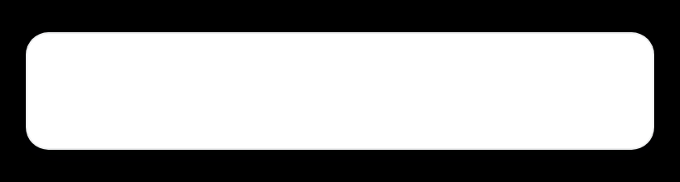
Private by design, secure via IAM
IAM Role: SafeShare-EC2-Role
Assume: ec2.amazonaws.com • Profile: safeshare-ec2-profile
EC2 instances have no public IP. All access and sync is controlled by least-privilege IAM role.
Policy 1: AWS Managed
Policy 2: Custom S3
AmazonSSMManagedInstanceCore
s3:ListBucket on bucket
No public IP
Session connect & logging
s3:PutObject, GetObject
Isolated private subnets 10.0.101/102.0/24
No key pair needed
s3:DeleteObject on /*

Slide 6

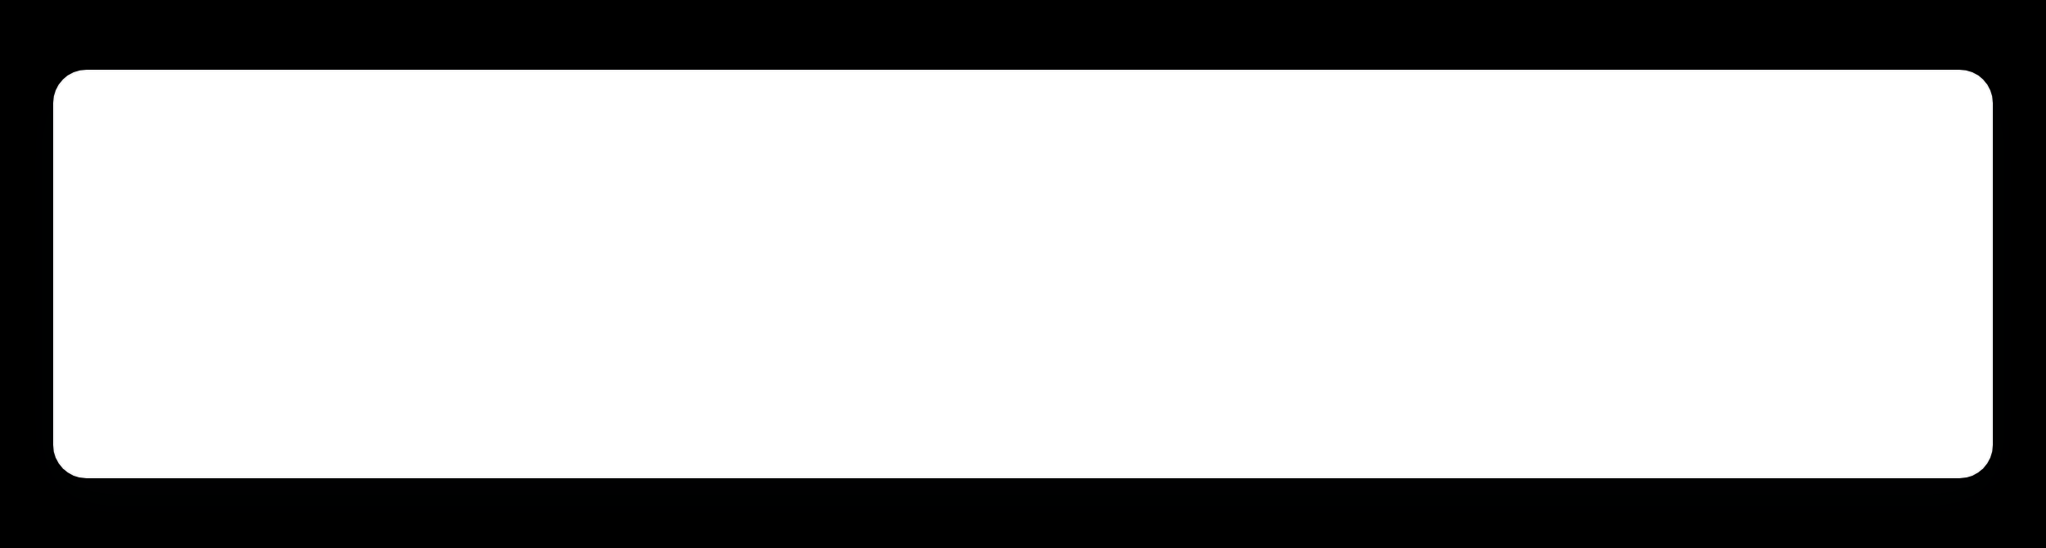

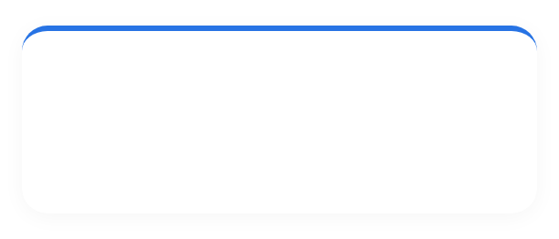






Upload hits ALB, lands on EC2, then cron syncs to S3
DATA FLOW
Bidirectional sync ensures every EC2 sees same files within 60 seconds.
1
User → IGW → ALB
2
ALB → Target Group
3
EC2 Flask save
4
Cron → S3 → All EC2s
Browser upload over 80/443. IGW routes to ALB in public 10.0.1.0/24 / 10.0.2.0/24.
TG SafeShare-TG :5000 health /health every 30s. Picks healthy EC2.
Flask saves to /home/ec2-user/uploads. Instance ID shown in UI for tracking.
* * * * * aws s3 sync --delete both ways. Log /var/log/s3-sync.log.

Slide 7
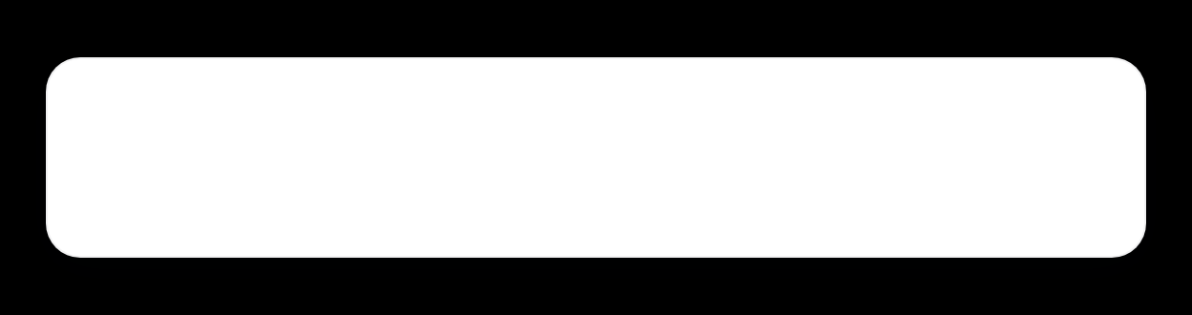




Highly available, persistent, and cost optimized
3-tier holds under replacement, scales with ASG, and syncs via S3 within 60s — no single point of failure.
HA across 2 AZs 10.0.1/2.0 & 101/102.0
Persistent via S3 sync
ALB in public subnets, EC2 in private. If AZ-a fails, AZ-b serves. Private has no public IP.
Central bucket safeshare-files-99 — bidirectional --delete every minute.
Self-healing & zero-downtime
Cost optimized & scalable
ASG min 3 / desired 3 / max 6. Instance refresh replaces with launch template t3.micro AL2023.
t3.micro . Scales automatically, logs at /var/log/s3-sync.log
Flask :5000 in /home/ec2-user/uploads • cron * * * * * • Health /health 30s
3
60s
DESIRED EC2
SYNC INTERVAL

Slide 8
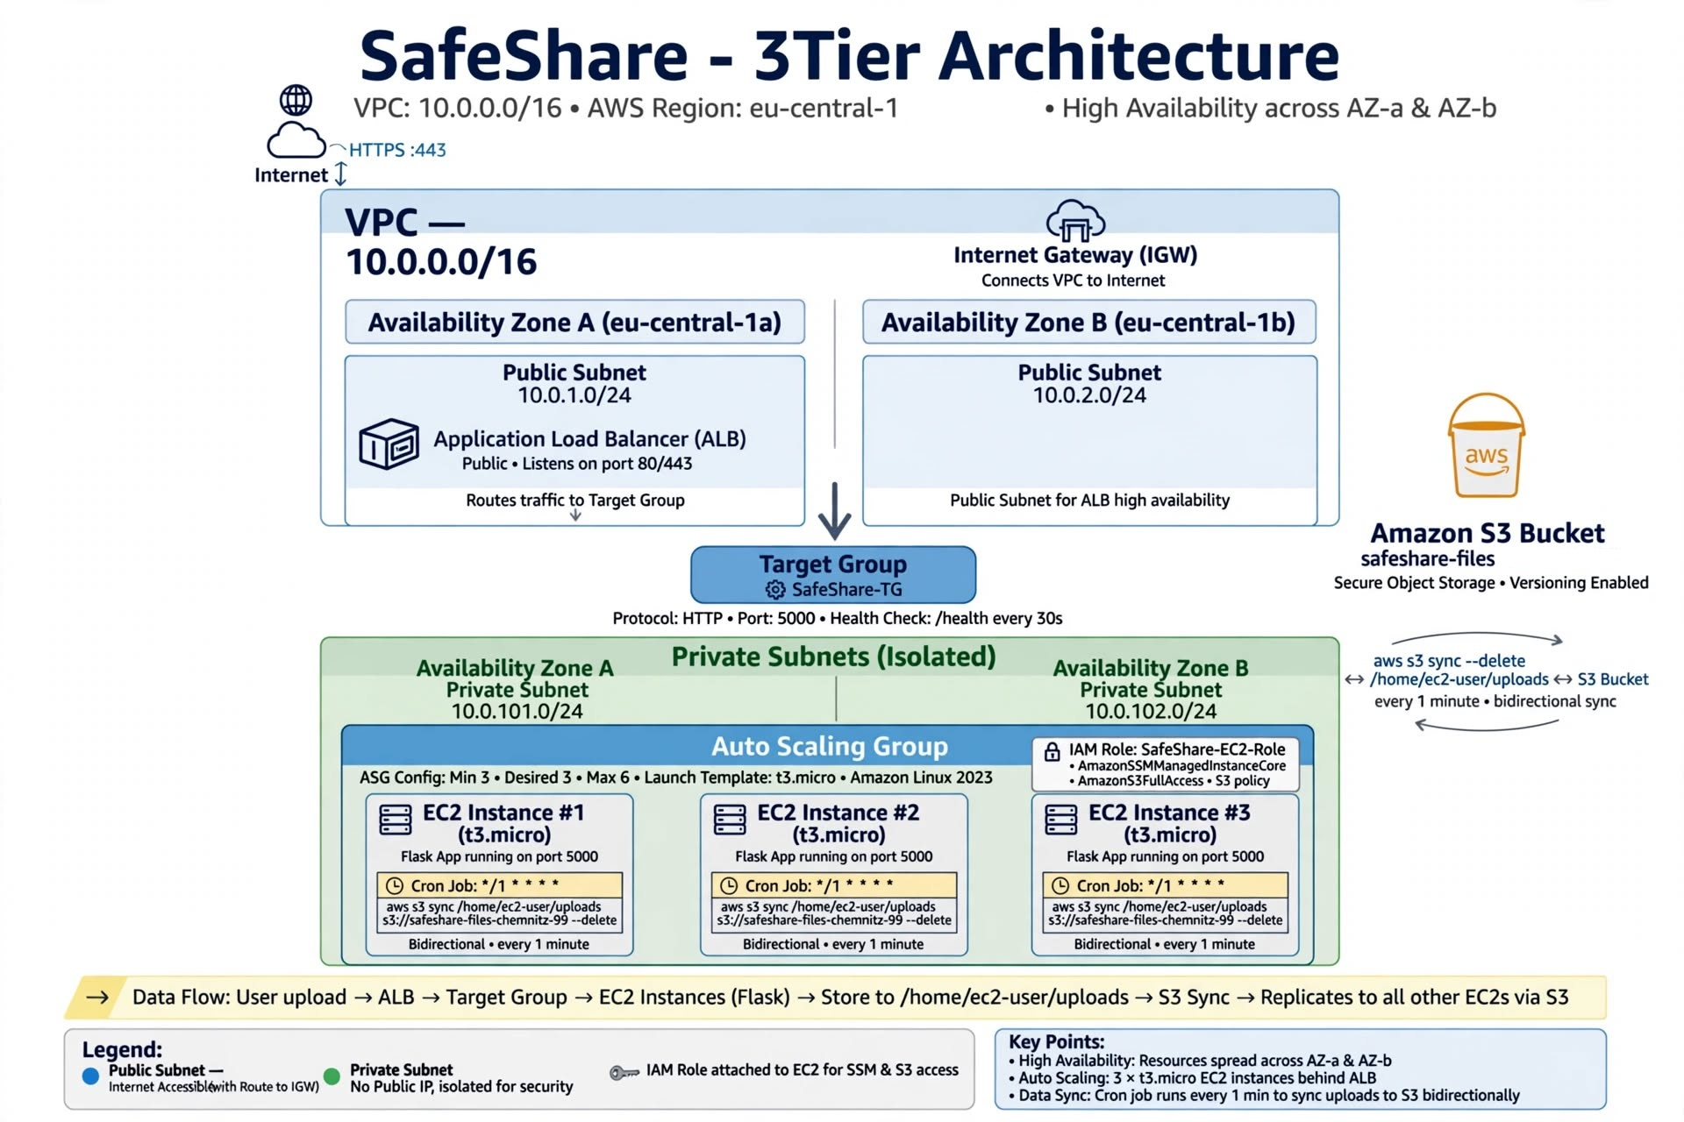

Slide 9
Live Demo

Slide 10



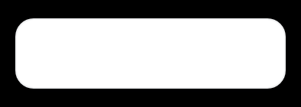
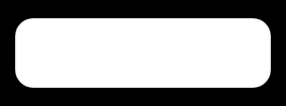
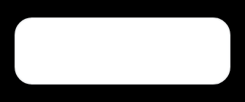
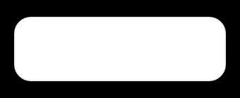
Q&A • SAFESHARE
Thank you!
Let's scale it.
RDS for metadata
CloudFront CDN
HTTPS / ACM
S3 versioning

