Slide 1



Instrumented & Monitored Cloud Service
Observability
Monitoring
Cloud Engineer / Ironhack
Faramarz Karamizadeh, Aug.2026

Slide 2

Agenda
1
1. Architecture & Instrumentation
16 widgets
2
2. Live Demo — Dashboard & Monitoring
• Period 60s • SingleValue + Golden Signals + Correlation
3
3. Incident Response Simulation
5 Custom metrics
4
4. Alerting & Response
request_count • api_latency • error_count • orders_per_minute • order_value
5
5. Improvements
6
6. Q&A

Slide 3



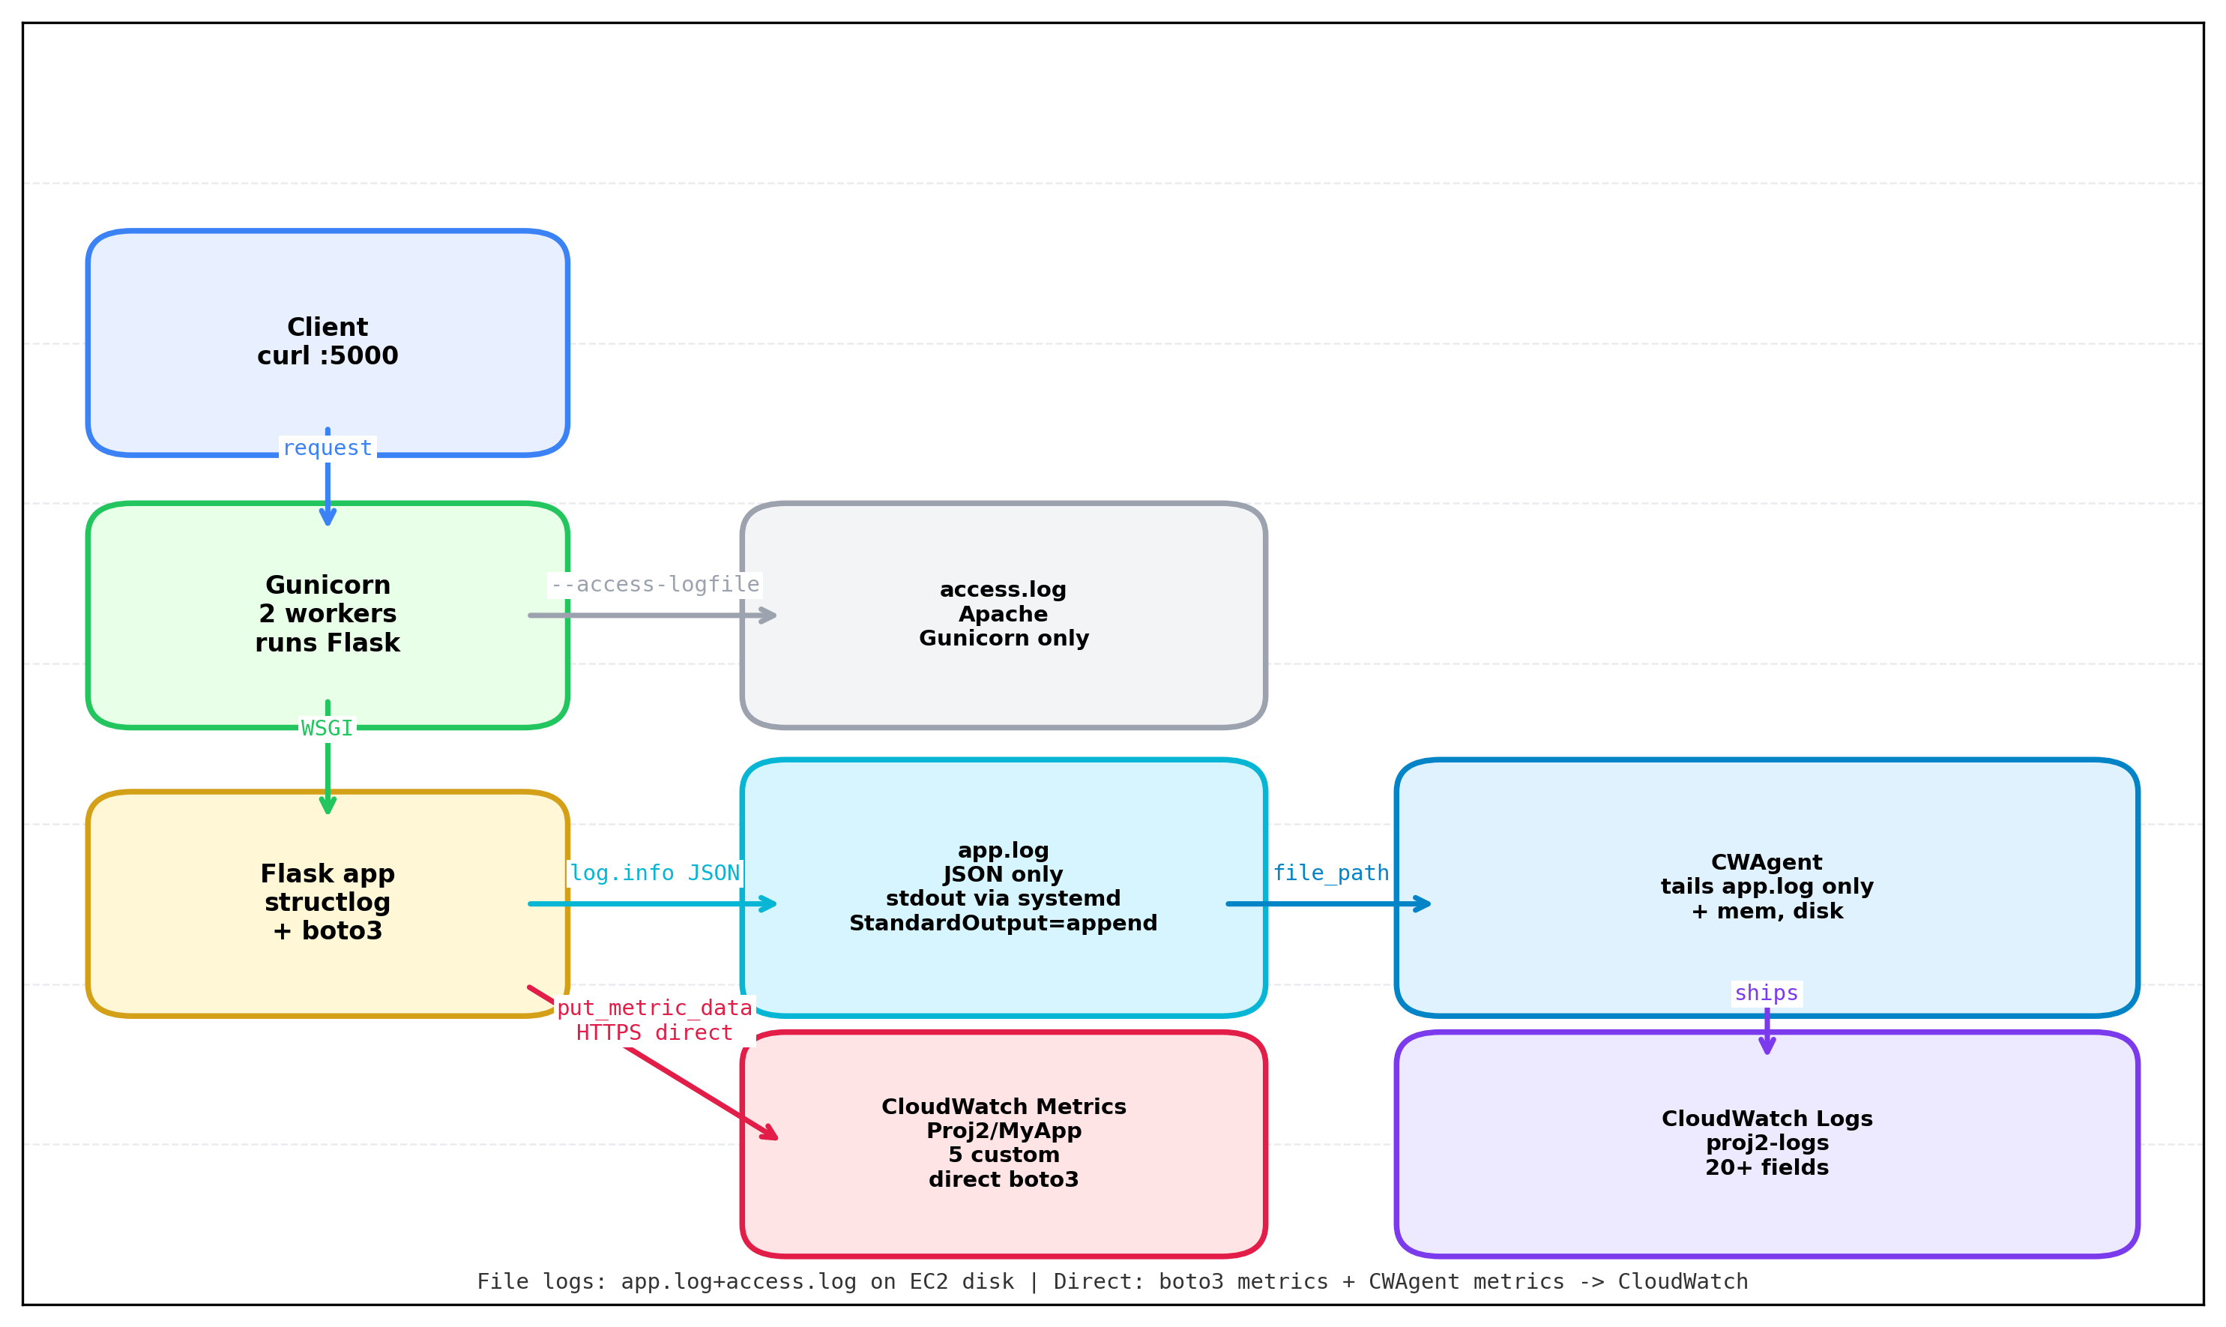
Architecture
INSTANCE
METRICS
LOGGING PIPELINE
i-01bxxx myapp.service • Flask + Gunicorn 2 sync workers. Systemd service
Namespaces: Proj2/MyApp (custom) + CWAgent (mem/disk) + AWS/EC2 (CPU/Network) • boto3 put_metric_data • period 60s
systemd StandardOutput → app.log JSON only • gunicorn-error.log • CWAgent → proj2-logs log group
Notes:
Test note

Slide 4
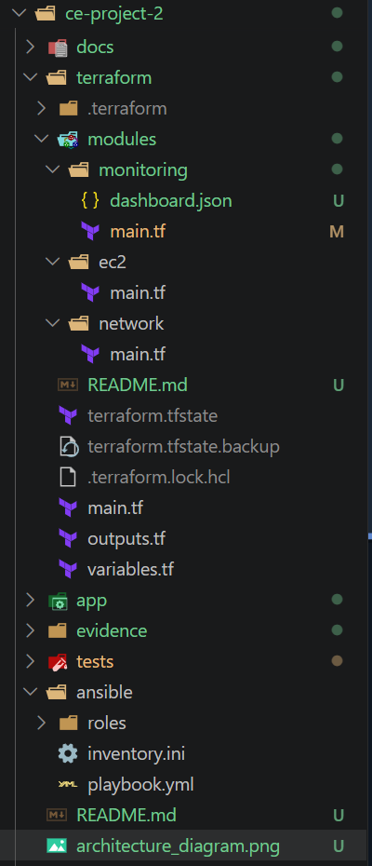
Project Highlights
100% IaC • Terraform + Ansible
Terraform modular + Ansible full stack
VPC, EC2 i-01b04296, SG, IAM-role, CWAgent configs, myapp.service. Reproducible.
Memory Anomaly alarm and dashboard [USE]
mem_used_percent detection
Infra saturation signal from CWAgent. SingleValue widget + anomaly band vs latency.
5 Custom Metrics [Business]
orders_per_minute + order_value
request_count api_latency error_count + biz orders_per_minute order_value via boto3.
Golden signals
Traffic→ Error→ Latency→ Saturation
EC2 → Gunicorn → Flask → CWAgent → CloudWatch - full traceability
6 Warn / Critical Alarms
high-error, high-latency, no-traffic, high-cpu
>5 errors /2x60s, P95 >800ms, no traffic 5m, cpu >85% → SNS proj2-alerts.
Composite alarms
combining multiple conditions
mem-use-anomaly-detection & high-latency
Structured Logging
correlation_id • level • latency_ms
structlog JSON → 20+ fields. X-Corr-ID 51e9ef29 → filter correlation_id='demo-123'.
Correlation Dashboard
Latency vs Traffic vs Errors vs CPU
One view: P95 latency ↔ request_count ↔ error_count ↔ CPU. Golden + USE.
Custom Widgets
SingleValue + USE
Rate, Duration, Errors, Saturation unified.

Slide 5



Custom Metrics — 5 signals via boto3 put_metric_data
request_count
api_latency
error_count
COUNT • Sum • after_request
MILLISECONDS • Avg/Max/P95
COUNT • Sum • if status >=400
Every request increments. Fuels Rate & health. Never rely on ALB logs.
latency_ms = (now - g.start)*1000. Duration golden signal.
Errors golden signal. Triggers high-error alarm when >5 in 2x60s.
orders_per_minute
BUSINESS
order_value
None
Business saturation signal. Sum per minute.
Amount metric. Tracks revenue proxy, no unit.

Slide 6
















Alerting — 6 Alarms CloudWatch
error-rate
latency
error_count • Sum >5 • 2 periods of 60s
api_latency • Average >500ms • 2 periods
RED Errors
Stat Sum
Treat missing as not-breaching
RED Duration
Avg
SLO 500ms
memory
disk
request_count • Sum <1 • 300s period • missing data BREACHING
DISKUtilization • Average >80% • 2 periods 300s • Dim: InstanceId=i-01b042…
Health-check
1 req /5min min
Missing → ALARM
USE Saturation
AWS/EC2
Avg 80%
memory anomaly
Composite
threshold > 40% • 60s period
anomaly + error rate
Health-check
1 req /5min min
Missing → ALARM
Health-check
1 req /5min min
Missing → ALARM
SNS → proj2-alerts + Email notification • IAM proj2-ec2-role needs cloudwatch:PutMetricData only; ListMetrics from Admin • Thresholds tuned for low-traffic demo, not prod scale

Slide 7

Structured Logging
OUTPUT — app.log / journalctl -u myapp
{
"event": "order_created",
"order_id": "09bcdd18-fd61-48b5-94a8...",
"amount": 150,
"correlation_id": "51e9ef29-4528-4582-a712...",
"timestamp": "2026-08-13T12:58:26.558Z"
}
{
"event": "request_completed",
"correlation_id": "51e9ef29...",
"method": "POST",
"path": "/orders",
"status_code": 201,
"latency_ms": 41,
"level": "INFO",
"timestamp": "2026-08-13T12:58:26.599Z"
}

Slide 8





Instrumentation — Key Decitions
STRUCTURED LOGGING
CORRELATION
structlog JSONRenderer + TimeStamper ISO
before_request → correlation_id
log.info("request_completed", correlation_id, method, path, status_code, latency_ms, level)
g.correlation_id = request.headers.get("X-Correlation-ID", uuid4())
g.start_time = time()
Decision: CloudWatch Logs Insights auto-parses JSON → 20+ fields
Every log line carries same ID → filter correlation_id="demo-123" finds full flow.
CUSTOM METRICS
ERROR LEVEL
boto3 put_metric_data • Namespace Proj2/MyApp
3 levels of error
cloudwatch.put_metric_data(
Namespace="Proj2/MyApp",
MetricData=[{Name: "request_count", Value:1, Timestamp:utcnow()}])
WARN-ERROR-INFO
5 signals in after_request + business hook.

Slide 9




RED / USE Analysis — how we triaged
DASHBOARD MAPPING
RED — SERVICE VIEW
Rate
request_count Sum • Traffic timeSeries
Errors
error_count Sum • red spike
Duration
api_latency Avg / Max / P95
USE — RESOURCE VIEW
Utilization
CPUUtilization + mem_used% + disk
Saturation
orders_per_minute • business queue
Errors
same error_count • overlay correlation
Evidence: Injected /fail 20x → Error Rate ↑ 5+ in 60s, Latency flat 30ms, CPU 8% flat → app error not infra. Top row = RED single value, Middle = Golden Signals, Bottom = USE, Correlation = all overlayed.

Slide 10






















Live Demo Plan — proj2-dashboard
01 — TOP ROW
02 — MIDDLE
SingleValue at a glance
Golden Signals
Current rate for decision in 3 seconds
RED mapping: traffic, errors, duration, saturation
request_count Sum
error_count Sum
api_latency Avg
Traffic request_count
Errors error_count
Latency Avg/Max
DASHBOARD
orders/min Sum
CPU + Orders
proj2-dashboard • 12 widgets • Period 60s • Region us-east-1 • Auto-refresh 60s
QUICK STATS
SingleValue → timeSeries → correlation. All three namespaces: Proj2/MyApp + CWAgent + AWS/EC2
03 — BOTTOM
04 — CORRELATION
EC2 USE Resources
Latency vs Traffic vs Errors vs CPU
Utilization + Saturation. Disk uses SEARCH
Overlay all in one graph. When /fail injected: Error spikes, Latency flat, CPU flat → app error not infra
CPUUtilization
mem_used_percent
Network In/Out
SEARCH disk% → [[ ]]
api_latency
request_count
error_count
CPU %

Slide 11


What Would I Do Differently?
01 — INSTRUMENTATION
02 — USING GRAFANA
Use OpenTelemetry SDK, not manual boto3 put_metric_data
Using a third-parthy opensource dashboard
Dimensions out of the box, context propagation, no try/except hand-rolled. OTEL → CloudWatch exporter keeps native but adds trace id.
It cloud be a good practice for multi-cloud environmet with no dependency on Cloudwatch

Slide 12
Thank You
Q&A

