Slide 1
Scrum of Scrums
Sos
Notes:
One other very interesting things about Scrum is that it’s been designed to scale to very large projects. But for Scrum to be effective the teams needs to be absolutely small, ideally 7 +-2. If we go higher than that number for a team we run into what’s called Brooks Law.

Slide 2
Brooks Law
“Brooks' law is a claim about software project management according to which "adding manpower to a late software project makes it later".^{[1][2]} It was coined by Fred Brooks in his 1975 book The Mythical Man-Month. According to Brooks, there is an incremental person who, when added to a project, makes it take more, not less time.”
Notes:
As teams get bigger in size. The productivity of each team member goes down. In fact it can be so bad that when you add more people to a big project, it actually makes it take longer instead of less. So to avoid that problem we keep the teams really small

Slide 3
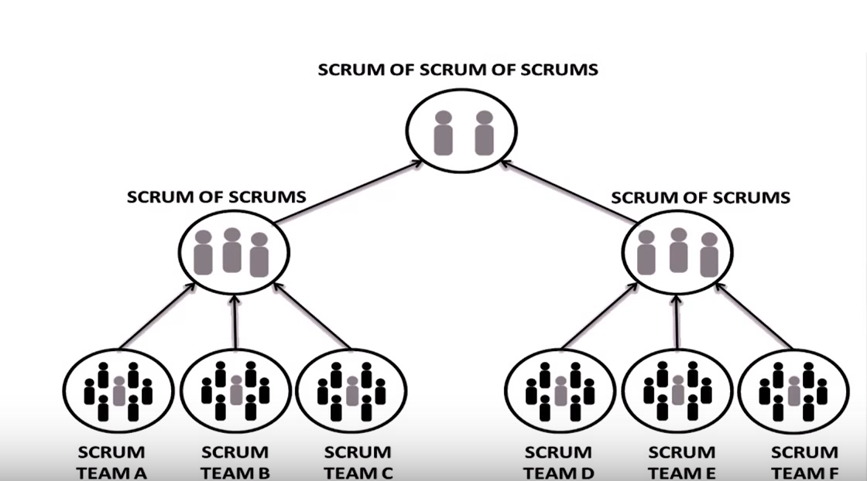
Solution: Scrum of Scrum
10+ people required
Multiple Scrum Teams
Each Scrum Team has a representative (usually Scrum Master)
Each representative attends SOS meetings and standup to resolve inter-dependencies related to the project.
Facilitated by the Chief Scrum Master
Notes:
When more than 10 people are required to carry out the work, Multiple Scrum Teams may be formed. Each Scrum Team has a representative usually the Scrum Master or anyone else from the team. Each representative then attends SoS meetings and standups. Anyone can attend, if required and is facilitated by the Chief Scrum Master intended to focus on coordination and integration between different Scrum Teams

Slide 4

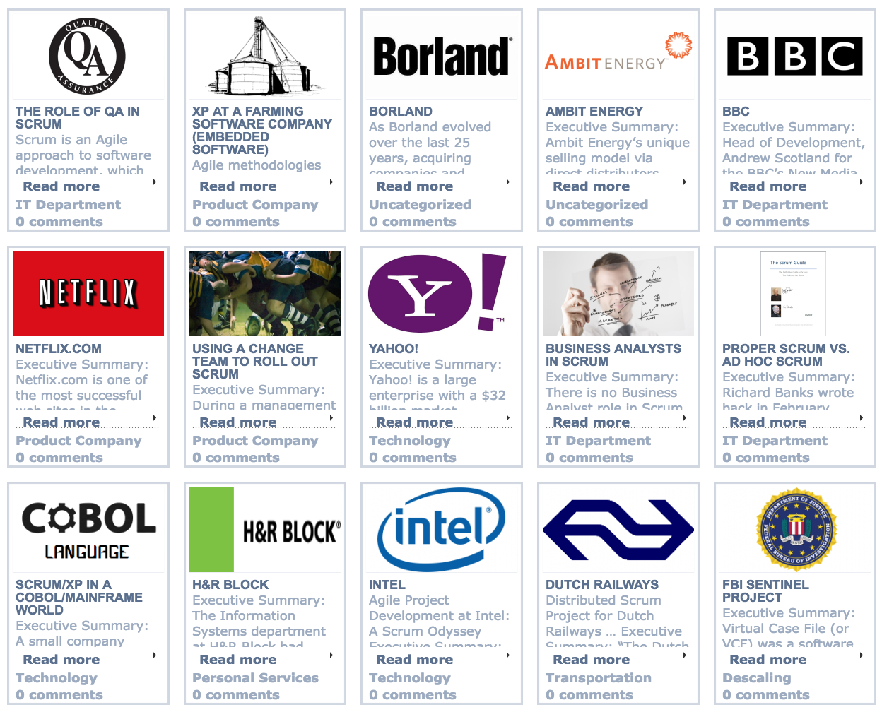
Examples of SOS
Notes:
Yahoo went from waterfall to Agile Scrum of Scrum. In 2004, Invited Jeff Sutherland, one of the inventor of Scrum. Took them couple of years before they found their best agile approach.

Slide 5
Questions?

