Slide 1


Tasker
Project done by Francisco Parrinha

Slide 2
Features
Create account:
Login
Register
Account modifications
Add and manage Tasks
Add new task
Manage created tasks with update and delete operations
Sort tasks by priority

Slide 3
Technologies
Spring
Angular
MySQL

Slide 4
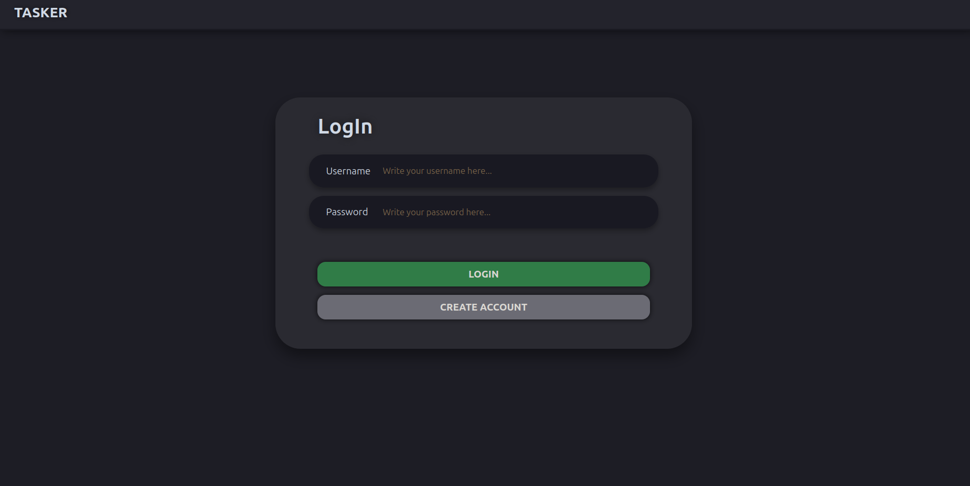
Login

Slide 5
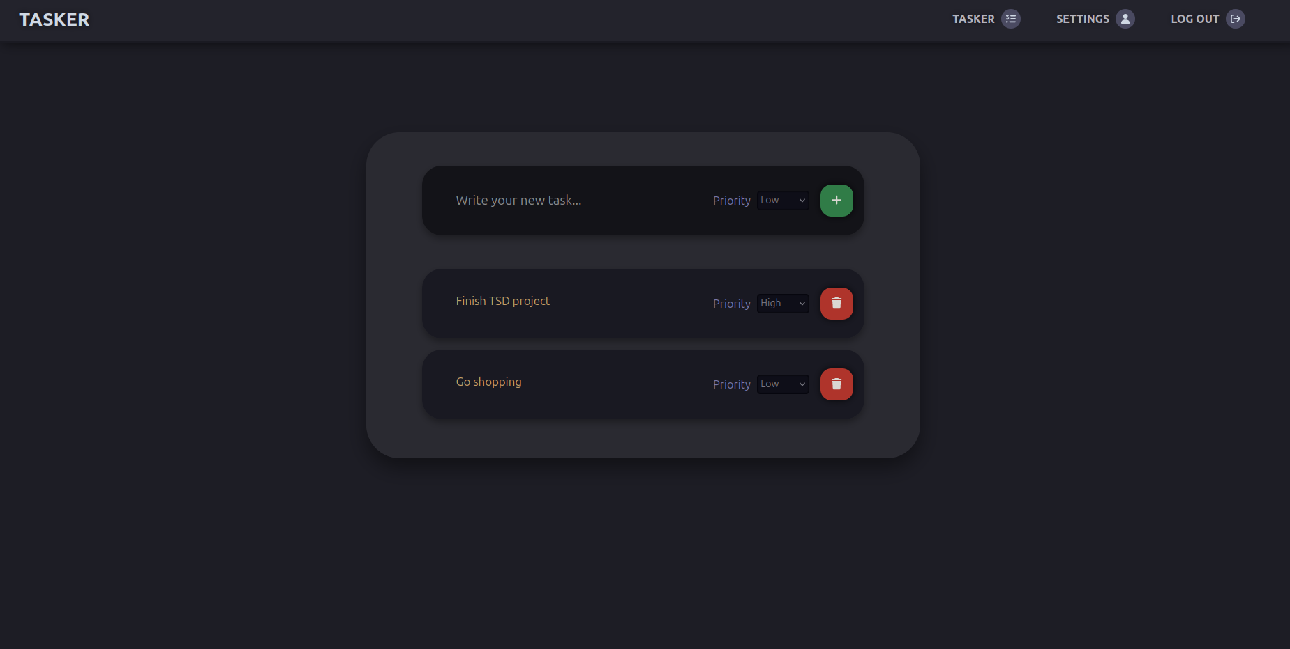
Main Application

Slide 6
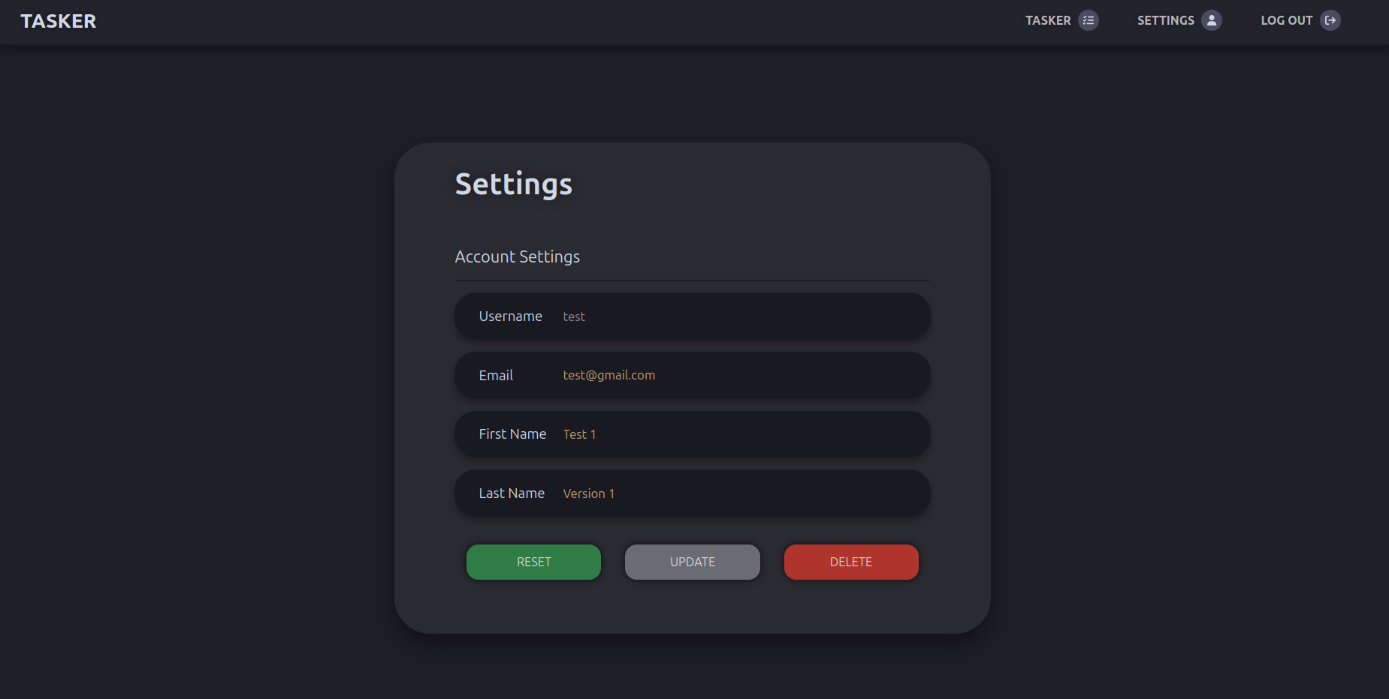
Account Change

Slide 7
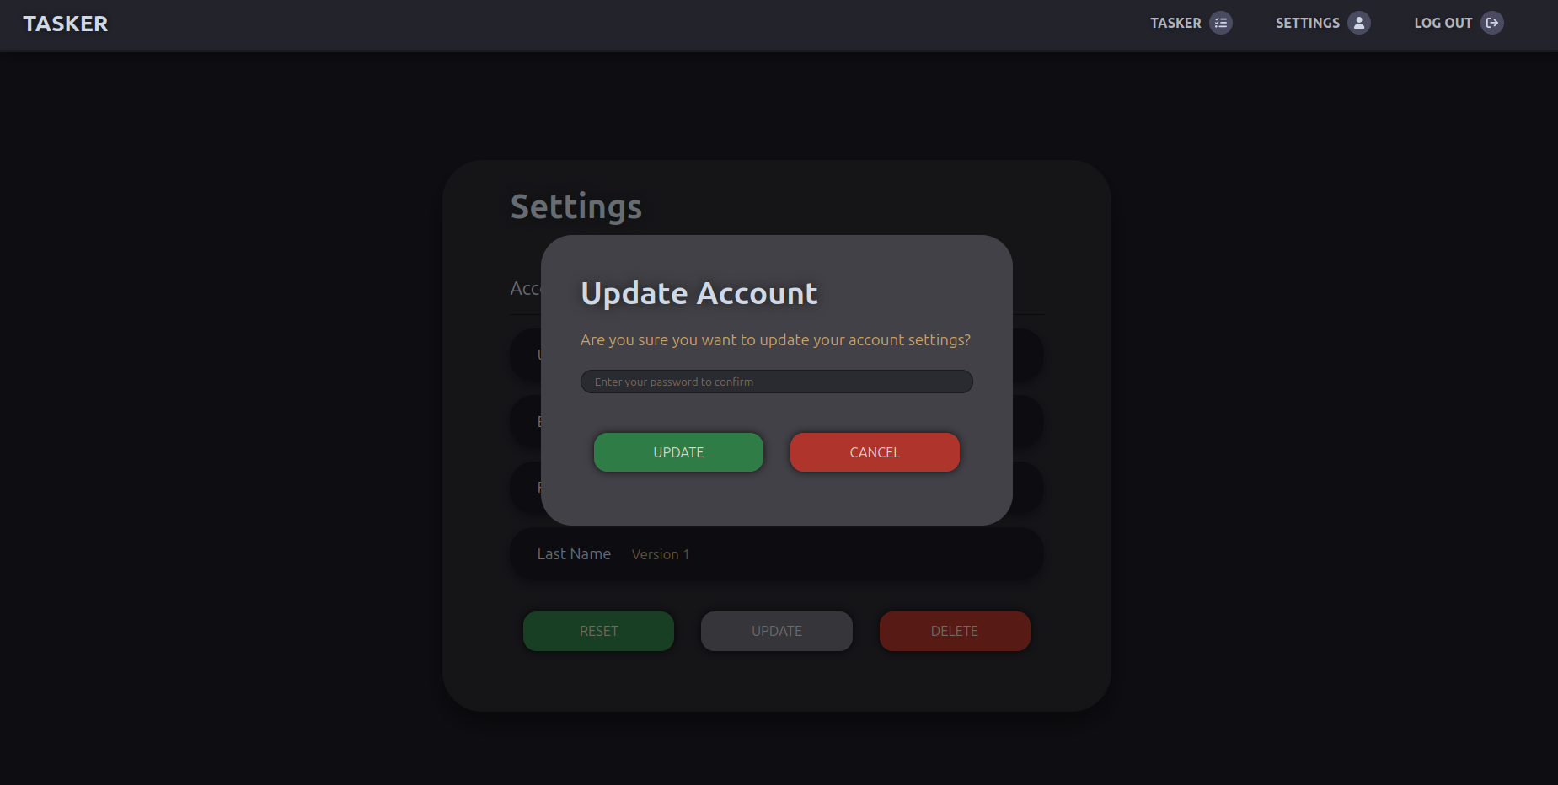
Account Change

Slide 8
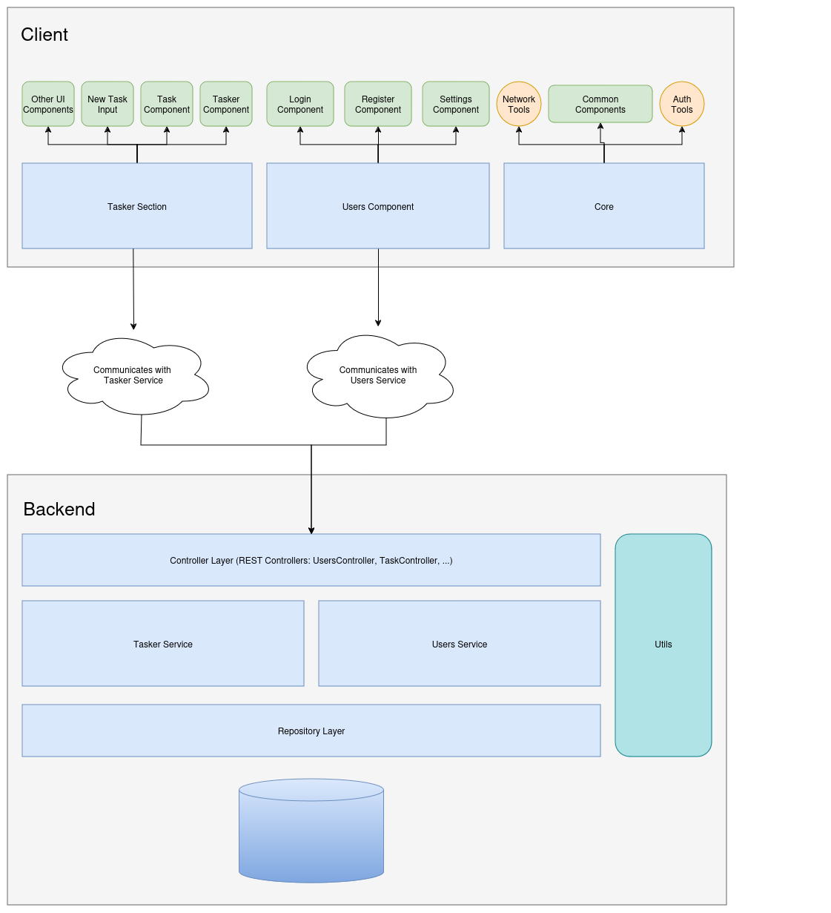

Slide 9
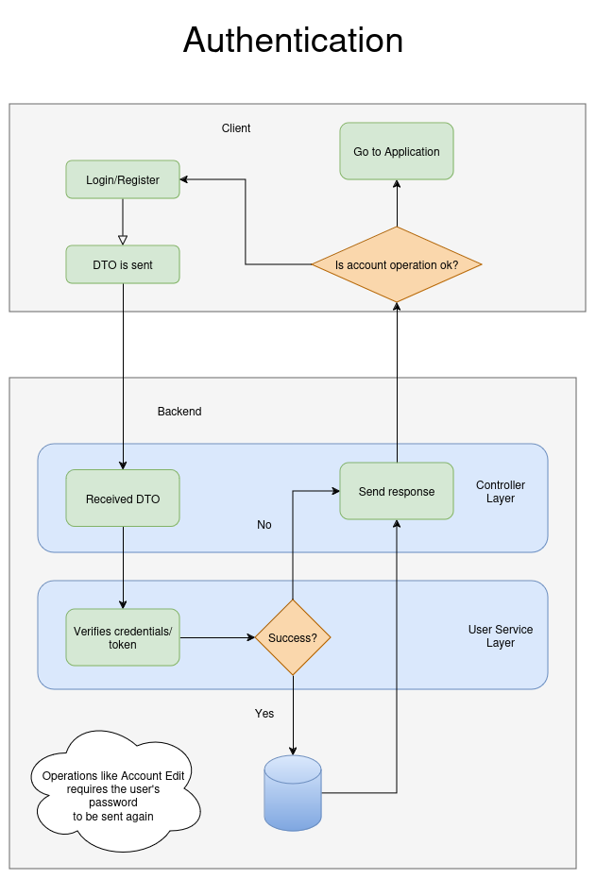

Slide 10
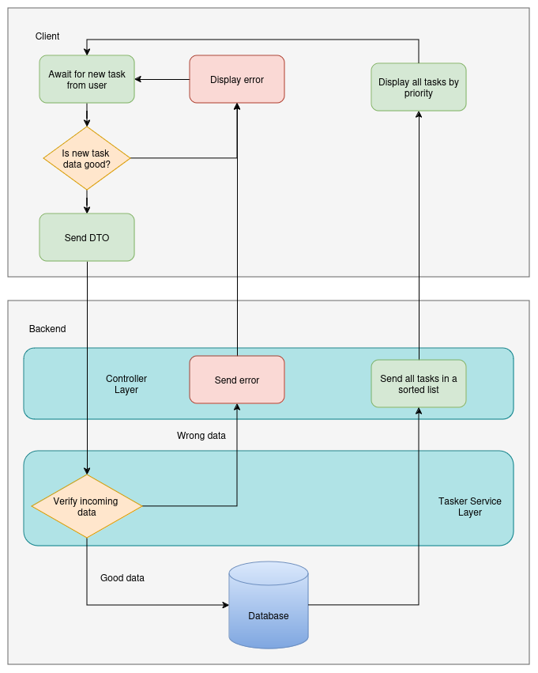

Slide 11
Where can the app improve?
Use HTTPS instead of HTTP
Add calendar component for the task's end date
Add automatic emails based on each task's end date

Slide 12
End

