Slide 1












Plant Species Distribution Patterns using Big Data Analysis
Fatemeh Ranjbaran Fatemeh.ranjbaran@studio.unibo.it

Slide 2
TABLE OF CONTENTS
Introduction
Data prepration
01
02
What is the problem and how can we solve it?
How does the data look?
Clustering Models
SEMI-clustering Model
03
04
Utilising KMeans, Bisecting-Kmeans and GMM
How LDA would benefit us?

Slide 3
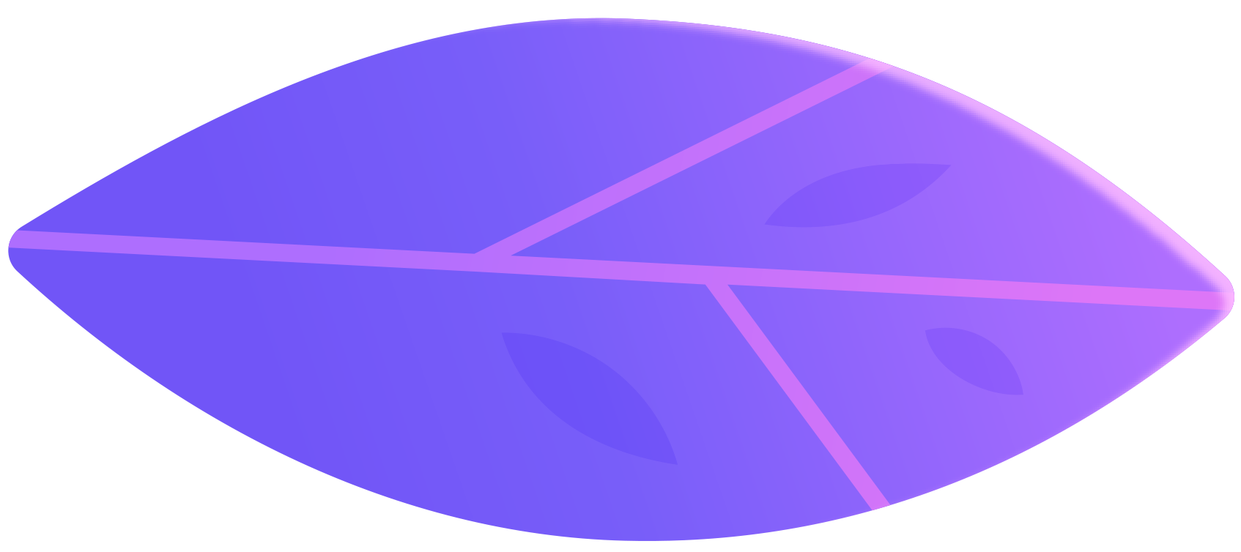

Introduction
01
What is the problem and how can we solve it?

Slide 4

Introduction
The dataset available at plants dataset contains information on plant species and genera, along with their occurrences in various states of the USA and Canada. This dataset, sourced from the USDA plants database, is ideal for applying clustering techniques to analyze plant distribution patterns. By leveraging PySpark's powerful capabilities, we can efficiently load, process, and cluster the data. Through clustering, I aim to identify groups of plant species with similar geographic distributions.

Slide 5
Introduction
Having a list of plants and the regions they appear in, what potential outcomes can be achieved through the utilization of clustering algorithms:
Clusters formed would consist of plants sharing highly similar environmental conditions, encompassing factors such as soil type, climate, and more.
By examining the frequency at which plants from a particular region coalesce into a single cluster, we can determine the individual contributions of each region across diverse clusters.
Subsequent analysis can be conducted to identify if any specific region necessitates conservation initiatives due to its essential role.

Slide 6
Data prepration
02
How does the data look?

Slide 7
Data
The Data has been extracted from the USDA plants database. It contains all plants (species and genera) in the database in the states of USA and Canada where they occur.
Each row contains a Latin name (species or genus) and a list of state abbreviations.
Plant | vi | mi | … | fl
abelia | 0 | 0 | … | 1
abelmoschus | 1 | 1 | … | 1
abies | 0 | 1 | … | 0

Slide 8
Data
Dataset Characteristics
Multivariate
Subject Area
Associated Task
Life
Clustering
# Instances
Attribute Type
22632
Categorical
# Attributes
70

Slide 9
Data
Prior to loading any data, we initiate a Spark session. Subsequently, we activate a specific configuration option within Spark, which is referred to as: spark.sql.execution.arrow.pyspark.enabled
Enabling this option enhances the efficiency of dataset-related tasks. For instance, when executing the code:
%timeit ps.range(300000).to_pandas()
without the mentioned option being enabled, it would take approximately 3.75 seconds to complete. However, by activating the option, the same operation can be accomplished in merely 390 milliseconds.

Slide 10
Data
With this consideration, we choose to load our data using the "pyspark.pandas" library instead of traditional pandas, enabling PySpark to handle all necessary operations. Subsequently, we convert the loaded data to a PySpark dataset using the command "pyspark_df = df.to_spark()", allowing us to have a dataframe for data visualization purposes and a Spark dataset for computational tasks.

Slide 11
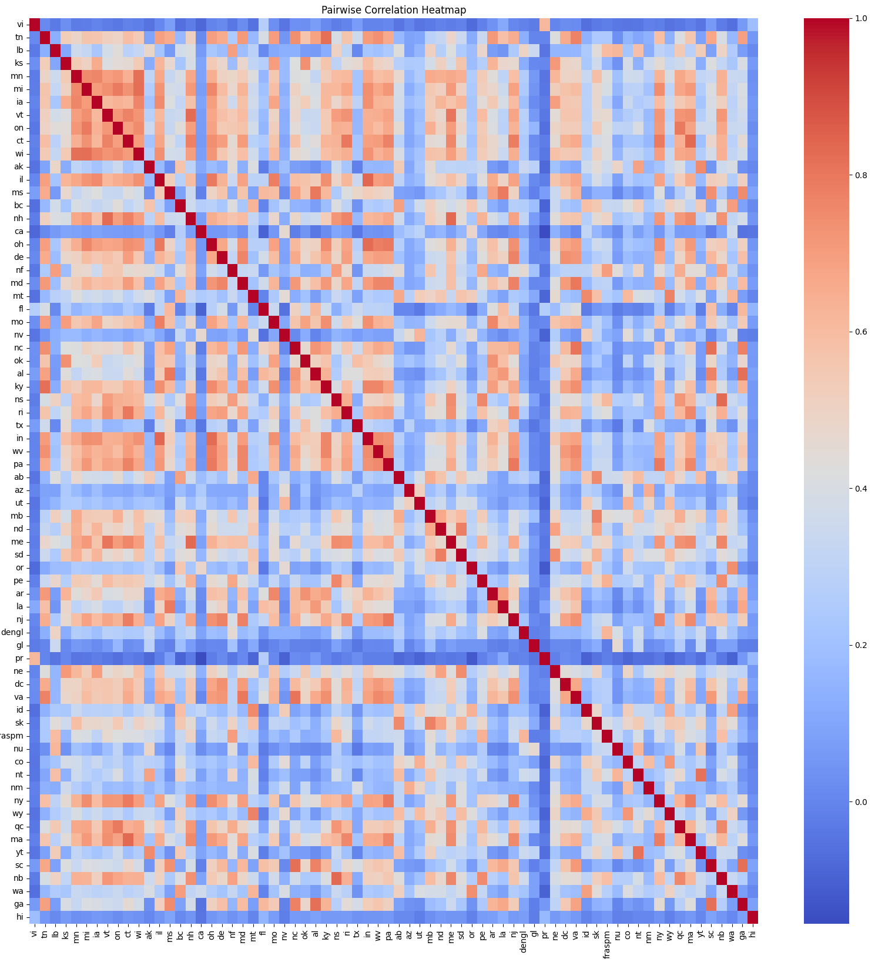
Data
In examining the pairwise correlation among regions, noticeable patterns emerge in the heatmap, indicating a dataset that is informative and characterized by strong correlations. Here we are observing certain patterns that indicate the need to preserve specific regions. Additionally, there are regions where certain plants overlap with many other regions, suggesting potential economic opportunities, such as exporting plants.

Slide 12
Clustering Models
03
Kmeans
Bisecting Kmeans
Gaussian Mixture Model

Slide 13
Almost identical result
With silhouette score of 0.718
Silhouette score of 0.448
Kmeans
B-KMEANS
GMM
k from 2 to 20
k from 2 to 20
maxIter of 50
k from 2 to 20
Tolarance of 0.01
All three models independently determined that the optimal number of clusters is 2.

Slide 14
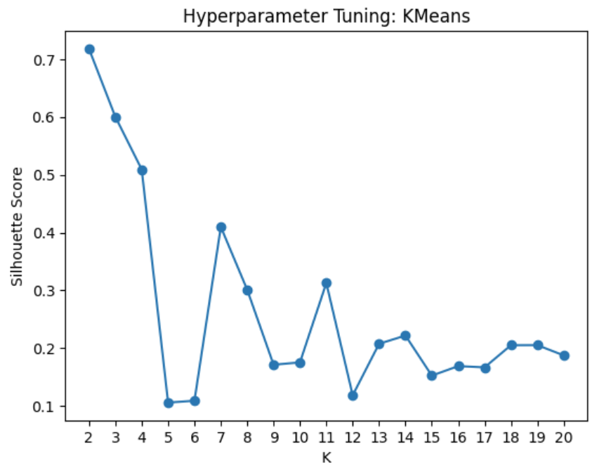
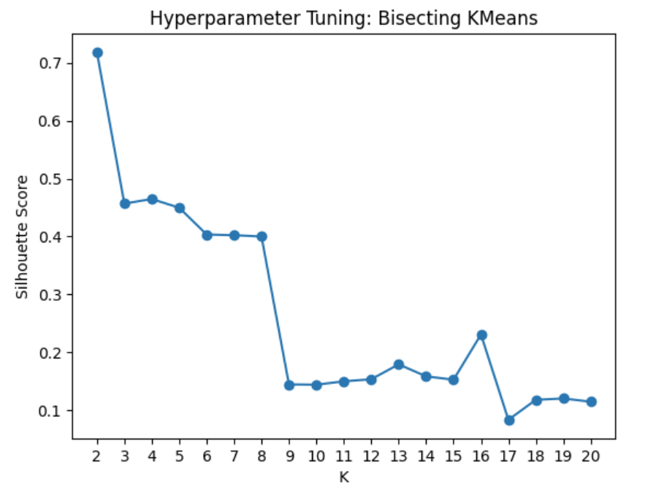
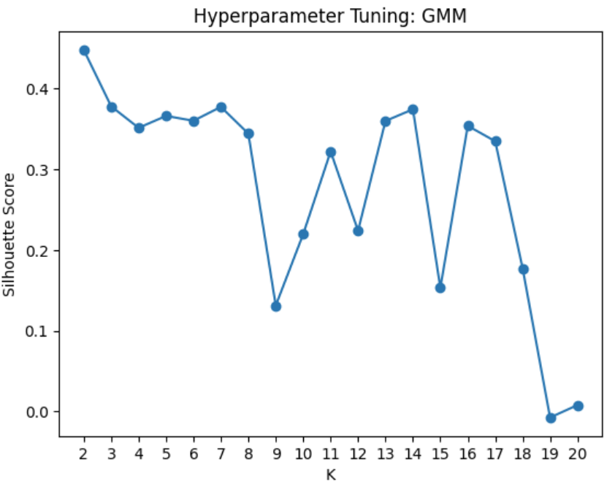

Slide 15
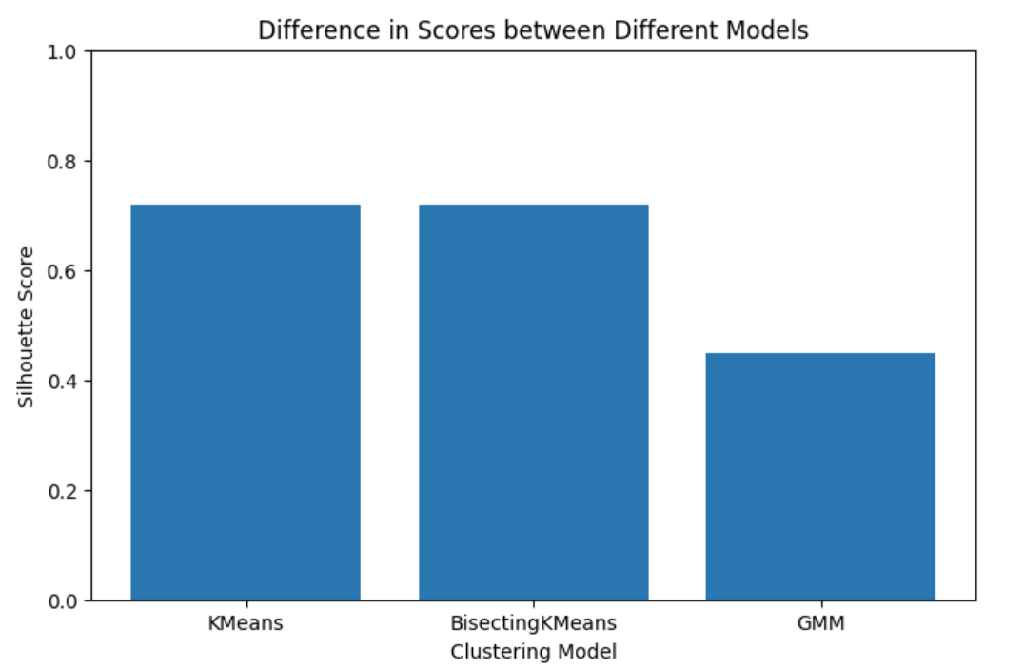
Comparing the the best model from each of 3 algorithms based on their Silhouette Score

Slide 16
Semi-Clustering model
04
LDA
Latent Dirichlet Allocation

Slide 17
LDA
Latent Dirichlet Allocation (LDA) is a probabilistic model used in natural language processing (NLP) for discovering topics within a collection of documents. However, I am using it in the plants dataset so that it clusters my plants.
Why we call it semi-clustering and not clustering?
The reason is that, unlike conventional clustering algorithms that assign a single unique cluster to each data point, in LDA, each data point is assigned to all clusters with probabilities that add up to one. This characteristic provides a greater level of flexibility. By employing LDA, we can observe two crucial aspects. Firstly, we can assess the proximity of each plant to each cluster. Secondly, we can determine the regions that have a greater influence in the decision of assigning a cluster to a plant.

Slide 18
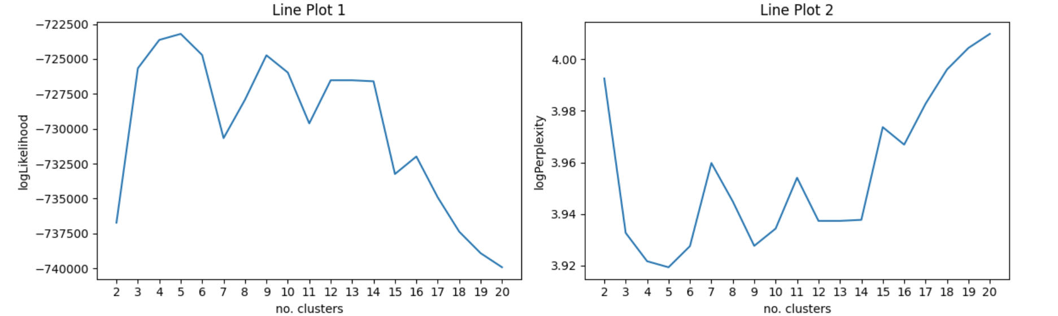
When we are training with LDA, the evaluation metric is different from what we saw previously.
We are looking for lowering the logPerplexity and raising the logLikelihood

Slide 19
Predictions
Plant | Topic Distribution
abelia | [0.050, 0.066, 0.080, 0.751, 0.053]
abelia x grandiflora | [0.050, 0.066, 0.080, 0.751, 0.053]
abelmoschus | [0.009, 0.233, 0.015, 0.733, 0.010]
abelmoschus esculentus | [0.010, 0.172, 0.015, 0.792, 0.010]
abelmoschus moschatus | [0.050, 0.758, 0.080, 0.059, 0.053]

Slide 20
The topics and their top-weighted terms
Topic | termIndices | termWeights (approx)
0 | [46, 14, 21] | [0.073, 0.063, 0.061]
1 | [25, 64, 32] | [0.186, 0.169, 0.116]
2 | [33, 1, 8] | [0.182, 0.094, 0.088]
3 | [26, 48, 17] | [0.055, 0.052, 0.052]
4 | [37, 6, 53] | [0.039, 0.035, 0.031]

Slide 21
Thank you for listening

