Slide 1
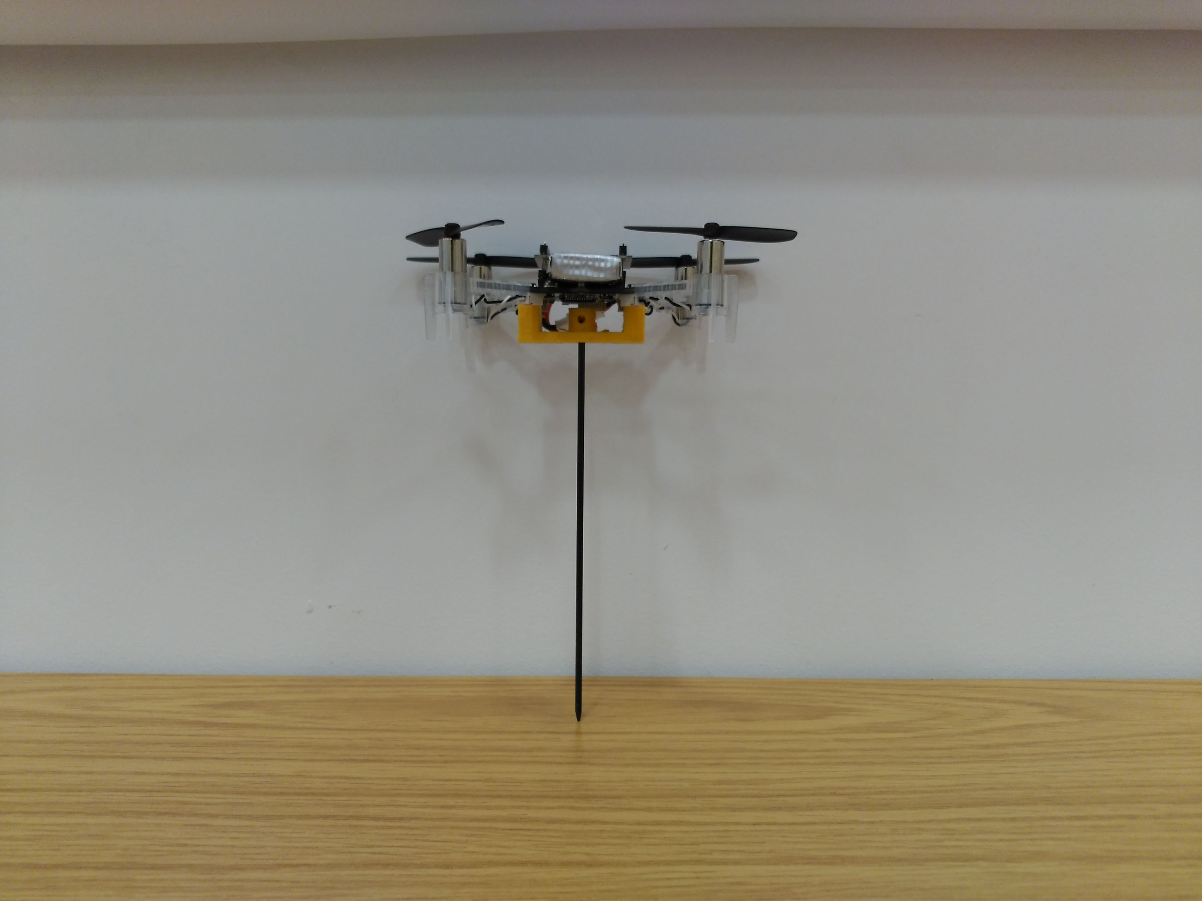
Crazyflie 2.0 Quadcopter
Monopod support
Monopod

