Slide 1
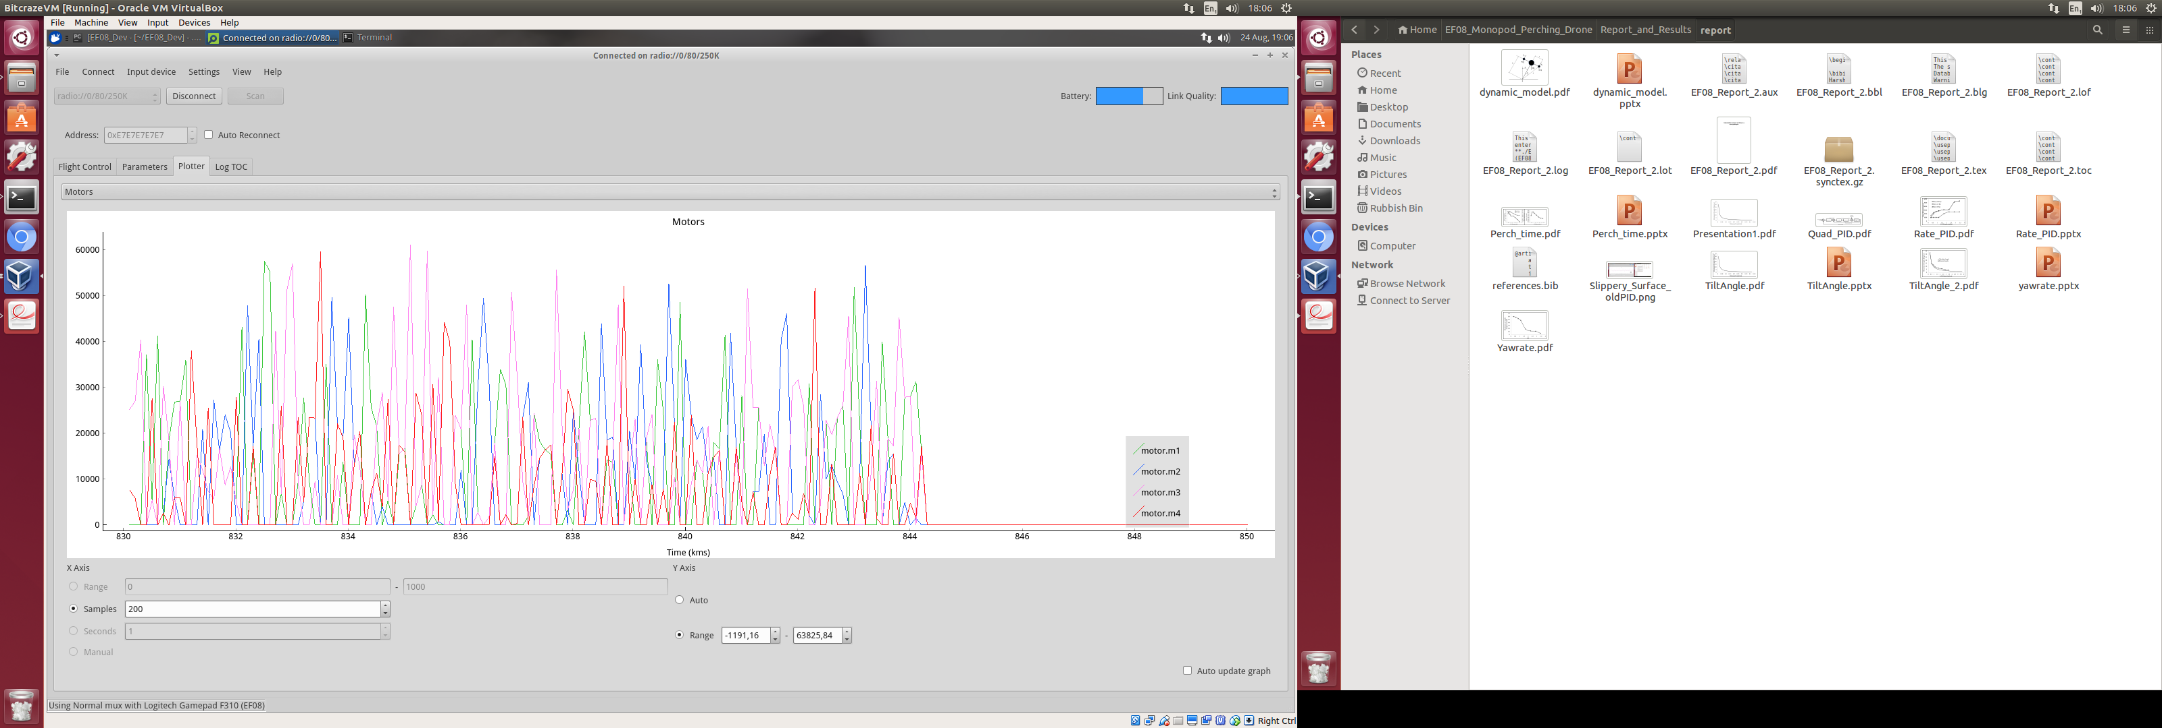
Motor speed [rpm]
Time [seconds]

