Slide 1
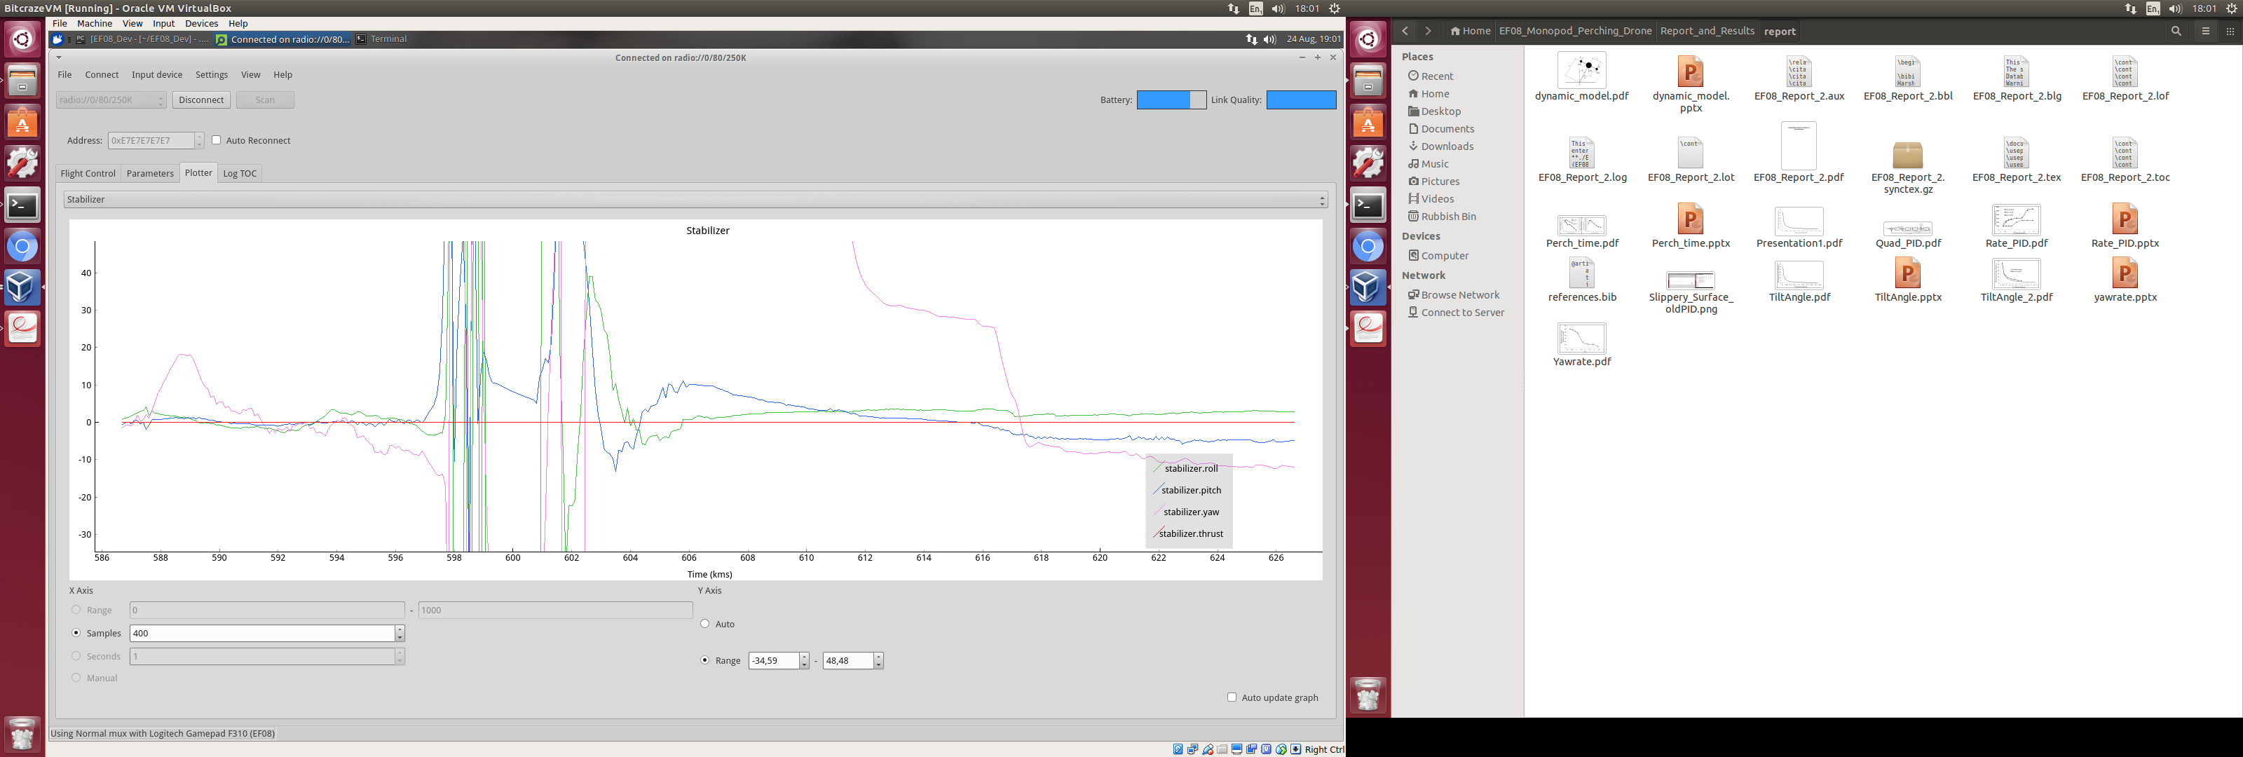
Angle [degrees]
Time [seconds]

