Slide 1
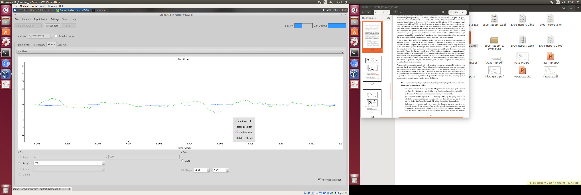
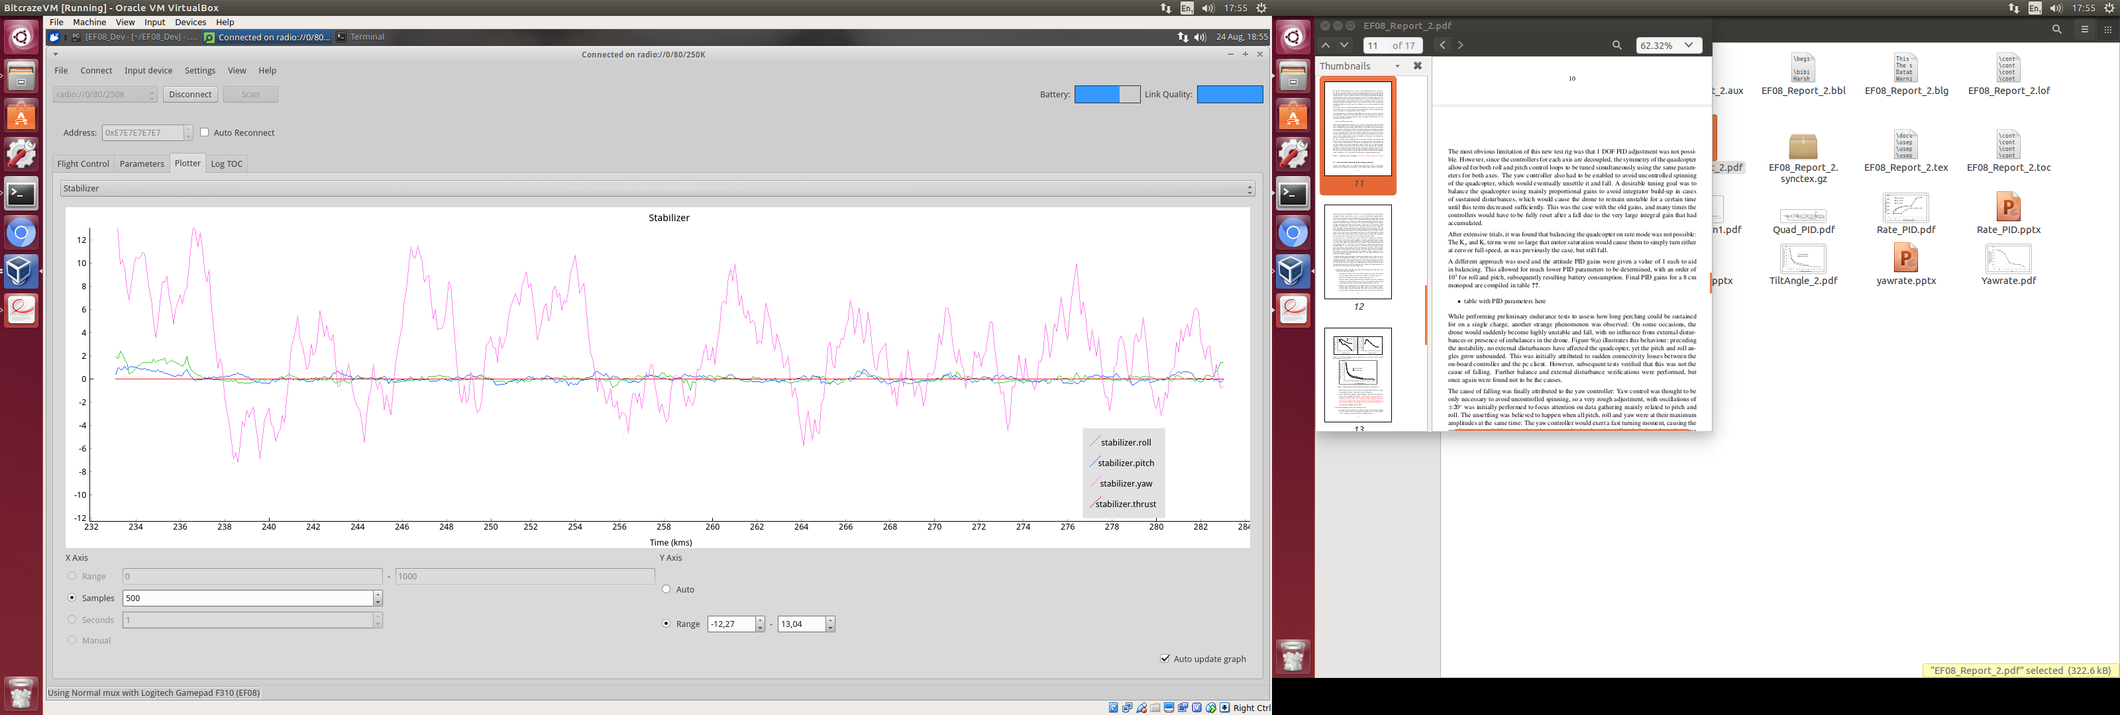
Angle [degrees]
Angle [degrees]
Roll
Pitch
Yaw
Roll
Pitch
Yaw
Time [seconds∙10³]
Time [seconds]

