Slide 1
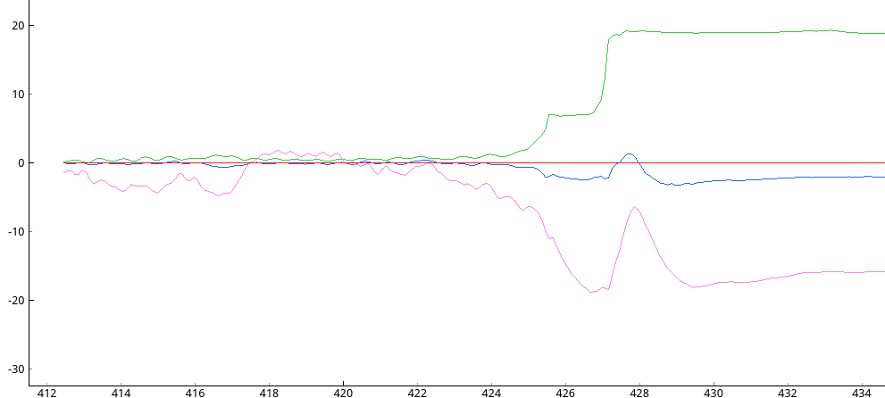
Angle [degrees]
-Roll
-Pitch
-Yaw
Time [seconds]

