Slide 1

Docker Quick Summary so far
What is the Docker platform?
Docker provides the ability to package and run an application in a loosely isolated environment called a container. The isolation and security allow you to run many containers simultaneously on a given host.
Introduction

Slide 2
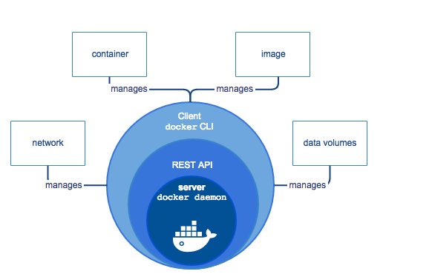
Docker Quick Summary so far
What is the Docker Engine?
Docker Engine is a client-server application with these major components:
A server which is a type of long-running program called a daemon process.
A REST API which specifies interfaces that programs can use to talk to the daemon and instruct it what to do.
A command line interface (CLI) client.
Introduction

Slide 3
Docker Quick Summary so far
Docker version
In order to find out the version of Docker you can execute the following command:
$ docker version
Introduction

