Slide 1
MOB-AUTO² Autonomous Shuttle Optimization
Fabio Sartori

Slide 2
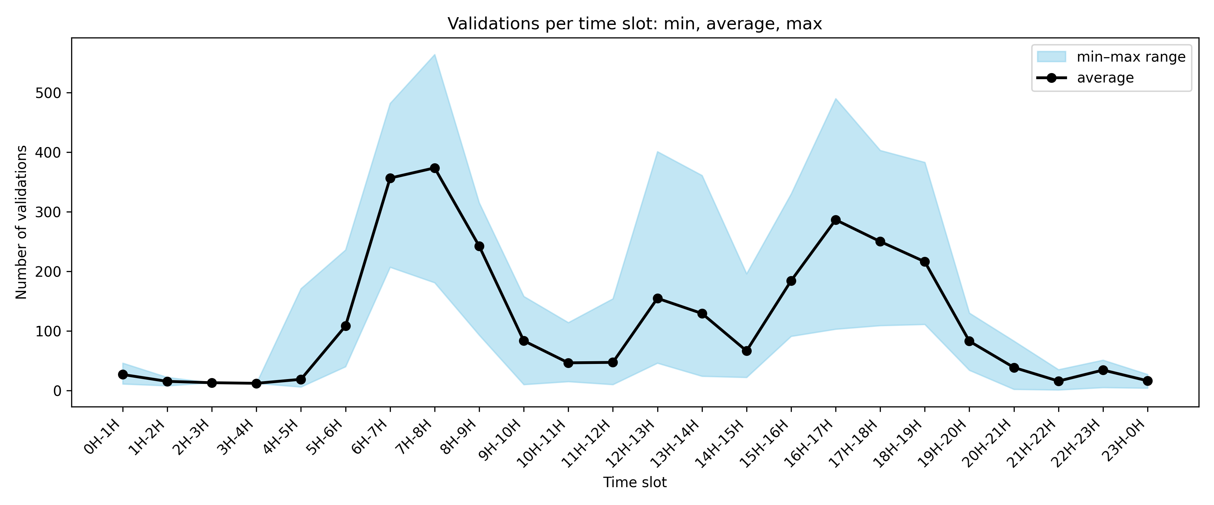
Project Overview
Express autonomous line (Longvilliers – Massy)
Public Transport peak-hour saturation, low frequency off-peak
85% of car trips on this corridor are single-occupancy
Validations per time slot on Tuesdays and Thursdays, Mar – Jun 2023
Notes:
Í

Slide 3
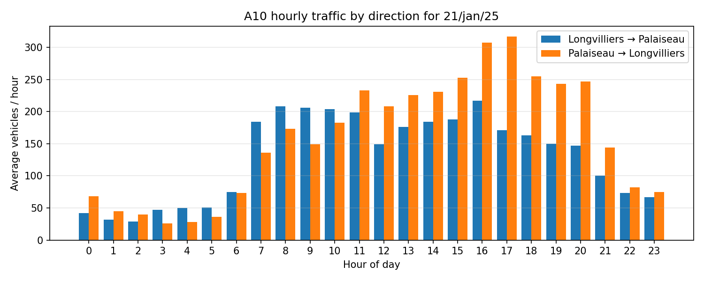
Project Overview
Express autonomous line (Longvilliers – Massy)
Public Transport peak-hour saturation, low frequency off-peak
85% of car trips on this corridor are single-occupancy
Traffic volumes per hour on the A10 corridor, Longvilliers – Massy
Notes:
Í

Slide 4
Shuttle Operation Parameters
Average speed: 65 km/h outbound, 63 km/h return (min 57, max 69)
Travel time: ~27 min + 3 min dwell time = 30 min/trip
Distance: 28 km each way (including Briis-sous-Forges)
Capacity: 15 seats/trip
Battery range: ~150 km
Energy use per trip: ~18% of full battery (≈ 28 km / 150 km)
Fast recharge: +50% (75 km) in 1h, available only if SoC < 33% (50 km)
Slow recharge: +25 km per 30 min block (75 km in 1.5h)

Slide 5
Integration of DCM and CP Optimization
Discrete Choice Model: demand profiles and choice probabilities
Input: Testing scenario, service atributes (currently standard)
Output: expected demand per hour, or the exact arrival times
Coinstraint Programming (CP) Model
Inputs: DCM output + operational parameters
Optimization:
Shuttle scheduling
Battery management
Passenger assignment
Output: service atributes (frequency, schedule)
Feedback loop

Slide 6
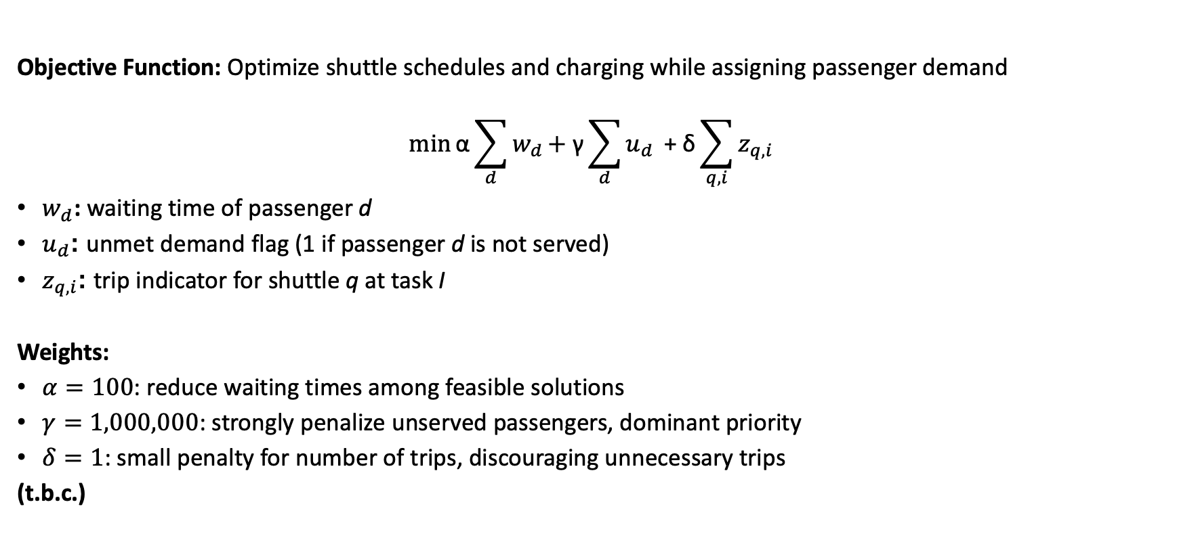
CP Model Framework
Objective Function: Optimize shuttle schedules and charging while assigning passenger demand
$$\min{\text{α}\sum_{d}{w_{d}}\text{+ }\text{γ}\sum_{d}{u_{d}}\text{​} \text{+} \text{δ}\text{​}}\sum_{q,i}{z_{q,i}}$$
$w_{d}$​: waiting time of passenger d
$u_{d}$: unmet demand flag (1 if passenger d is not served)
$z_{q,i}$: trip indicator for shuttle q at task I
Weights:
$α=100$: reduce waiting times among feasible solutions
$γ=1,000,000$: strongly penalize unserved passengers, dominant priority
$δ=1$: small penalty for number of trips, discouraging unnecessary trips
(t.b.c.)

Slide 7
CP Model Decision Variables
Sequential Logic Transitions
Shuttle activity variables (intervals):
OUT – outbound trip (Longvilliers → Massy)
RET – return trip (Massy → Longvilliers)
CRGp – partial (fast) recharge
CRGf – full (slow) recharge
END – end of daily service
Passenger-related variables:
a[q,i,d] – binary, passenger d assigned to shuttle q in trip i
u[d] – binary, 1 if passenger d is unserved
w[d] – integer, waiting time for passenger d
Trip indicators:
z[q,i] – binary, 1 if shuttle q executes trip i
CRp
OUT
RET
END
CRf

Slide 8
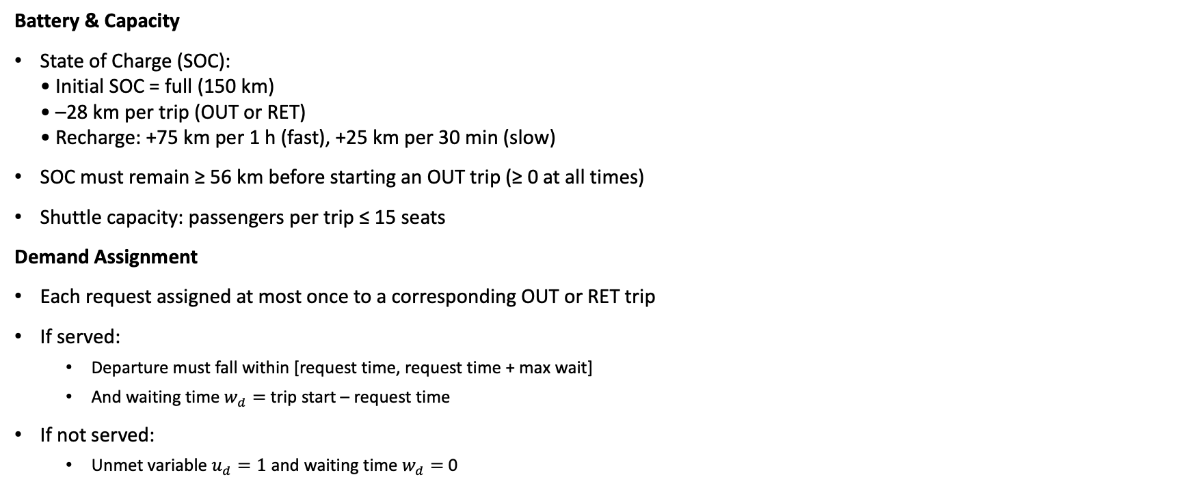
CP Model Constraints
Battery & Capacity
State of Charge (SOC): • Initial SOC = full (150 km) • –28 km per trip (OUT or RET) • Recharge: +75 km per 1 h (fast), +25 km per 30 min (slow)
SOC must remain ≥ 56 km before starting an OUT trip (≥ 0 at all times)
Shuttle capacity: passengers per trip ≤ 15 seats
Demand Assignment
Each request assigned at most once to a corresponding OUT or RET trip
If served:
Departure must fall within [request time, request time + max wait]
And waiting time $w_{d}=$ trip start – request time
If not served:
Unmet variable $u_{d}=1$ and waiting time $w_{d}=$ 0

Slide 9
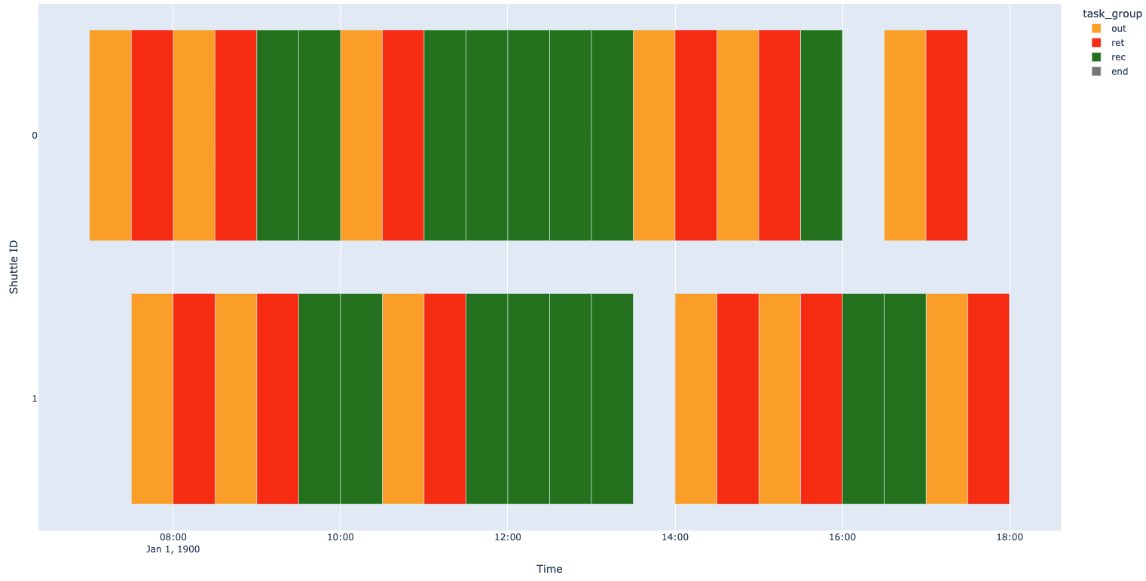
Results I: departures allowed every 30 min
Demand: 360 passengers in optimal cycles, aligned (wait time = 0)

Slide 10
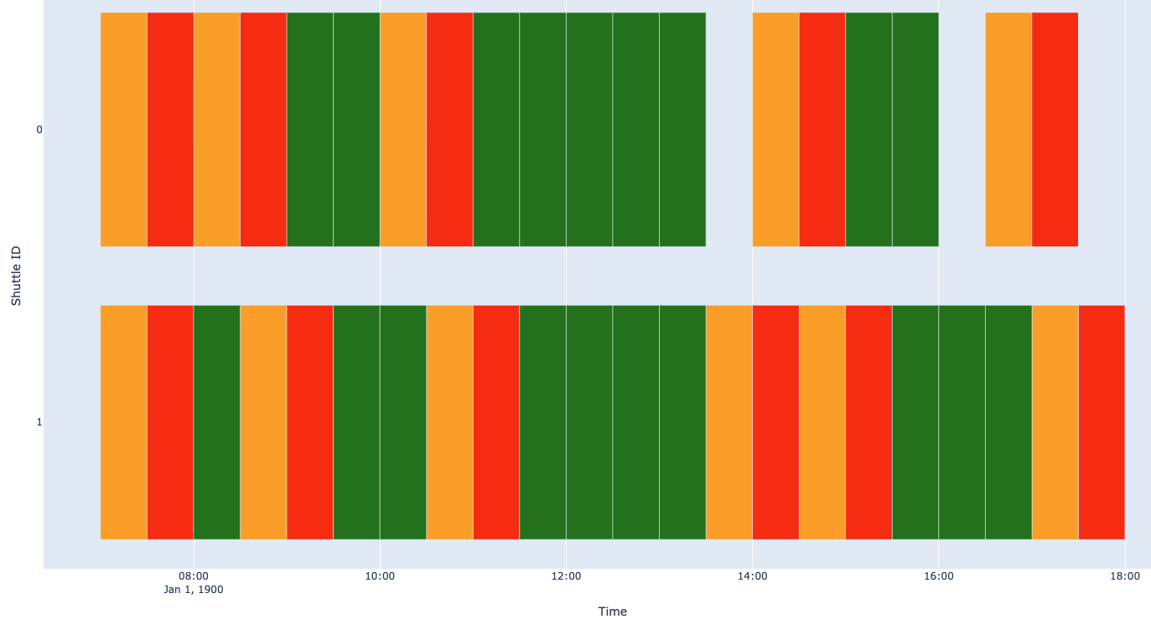
Results I: departures allowed every 15 min
Demand: 360 passengers in optimal cycles, aligned (wait time = 0)

Slide 11
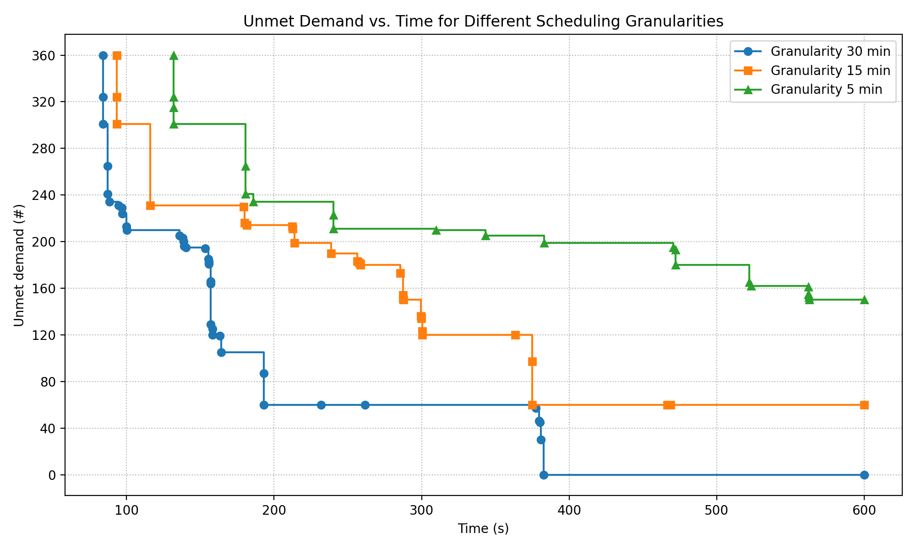
Solver Convergence Across Granularities
30 min granularity: Solver converges to the optimum (all passengers served) in < 400 s of search
5 min granularity: Larger search space, solver struggles.

Slide 12
Results II: Scenarios (120 requests, 10-min)
Scenario setup (120 passengers, 10-min granularity):
Aligned requests
Passenger arrivals exactly match departure slots (07:00, 07:30, …)
Baseline “easier” case for the solver
Randomized requests
Passenger arrivals uniformly distributed within each slot (e.g., 07:00–07:30 → arrivals at 07:00, 07:10, 07:20…)
Requests must be served within 30 min of arrival
Capacity-constrained
Shuttle seat capacity reduced to 80% of full (≈4 seats)
Forces reallocation on full shuttles and capacity constraints for trips

Slide 13
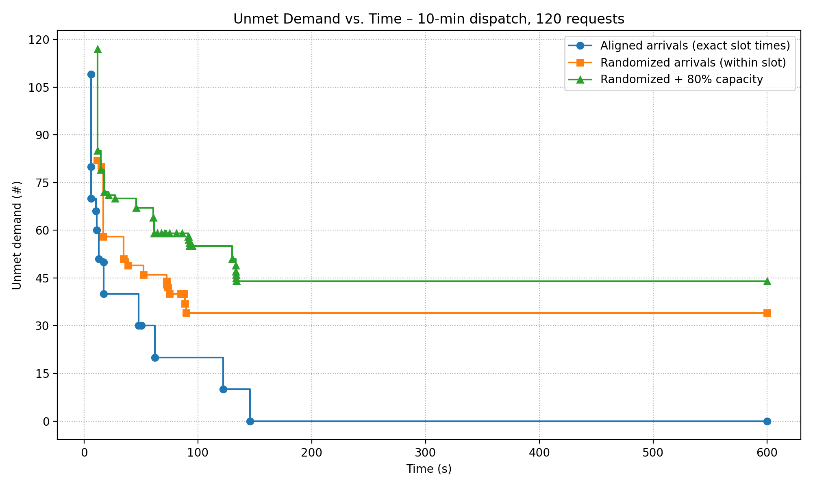
Results II: Scenarios (120 requests, 10-min)

Slide 14
Results III: Continuous demand
Demand arrives continuously, independent of vehicle charging cycles.
Demand level ≈ 5% of total road traffic.
284 passengers
28 slots from 07:00 to 21:00
Requests arrive at random times.
Departures scheduled at 10-minute intervals.

Slide 15
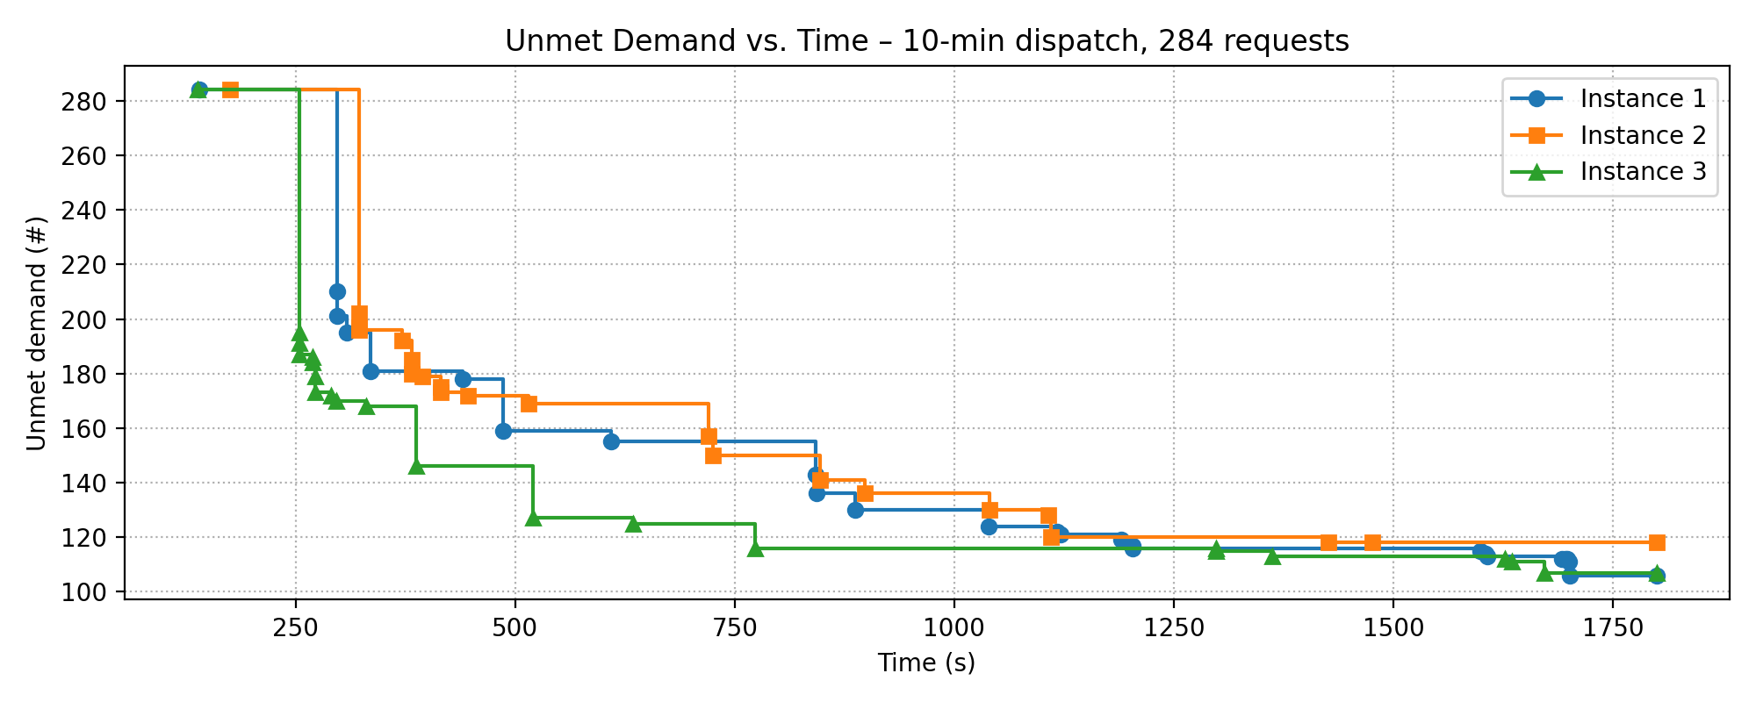
Results III: Continuous demand
Instance 1
34 trips Carrying 178 pax Waiting time of 10 min. Rejected 106 pax
Instance 2
34 trips Carrying 166 pax Waiting time of 9.75 min. Rejected 118 pax
Instance 3
34 trips Carrying 177 pax Waiting time of 9.71 min. Rejected 107 pax
Instance 4 (36-hours running time)
34 trips Carrying 179 pax Waiting time of 8.94 min. Rejected 105 pax

Slide 16
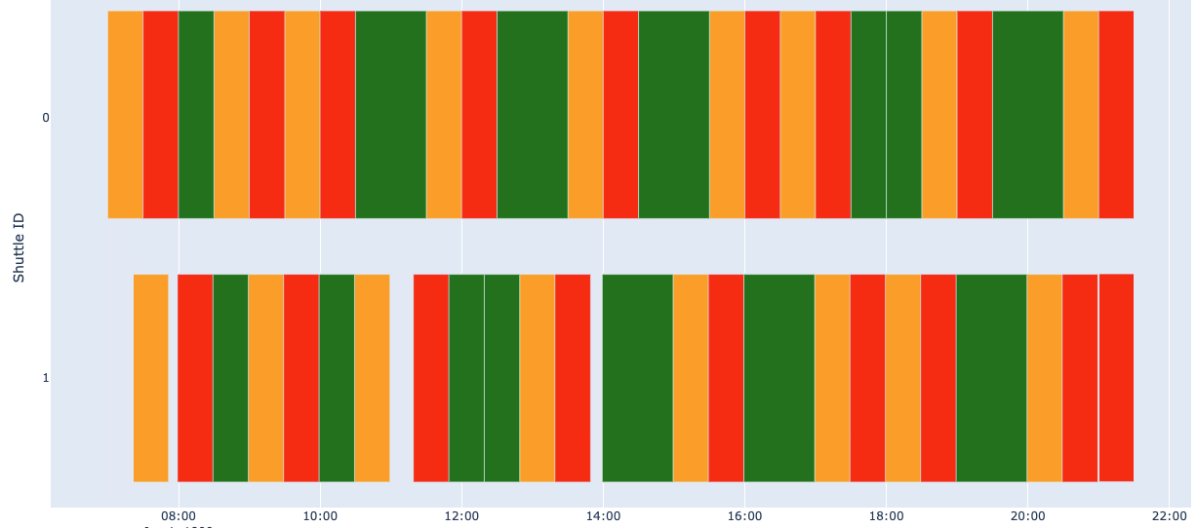

Results III: Continuous demand

Slide 17
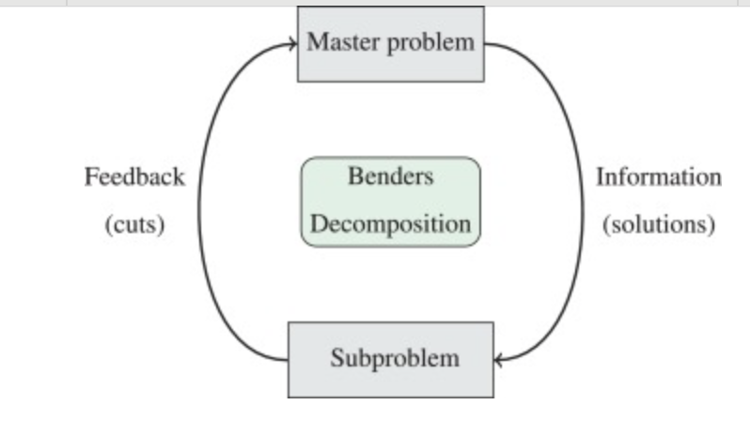
Decomposition Approach
Split the problem into:
Master problem: task assignment and battery management in time windows
Subproblem: passenger assignment and optimality and feasibility checks.

Slide 18

Master problem
07:00
09:00
11:00
13:00
15:00
17:00
19:00
21:00

Slide 19
Master problem
07:00
09:00
11:00
13:00
15:00
17:00
19:00
21:00

Slide 20
Master problem: possible task combinations
NUL
OUT
RET
OUT
RET
CRG
OUT
OUT
RET
OUT
RET
OUT
RET
OUT
OUT
RET
CRG
OUT
RET
RET
OUT
RET
CRG
OUT
OUT
RET
CRG
RET
OUT
RET
CRG
OUT
CRG
RET
OUT
RET
CRG
RET
OUT
RET
RET
CRG
OUT
RET
OUT
RET
CRG
OUT
RET
RET
CRG
OUT
RET
CRG
OUT
RET
CRG
OUT
RET
CRG
OUT
RET
OUT
CRG
OUT
RET
CRG
OUT
RET
OUT
RET
RET
OUT
CRG
OUT
RET
CRG
RET
CRG
CRG
OUT
RET
CRG
OUT
CRG
OUT

Slide 21

Master problem
07:00
09:00
11:00
13:00
15:00
17:00
19:00
21:00

Slide 22
Master problem
07:00
09:00
11:00
13:00
15:00
17:00
19:00
21:00

Slide 23
Master problem
07:00
09:00
11:00
13:00
15:00
17:00
19:00
21:00

Slide 24
Master problem – Subproblem Feasibility
NUL
OUT
RET
OUT
RET
RET
OUT
RET
CRG
RET
OUT
RET
RET
CRG
OUT
RET
OUT
RET
CRG
RET
CRG
OUT
RET
RET
OUT
RET
CRG
OUT
RET
CRG
OUT
RET
OUT
RET
CRG
OUT
RET
CRG
07:00
09:00
11:00
13:00
15:00
17:00
19:00
21:00

Slide 25
Master problem – Subproblem Feasibility
NUL
OUT
RET
OUT
RET
RET
OUT
RET
CRG
RET
OUT
RET
RET
CRG
OUT
RET
OUT
RET
CRG
RET
CRG
OUT
RET
RET
OUT
RET
CRG
OUT
RET
CRG
OUT
RET
OUT
RET
CRG
OUT
RET
CRG
07:00
09:00
11:00
13:00
15:00
17:00
19:00
21:00

Slide 26
Master problem
07:00
09:00
11:00
13:00
15:00
17:00
19:00
21:00

Slide 27
Master problem – Subproblem Feasibility
OUT
RET
OUT
RET
CRG
OUT
RET
CRG
CRG
OUT
CRG
OUT
RET
CRG
OUT
RET
CRG
07:00
09:00
11:00
13:00
15:00
17:00
19:00
21:00

Slide 28


Subproblem
OUT
07:00
09:00
11:00
13:00
15:00
17:00
19:00
21:00
RET
07:00
09:00
11:00
13:00
15:00
17:00
19:00
21:00

Slide 29



Subproblem
07:00
09:00
11:00
13:00
15:00
17:00
19:00
21:00
07:00
09:00
11:00
13:00
15:00
17:00
19:00
21:00

Slide 30
Subproblem
OUT
RET
OUT
OUT
RET
07:00
08:00
09:00
07:00
08:00
09:00

Slide 31


Subproblem
OUT
RET
OUT
OUT
RET
07:00
08:00
09:00
07:00
08:00
09:00

Slide 32
Subproblem
OUT
RET
OUT
OUT
RET
07:00
08:00
09:00
07:00
08:00
09:00

Slide 33
Subproblem
OUT
RET
OUT
OUT
RET
07:00
08:00
09:00
07:00
08:00
09:00

Slide 34
Subproblem
OUT
RET
OUT
OUT
RET
07:00
08:00
09:00
07:00
08:00
09:00

Slide 35
Subproblem
OUT
RET
OUT
OUT
RET
07:00
08:00
09:00
07:00
08:00
09:00

Slide 36
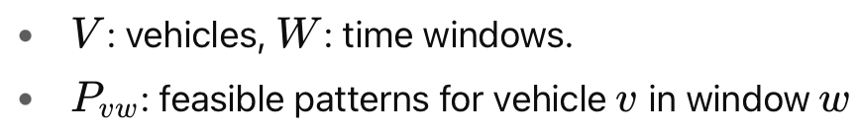
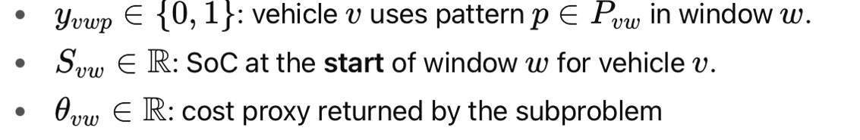
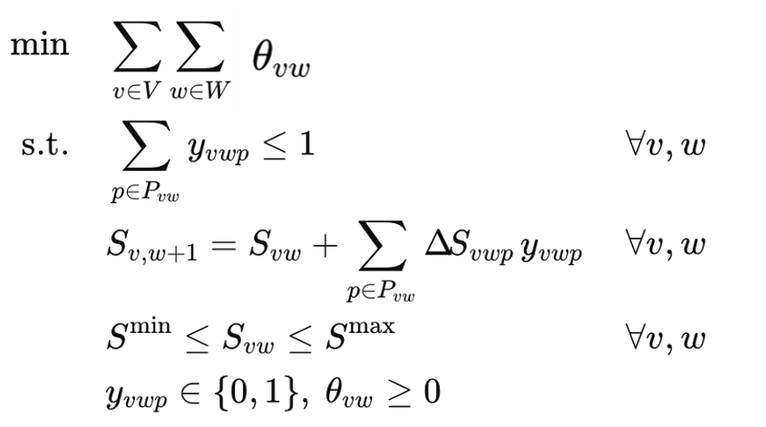
Coupling and Iteration – Master problem

Slide 37
Subproblem Relaxation - Granularity
OUT
RET
07:00
08:00
09:00

Slide 38


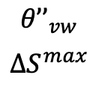
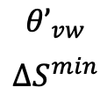

Subproblem Relaxation - Charging
RET
CRG
OUT
$$δ_{min}$$
$${θ’}_{vw}$$
$$∆S^{min}$$
RET
CRG
OUT
$$δ_{max}$$
$${θ’’}_{vw}$$
$$∆S^{max}$$
07:00
08:00
09:00

Slide 39
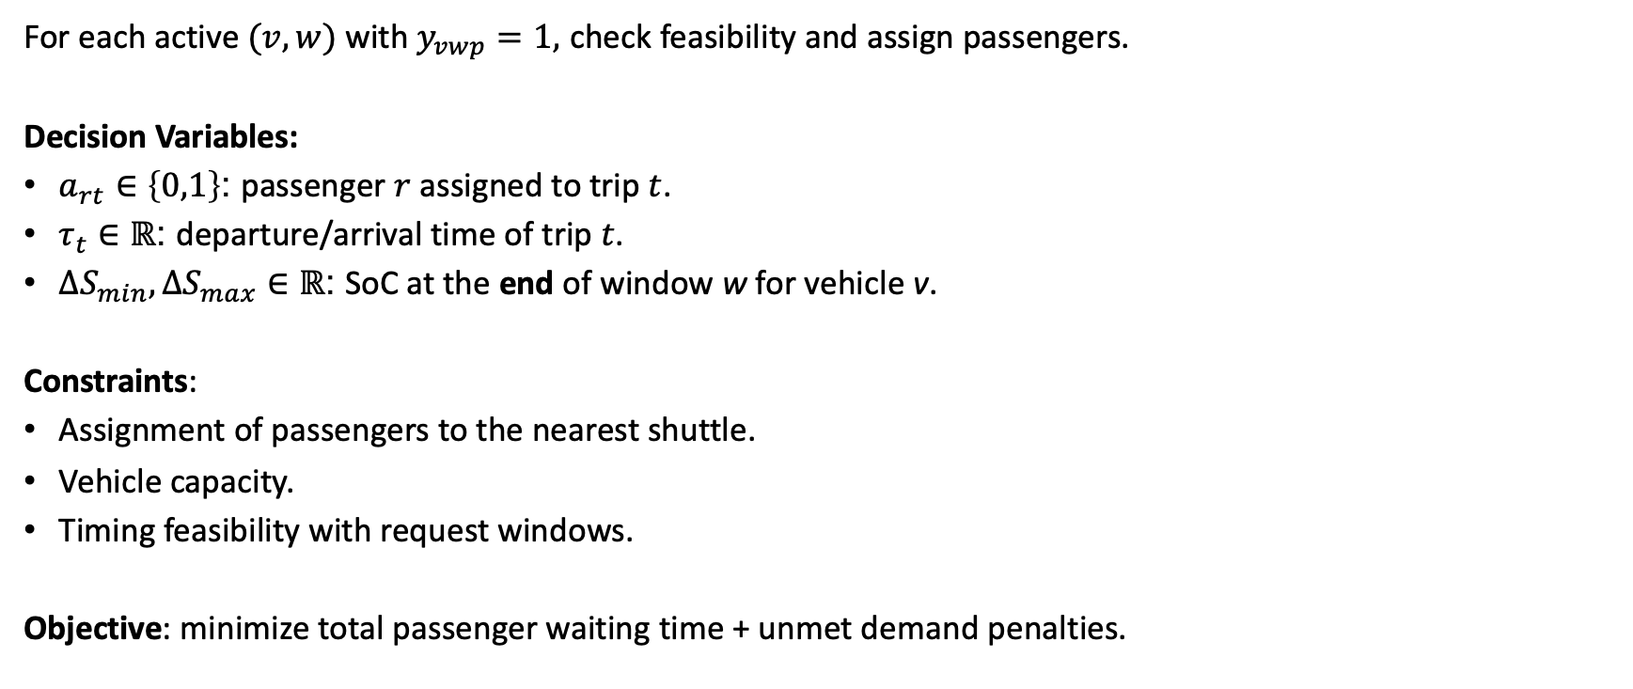
Coupling and Interaction - Subproblem
For each active $(v,w)$ with $y_{vwp}=1,$ check feasibility and assign passengers.
Decision Variables:
$a_{rt}∈\left\{0,1\right\}$: passenger $r$ assigned to trip $t$.
$τ_{t}∈ℝ$: departure/arrival time of trip $t$.
${{ΔS}_{min},ΔS}_{max}∈ℝ$: SoC at the end of window w for vehicle v.
Constraints:
Assignment of passengers to the nearest shuttle.
Vehicle capacity.
Timing feasibility with request windows.
Objective: minimize total passenger waiting time + unmet demand penalties.

Slide 40
Conclusion / Next Steps
Current stage: CP model implemented, solves small/medium instances, feasible schedules obtained but optimality proofs still hard.
Challenges: Scaling to higher demand, continuous-time dispatching, and larger fleets quickly becomes complex.
Next steps:
Explore and implement decomposition (Master–Subproblem).
Refine relaxations and cut generation for scalability.
Test on larger continuous-demand scenarios.
Code available: https://github.com/f-sartori-v/mobauto2_concert_cpp

