Slide 1
Finding Best Location for Seafood Restaurants in Toronto
Applied Data Science Capstone
IBM Data Science Professional Certification
Farnoosh Shirani

Slide 2
Business Problem
Find the best location for opening seafood restaurant in Toronto.
Finding optimal place to start a restaurant would greatly increase the likelihood of the restaurant succeeding especially in this competitive era.

Slide 3
Data
Scrape the Wikipedia page: https://en.wikipedia.org/wiki/List_of_postal_codes_of_Canada:_M
a link to a CSV file that has the geographical coordinates of each postal code: http://cocl.us/Geospatial_data
Finding restaurants in each neighbourhood of Toronto using Foursquare API.
The population and income distribution of each neighbourhood: https://www.toronto.ca/city-government/data-research-maps/open-data/open-data-catalogue

Slide 4
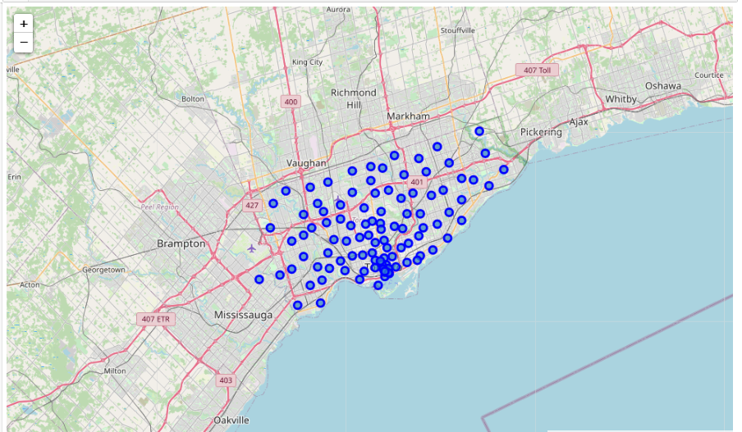
Location of all restaurants in Toronto

Slide 5
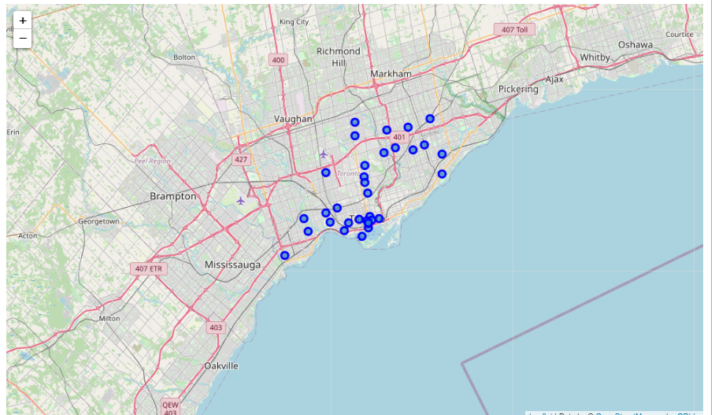
Location of all Seafood Restaurants in Toronto

Slide 6
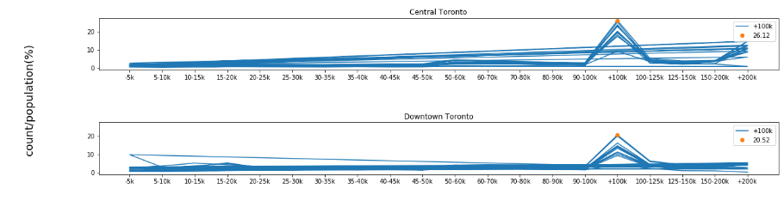
The relation of income distribution and the percent of people in each borough

Slide 7
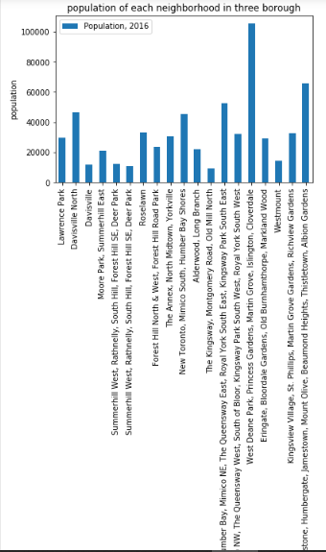
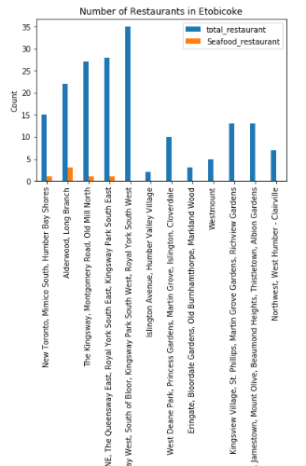
Population of each neighbourhood in three borough
Number of restaurants in Etobicoke borough

Slide 8
Conclusion
According to the analysis and discussion, I suggest Cloverdale, Islington, Martin Grove, Princess Gardens, West Deane Park.

