Slide 1
Update on
Morpheus project
Morpheus Meeting
Hiwi

Slide 2
GCC result
Problem:
Models w/ default param
performs better or equally well (RF)
- SF perform better than MF (MLPC)
What could confuse the model?
-> Dataset
-> DMSO as a datapoint
-> curation
-> training/ test repartition

Slide 3
GCC result
What could confuse the model?
-> Dataset
-> DMSO as a datapoint (structure is an “outliers”, mfps is null) -> removed
-> curation
-> training/ test repartition

Slide 4
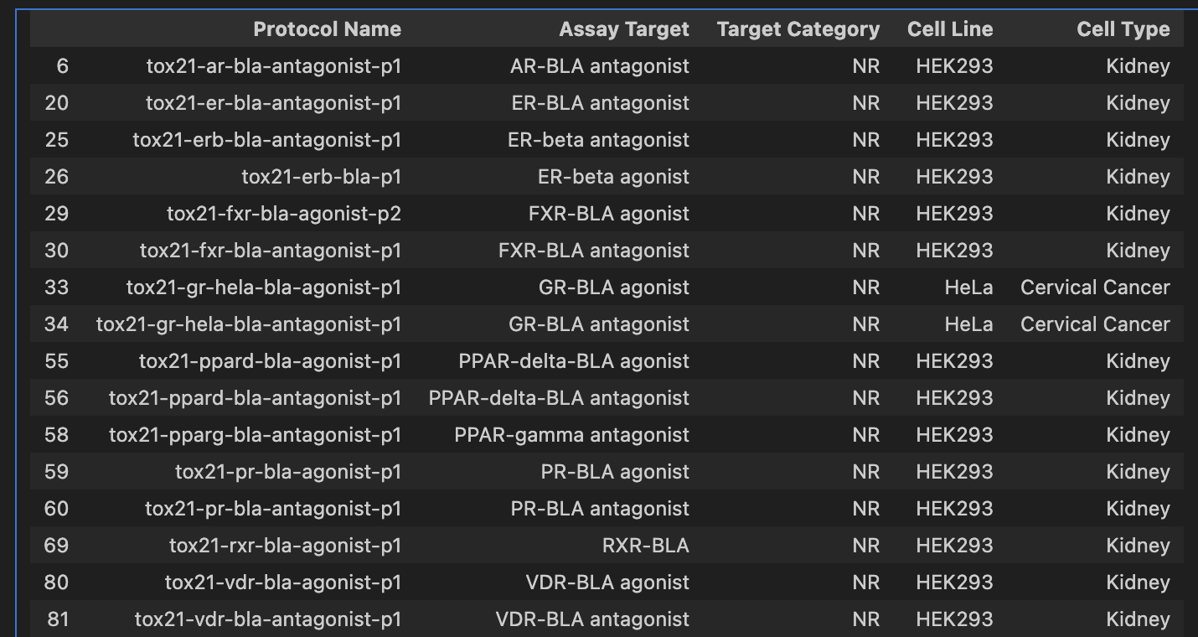
Dataset curation : Tox21 8947 unique molecules
Different assay readout :
Luciferase Reporter
b-lactamase reporter gene assay
15 BLA assays for 10 unique receptors
2 cells types
Measurement :
['activity', 'viability', 'signal', 'control’]
Outcome: distinction between assay outcome and channel outcome
-> b-lactamase + Activity + channel outcome

Slide 5
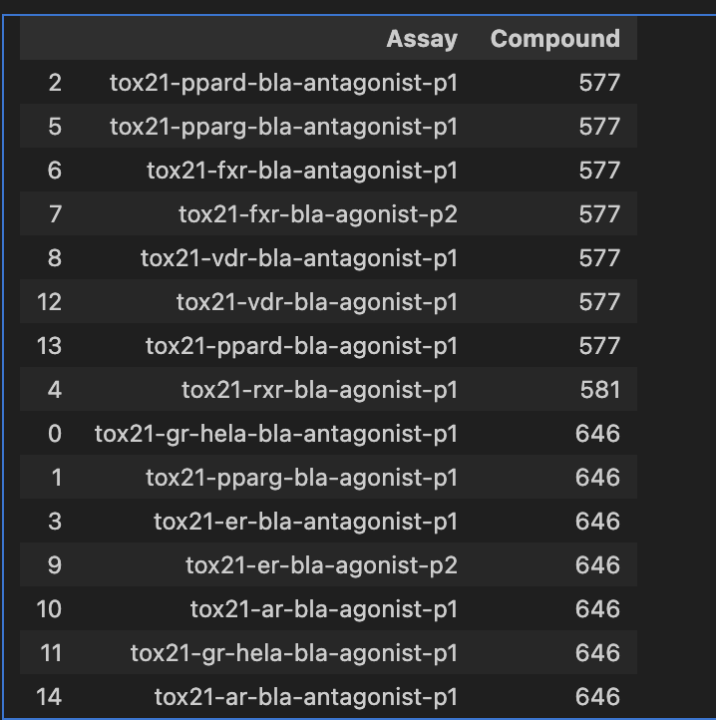
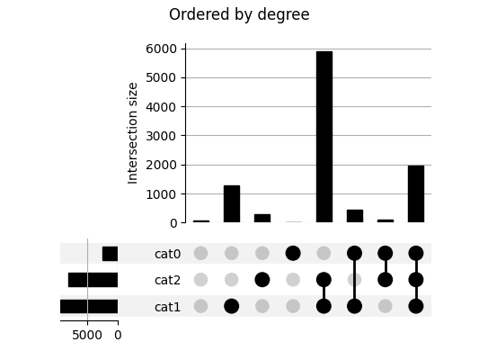
BBC047 (650 mol) overlaps with the 10 NR assays
Visualisation of overlapping set :
Wien diagram to messy
Upset plot unclear (not displayed here)
Example of upset plot taken from website

Slide 6
Define the Endocrine classes (active/inactive)
1. Exclude assays with inconsistent outcomes for a compound.
2. Discard inconclusive assays
3. Evaluate remaining assays:
- If ≥1 active → classify compound as endocrine-active.
- If all inactive → classify a compound as inactive.
327 active
323 inactive

Slide 7
Define the Endocrine classes (active/inactive)
1. Exclude assays with inconsistent outcomes for a compound.
2. Discard inconclusive assays
3. Evaluate remaining assays:
- If ≥1 active → classify compound as endocrine-active.
- If all inactive → classify a compound as inactive.
->This step could confuse the model since I used agonist/antagonist assay together for final classes annotation

Slide 8
Define the Endocrine classes (active/inactive)
1. Exclude assays with inconsistent outcomes for a compound.
2. Discard inconclusive assays
3. Evaluate remaining assays:
- If ≥1 active → classify compound as endocrine-active.
- If all inactive → classify a compound as inactive.
-> Code modify to make the distinction between agonist / antagonist
 | Active | Inactive
initial | 327 | 323
Agonist assay | 245 | 405
Antagonist assay | 272 | 374

Slide 9
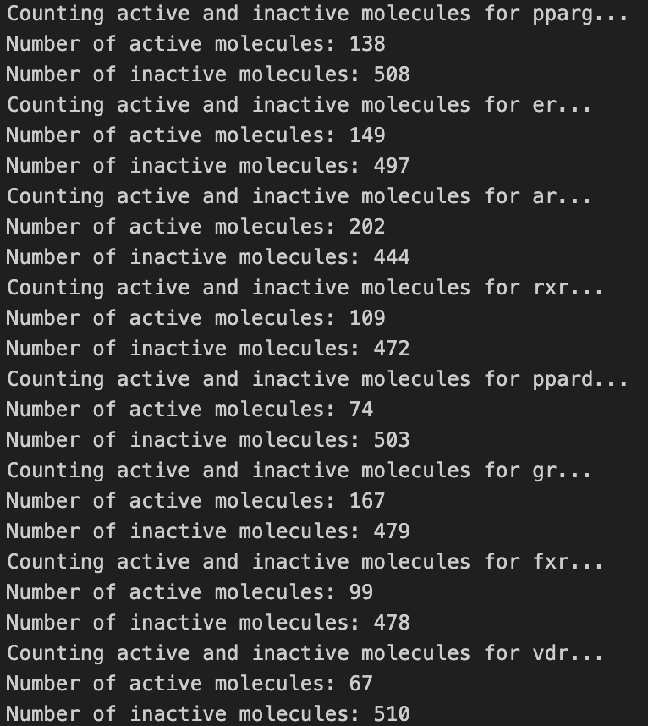
Define the Endocrine classes (active/inactive)
1. Exclude assays with inconsistent outcomes for a compound.
2. Discard inconclusive assays
3. Evaluate remaining assays:
- If ≥1 active → classify compound as endocrine-active.
- If all inactive → classify a compound as inactive.
Done for each of receptor for LM work
LM work
- model for each receptor + ensemble model
- morpho features importance
- (in-house data) ?
Notes:
Multi label by concatening

Slide 10
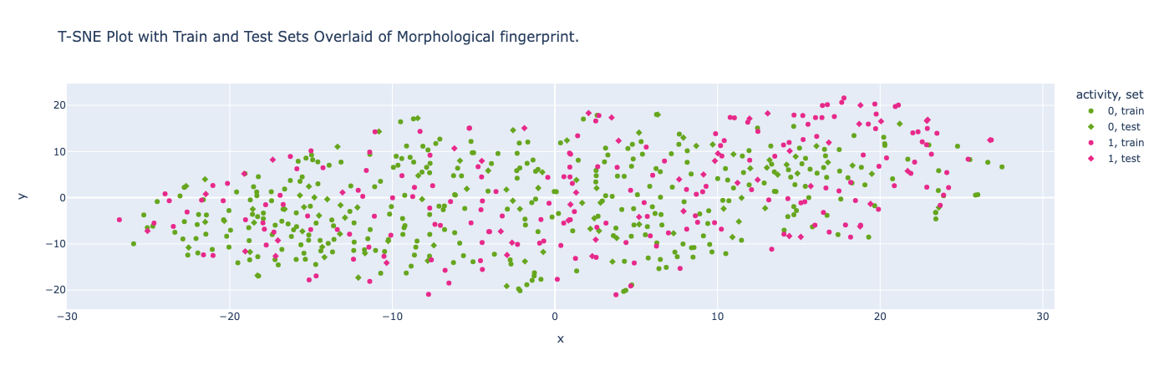
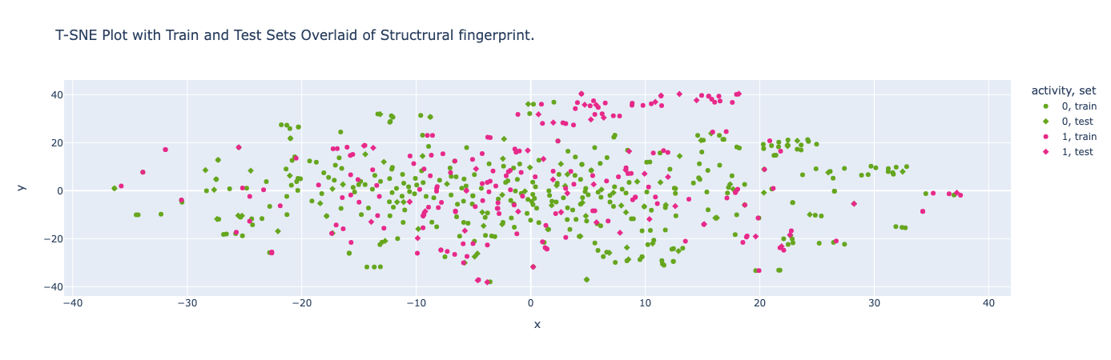
Result on Agonist set
 | Active | Inactive
initial | 327 | 323
Agonist assay | 245 | 405
Antagonist assay | 272 | 374

Slide 11
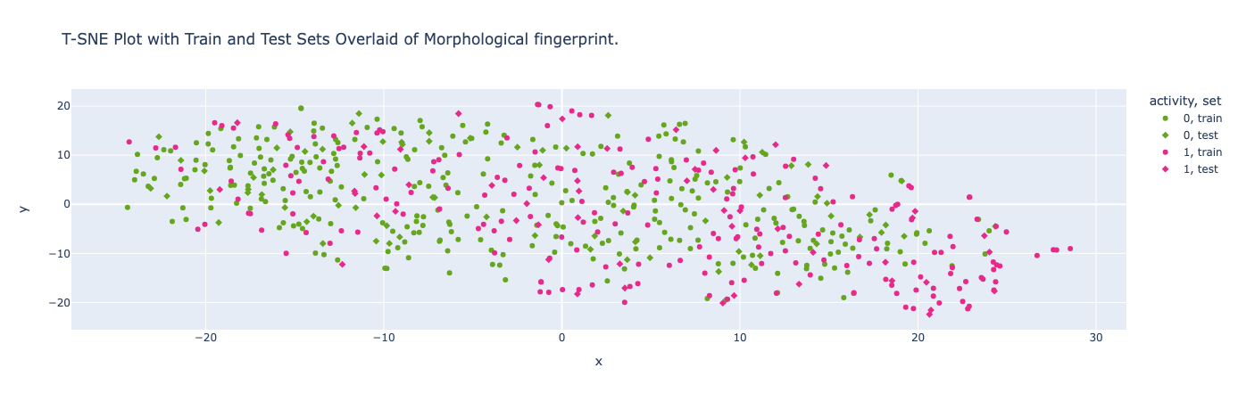
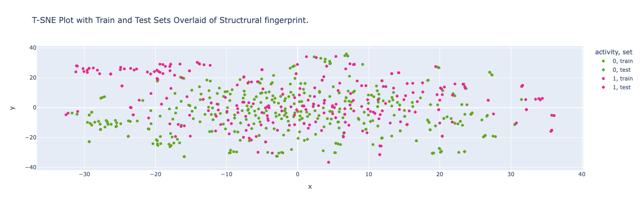
Result on Antagonist set
 | Active | Inactive
initial | 327 | 323
Agonist assay | 245 | 405
Antagonist assay | 272 | 374

Slide 12
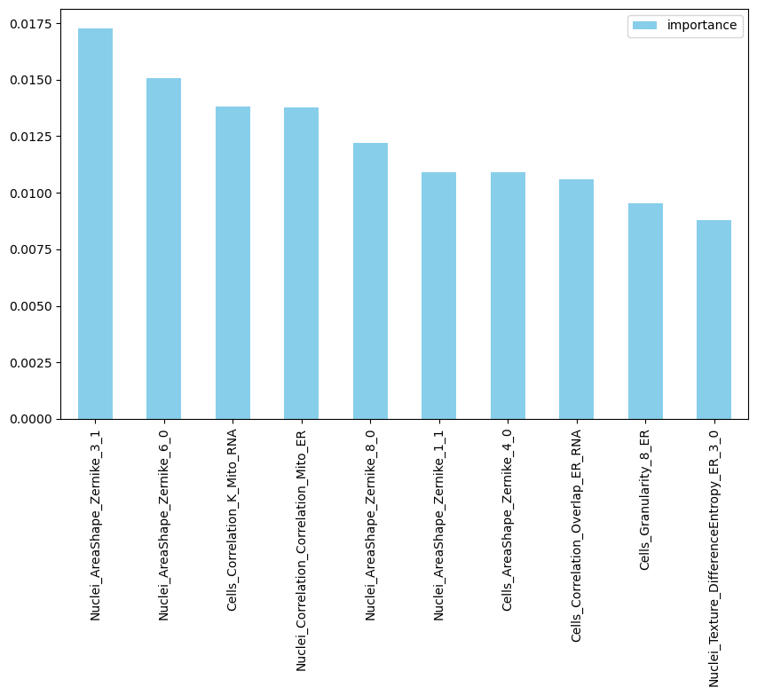
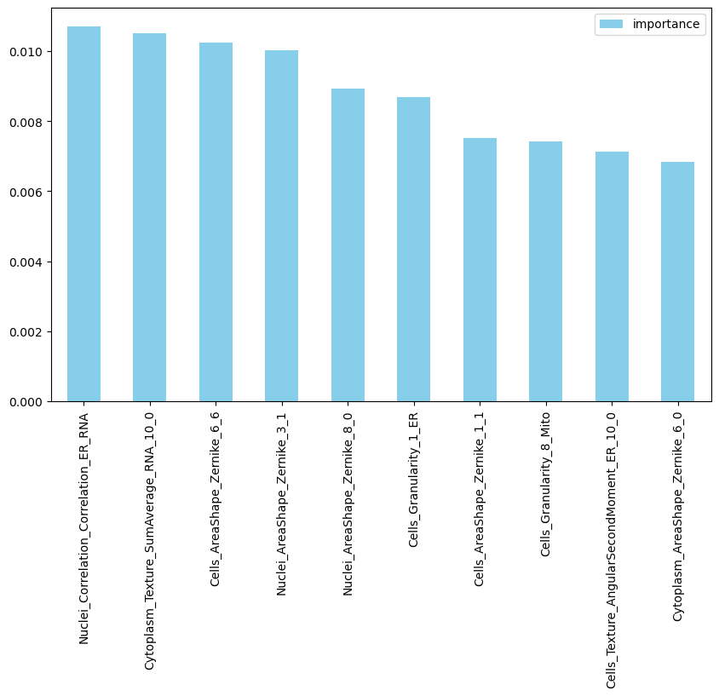
Comparison and fts importance
Morphological fps
Data : “Agonist”
Data : “Antagonist”

Slide 13
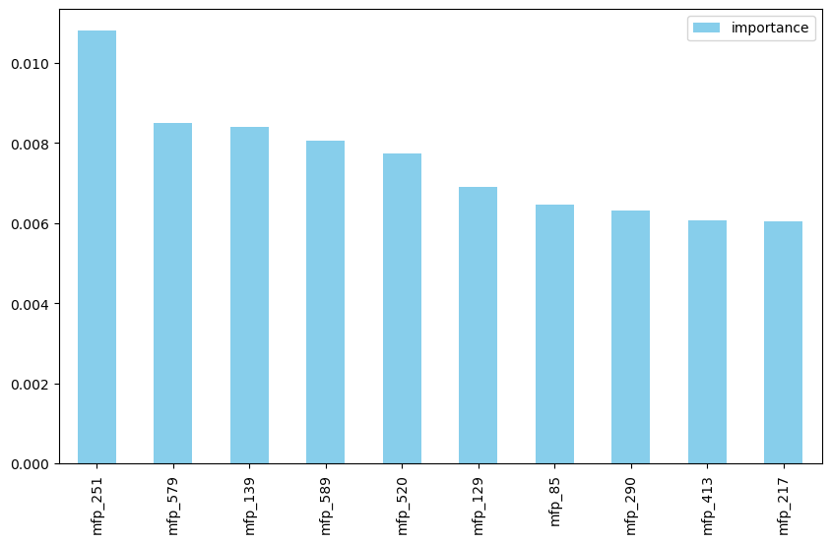
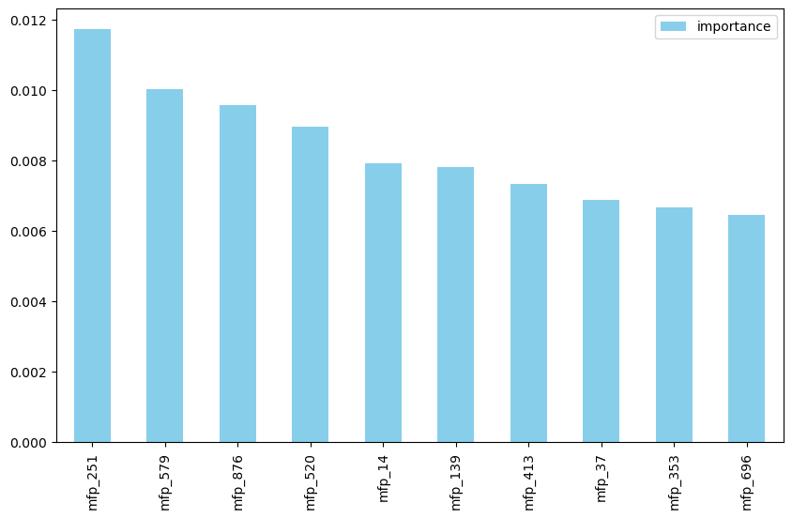
Comparison and fts importance
Structural fps -> mfp : morgan fingerprints
Data : “Agonist”
Data : “Antagonist”

Slide 14
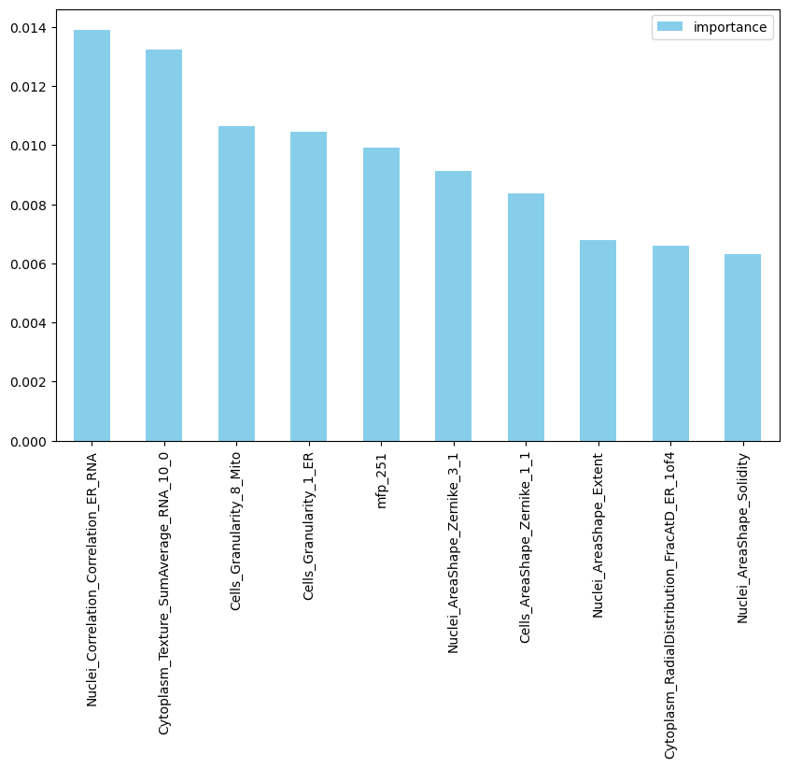
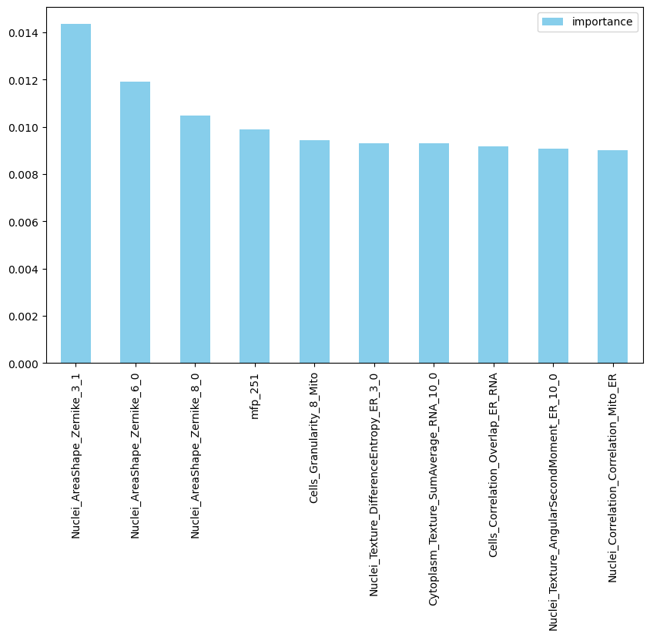
Comparison and fts importance
Combined fps -> mfp : morgan fingerprints
Data : “Agonist”
Data : “Antagonist”

Slide 15
Discussion
Default model > better than tuned model
- overfitting of the train set (performance on the train set are for most of the case BA : 100%, MCC : 1 ) -> dummy model or different approach for optimization ?
- Why is it easier for the model to learn on struct
Despite the train test set split visualisation that seems homogenous data leakage for the structural fps? (to use Datasail)
- Can we make a sub-structure or pattern out of the feature's importance output of structural fps?

Slide 16
Morpheus meeting
Agenda ?
- Book chapter?
Could Lisa Marie join?
- presentation of the Knime pipeline (LM) and semi-supervised work
- new task ongoing
Me presentation :
- Review
MLPC vs RF
See with milestones and work done on ft importance
Hiwi
Anjali subject ✅ / contract ❌

