Slide 1
keras_shiny-rsuite
A problem building a project/package with Python in Linux

Slide 2
keras_shiny-rsuite is a tutorial project to demonstrate how to build Shiny applications using the rsuite paradigm.
This tutorial was built from the rsuite examples in
https://rsuite.io/RSuite_Tutorial.php?article=rsuite_templates.md#user-content-shiny-app-development

Slide 3
How the project was created
The construction of the Keras-Shiny project is explained in the set of slides keras_and_shiny_tutorial.odp
These slides explain the problem building the keras-shiny application in Linux at the moment of installing the system requirements for Python
The name of the project is keras_and_shiny-tutorial
The next slides show the steps to reproduce the problem in Linux

Slide 4
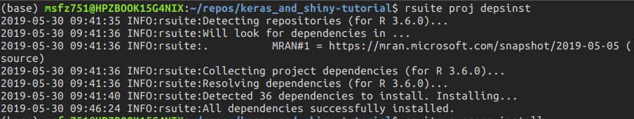
terminal: Install dependencies
rsuite proj depsinst

Slide 5
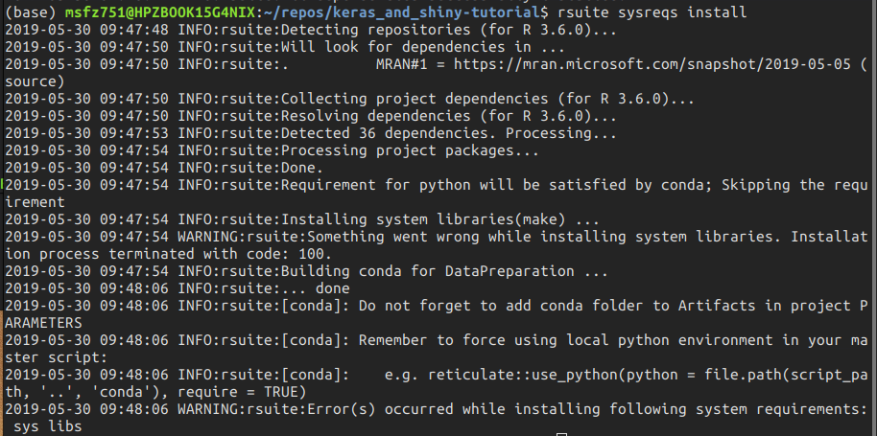
terminal: Install the system requirements
rsuite sysreqs install

Slide 6
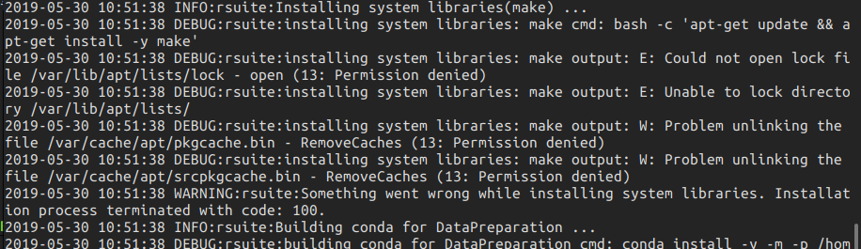
terminal: Verbose system requirements
rsuite sysreqs install -v

Slide 7
terminal: Build the project
rsuite proj depsinst
The project cannot be built because the system requirements step fails

Slide 8
Notes
The zfactor-rsuite project in Github at https://github.com/f0nzie/zfactor-rsuite
The package zFactor is a sub-module of zfactor-rsuite
The operating system is Linux Ubuntu 18.04, 64-bit
Tested in two Linux physical machines and one Virtual Machine with same settings
R-3.6.0, RStudio 1.2.1335
Rsuite version 0.36-252

Slide 9
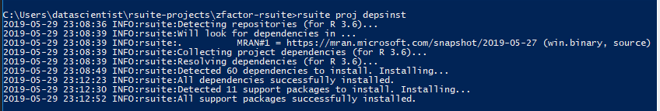

The same project runs fine in Windows 10
rsuite proj depsinst
rsuite proj build
Windows 10
R-3.6.0
RStudio 1.2.1335
Rsuite 0.36-252

Slide 10
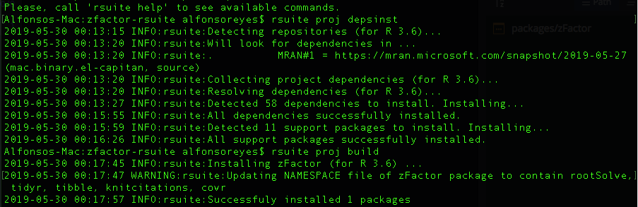
… and also runs fine in Mac osX
Mac osX 10.12 Sierra
R-3.6.0
RStudio 1.2.1335
Rsuite 0.36-252

