Slide 1
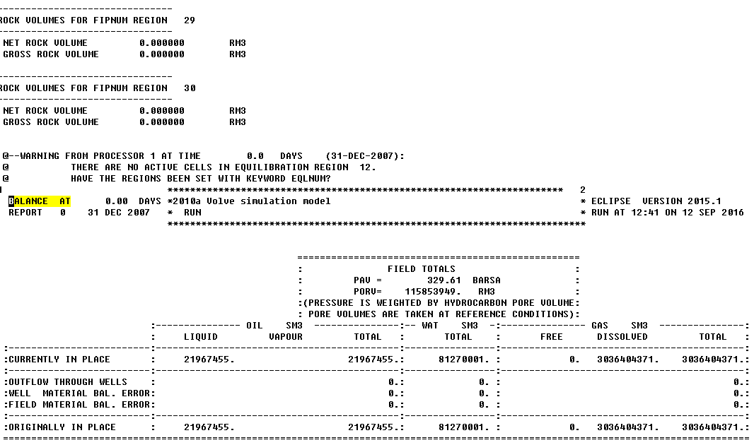
The Eclipse output file

Slide 2
" BALANCE AT 0.00 DAYS *2010a Volve simulation model * ECLIPSE VERSION 2015.1 "
" REPORT 0 31 DEC 2007 * RUN * RUN AT 12:41 ON 12 SEP 2016 "
" **************************************************************************"
""
""
" =================================================="
[7] " : FIELD TOTALS :"
[8] " : PAV = 329.61 BARSA :"
[9] " : PORV= 115853949. RM3 :"
[10] " :(PRESSURE IS WEIGHTED BY HYDROCARBON PORE VOLUME:"
[11] " : PORE VOLUMES ARE TAKEN AT REFERENCE CONDITIONS):"
[12] " :--------------- OIL SM3 ---------------:-- WAT SM3 -:--------------- GAS SM3 ---------------:"
[13] " : LIQUID VAPOUR TOTAL : TOTAL : FREE DISSOLVED TOTAL :"
[14] " :-------------------------:-------------------------------------------:----------------:-------------------------------------------:"
[15] " :CURRENTLY IN PLACE : 21967455. 21967455.: 81270001. : 0. 3036404371. 3036404371.:"
[16] " :-------------------------:-------------------------------------------:----------------:-------------------------------------------:"
[17] " :OUTFLOW THROUGH WELLS : 0.: 0. : 0.:"
[18] " :WELL MATERIAL BAL. ERROR: 0.: 0. : 0.:"
[19] " :FIELD MATERIAL BAL. ERROR: 0.: 0. : 0.:"
[20] " :-------------------------:-------------------------------------------:----------------:-------------------------------------------:"
[21] " :ORIGINALLY IN PLACE : 21967455. 21967455.: 81270001. : 0. 3036404371. 3036404371.:"
[22] " ===================================================================================================================================="

Slide 3
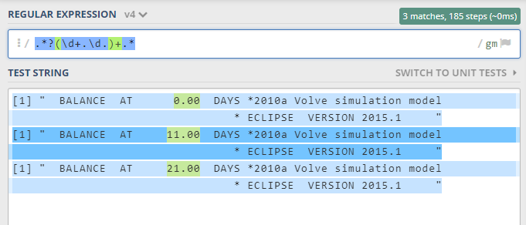
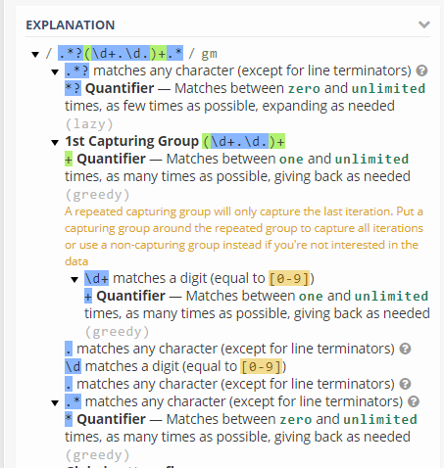
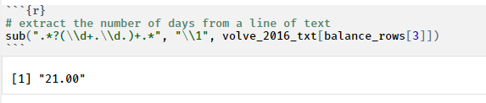
Extract number of days in a row
[1] " BALANCE AT 0.00 DAYS *2010a Volve simulation model * ECLIPSE VERSION 2015.1 "
[1] " BALANCE AT 11.00 DAYS *2010a Volve simulation model * ECLIPSE VERSION 2015.1 "
[1] " BALANCE AT 21.00 DAYS *2010a Volve simulation model * ECLIPSE VERSION 2015.1 "

Slide 4
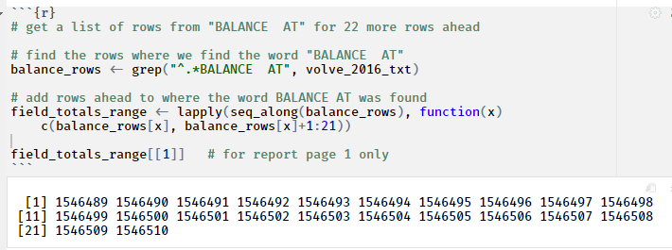
Get row indices for a word

Slide 5
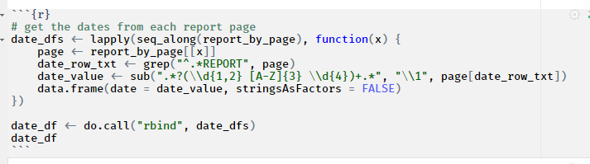
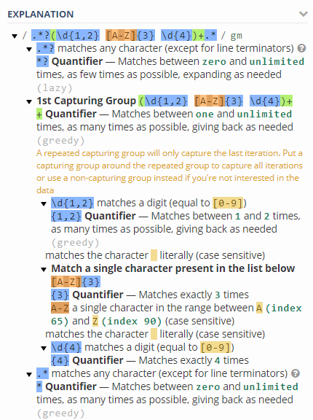
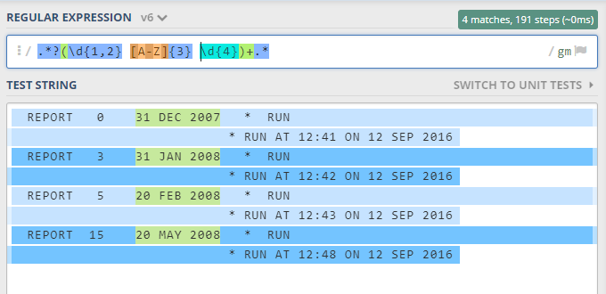
Get the dates from a report
REPORT 0 31 DEC 2007 * RUN * RUN AT 12:41 ON 12 SEP 2016
REPORT 3 31 JAN 2008 * RUN * RUN AT 12:42 ON 12 SEP 2016
REPORT 5 20 FEB 2008 * RUN * RUN AT 12:43 ON 12 SEP 2016
REPORT 15 20 MAY 2008 * RUN * RUN AT 12:48 ON 12 SEP 2016

Slide 6
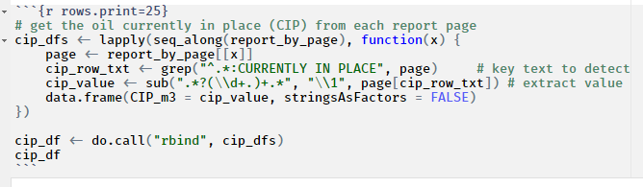
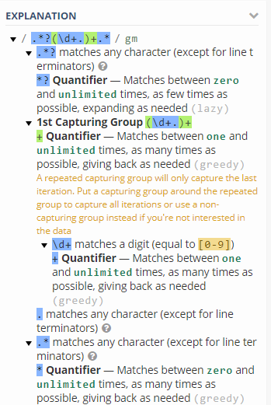
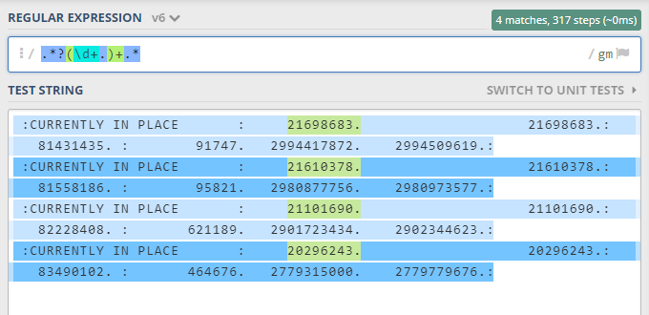
Get oil currently in place
Text sample
:CURRENTLY IN PLACE : 21698683. 21698683.: 81431435. : 91747. 2994417872. 2994509619.:
:CURRENTLY IN PLACE : 21610378. 21610378.: 81558186. : 95821. 2980877756. 2980973577.:
:CURRENTLY IN PLACE : 21101690. 21101690.: 82228408. : 621189. 2901723434. 2902344623.:
:CURRENTLY IN PLACE : 20296243. 20296243.: 83490102. : 464676. 2779315000. 2779779676.:

Slide 7
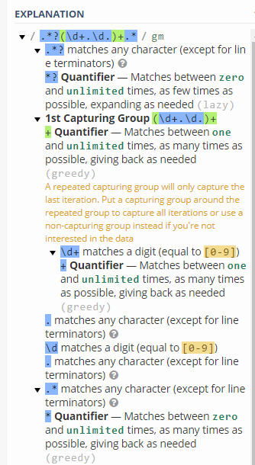
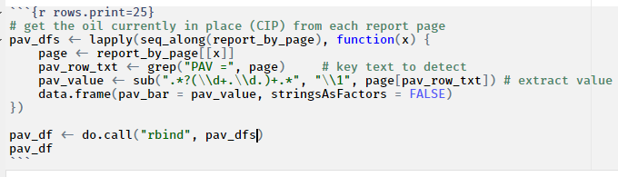
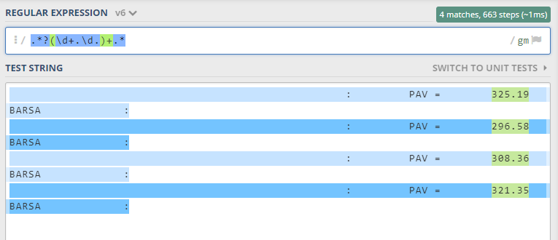
Get average pressure
Text sample
: PAV = 325.19 BARSA :
: PAV = 296.58 BARSA :
: PAV = 308.36 BARSA :
: PAV = 321.35 BARSA :

Slide 8

Get oil outflow

Slide 9

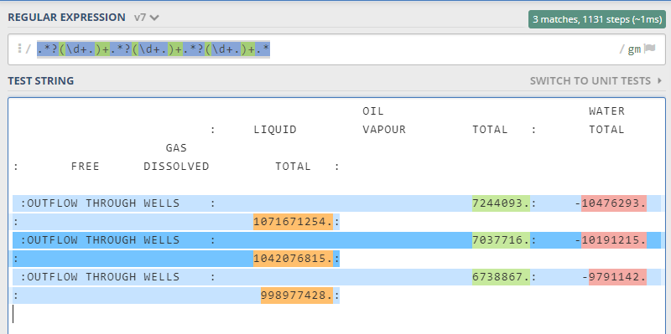
Get the fluid outflow in one shot, by groups
OIL WATER
: LIQUID VAPOUR TOTAL : TOTAL
GAS
: FREE DISSOLVED TOTAL :
:OUTFLOW THROUGH WELLS : 7244093.: -10476293. : 1071671254.:
:OUTFLOW THROUGH WELLS : 7037716.: -10191215. : 1042076815.:
:OUTFLOW THROUGH WELLS : 6738867.: -9791142. : 998977428.:

Slide 10
From STEP blocks

Slide 11
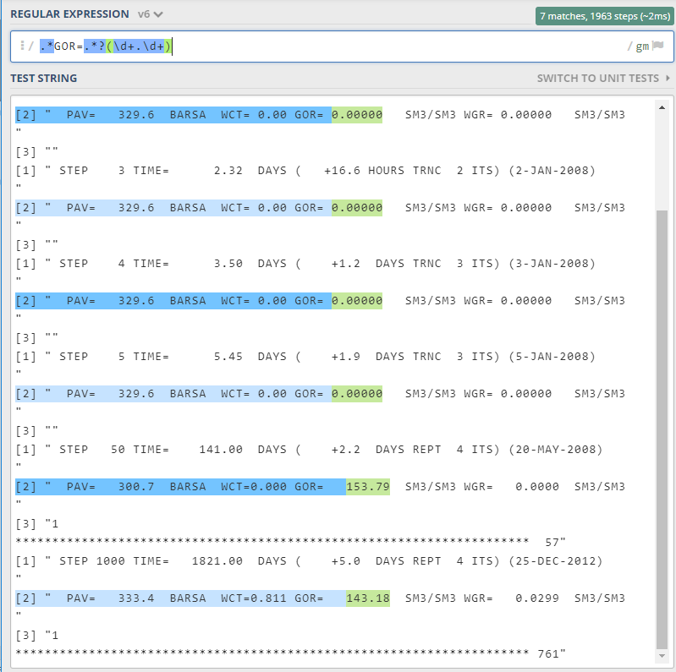
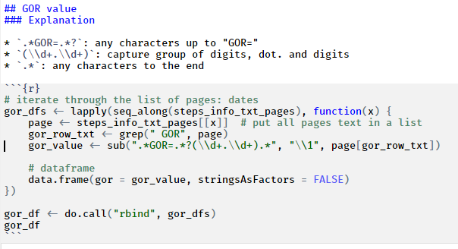
Extract the days
Text sample
[1] " STEP 1 TIME= 1.00 DAYS ( +1.0 DAYS INIT 5 ITS) (1-JAN-2008) "
[2] " PAV= 329.6 BARSA WCT= 0.00 GOR= 0.00000 SM3/SM3 WGR= 0.00000 SM3/SM3 "
[3] ""
[1] " STEP 2 TIME= 1.63 DAYS ( +15.2 HOURS TRNC 2 ITS) (1-JAN-2008) "
[2] " PAV= 329.6 BARSA WCT= 0.00 GOR= 0.00000 SM3/SM3 WGR= 0.00000 SM3/SM3 "
[3] ""
[1] " STEP 3 TIME= 2.32 DAYS ( +16.6 HOURS TRNC 2 ITS) (2-JAN-2008) "
[2] " PAV= 329.6 BARSA WCT= 0.00 GOR= 0.00000 SM3/SM3 WGR= 0.00000 SM3/SM3 "
[3] ""
[1] " STEP 4 TIME= 3.50 DAYS ( +1.2 DAYS TRNC 3 ITS) (3-JAN-2008) "
[2] " PAV= 329.6 BARSA WCT= 0.00 GOR= 0.00000 SM3/SM3 WGR= 0.00000 SM3/SM3 "
[3] ""
[1] " STEP 5 TIME= 5.45 DAYS ( +1.9 DAYS TRNC 3 ITS) (5-JAN-2008) "
[2] " PAV= 329.6 BARSA WCT= 0.00 GOR= 0.00000 SM3/SM3 WGR= 0.00000 SM3/SM3 "
[3] ""
[1] " STEP 50 TIME= 141.00 DAYS ( +2.2 DAYS REPT 4 ITS) (20-MAY-2008) "
[2] " PAV= 300.7 BARSA WCT=0.000 GOR= 153.79 SM3/SM3 WGR= 0.0000 SM3/SM3 "
[3] "1 ********************************************************************** 57"
[1] " STEP 1000 TIME= 1821.00 DAYS ( +5.0 DAYS REPT 4 ITS) (25-DEC-2012) "
[2] " PAV= 333.4 BARSA WCT=0.811 GOR= 143.18 SM3/SM3 WGR= 0.0299 SM3/SM3 "
[3] "1 ********************************************************************** 761"

Slide 12
Extract the GOR from calculation step
Text sample
[1] " STEP 1 TIME= 1.00 DAYS ( +1.0 DAYS INIT 5 ITS) (1-JAN-2008) "
[2] " PAV= 329.6 BARSA WCT= 0.00 GOR= 0.00000 SM3/SM3 WGR= 0.00000 SM3/SM3 "
[3] ""
[1] " STEP 2 TIME= 1.63 DAYS ( +15.2 HOURS TRNC 2 ITS) (1-JAN-2008) "
[2] " PAV= 329.6 BARSA WCT= 0.00 GOR= 0.00000 SM3/SM3 WGR= 0.00000 SM3/SM3 "
[3] ""
[1] " STEP 3 TIME= 2.32 DAYS ( +16.6 HOURS TRNC 2 ITS) (2-JAN-2008) "
[2] " PAV= 329.6 BARSA WCT= 0.00 GOR= 0.00000 SM3/SM3 WGR= 0.00000 SM3/SM3 "
[3] ""
[1] " STEP 4 TIME= 3.50 DAYS ( +1.2 DAYS TRNC 3 ITS) (3-JAN-2008) "
[2] " PAV= 329.6 BARSA WCT= 0.00 GOR= 0.00000 SM3/SM3 WGR= 0.00000 SM3/SM3 "
[3] ""
[1] " STEP 5 TIME= 5.45 DAYS ( +1.9 DAYS TRNC 3 ITS) (5-JAN-2008) "
[2] " PAV= 329.6 BARSA WCT= 0.00 GOR= 0.00000 SM3/SM3 WGR= 0.00000 SM3/SM3 "
[3] ""
[1] " STEP 50 TIME= 141.00 DAYS ( +2.2 DAYS REPT 4 ITS) (20-MAY-2008) "
[2] " PAV= 300.7 BARSA WCT=0.000 GOR= 153.79 SM3/SM3 WGR= 0.0000 SM3/SM3 "
[3] "1 ********************************************************************** 57"
[1] " STEP 1000 TIME= 1821.00 DAYS ( +5.0 DAYS REPT 4 ITS) (25-DEC-2012) "
[2] " PAV= 333.4 BARSA WCT=0.811 GOR= 143.18 SM3/SM3 WGR= 0.0299 SM3/SM3 "
[3] "1 ********************************************************************** 761"

Slide 13

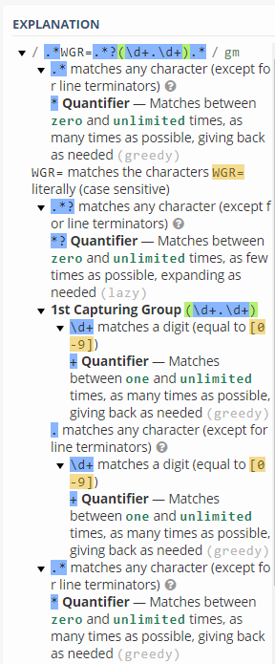
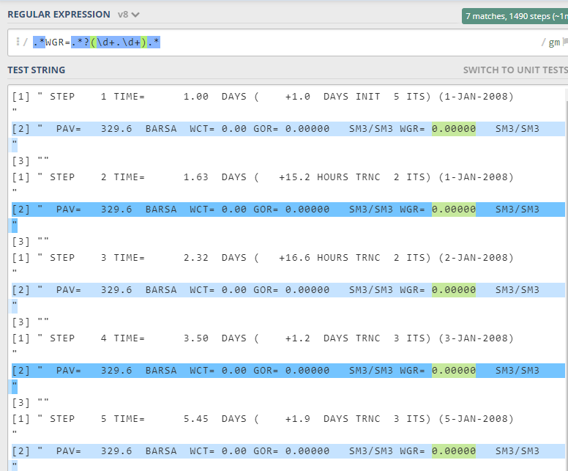
Extract the WGR from calculation step
Text sample
Use data from previous slide

Slide 14
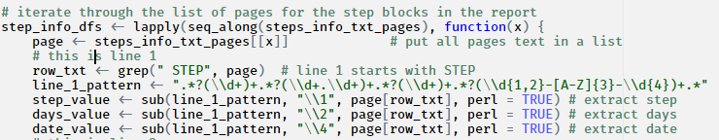
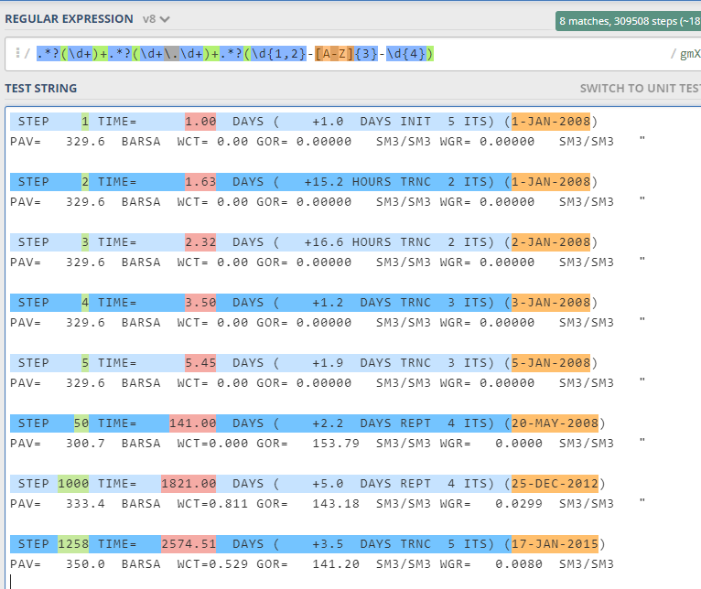
Extract the whole 1st row by groups
Text sample
STEP 1 TIME= 1.00 DAYS ( +1.0 DAYS INIT 5 ITS) (1-JAN-2008)
PAV= 329.6 BARSA WCT= 0.00 GOR= 0.00000 SM3/SM3 WGR= 0.00000 SM3/SM3
STEP 2 TIME= 1.63 DAYS ( +15.2 HOURS TRNC 2 ITS) (1-JAN-2008)
PAV= 329.6 BARSA WCT= 0.00 GOR= 0.00000 SM3/SM3 WGR= 0.00000 SM3/SM3
STEP 3 TIME= 2.32 DAYS ( +16.6 HOURS TRNC 2 ITS) (2-JAN-2008)
PAV= 329.6 BARSA WCT= 0.00 GOR= 0.00000 SM3/SM3 WGR= 0.00000 SM3/SM3
STEP 4 TIME= 3.50 DAYS ( +1.2 DAYS TRNC 3 ITS) (3-JAN-2008)
PAV= 329.6 BARSA WCT= 0.00 GOR= 0.00000 SM3/SM3 WGR= 0.00000 SM3/SM3
STEP 5 TIME= 5.45 DAYS ( +1.9 DAYS TRNC 3 ITS) (5-JAN-2008)
PAV= 329.6 BARSA WCT= 0.00 GOR= 0.00000 SM3/SM3 WGR= 0.00000 SM3/SM3
STEP 50 TIME= 141.00 DAYS ( +2.2 DAYS REPT 4 ITS) (20-MAY-2008)
PAV= 300.7 BARSA WCT=0.000 GOR= 153.79 SM3/SM3 WGR= 0.0000 SM3/SM3
STEP 1000 TIME= 1821.00 DAYS ( +5.0 DAYS REPT 4 ITS) (25-DEC-2012)
PAV= 333.4 BARSA WCT=0.811 GOR= 143.18 SM3/SM3 WGR= 0.0299 SM3/SM3

Slide 15
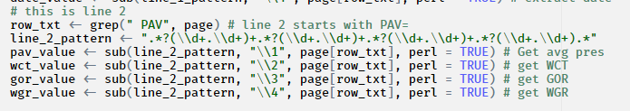
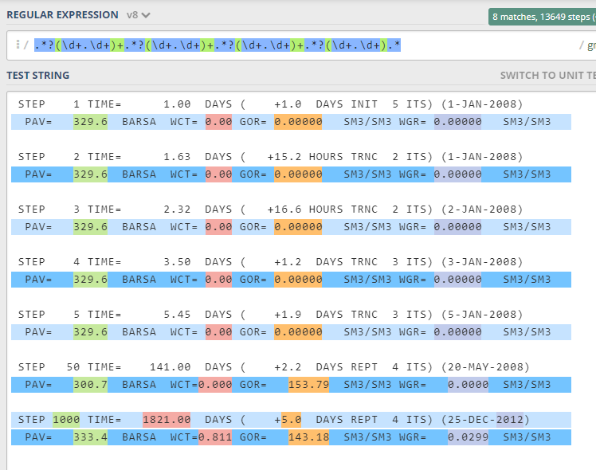
Extract the whole 2nd row by groups
Text sample
STEP 1 TIME= 1.00 DAYS ( +1.0 DAYS INIT 5 ITS) (1-JAN-2008)
PAV= 329.6 BARSA WCT= 0.00 GOR= 0.00000 SM3/SM3 WGR= 0.00000 SM3/SM3
STEP 2 TIME= 1.63 DAYS ( +15.2 HOURS TRNC 2 ITS) (1-JAN-2008)
PAV= 329.6 BARSA WCT= 0.00 GOR= 0.00000 SM3/SM3 WGR= 0.00000 SM3/SM3
STEP 3 TIME= 2.32 DAYS ( +16.6 HOURS TRNC 2 ITS) (2-JAN-2008)
PAV= 329.6 BARSA WCT= 0.00 GOR= 0.00000 SM3/SM3 WGR= 0.00000 SM3/SM3
STEP 4 TIME= 3.50 DAYS ( +1.2 DAYS TRNC 3 ITS) (3-JAN-2008)
PAV= 329.6 BARSA WCT= 0.00 GOR= 0.00000 SM3/SM3 WGR= 0.00000 SM3/SM3
STEP 5 TIME= 5.45 DAYS ( +1.9 DAYS TRNC 3 ITS) (5-JAN-2008)
PAV= 329.6 BARSA WCT= 0.00 GOR= 0.00000 SM3/SM3 WGR= 0.00000 SM3/SM3
STEP 50 TIME= 141.00 DAYS ( +2.2 DAYS REPT 4 ITS) (20-MAY-2008)
PAV= 300.7 BARSA WCT=0.000 GOR= 153.79 SM3/SM3 WGR= 0.0000 SM3/SM3
STEP 1000 TIME= 1821.00 DAYS ( +5.0 DAYS REPT 4 ITS) (25-DEC-2012)
PAV= 333.4 BARSA WCT=0.811 GOR= 143.18 SM3/SM3 WGR= 0.0299 SM3/SM3

