Slide 1
Connecticut Housing Price Forecasting
A Comparative Analysis of Time Series and Regression Models GMGT-643 Data Analytics December 2025

Slide 2
Why Forecast Housing Prices?
• Housing affects everyone: buyers, investors, lenders
• Better predictions = better decisions
• Research Question: Which forecasting model works best?
•
• Why Connecticut?
• Largest public real estate dataset in the country (1.1M+ transactions)
• Interesting market: NYC proximity, COVID-19 migration impact

Slide 3
Data Sources
Source | Data | Details
CT Open Data Portal | Housing Transactions | 1.1M records (2001-2024)
FRED Database | Economic Indicators | Mortgage, Unemployment, CPI, Population

Slide 4
Data Preparation
• Filtered transactions under $10,000 (arm's length only)
• Residential properties only (no commercial)
• Created monthly MEDIAN prices (not average - avoids outlier skew)
•
• Final Dataset:
• 279 months of data (1999-2024)
• 70/30 train-test split (195 / 84 months)
• Test period includes COVID-19 pandemic (stress test)

Slide 5
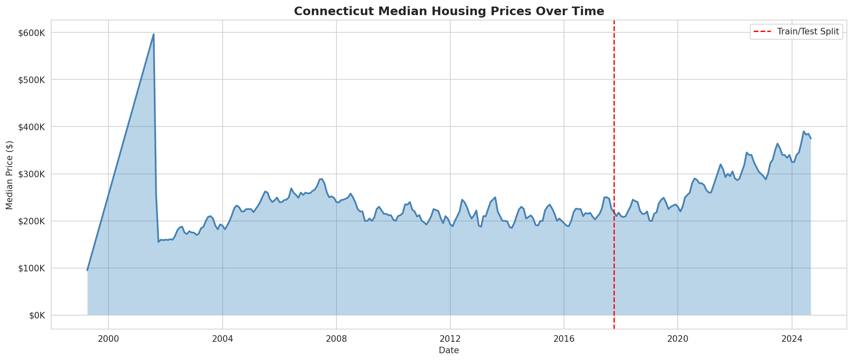
Connecticut Housing Price Trends
Key events: 2008 bubble/crash, long recovery, COVID-19 surge (2020+)

Slide 6
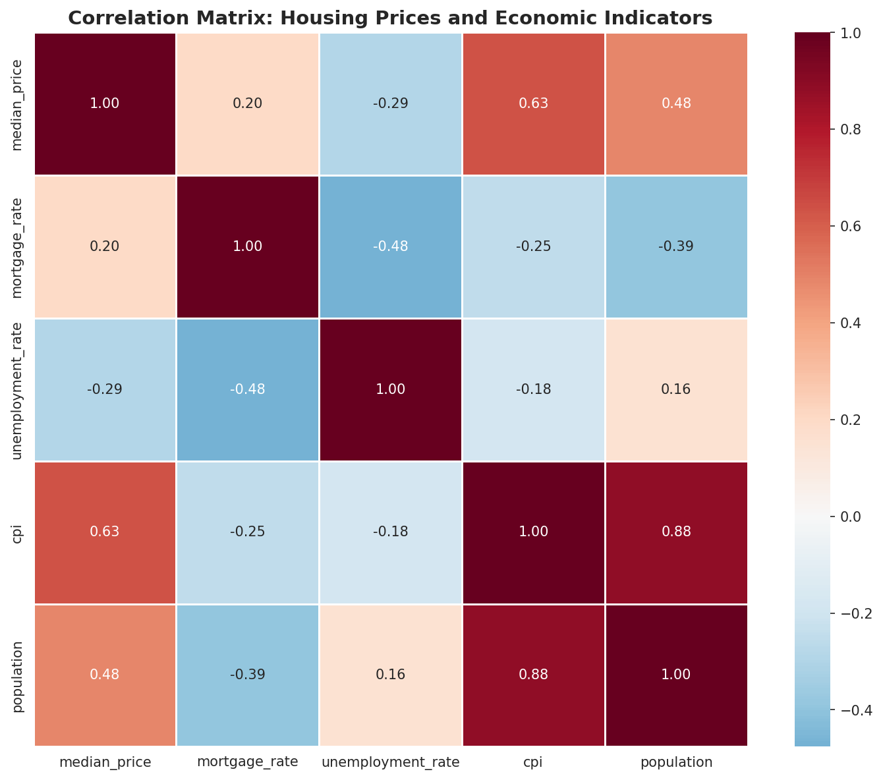
Economic Indicator Correlations
CPI and population strongly correlated; mortgage rates show complex time-lag relationship

Slide 7
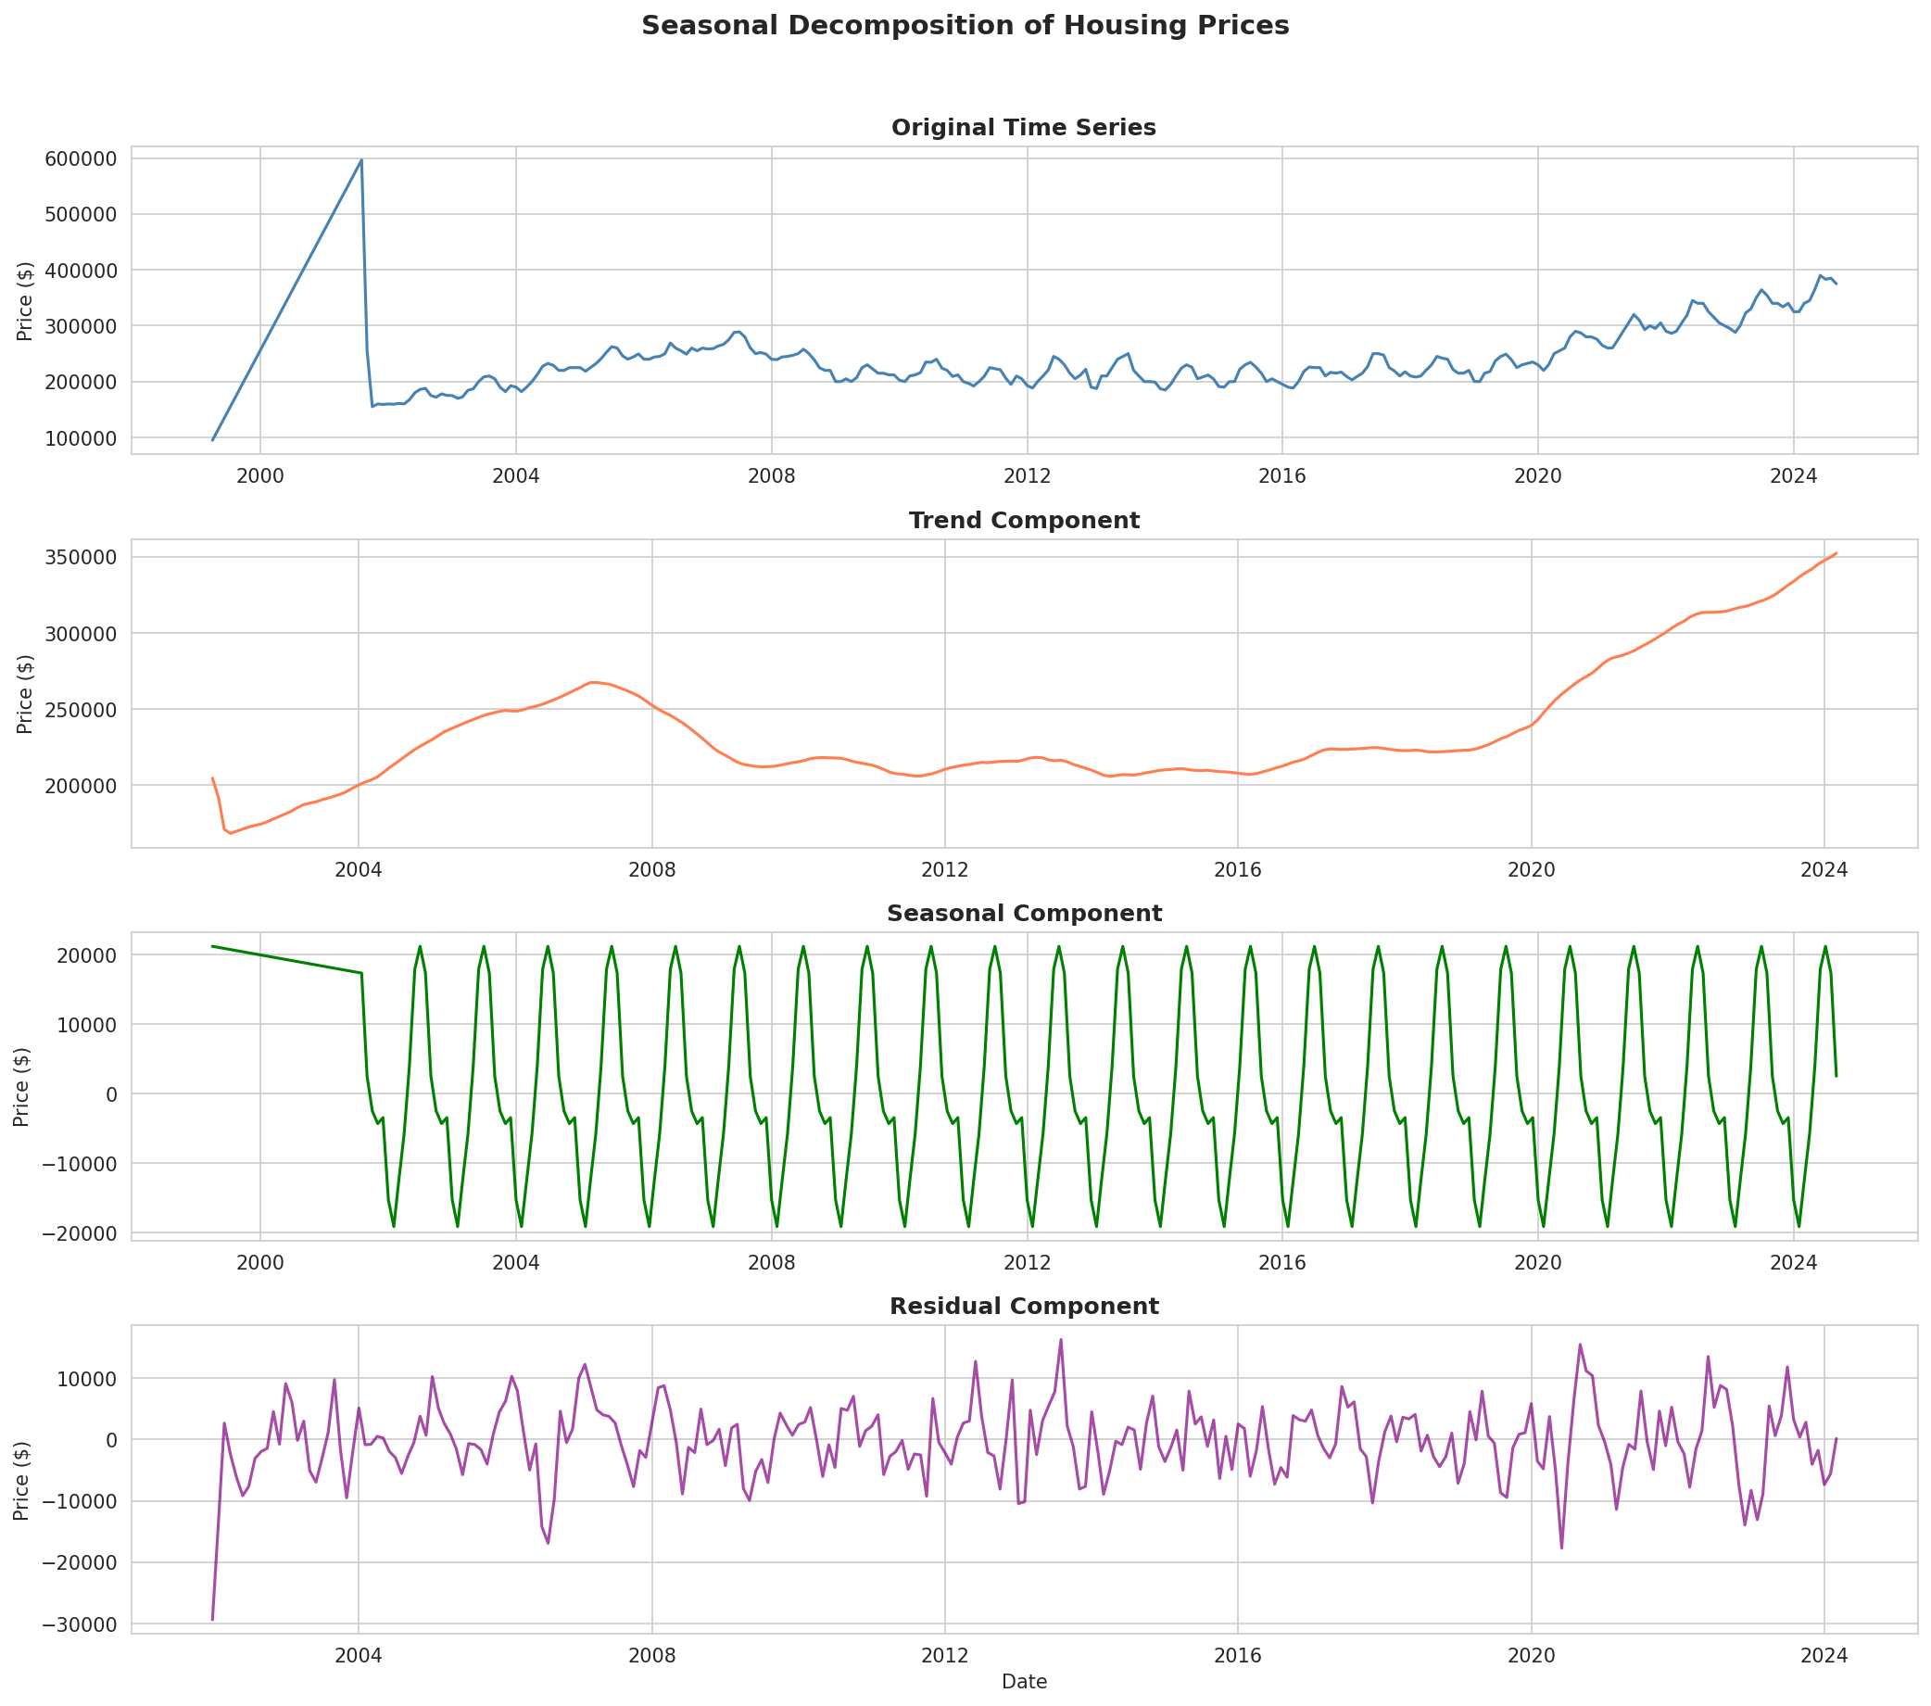
Seasonal Decomposition
Clear upward trend, seasonal peaks in spring/summer, COVID surge visible in 2020

Slide 8
9 Forecasting Models Tested
Model | Type | Key Feature
Naive | Baseline | Last value = future
Seasonal Naive | Baseline | Same month last year
Moving Average | Time Series | 3-month window (tuned)
Holt-Winters | Time Series | Trend + seasonality
Ridge (Tuned) | Regression | Lagged features
XGBoost | Machine Learning | Non-linear patterns
Prophet | Time Series | Facebook's tool
SARIMAX | Time Series | ARIMA + economic data
Weighted Ensemble | Combined | Best models averaged

Slide 9
Key Insight: Feature Engineering
Ridge Configuration | MAPE | Improvement
Current indicators only | ~14% | Baseline
With lagged prices (1,3,6,12 months) | 3.35% | 10+ percentage points!

Slide 10
Why Lagged Features Work
• Housing prices have momentum
• If prices went up last month, likely to go up this month
• Economic changes take time to affect prices
• Past prices are highly predictive of future prices
•
• This was the biggest lesson:
• Feature engineering matters more than model complexity

Slide 11
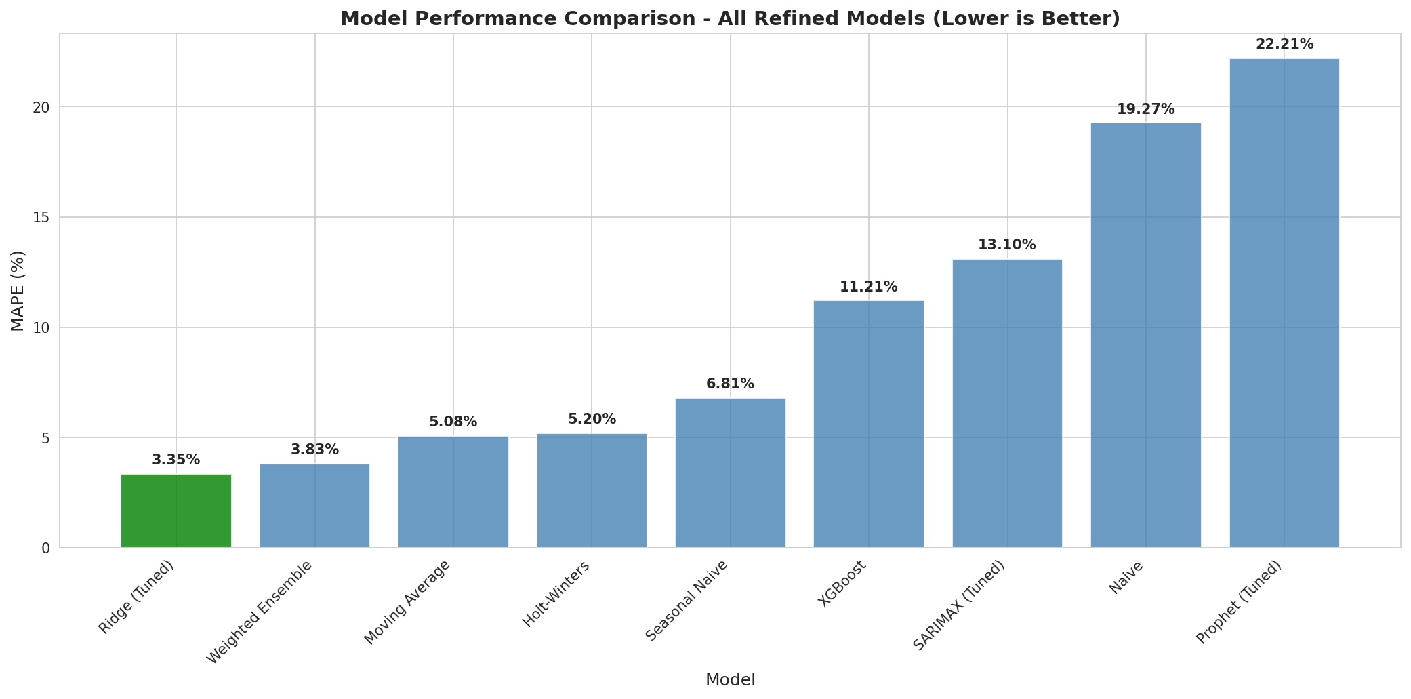
Model Performance Results
Ridge Regression (3.35% MAPE) outperformed all other models

Slide 12
Model Performance Comparison
Model | MAPE | Interpretation
Ridge (Tuned) | 3.35% | $100K home → off by $3,350
Weighted Ensemble | 3.83% | Combined best models
Moving Average | 5.08% | Simple but effective
Holt-Winters | 5.20% | Captures seasonality
Seasonal Naive | 6.81% | Good baseline
XGBoost | 11.21% | Machine learning approach
Naive | 19.27% | Poor baseline
Prophet | 22.21% | Underperformed

Slide 13
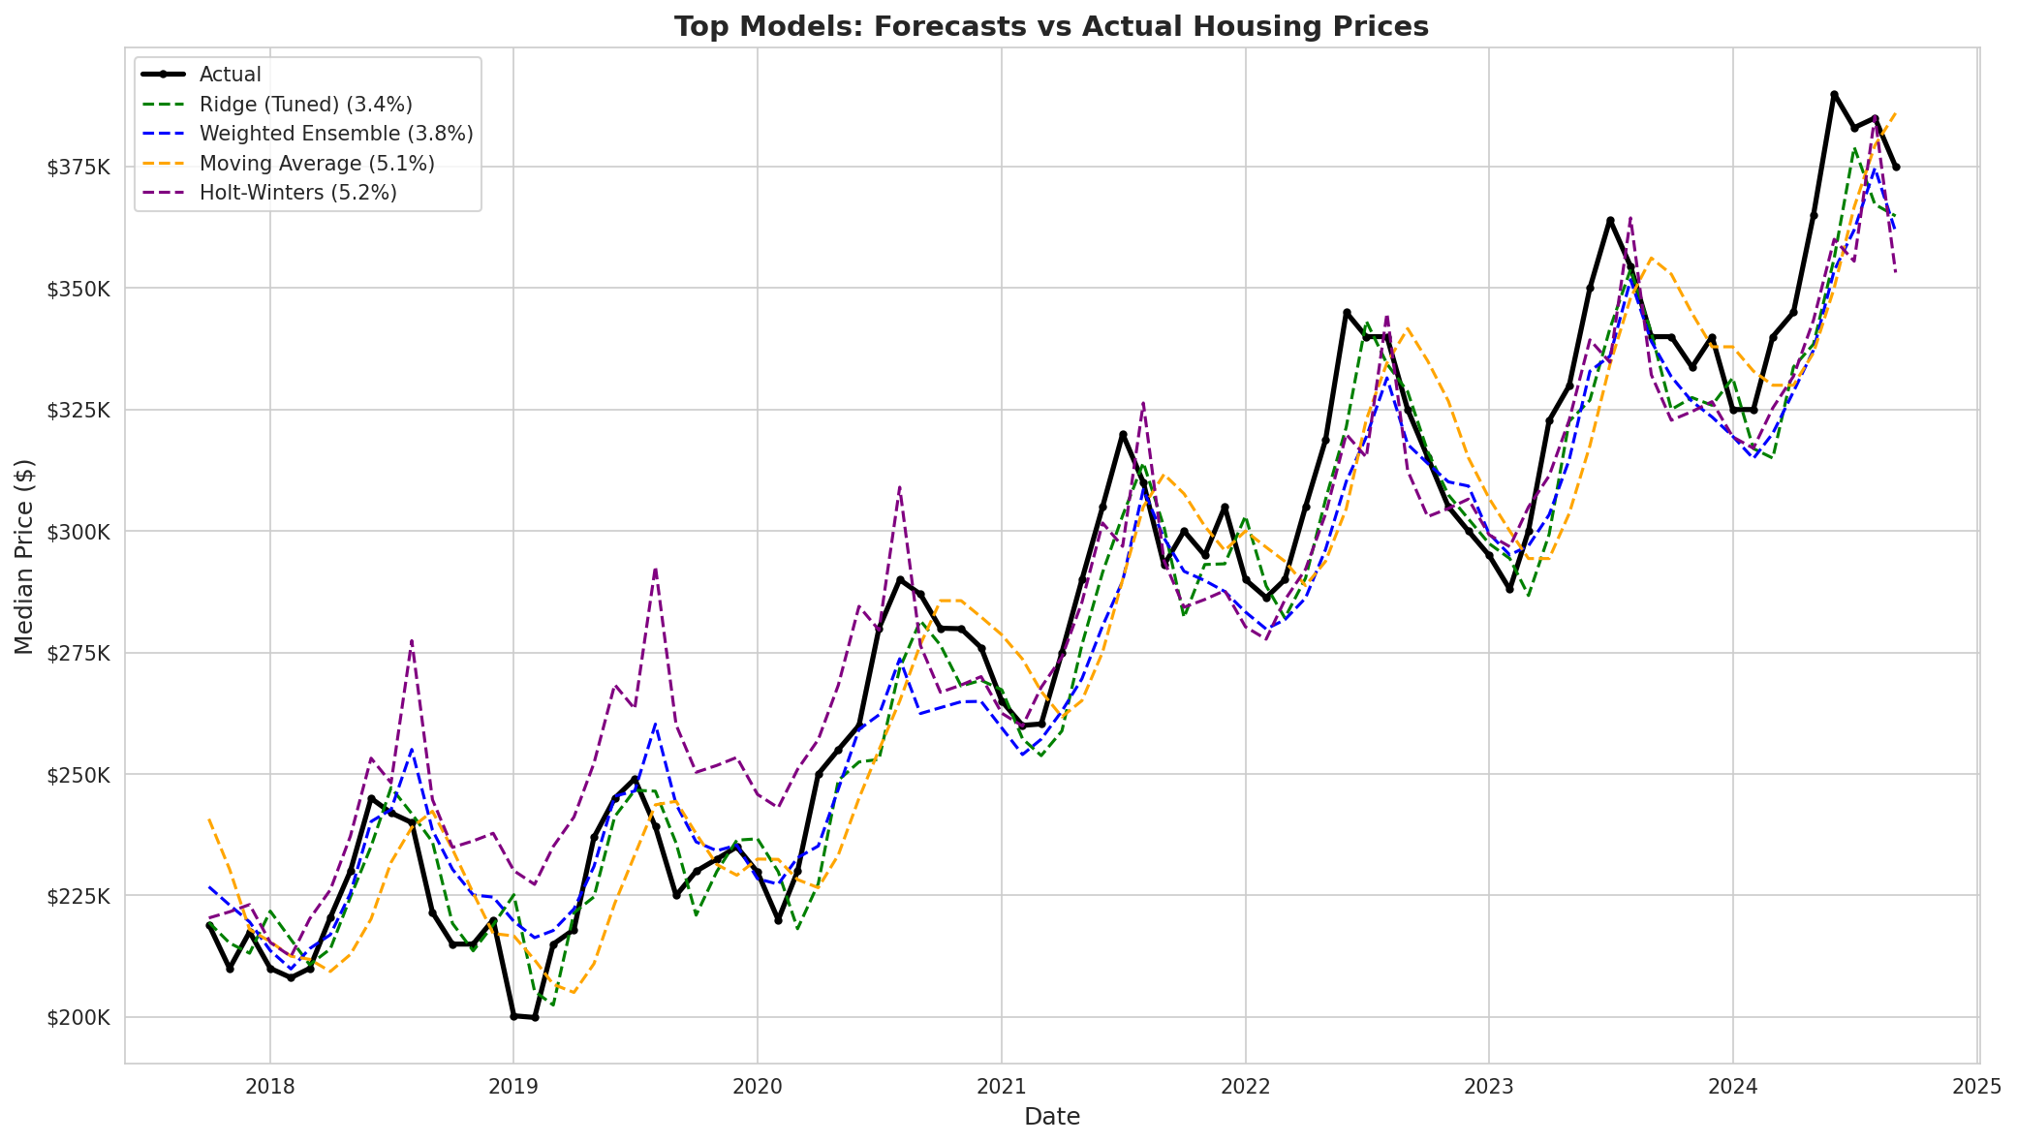
Forecasts vs Actual Prices
Top models tracked actual prices closely, even during COVID-19 surge

Slide 14
Limitations
• State-level data only
• - Local markets vary (Fairfield County vs rural CT)
•
• Lagged features assume trends continue
• - May be slow to detect market turning points
•
• Results specific to this time period
• - Performance may differ in other market conditions

Slide 15
Key Takeaways
• Feature engineering > model complexity
• - Lagged prices improved MAPE by 10+ percentage points
•
• Simple models work when tuned
• - Moving Average and Holt-Winters achieved ~5% MAPE
•
• Baselines are essential
• - Without Naive model, can't measure improvement
•
• Best Model: Ridge Regression with Lagged Features (3.35% MAPE)

Slide 16
Questions?
Thank you! Data: Connecticut Open Data Portal Economic Data: FRED (Federal Reserve)

