Slide 1


About hearing loss
Learn more about hearing loss
Experience a gradual age-related hearing loss
EN
HOME
BACK
LANGUAGE

Slide 2
What is hearing loss?
Types of hearing loss
The ear is a very sensitive organ which transforms and transmits sounds to the brain. A number of pathological or genetic factors affecting the ear or the brain can cause a hearing loss. A hearing loss is described by its type, degree, and cause.
The first sign of hearing loss is the reduced ability to hear sounds. Hearing loss impacts communication especially in challenging listening environments.
Causes of hearing loss
Degrees of hearing loss
EN
HOME
BACK
LANGUAGE

Slide 3
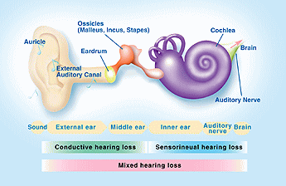
Types of hearing loss
Sensorineural hearing loss
There are three main types of hearing loss: sensorineural hearing loss, conductive hearing loss, and mixed hearing loss.
You can read more about each type by clicking on the buttons on the right. ((May vary depending on design))
Conductive hearing loss
(in Bernafon Style)
Mixed hearing loss
EN
EN
HOME
BACK
LANGUAGE

Slide 4
Types of hearing loss
Sensorineural hearing loss
Sensorineural hearing loss is the most common type of hearing loss. It is in most cases permanent and caused either by damage to tiny hair cells in the inner ear or to the auditory nerve. The auditory nerve carries important information about the loudness, pitch, and frequency of sounds to the brain. Sensorineural hearing loss can often result in difficulty understanding speech even though it might be audible.
Conductive hearing loss
Mixed hearing loss
EN
EN
HOME
BACK
LANGUAGE

Slide 5
Types of hearing loss
Sensorineural hearing loss
Conductive hearing loss is caused by a mechanical problem in the outer or middle ear or an obstruction in the ear canal such as ear wax that blocks sound from getting to the eardrum. It can be permanent but more often, it is temporary and can be medically treated.
Conductive hearing loss
Mixed hearing loss
EN
EN
HOME
BACK
LANGUAGE

Slide 6
Types of hearing loss
Sensorineural hearing loss
Mixed hearing loss results when there are components of both sensorineural and conductive hearing loss present.
Conductive hearing loss
Mixed hearing loss
EN
HOME
BACK
LANGUAGE

Slide 7
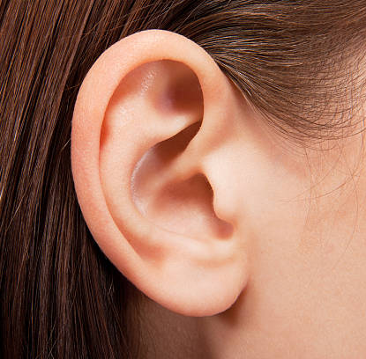
Causes of hearing loss
Hearing loss can be caused by the following:
Advancing age (age-related hearing loss is called presbycusis)
Ototoxic medications
Head trauma or injury
Genetic factors
Noise induced hearing loss caused by an intense impulse sound or the continuous exposure to loud sounds over an extended period of time
Illnesses such as mumps, Meniere’s disease, otosclerosis, or autoimmune disease
A tumor on the acoustic nerve or acoustic neuroma
EN
HOME
BACK
LANGUAGE

Slide 8
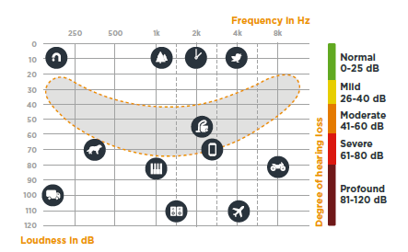
Degrees of hearing loss
What is an audiogram?
Mild hearing loss
Difficulty hearing faint or distant speech, even in a quiet environment
Moderate hearing loss
Hears conversational speech only at a close distance
Severe and profound hearing loss
Cannot hear conversational speech
The degree of hearing loss is defined with a hearing test and results of an audiogram. The audiogram is a graph which gives a detailed description of your hearing ability.
(in Bernafon Style)
EN
EN
HOME
BACK
LANGUAGE

Slide 9
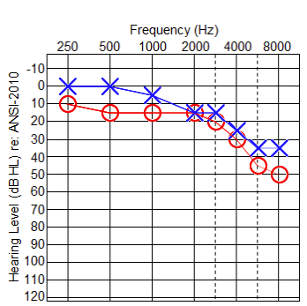
The audiogram
How to read an audiogram
The vertical axis of the audiogram represents sound volume or intensity, which is measured in decibels (dB). The more one moves down the axis, the louder the sound becomes. Zero decibel at the top of the axis represents the softest sound a normal-hearing person is able to hear.
The horizontal axis of the audiogram represents sound frequency measured in Hertz (Hz). Sound frequency increases gradually the further one moves to the right along the axis. This movement can be compared to playing on the left side of a piano and gradually moving to the right side where the tone becomes more and more high-pitched.
Red is the right ear and blue is the left ear.
(in Bernafon Style)
EN
EN
HOME
BACK
LANGUAGE

Slide 10






Hearing loss simulator
20 years old
60 years old
80 years old
Experience an age-related hearing loss As we get older, we gradually lose the ability to hear soft, high-pitched sounds, like birdsong or some specific speech sounds. Speech understanding might be challenging especially in noisy situations or group conversations.
Click on the play button to hear the sound in the respective age groups with an age-related hearing loss. ((Text may varies depending on solution))
EN
EN
HOME
BACK
LANGUAGE

Slide 11
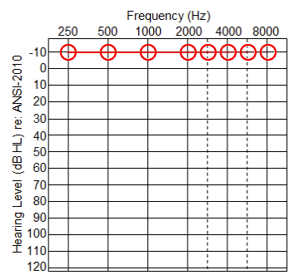
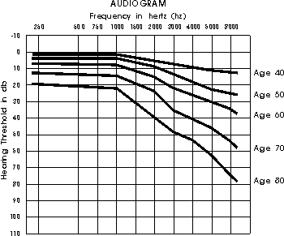
Hearing loss simulator
What is an audiogram?
20 years old
60 years old
80 years old
Age 20
EN
EN
HOME
BACK
LANGUAGE

Slide 12
Hearing loss simulator
What is an audiogram?
20 years old
60 years old
80 years old
Age 20
EN
HOME
BACK
LANGUAGE

Slide 13
Hearing loss simulator
What is an audiogram?
20 years old
60 years old
80 years old
Age 20
EN
EN
HOME
BACK
LANGUAGE

Slide 14
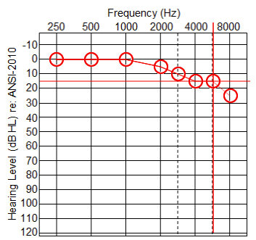
Hearing loss simulator
What is an audiogram?
20 years old
60 years old
80 years old
Age 20
EN
EN
LANGUAGE
BACK
LANGUAGE
HOME
BACK
HOME

Slide 15
Hearing loss simulator
What is an audiogram?
20 years old
60 years old
80 years old
Age 20
EN
EN
HOME
BACK
LANGUAGE

Slide 16
Hearing loss simulator
What is an audiogram?
20 years old
60 years old
80 years old
Age 20
EN
EN
HOME
BACK
LANGUAGE

Slide 17
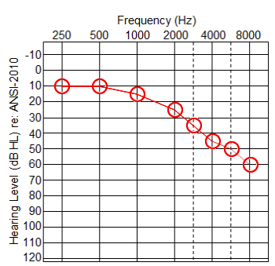
Hearing loss simulator
What is an audiogram?
20 years old
60 years old
80 years old
Age 20
EN
EN
HOME
BACK
LANGUAGE

Slide 18
Hearing loss simulator
What is an audiogram?
20 years old
60 years old
80 years old
Age 20
EN
EN
HOME
BACK
LANGUAGE

Slide 19
Hearing loss simulator
What is an audiogram?
20 years old
60 years old
80 years old
Age 20
EN
EN
HOME
BACK
LANGUAGE

Slide 20
Select your language
English
Deutsch
Français
Español
EN
EN
HOME
BACK
LANGUAGE

