Slide 1

SubPy
Analyzing the correlation of NYC subways on NYC Housing Prices
George Guo, Robert James, Carmelo Urena, Ali Rizvi

Slide 2
Contents
Item 1 X
Item 2 X
Item 3 X
Item 4 X
Sub item text runs here X
Sub item text runs here X
Sub item text runs here X

Slide 3

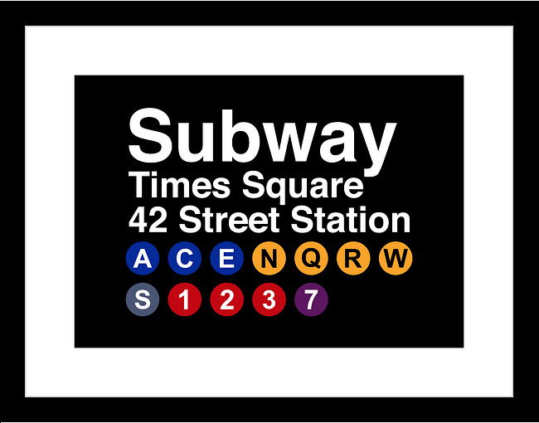

Hypothesis|
The proximity of NYC Subway Stations has a strong correlation to NYC housing prices.
To arrive at a conclusion, the following will be considered:
Housing Prices for various Home Types.
Housing Prices for various boroughs.
Housing Prices based on Proximity to MTA Stations.

Slide 4



Data|
API’s and Variables Considered.
MTA
Used the MTA Station CSV to locate: Stop Name, Stop Latitude and Longitude.
This helped us generate:
Determine the average home prices across the 5 boroughs
Housing types that are most common.
Zillow
Used Zillow API Connection which included: Housing Prices, House Details, Home Type, Bedrooms Bathrooms.
This helped us generate:
The Number of stations.
Stations per borough.
Total numbers of lines.
Google Maps
Used google maps API Connection which included: zip code, latitude and longitude
This helped us generate:
Convert the housing data from zip code to latitude and longitude.

Slide 5
Modules|
Modules imported to wrangle data
Pandas
Read in data.
Create merged data csv outputs
Create data frames.
NumPy
Create array for data.
Calculation of distance between points.
Reshape and sub set data
Gmaps
Creating heatmaps
Helped convert housing data from zip code format to latitude and longitude
This is dummy text it is not here to be read
Matplot
Generate bar graphs by borough.
Generate a box plot of all boroughs.
Generate a pie chart of XXXXXXXX

Slide 6
Conclusion|
Based upon the data reviewed and the outputs generated, it was determined that there is no correlation between the proximity of the subway station and the price of homes

