Slide 2

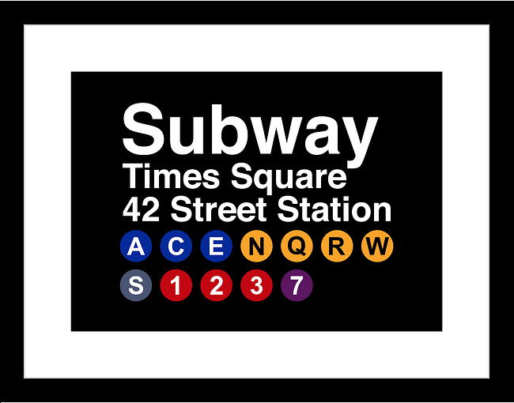

Hypothesis | MTA train station proximity is directly correlated to NYC housing prices across the 5 Boroughs
Update Images below to show MTA station vs. Housing
Due to the integral part the MTA plays in the NYC landscape we believe that it would have a direct connection to housing prices
In order to prove or disprove our hypothesis we will be looking at;
Housing Prices for various Home Types
Housing Prices for various boroughs
Housing Prices based on Proximity to MTA Stations

Slide 3


Data | Where are we getting data
MTA Station CSV
List of MTA train Stations Across the 5 Boroghs
API Connection
Housing Prices
House Details
Home Type
Bedrooms
Bathrooms

Slide 4
Data | What Modules did we use to analyze the Data
WIP – Insert the Module Names
Pandas
USZIPCODE
Etc.
MTA Station CSV
List of MTA train Stations Across the 5 Boroghs
API Connection
Housing Prices
House Details
Home Type
Bedrooms
Bathrooms

Slide 5
NYC Realestate |Understanding the New York City Landscape
Inserting Avg Home Prices across the 5 borogos
Housing types that are most common
Insert charts here (Bar Graphs of Counts)

Slide 6
MTA |Understanding the MTA
Insert the Number of station
Stations per borough
Total numbers of lines
Insert Charts – And
Map of plotted stations

