Slide 1

SubPy
Analyzing the correlation of NYC subways on NYC Housing Prices
George Guo, Robert James, Carmelo Urena, Ali Rizvi

Slide 2
Contents|
Hypothesis, Data, Modules 2-4
Item 1 X
Item 2 X
Item 3 X
Results and Challenges 6-7

Slide 3



Hypothesis|
The proximity of NYC Subway Stations has a strong correlation to NYC housing prices. The closer the station, the higher the price.
To arrive at a conclusion, the following will be considered:
Housing Prices for various Home Types.
Housing Prices for various boroughs.
Housing Prices based on Proximity to MTA Stations.

Slide 4



Data|
MTA
Used the MTA Station CSV to locate: Stop Name, Stop Latitude and Longitude.
This helped us generate:
The Number of stations.
Stations per borough.
Total numbers of lines.
Zillow
Used Zillow API Connection which included: Housing Prices, House Details, Home Type, Bedrooms Bathrooms.
This helped us generate:
Station address and location.
Housing types that are most common.
Google Maps
Used google maps API Connection which included: zip code, latitude and longitude
This helped us generate:
Used geomaps to visualize station and housing locations.

Slide 5
Modules|
PANDAS
XML to JSON
Used to convert XML output into JSON.
Create merged data csv outputs
Create data frames.
GEOPY
Finds the closest address to a lat and long location.
Used this to search Zillow app and compare homes.
US ZIP CODE
SCIPY
Zillow API needed a zip code which we used to merge data and compare.
Calculate the distance between subway station and homes.
GMAPS
MATPLOT
Creating heatmaps
Generate bar graphs by borough.
Generate a box plot of all boroughs.

Slide 6
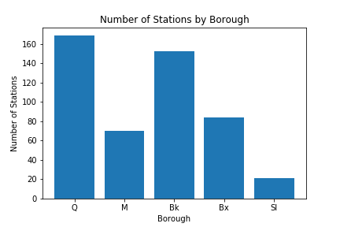
Figure 1: Determining Which Boroughs Have the Most Stations|
Bar Graph:
Using pandas and matplot.lib, we were able to view the number of stations per borough.
Queens- the largest borough contained the most stations.
Staten Island- which only has one line has the fewest.

Slide 7
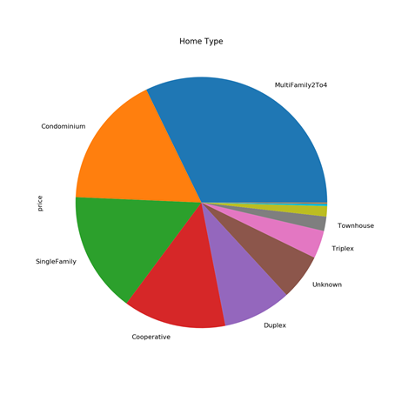
Figure 2: Pie Chart of Home Type|
Pie Chart:
Using pandas and matplot.lib we generated a pie chart to see the most common home types.
Based on the data, we were able to determine that the multi family home type is the most common home type in the five boroughs.

Slide 8
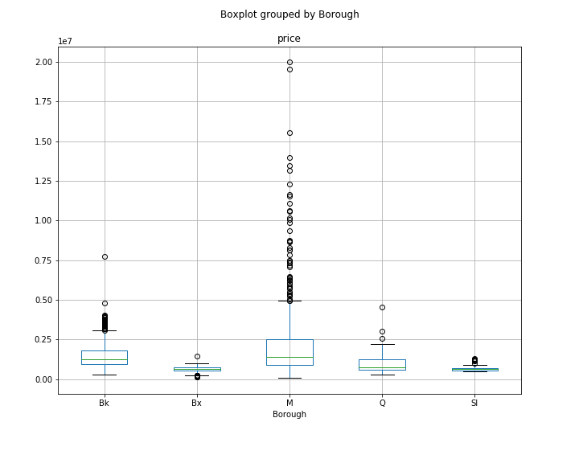
Figure 3: Box Plot by Borough|
Box Plot by Borough:
Using pandas and matplot.lib we created a box plot of home prices by borough. Based on our results, we were able to determine:
Manhattan has the highest price on average because it contains more outliers than any other boroughs.
There are more outside factors affecting Manhattan’s home price aside from subway station proximity.

Slide 9
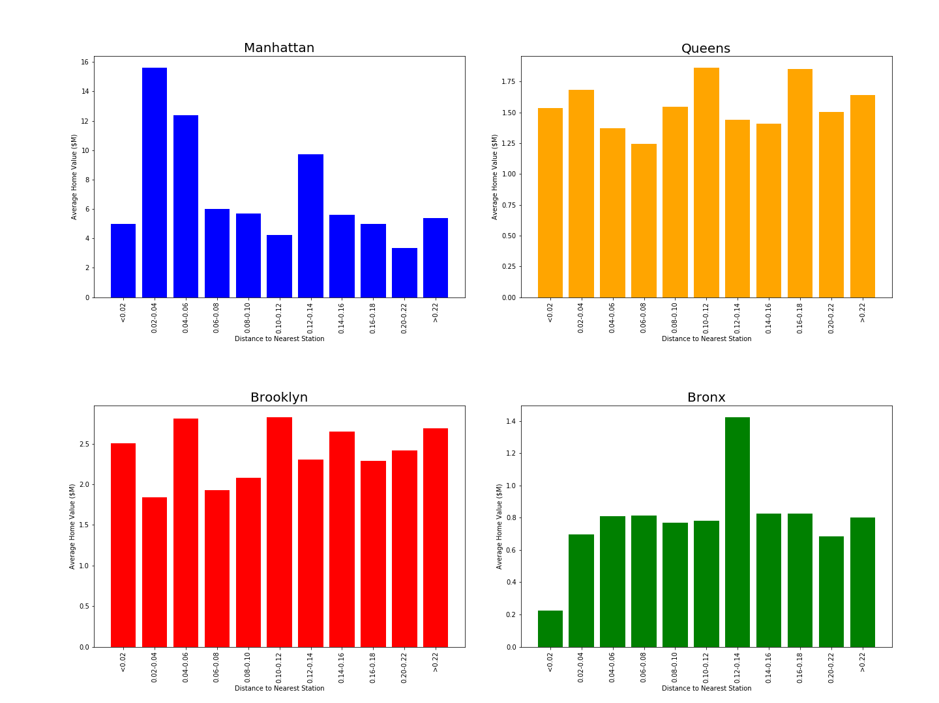
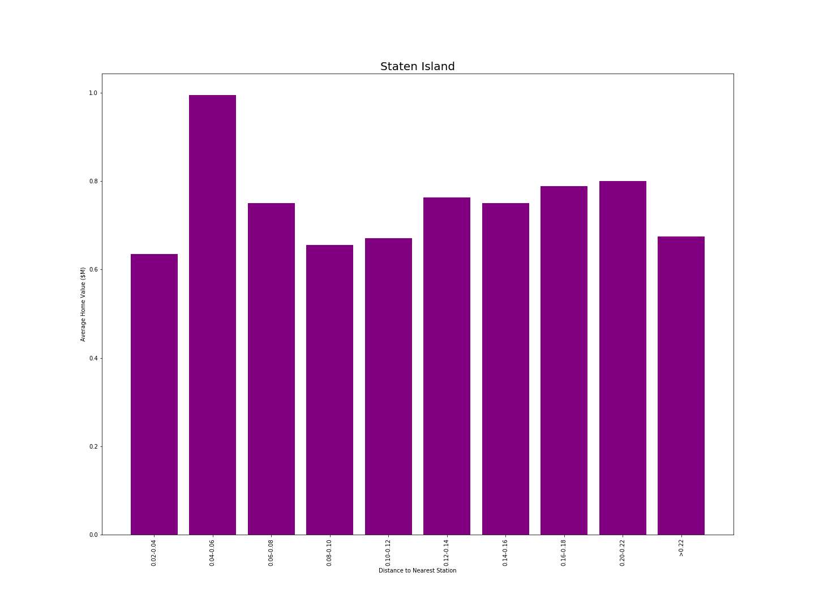
Figure 4 : Average Price by Borough|

Slide 10
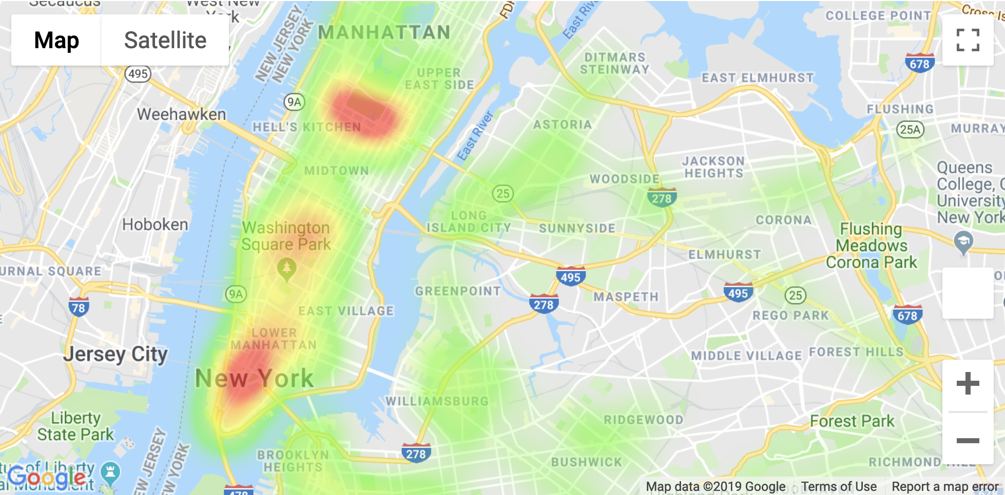
Figure 5: Home Prices Relative to Number of Stations|
Heat Map
Using the Google API, specifically the GMAPS package we were able to see:
There is no correlation between proximity and value of homes.
The red areas signify stations which are junctions and have multiple subway lines passing through.
From this, we can determine that value has a correlation to convenience. If a station has multiple lines passing through, the value of the homes will be higher.

Slide 11
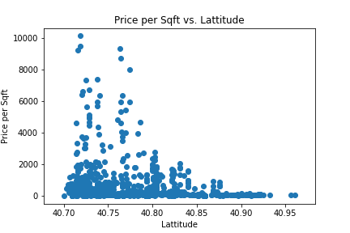
Figure 6: Manhattan Square Footage vs. Distance |
Scatter Plot
Using pandas and matplot.lib we generated a scatter plot comparing the price per square foot against the distance.
Manhattan was selected based on the number of outliers.

Slide 12
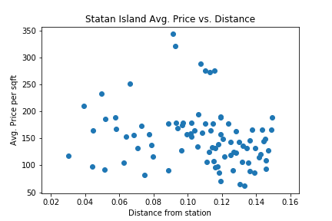
Figure 7: Staten Island Average Price vs. Distance|
Staten Island Scatter Plot:
Using pandas and matplot.lib we generated a scatter plot to see the correlation between the average Staten Island home price and the distance to the subway station.
Staten Island has only one subway line in the borough, making it easier to see the correlation.
Based on the analysis, we are able to see that the proximity of the subway station has no correlation on the average home price.

Slide 13
Conclusion|
Based upon the data reviewed and the outputs generated, it was determined that there is no correlation between the proximity of the subway station and the price of homes

Slide 14
Challenges|
Zillow API
XML to JSON
Demonstrating Correlation
Zillow API did not provide the information anticipated.
Housing data came in latitude and longitude, had to use SCIPY to convert to zip code.
Outputs not returned in JSON format.
Unsuccessfully attempted to import beautiful soup.
Took time to convert from XML to JSON to create data frames.
Ultimately there was no correlation.
Using data generated to see other trends.

Slide 15
Questions|

