Slide 1

SubPy
Analyzing the correlation of NYC subways on NYC Housing Prices
George Guo, Robert James, Carmelo Urena, Ali Rizvi

Slide 2
Contents|
Hypothesis, Data, Modules 3-5
Understanding the MTA System 6
NYC Home Types & Average Home Price 7-8
Stations Proximity to Homes 9
Home Prices and Stations 10
Deeper Dive- Manhattan & Staten Island 11-12
Conclusion 13
Challenges 14
Open Discussion 15

Slide 3

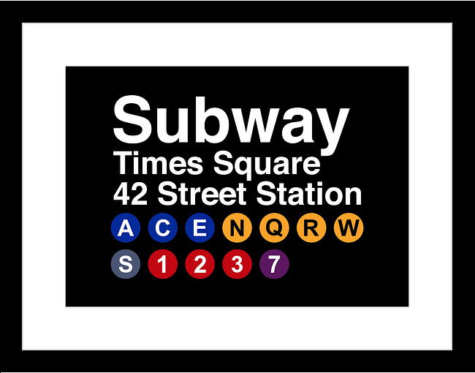

Hypothesis|
The proximity of NYC Subway Stations has a strong correlation to NYC housing prices. The closer the station, the higher the price.
To arrive at a conclusion, the following will be considered:
Housing Prices for various Home Types.
Housing Prices for various boroughs.
Housing Prices based on Proximity to MTA Stations.

Slide 4



Data|
MTA
Used the MTA Station CSV to locate: Stop Name, Stop Latitude and Longitude.
This helped us generate:
The Number of stations.
Stations per borough.
Total numbers of lines.
Zillow
Used Zillow API Connection which included: Housing Prices, House Details, Home Type, Bedrooms Bathrooms.
This helped us generate:
Station address and location.
Housing types that are most common.
Google Maps
Used google maps API Connection which included: zip code, latitude and longitude
This helped us generate:
Used geomaps to visualize station and housing locations.

Slide 5






Modules Used for Data Analysis
Dataframe manipulations
Creating Box Plots
Used to find the closest address to a specified Lat, Long
These addresses were used to search through the Zillow API
Used to create heatmaps using Zillow Data and MTA Data
Used to process Lat Long data for easier data manipulation
Used to convert XML API data into JSON for more manageable manipulation
Used for plotting Graphs through the data exploration process through visualizations
USZIPCODE
Used to convert Lat Long Data into Zip Code data across the Zillow API and MTA data

Slide 6
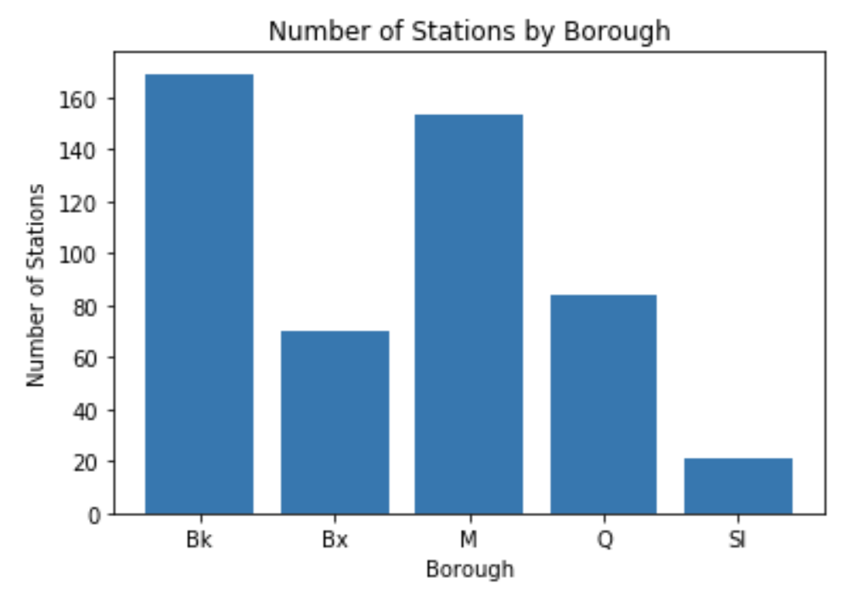
Understanding the MTA System
Brooklyn & Manhattan accounted for 64.8% of the total train stations in NYC
With this information two things were expected.
Manhattan & Brooklyn would be outliers that may show a weaker correlation due to the increased number of lines
Staten Island would be borough that could lead to more stable analysis due to the decreased number of train stations
Figure 1: Determining Which Boroughs Have the Most Stations

Slide 7
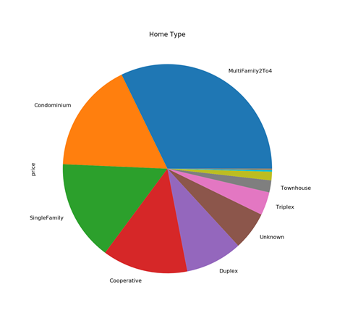
New York Real Estate had a healthy mix of Home Types helping even the playing field
Surprisingly New York City had a strong mix of home types throughout the 5 Boroughs.
Multi Family homes, Condos and Single Family homes accounted for the majority of home listings around the Train Stations
With this information looking at data across the 5 boroughs became more stable.
Figure 2: Pie Charts for sales by Home Types

Slide 8
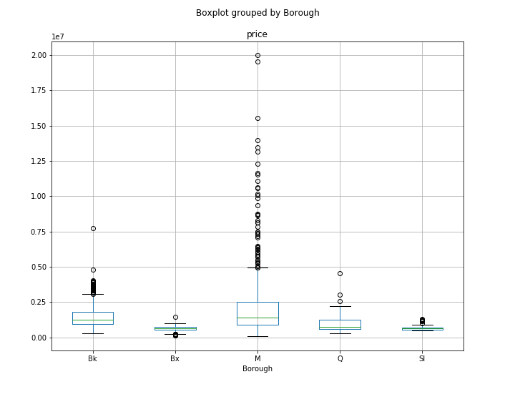
Average home prices across the 5 Boroughs varied with no clear pattern
Manhattan had the largest distribution of Home pricing, containing a large amount of outliers making Manhattan unique and more difficult to understand
This could be do to a multitude of factors which make Manhattan very different from the other boroughs
The box plot also shows the variability of prices by borough:
Bronx and Staten Island prices closer to the mean than the other boroughs
Figure 3: Sale Price Distribution

Slide 9
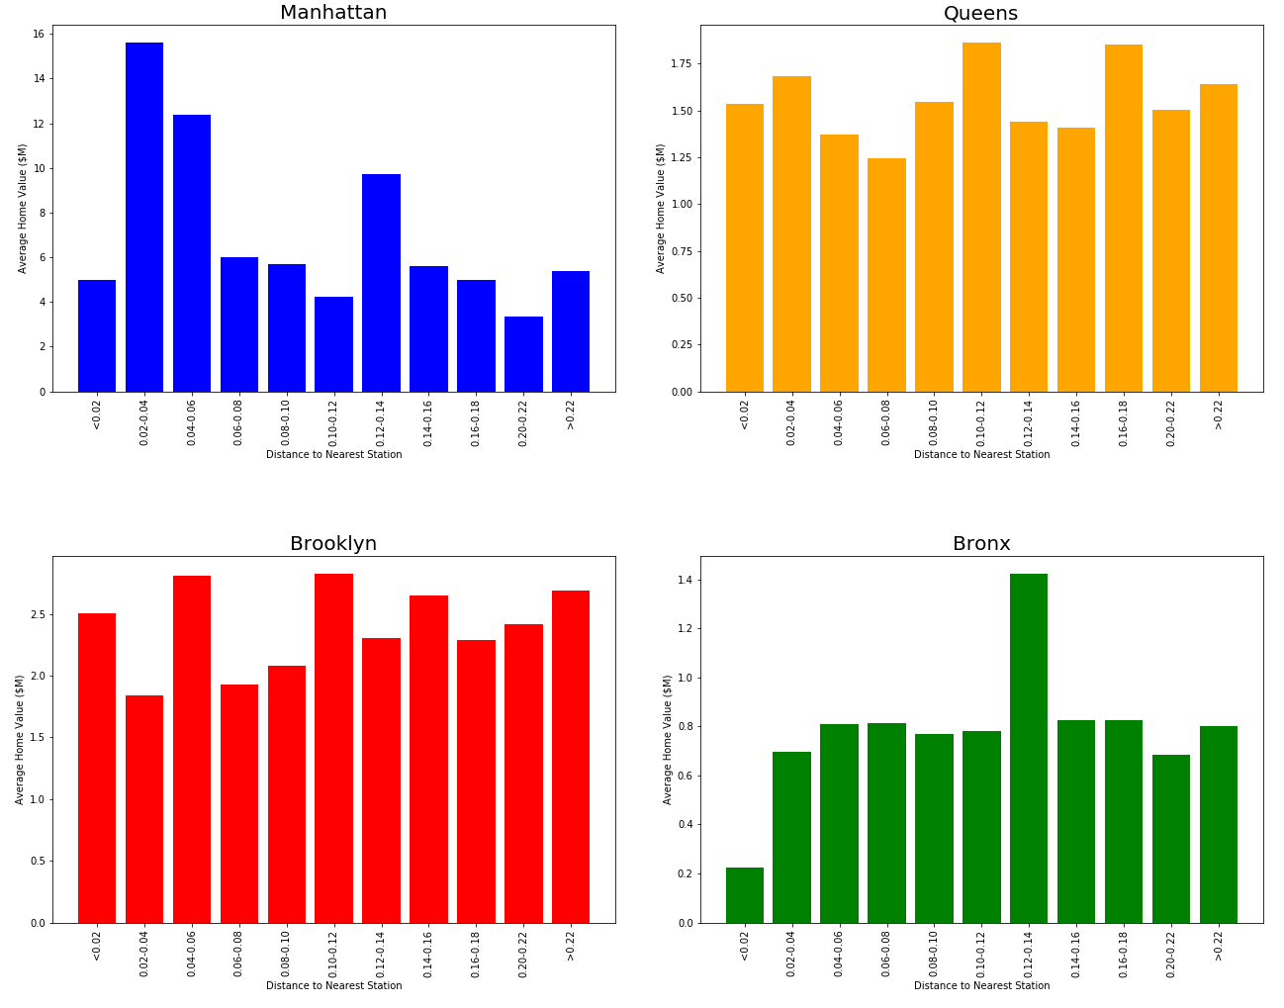
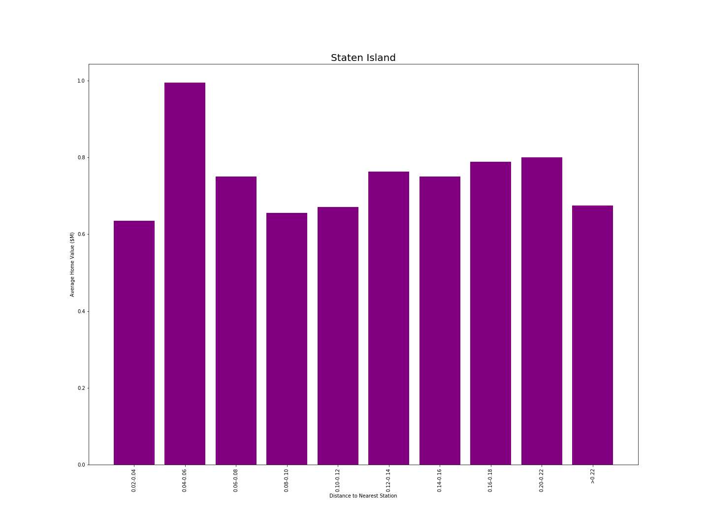
Proximity to train stations had varying effects across the 5 boroughs
There were no clear trends across the 5 boroughs when comparing home prices and station distance
This finding led us to get more granular in our analysis to look for the effect that the MTA had on home prices
Figure 4: Distance vs. Home Prices by Borough

Slide 10
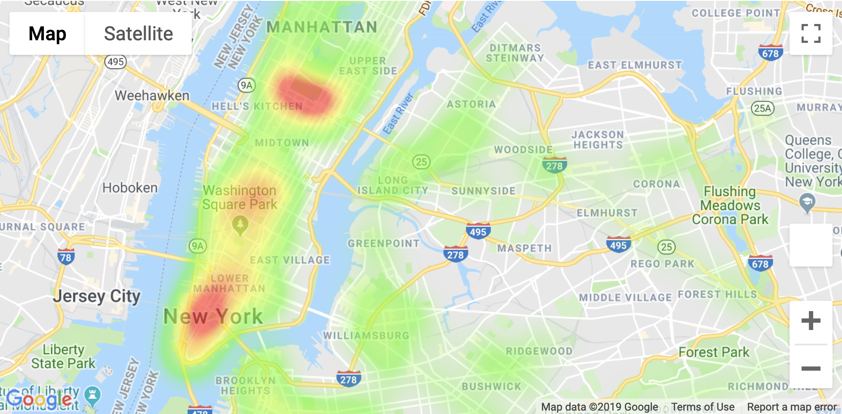
Home Prices Relative to Number of Stations|
There was no correlation between train proximity and home values.
The red areas signify stations which are train junctions and have multiple subway lines passing through.
From this, we can determine that value has a correlation to convenience. If a station has multiple lines passing through, the value of the homes will be higher.
Figure 5: Home Prices vs. Train Proximity

Slide 11
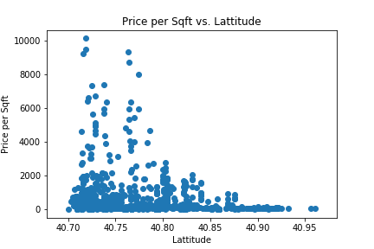
Manhattans unique real estate values had varying pricing across different locations outside of the MTA
In an attempt understand pricing we furthered our analysis into the borough to find trends within the data we had.
Our location based data was limited and this further disproved our original hypothesis about the MTA
However, the plot does show that the closer we move towards the city the variability of home prices increases:
This is due to diversity of home options in the city
Closer proximity to services, such as stations, schools, etc.
Figure 6: Manhattans Price per Sqft vs. Latitude

Slide 12
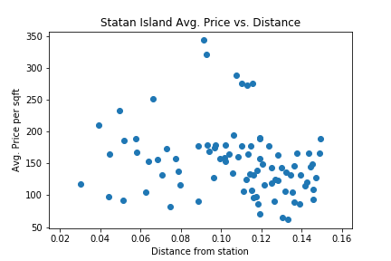
Further analysis was done on Staten Island as it was the most stable of the 5 boroughs
Staten Island: Avg. Price vs. Distance
Staten Island is the only borough that had one Subway line throughout
Knowing this we believed that we would be able to see the direct effect of MTA train distances but this was not true
We also tried to group the house data by home type, bedroom number, bathroom number and some combination of these factors, but this resulted to similar conclusions
Figure 7: Staten Island Price per Sqft vs. Train Distance
(Single Family Homes Only)

Slide 13
Conclusion|
Based upon the data reviewed and the outputs generated, it was determined that there is no correlation between the proximity of the subway station and the price of homes

Slide 14
Challenges|
Zillow API
XML to JSON
Demonstrating Correlation
Zillow API did not provide the information anticipated.
Housing data came in latitude and longitude, had to use SCIPY to convert to zip code.
Outputs not returned in JSON format.
Unsuccessfully attempted to import beautiful soup.
Took time to convert from XML to JSON to create data frames.
Ultimately there was no correlation.
Using data generated to see other trends.
Using different data sets to enhance our analysis

Slide 15
Questions|

