Slide 1

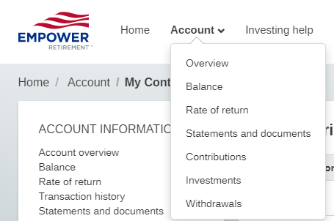
You can make changes to your 401K deferral rates from now until Aug 6, 2021.
Log into www.empowermyretirement.com
Click on Account > Contributions
Then click Edit
No action required if leaving deferral rate the same.
Contact HR if you have any questions.

