Slide 1
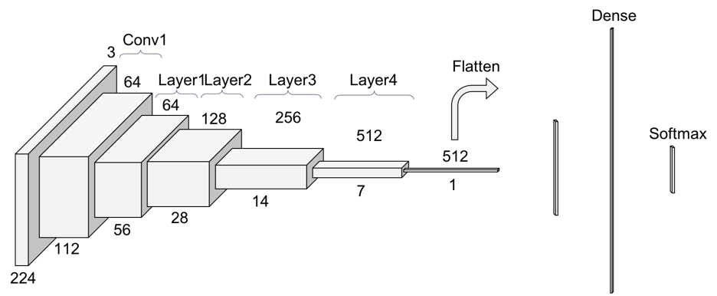
base_model
input_shape

Slide 2
GlobalAveragePooling2D

Slide 3
num_classes=1
Dense

Slide 4
outputs
inputs

Slide 5
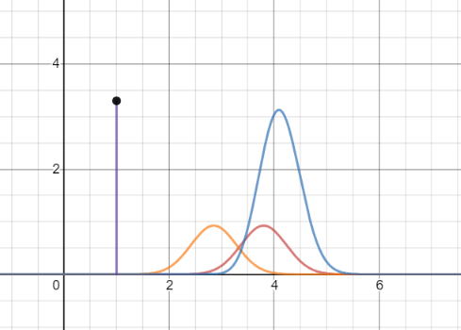
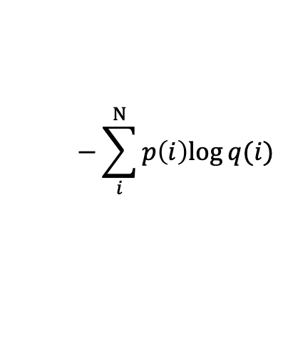
$$−\sum_{i}^{N}{p\left(i\right)log⁡q(i)}$$

Slide 6
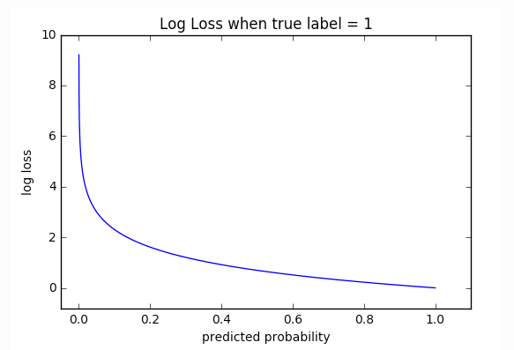
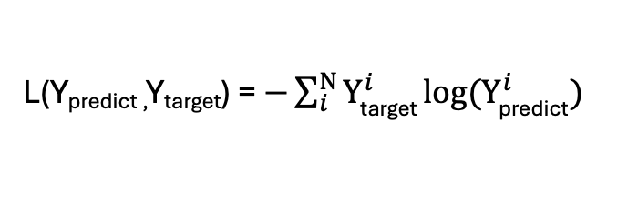
Y_{predict}
Y_{target}
0.8
1.0
0.2
0.0
loss
0.1
0.0
L(Y_{predict ,}Y_{target}) = $−\sum_{i}^{N}{Y_{\text{target}}^{i} log⁡(Y_{\text{predict}}^{i})}$

Slide 7
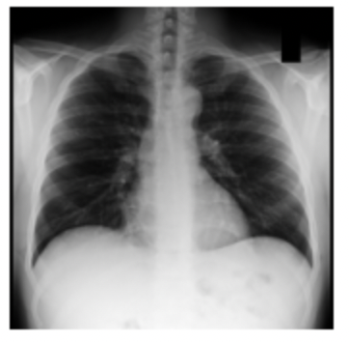
CXR model
Pneumothorax (label: 1)
?
OR
No finding (label: 0)

