Slide 1

Early detection of Alzheimer’s disease using blood gene expression data
M.Tech - Design Project Review - 2
Guided by
Dr. Jothi R
Date : 17.05.2023
By
Hariharan J
22MCB1006

Slide 2
Abstract
Alzheimer's disease (AD), a type of neurodegenerative disorder, has seen an increase in cases over the past decade, necessitating the construction of a comprehensive early detection method. Existing methods are typically invasive and costly, so our research concentrates on blood gene expression as a possible biomarker. The high dimensionality of the gene expression data and the small sample size complicate blood gene expression data analysis. Our novel approach attempts to address these issues by identifying a suitable feature selection, a feature extraction method to reduce the dimension size, and synthetic data modelling to address the issue of a small sample size. The classification of the resulting dataset using DNN yielded an accuracy of 90.6%. Feature selection along with synthetic data modelling significantly enhanced the early detection of Alzheimer's disease using blood gene expression.

Slide 3
Introduction
Alzheimer’s disease (AD) or also called as senile dementia is the most common type of dementia among humans.
AD is formally defined as the pathological deposition of folded beta-amyloid plagues, and hyper-phosphorylated neurofibrillary t au tangles in the brain leading to neurodegeneration.
Currently there is no cure exists for this, But early detection of the AD possibility will help to manage the control and temporarily improve the symptoms.
Gene Expression is an information which is stored in all our genes which are used for synthesis of a functional gene product which intern is used to produce end products like protein or non-coding RNA.
There are many studies carried out to find the genetic associations of AD through big data and statistical methods and through Machine Learning (ML) models. The major challenge of using ML models is the small sample size compared with the huge dimension of characteristic features.

Slide 4
Introduction – Cont.
Differential gene expression, commonly abbreviated as DG or DGE analysis refers to the analysis and interpretation of differences in abundance of gene transcripts within a transcriptome.
Lists of genes that differ between 2 sample sets are often provided by RNA sequence data analysis tools or can be generated manually by statistical testing of data sets.
Due to the large number of genes to be tested, (e.g., >20,000 in the human genome), multiple testing correction such as Bonferroni correction is usually applied.
Dataset | Samples | Probes
ADNI | 465 | 49386
ANM1 | 329 | 38329
ANM2 | 388 | 32049

Slide 5

Motivation
Primary objective is to find the best algorithm to extract the genes from blood gene expression that influence the possibility of Alzheimer’s.
Secondary objective is to find the best algorithm which can classify using DEG’s the possibility of Alzheimer’s.

Slide 6

Literature Survey

Slide 7
Study | Dataset Used | Feature Selection Alg. | No. of Genes | Classification Alg. | Performance
Lee, T et al. | GSE3060, GSE3061 | SAM | 697 | SVM | AUC: 87.4%
M. S. Kamal et al. | GSE174367 | - | 18,234 | KNN SVM | ACC: 64.5% ACC: 82.4%
Mahendran, N et al. | GSE76105 | Adaboost | 12 | DRNN | ACC: 89.4%
S. Khanal et al. | ADNI | t-test + SelectFromFeature | 25 | XGBoost | ACC: 65% AUC: 67%
El-Gawady, A et al. | GSE33000 GSE44770 GSE44768 GSE44771 | χ², ANOVA, MI | 30 | SVM | ACC: 97.5% AUC: 97.2%
S. Perera et al. | GSE5281 | PCA, RF, ETC | 14 | SVM | ACC: 93.9%
C. Park et al. | GSE33000 GSE44770 GSE80970 | t-test | 35 | DNN | ACC: 82.3%
H. M. AL-Bermany et al. | GSE3060 GSE3061 | ANOVA + k-means | 2500 | CNN | ACC: 92.9%
A. Sharma et al. | GSE33000, GSE44770 GSE118553, GSE1132903 GSE5281, GSE48350 GSE28146, GSE5281 GSE48350, GSE4757 | varSelRF + LASSO | 208 | ElasticN | ACC: 0.98
Kalkan H et al. | GSE63060 GSE63061 GSE140829 | LASSO | 488 | CNN | ACC: 84.2% AUC: 87.5%
D. Sun et al. | GSE5281, GSE44771, GSE109887, GSE132903 | RF | 6 | DNN | ACC: 92.3%
Table 1: Summary of studies conducted on detection of AD using various feature selection and classification techniques with gene expression.

Slide 8
Study | Dataset | Classification Alg. | Accuracy
S. Pavalarajan et al. | OASIS | RF | ACC: 83.50%
S. S. Rajeswari et al. | ADNI | VGG-19 | ACC: 98.00%
J. Li et al. | ADNI | 3-D U-Net CNN | ACC: 95.06%
S. Basheer et al. | OASIS | CapNet | ACC: 92.39%
G. Chutani et al. | Dubey, S. Alzheimer's Dataset ( 4 class of Images) | VGG-16 + SVM | ACC: 99.33%
D. Chaihtra et al. | Dubey, S. Alzheimer's Dataset ( 4 class of Images) | DenseNet121 | ACC: 96.00%
U. R. K et al. | Dubey, S. Alzheimer's Dataset ( 4 class of Images) | GLCM + SVM | ACC: 84.00%
S. Buyrukoğlu et al. | ADNI | Stacked Ensemble | ACC: 91.20%
Table 2: Summary of studies using biomarkers other than gene expression

Slide 9
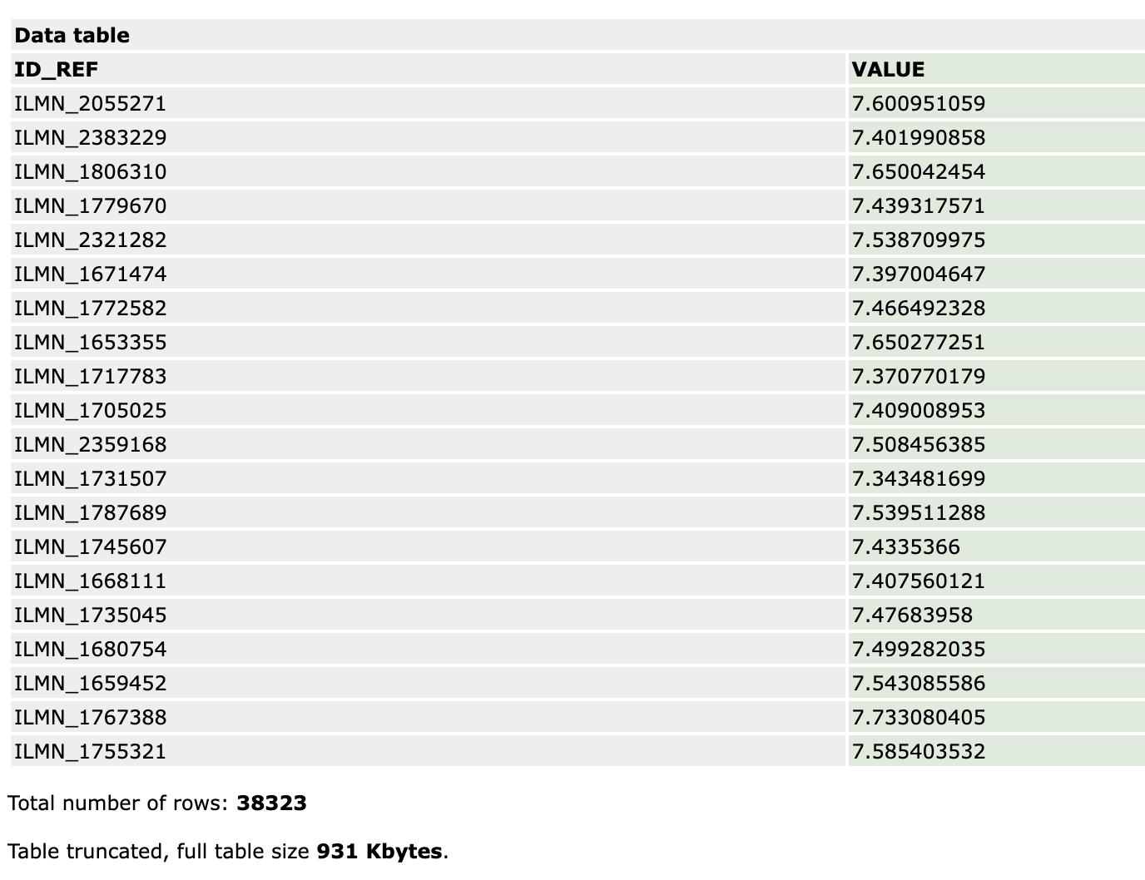
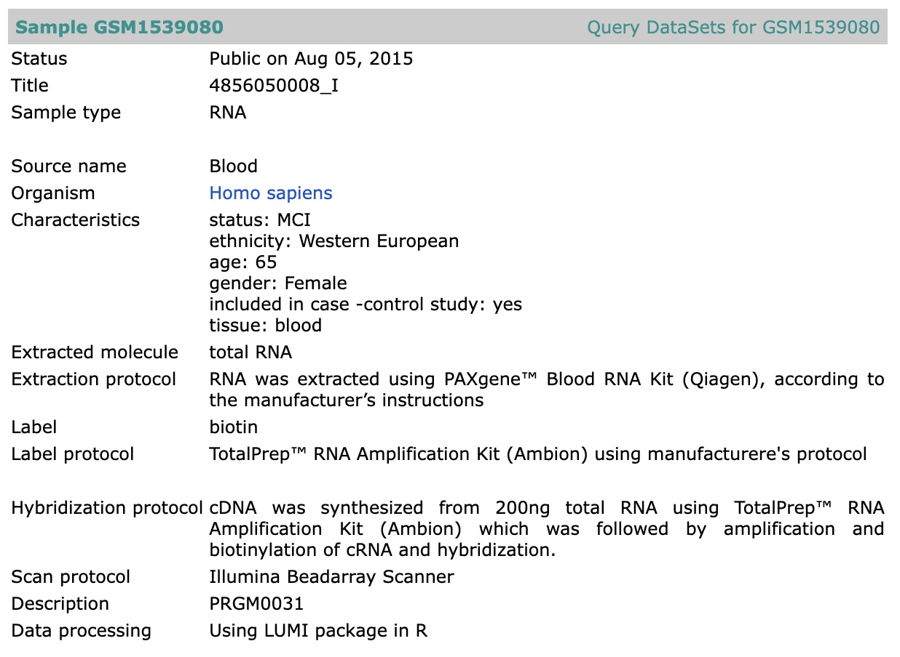
Dataset

Slide 10
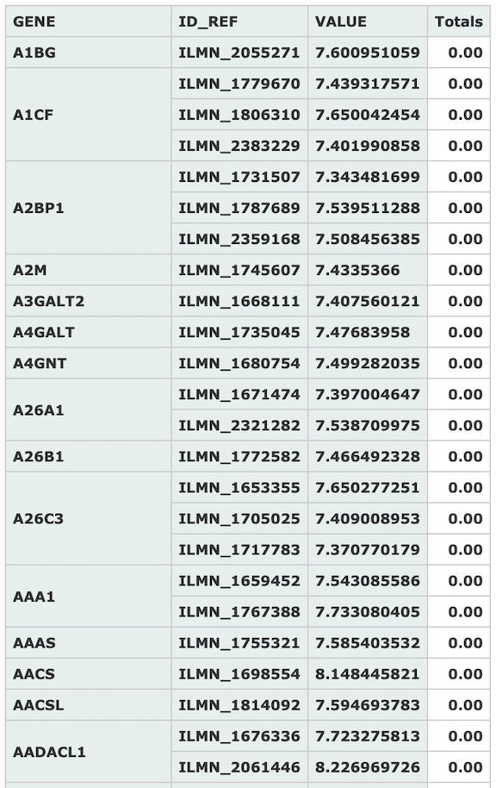
Gene Expression
Summary of blood gene expression values of top 15 Gene symbols measured against different probe identifiers taken from sample GSM1539080 which was measured as part of dataset GSE63060

Slide 11
Implementation

Slide 12
Proposed Method
Data Preprocessing
Feature Selection
Data Modelling
Feature Extraction
Classification

Slide 13
Preprocessing
GSE63060
Min-Max Normalize
GSE63061
Min-Max Normalize
Integrate
ADNI
Min-Max Normalize
Min-Max Normalize
Feature Selection
Master Set

Slide 14
Feature Selection
Statistical Methods | t-test Chi-square ANOVA Mutual Information (MI) Least Absolute Shrinkage and Selection Operator (LASSO) Significance Analysis on Microarrays (SAM)
Ensemble Methods | Adaptive Boosting (Adaboost) Random Forest (RF) Extra Tree Classifier Variable Selection using RF (varSelRF)
Others | VAE

Slide 15
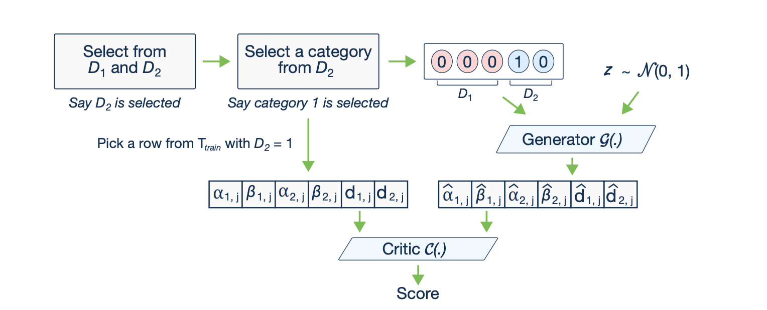
Synthetic Data Modelling
GANs are a type of machine learning model that consists of two main components: a generator and a discriminator.
The generator aims to generate synthetic data samples that resemble real data, while the discriminator's role is to distinguish between real and fake samples.

Slide 16
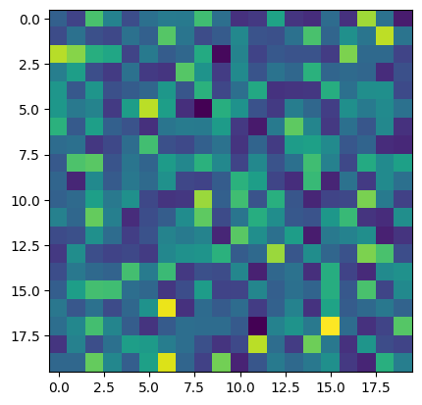
Feature Extraction
Gene Expression
Linear Discriminant Analysis

Slide 17
Classification
Type | Name
Ensemble | AdaBoost
 | Random Forest
Deep Learning | DNN
 | CNN
Others | SVM

Slide 18
Results
Feature Selection | Feature Extraction | No of Genes Selected | Classification | Modelled Synthetic Data | Accuracy (Training Set) | Accuracy (Testing Set)
Chi Square | - | 10814 | SVM Gaussian Kernel | No | 99.67% | 77%
Chi Square | - | 10814 | DNN (64, 128, 128, 1) | No | 97.13% | 77.33%
Chi Square | - | 10814 | DNN (6, 4, 4, 1) | No | 96.68% | 89.33%
Chi Square | PCA | 30 | RF | No | 100% | 75%
ANOVA | PCA | 30 | RF | No | 100% | 82%
ANOVA | - | 514 | AdaBoost | No | 100% | 90.20%
ANOVA | - | 514 | RF | No | 100% | 86.45%
ANOVA | - | 514 | SVM Gaussian Kernel | No | 99.83% | 87.42%
ANOVA | - | 514 | DNN (6, 5, 5, 5, 1) | Yes | 93.77% | 90.60%

Slide 19
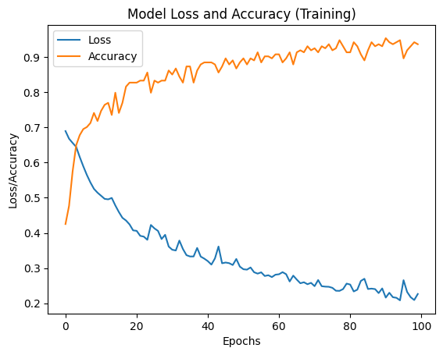
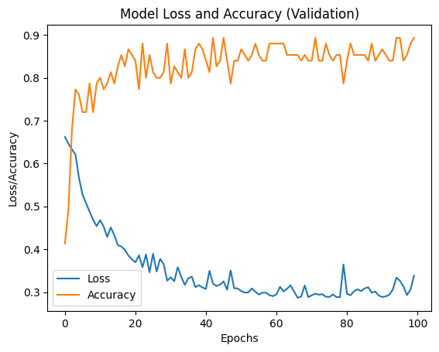

Slide 20
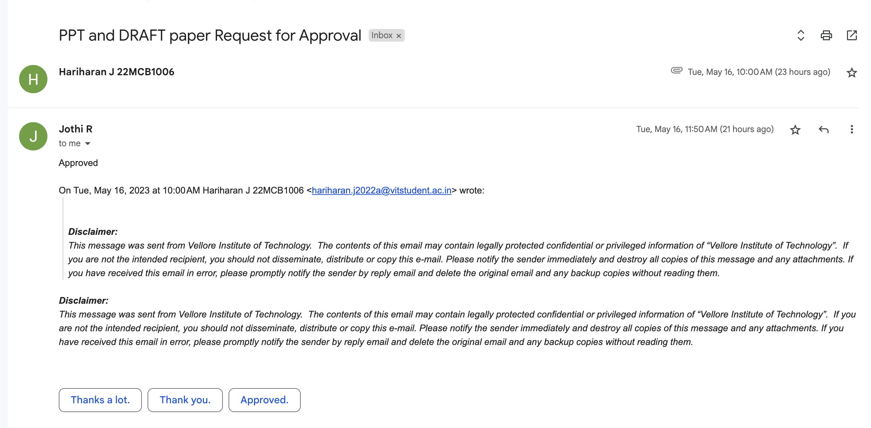

Slide 21
References
[1] Nandi, A et al, “Global and regional projections of the economic burden of Alzheimer's disease and related dementias from 2019 to 2050: A value of statistical life approach”, EClinicalMedicine - The Lancet Discovery Science, Volume 51, 101580, 2022. https://doi.org/10.1016/j.eclinm.2022.101580.
[2] Lee, T., Lee, H. Prediction of Alzheimer’s disease using blood gene expression data. Sci Rep 10, 3485, 2020. https://doi.org/10.1038/s41598-020-60595-1.
[3] M. S. Kamal, A. Northcote, L. Chowdhury, N. Dey, R. G. Crespo and E. Herrera-Viedma, "Alzheimer’s Patient Analysis Using Image and Gene Expression Data and Explainable-AI to Present Associated Genes," in IEEE Transactions on Instrumentation and Measurement, vol. 70, pp. 1-7, 2021, Art no. 2513107, doi: 10.1109/TIM.2021.3107056.
[4] Mahendran N, P M DRV. A deep learning framework with an embedded-based feature selection approach for the early detection of the Alzheimer's disease. Comput Biol Med. 2022 Feb; 141:105056. doi: 10.1016/j.compbiomed.2021.105056. Epub 2021 Nov 22. PMID: 34839903.
[5] S. Khanal, J. Chen, N. Jacobs, and A. -L. Lin, "Alzheimer’s Disease Classification Using Genetic Data," 2021 IEEE International Conference on Bioinformatics and Biomedicine (BIBM), 2021, pp. 2245-2252, doi: 10.1109/BIBM52615.2021.9669730.
[6] El-Gawady, A.; Makhlouf, M.A.; Tawfik, B.S.; Nassar, H. Machine Learning Framework for the Prediction of Alzheimer’s Disease Using Gene Expression Data Based on Efficient Gene Selection. Symmetry 2022, 14, 491. https://doi.org/10.3390/sym14030491.
[7] S. Perera, K. Hewage, C. Gunarathne, R. Navarathna, D. Herath and R. G. Ragel, "Detection of Novel Biomarker Genes of Alzheimer’s Disease Using Gene Expression Data," 2020 Moratuwa Engineering Research Conference (MERCon), 2020, pp. 1-6, doi: 10.1109/MERCon50084.2020.9185336.
[8] C. Park, J. Ha, and S. Park, "Prediction of Alzheimer's disease based on deep neural network by integrating gene expression and DNA methylation dataset," Expert Systems with Applications, vol. 140, pp. 112873, 2020, doi: 10.1016/j.eswa.2019.112873.
[9] H. M. AL-Bermany and S. Z. AL-Rashid, "Microarray Gene Expression Data for Detection Alzheimer’s Disease Using k-means and Deep Learning," 2021 7th International Engineering Conference “Research & Innovation amid Global Pandemic" (IEC), 2021, pp. 13-19, doi: 10.1109/IEC52205.2021.9476128.
[10] A. Sharma, P. Dey, "A Machine Learning Approach to Unmask Novel Gene Signatures and Prediction of Alzheimer's Disease Within Different Brain Regions," Genomics, vol. 113, no. 4, pp. 1778-1789, Apr. 2021, doi: 10.1016/j.ygeno.2021.04.028.
[11] Kalkan H, Akkaya UM, Inal-Gültekin G, Sanchez-Perez AM. Prediction of Alzheimer's Disease by a Novel Image-Based Representation of Gene Expression. Genes (Basel). 2022 Aug 8;13(8):1406. doi: 10.3390/genes13081406. PMID: 36011317; PMCID: PMC9407775.
[12] D. Sun, H. Peng and Z. Wu, "Establishment and Analysis of a Combined Diagnostic Model of Alzheimer's Disease with Random Forest and Artificial Neural Network," Frontiers in Aging Neuroscience, 2022. Available: https://www.proquest.com/scholarly-journals/establishment-analysis-combined-diagnostic-model/docview/2682564611/se-2. DOI: https://doi.org/10.3389/fnagi.2022.921906.

Slide 22
References
[13] Yuen, S.C., Liang, X., Zhu, H., Jia, Y., and Leung, S.W. "Prediction of differentially expressed microRNAs in blood as potential biomarkers for Alzheimer's disease by meta-analysis and adaptive boosting ensemble learning." Alzheimer's Research & Therapy, vol. 13, no. 1, 2021, p. 126. doi: 10.1186/s13195-021-00862-z.
[14] S. Pavalarajan, B. A. Kumar, S. S. Hammed, K. Haripriya, C. Preethi and T. Mohanraj, "Detection of Alzheimer's disease at Early Stage using Machine Learning," 2022 International Conference on Advanced Computing Technologies and Applications (ICACTA), Coimbatore, India, 2022, pp. 1-5, doi: 10.1109/ICACTA54488.2022.9752827.
[15] S. S. Rajeswari and M. Nair, "A Transfer Learning Approach for Predicting Alzheimer's Disease," 2021 4th Biennial International Conference on Nascent Technologies in Engineering (ICNTE), NaviMumbai, India, 2021, pp. 1-5, doi: 10.1109/ICNTE51185.2021.9487746.
[16] J. Li, Y. Wei, C. Wang, Q. Hu, Y. Liu and L. Xu, "3-D CNN-Based Multichannel Contrastive Learning for Alzheimer’s Disease Automatic Diagnosis," in IEEE Transactions on Instrumentation and Measurement, vol. 71, pp. 1-11, 2022, Art no. 5008411, doi: 10.1109/TIM.2022.3162265.
[17] S. Basheer, S. Bhatia and S. B. Sakri, "Computational Modelling of Dementia Prediction Using Deep Neural Network: Analysis on OASIS Dataset," in IEEE Access, vol. 9, pp. 42449-42462, 2021, doi: 10.1109/ACCESS.2021.3066213.
[18] G. Chutani, H. Bohra, D. Diwan and N. Garg, "Improved Alzheimer Detection using Image Enhancement Techniques and Transfer Learning," 2022 3rd International Conference for Emerging Technology (INCET), Belgaum, India, 2022, pp. 1-6, doi: 10.1109/INCET54531.2022.9824008.
[19] D. Chaihtra and S. Vijaya Shetty, "Alzheimer’s Disease Detection from Brain MRI Data using Deep Learning Techniques," 2021 2nd Global Conference for Advancement in Technology (GCAT), Bangalore, India, 2021, pp. 1-5, doi: 10.1109/GCAT52182.2021.9587756.
[20] U. R. K, S. S. S, U. M. G and V. B. C, "Binary Classification of Alzheimer's disease using MRI images and Support Vector Machine," 2021 IEEE Mysore Sub Section International Conference (MysuruCon), Hassan, India, 2021, pp. 423-426, doi: 10.1109/MysuruCon52639.2021.9641661.
[21] S. Buyrukoğlu, "Improvement of Machine Learning Models’ Performances based on Ensemble Learning for the detection of Alzheimer Disease," 2021 6th International Conference on Computer Science and Engineering (UBMK), Ankara, Turkey, 2021, pp. 102-106, doi: 10.1109/UBMK52708.2021.9558994.
[22] Dubey, S. (2019, December 26). Alzheimer's Dataset ( 4 class of Images),Kaggledatase. https://www.kaggle.com/tourist55/alzheimers-dataset-4-class-of-images?select=Alzheimer_s%2Bt.
[23] Xu, L., Skoularidou, M., & Veeramachaneni, K. (2019). Modeling Tabular data using Conditional GAN. ArXiv. /abs/1907.00503

