Slide 1

Early detection of Alzheimer’s disease using blood gene expression data
M.Tech - Study Oriented Project Review - 2
Guided by
Dr. Jothi R
Date : 07.12.2022
By
Hariharan J
22MCB1006

Slide 2
Abstract
Alzheimer’s a type of neurological disorder is seeing a surge in the numbers of cases from the past decade. Especially in India the cases are expected to grow to 11,422,692 by 2050 from 3,848,118 measured in 2019 according to Lancet report as of July 2022 [1]. Early detection of the genes responsible for Alzheimer's is an important pre-requisite for its diagnosis. This study focuses to explore the various feature extraction and classifier algorithms that make use of gene expression data and find and design the best among them extract the specific genes (feature selection) and their characteristics that translate to Alzheimer’s disease (classification). Gene expression datasets used for the study are curated from multiple public repositories ADNI, AddNeuroMed1, AddNeuroMed2. The classifiers algorithms are put for internal validation (training and testing dataset are from same set) and external validation ( training and testing dataset are from different sets). Study also aims to explore explainable artificial intelligence methods (XAI) of classification for a simple human interpretation and measure its trustworthiness.

Slide 3
Introduction
Alzheimer’s disease (AD) or also called as senile dementia is the most found type of dementia among humans.
AD is formally defined as the pathological deposition of folded beta-amyloid plagues, and hyper-phosphorylated neurofibrillary t au tangles in the brain leading to neurodegeneration [2].
Currently there is no cure exists for this, But early detection of the AD possibility will help to manage the control and temporarily improve the symptoms [3].
Gene Expression is an information which is stored in all our genes which are used for synthesis of a functional gene product which intern is used to produce end products like protein or non-coding RNA.
There are many studies carried out to find the genetic associations of AD through big data and statistical methods [4 - 5] and through Machine Learning (ML) models [6]. The major challenge of using ML models is the small sample size compared with the huge dimension of characteristic features.

Slide 4
Introduction – Cont.
Differential gene expression, commonly abbreviated as DG or DGE analysis refers to the analysis and interpretation of differences in abundance of gene transcripts within a transcriptome.
Lists of genes that differ between 2 sample sets are often provided by RNA sequence data analysis tools or can be generated manually by statistical testing of data sets.
Due to the large number of genes to be tested, (e.g., >20,000 in the human genome), multiple testing correction such as Bonferroni correction is usually applied.
Dataset | Samples | Probes
ADNI | NA | 49386
ANM1 | 329 | 38329
ANM2 | 388 | 32049

Slide 5

Motivation
Primary objective is to find the best algorithm to extract the genes from blood gene expression that influence the possibility of Alzheimer’s.
Secondary objective is to find the best algorithm which can classify using the DEG the possibility of Alzheimer’s.

Slide 6

Literature Survey

Slide 7
Detection of Novel Biomarker Genes of Alzheimer’s Disease Using Gene Expression Data, Shehan Perera, Kaveesha Hewage, Chamara Gunarathne, Rajitha Navathana, Damayanthi Herath, Roshan G. Ragel, IEEE - 2020
This study was conducted to understand the underlying mechanism and the pathogenesis of the Alzheimer’s disease.
Underlying genetic structure of the disease, gene expression data were used to identify possible genes that are risk.
A machine learning framework that can be used to identify possible bio-marker genes is proposed.
Discovered possible set of 14 genes are validated by biological sources.
Model | Testing | Training
Random Forest | 83.67 | 87.48
SVM + Gaussian Kernel | 83.67 | 91.06
SVM + Linear Kernel | 89.80 | 93.76

Slide 8
GSE5281 gene dataset is used to present a critical analysis of the proposed machine learning framework.
Method:
Data Pre-processing: Extracting 24,438 unique gene symbols from 161 samples with 87 diagnosed with Alzheimer’s.
Differently Expressed Genes: t-test done to extract the p-value for each gene and gene rejected having pValue < 0.05.
Feature Selection: using PCA top 50 genes are extracted. PCA (Principal Component Analysis) is technique which uses set of orthogonal transformation to reduce the feature size. RF is also used to cross validate.
Classification: following classification were used
Naïve Bayes
Decision Trees
Radom Forest
Nearest Neighbor
SVM with linear and gaussian kernel

Slide 9
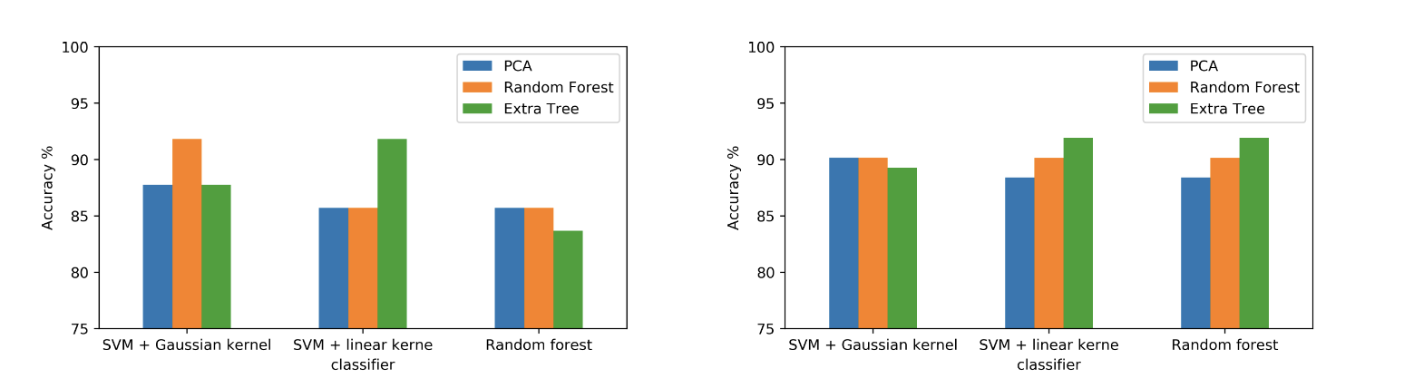
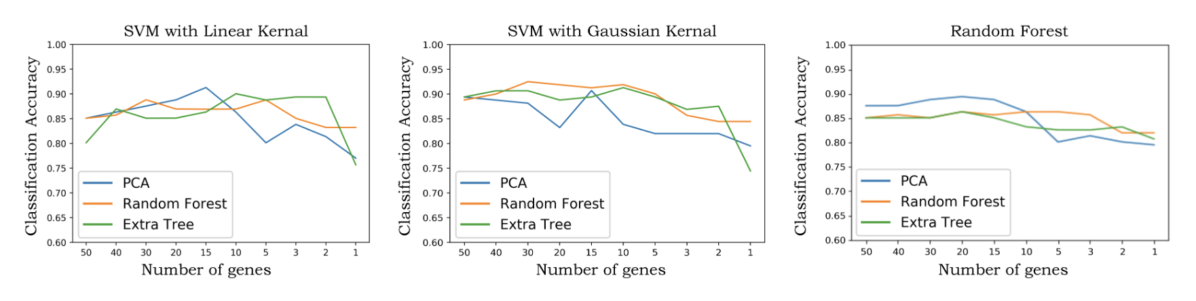
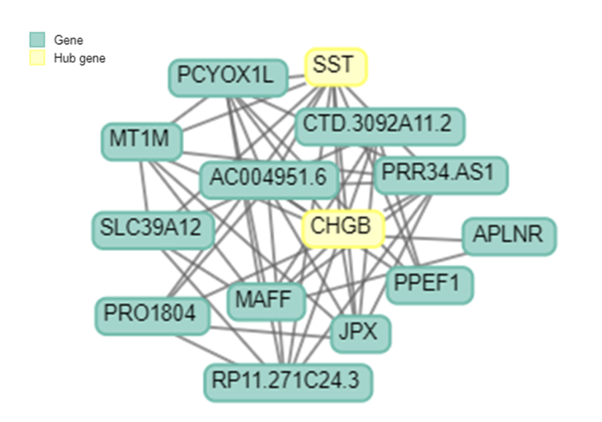

Slide 10
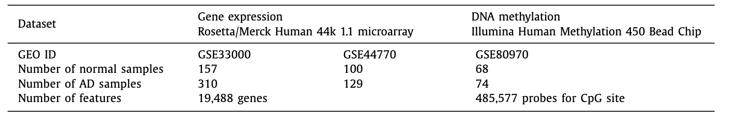
Prediction of Alzheimer’s disease based on deep neural network by integrating gene expression and DNA methylation datasets, Chihyun Park, Kihwan Ha, Sanghyun Park – Elsevier - 2021
This study is performed to explore gene expression extracted from brains prefrontal cortex for early detection of Alzheimer’s rather relying on the conventional way of detection using brain images using MRI’s.
Involves selection of differently expressed gene and differently expressed methylated position in multi omnics dataset.
Showcases integration of gene expression data and DNA methylation data.
Feature selection and Prediction model seen to be outperformed the existing conventional machine learning algorithms.

Slide 11
Method:
Dataset: GSE33000 and GSE44770 were used from GEO Omnibus for gene expression data and GSE80970 were used for DNA methylation profiles.
Feature Selection: Does not consider traditional feature reduction algorithms PCA, instead use LIMMA packages which is based on t-test.
Prediction Model:
SVM
Naïve Bayesian
Random Forest
DNN
These were also verified with k-fold cross validation.

Slide 12
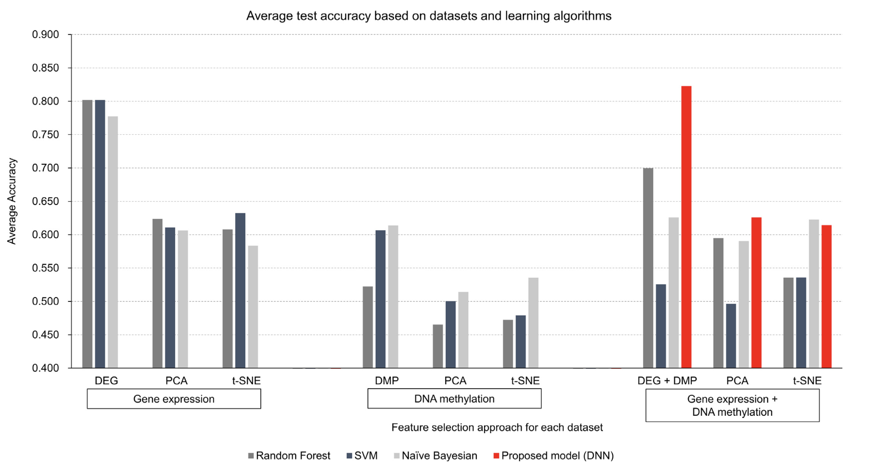

Slide 13
Microarray Gene Expression Data for Detection Alzheimer’s Disease Using k-means and Deep Learning, Heba M. AL-Bermany, Sura Z. AL-Rashid – IEEE - 2021
This study aims to identify the most important genes that causes the Alzheimer’s disease by using feature(gene) selection to reduce the high dimensional data size
Two-fold approach, first to remove the irrelevant features and second to predicting the AD patients.
Statistical methods are explored for Gene Selection and CNN (Convolutional Neural Networks) along with K-Means is explored for classification.
Feature Selection | Prediction Method | Accuracy
ANNOVA | K-means with CNN | 0.929
MI | K-means with CNN | 0.886

Slide 14
Method:
Dataset: from GEO Omnibus the following were used, GSE63060 and GSE63061. These have 16382 gene symbols and 569 samples, out of which 245 are samples are of AD patients.
Preprocessing: Noise removed and did batch normalization using Min-Max normalization.
Gene Selection:
ANOVA
MI (Mutual Information)
Prediction:
K-Means clustering: employed to reduce D genes from N samples to K.
CNN: Output from previous used for classification. 3 Convolution layers and 3 MaxPooling layers.

Slide 15
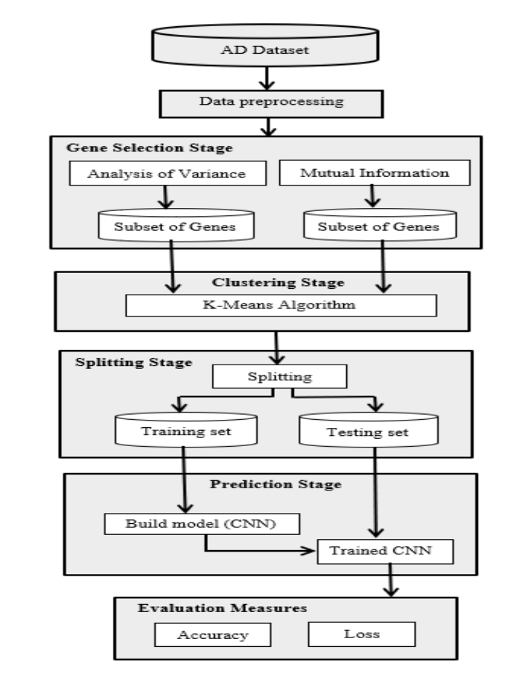
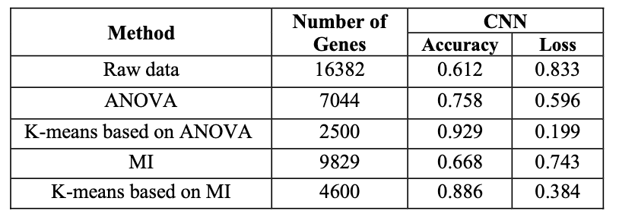

Slide 16
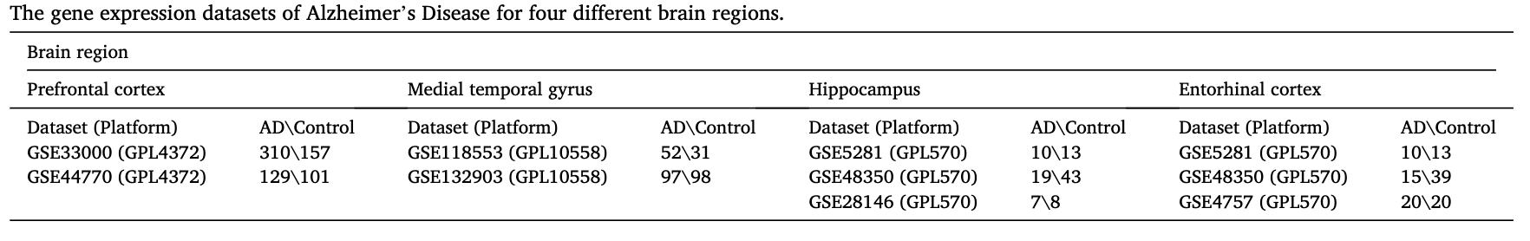
A machine learning approach to unmask novel gene signatures and prediction of Alzheimer’s disease within different brain regions, Abhibhav Sharma, Pinki Dey – Elsevier - 2021
Study aims to employ the ensemble of random-forest and regularized regression model (LASSO) to the AD-associated microarray datasets from four brain regions - Prefrontal cortex, Middle temporal gyrus, Hippocampus and Entorhinal cortex.
Proposed system was observed to be the most optimum and biologically significant.
Numerous relation between non-coding RNA genes were identified.

Slide 17
Method:
Dataset: NCBI-GEO database was used. To extract gene expression from different regions of brain.
Feature Selection:
Dataset from multiple sources are merged
varSelRF (Variable Selection using Random Forest): ensemble of RF classifiers and employ's bootstrap sample of the data.
Implementation available in CRAN repository of R
LASSO (Lease Absolute Shrinkage and Selection Operator)
Classification:
SVM (Support Vector Machines)
RF (Random Forest)

Slide 18
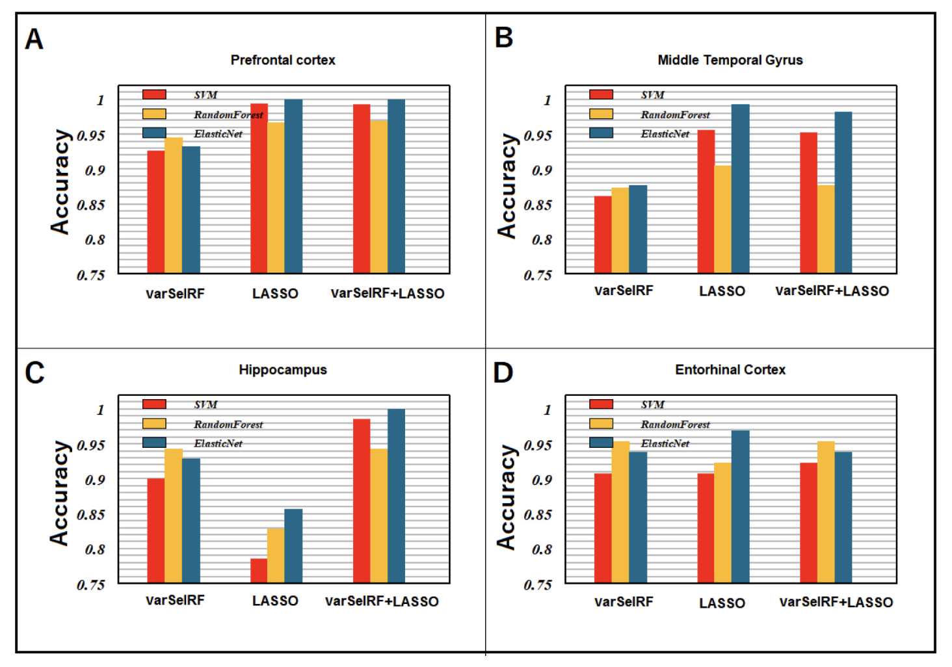

Slide 19
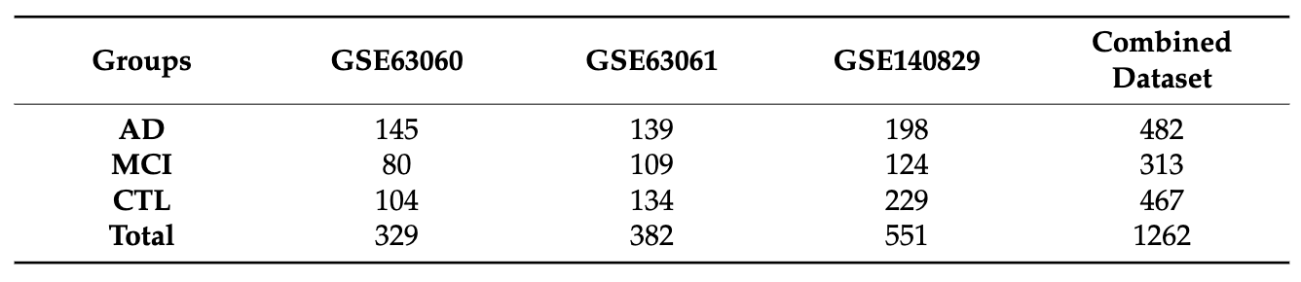
Prediction of Alzheimer’s Disease by a Novel Image-Based Representation of Gene Expression, Habil Kalkan, Umit Murat Akkaya, Guldal Inal-Gultekin and Ana Maria Sanchez-Perez - MDPI - 2022
This study aims to generate a reliable artificial model capable of detecting the high risk of AD, based on gene expression array collected from blood samples.
Single dimension gene expression is converted into a discriminative 2D image which is then used by the CNN model for classification.
Study is conducted using 11.618 common genes expression values which are categorized based on Fisher distance.
Proposed method of 2D conversion of gene expression was found to have a unique advantage for improving accuracy and can be easily transferred to the clinic to drastically improve AD early detection.

Slide 20
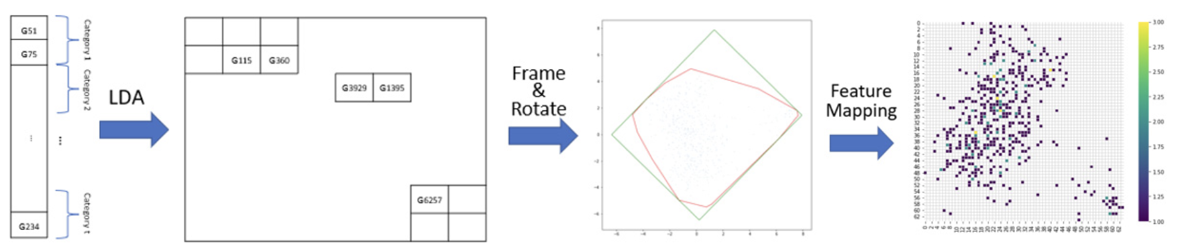
Method:
Dataset and Data Preprocessing: datasets were extracted from NCBI, GSE63060, GSE63062 and GSE140829. All these datasets were combined, and values were min-max normalized.
Image-Based Representation of mRNA Expression: LASSO regression is used to eliminate irrelevant genes for AD. Linear discriminant analysis is used to determine the position of gene in the 2D space.

Slide 21
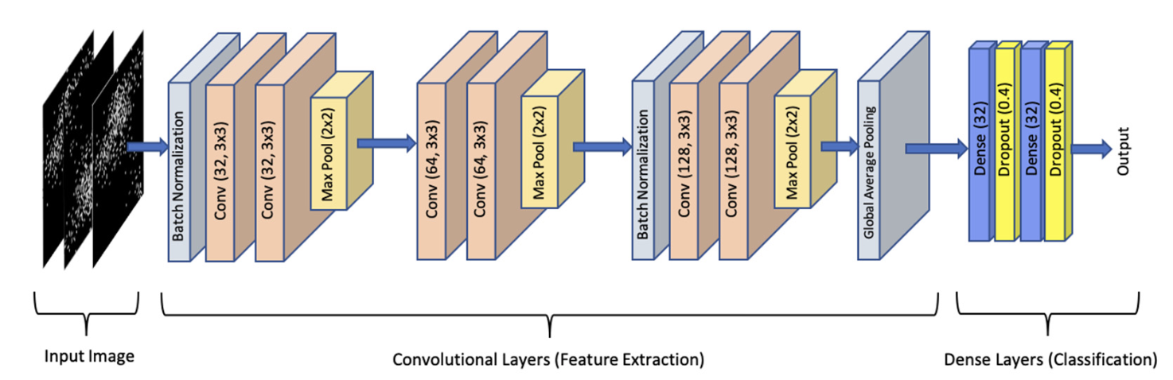
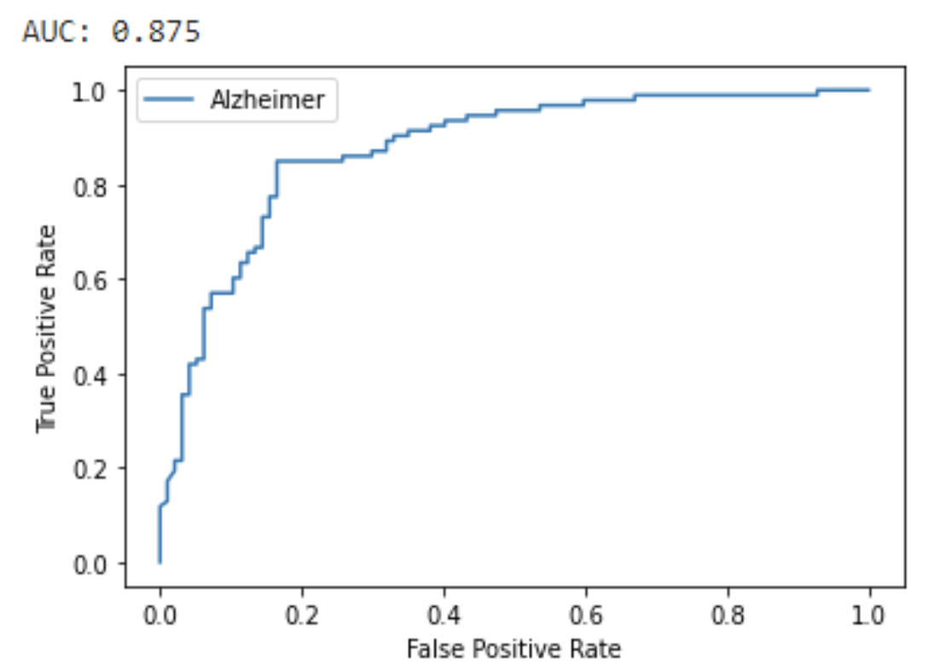
Classification:
Done using CNN with following configurations
Results:
LDA based image imaging along with CNN observed to performing well compared to the existing method like LASSO+SVM, tSNE + CNN.

Slide 22
3-D CNN-based Multichannel Contrastive Learning for Alzheimer’s Disease Automatic Diagnosis, Jiaguang Li, Ying Wei, Chuyuan Wang, Quian Hu, Yue Liu, Long Xu – IEEE - 2022
Study aims to propose an automatic classification method of AD versus normal control (NC) and mild cognitive impairment (MCI) based on the magnetic resonance images (MRI).
Complete 3D channel form the MRI images is used as the input, which can obtain image information to the greatest extent.
Contrastive learning strategy based on multiple data transformation methods are used to combine supervised classification loss with the unsupervised contrastive loss.
Results were verified used the samples collected from ADNI dataset which showed the model’s effectiveness to classify AD and MCI samples.
Multichannel contrastive learning strategy greatly improved classification accuracy and generalization ability of the network.

Slide 23
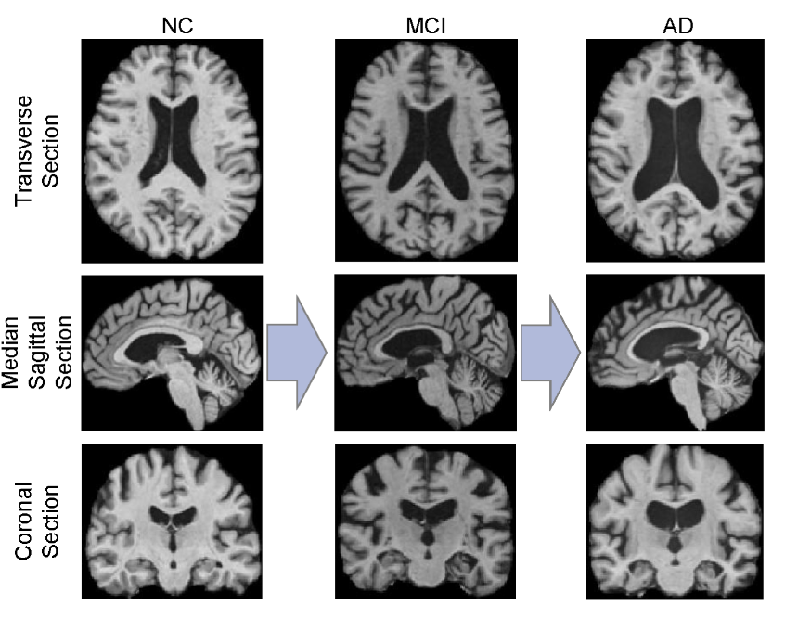
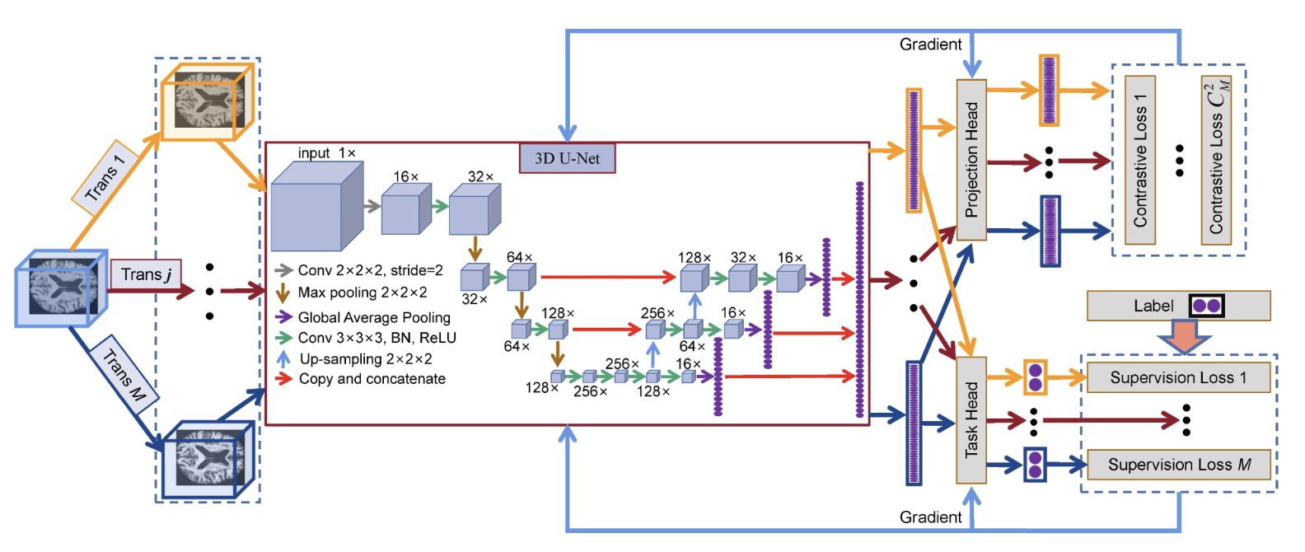
Self-Supervised Contrastive Learning:
Was proposed to learn visual features from large-scale unlabeled images or videos by constructing pretext task without using human annotations.
Constructs positive samples and negative samples through two different data transformation methods.
Data Preprocessing:
Resample
Skull Stripping
Intensity correction
Clip
Framework:

Slide 24
Detection of Novel Biomarker Genes of Alzheimer’s Disease Using Gene Expression Data, Shehan Perera, Kaveesha Hewage, Chamara Gunarathne, Rajitha Navathana, Damayanthi Herath, Roshan G. Ragel, IEEE - 2020

Slide 25
Detection of Novel Biomarker Genes of Alzheimer’s Disease Using Gene Expression Data, Shehan Perera, Kaveesha Hewage, Chamara Gunarathne, Rajitha Navathana, Damayanthi Herath, Roshan G. Ragel, IEEE - 2020

Slide 26
Detection of Novel Biomarker Genes of Alzheimer’s Disease Using Gene Expression Data, Shehan Perera, Kaveesha Hewage, Chamara Gunarathne, Rajitha Navathana, Damayanthi Herath, Roshan G. Ragel, IEEE - 2020

Slide 27
Detection of Novel Biomarker Genes of Alzheimer’s Disease Using Gene Expression Data, Shehan Perera, Kaveesha Hewage, Chamara Gunarathne, Rajitha Navathana, Damayanthi Herath, Roshan G. Ragel, IEEE - 2020

