Slide 1
HPC Workshop Series: Profiling and Scaling
Andrew Monaghan*
Research Computing
Slides: https://github.com/ResearchComputing/Fundamentals_HPC_Spring_2019/profiling/profiling_hpc_spring_2019.pdf
*Based on original course material by Nick Featherstone

Slide 2
Outline
Basic Timing
the Linux “time” utility
timing functions in C++, Python, and Fortran
Serial Profiling with Intel Vtune
Command Line
GUI
Parallel Scaling Analysis

Slide 3
Before we begin
Login
ssh -X username@tlogin1.rc.colorado.edu
ssh –X scompile
Start an interactive session:
sinteractive –n4 –t60 --reservation=hpc_tutorial
Set up the environment and compile the code:
module load intel impi python/3.5.1
cd /scratch/summit/$USER
cd Fundamentals_HPC_Spring_2019/profile
make

Slide 4
Nano survival guide
Simple, text-based editor
These 4 commands are useful
Ctrl+o save (need to confirm filename)
Ctrl+x exit
Ctrl+k cut
Ctrl+u paste

Slide 5
The Linux Time Utility
First place to start when profiling your program
export OMP_NUM_THREADS=4
time ./prog.omp (try ./prog.serial also)
real 0m17.801s Wall Clock Time
user 0m58.125s Threads x Wall Clock Time
sys 0m0.081s System Overhead
Works with MPI as well
Only reports info on cpu that called mpirun
time mpirun –np 4 ./prog.mpi

Slide 6
Fine-Grained Timing
Often useful to time portions of a program
Good idea when developing your own code
Tough when its 3rd-party software
Useful functions:
Fortran: system_clock
C++ clock()
Python: time.time( )
Examples follow

Slide 7
Simple Timing (Fortran)
Use the system_clock function (F90 onward)
INTEGER :: t1, t2, count_rate, count_max
REAL*8 :: elapsed
CALL SYSTEM_CLOCK(t1, count_rate, count_max)
test code
CALL SYSTEM_CLOCK(t2, count_rate, count_max)
elapsed = real(t2-t1) / real(count_rate)
WRITE(6,*)’Time (s): ‘, elapsed

Slide 8
Simple Timing (C++)
#include <iostream>
#include <cstdio>
#include <ctime>
int main() {
std::clock_t tstart;
std::clock t_end;
double elapsed;
tstart = std::clock();
test code
tend=std::clock();
elapsed = ( tend- tstart ) / (double) CLOCKS_PER_SEC;
std::cout<<"printf: "<< elapsed <<'\n';
}
With c++ 11, can use std::chrono as well

Slide 9
Simple Timing (Python)
Use the time function from the time module
import time
t1 = time.time( )
Test code
t2 = time.time( )
seconds = t2-t1
print(‘Elapsed time: ‘, seconds)

Slide 10
Advanced Timing (Python)
Use the cProfile module to profile your code
https://docs.python.org/3/library/profile.html
Examine:
my_code.py
time_my_code.py
Run python time_my_code.py

Slide 11
Timing with MPI
Use the MPI_WTIME function
Calling syntax same in C++ & FORTRAN
Can be synchronized across all processes
USE MPI
REAL*8 :: t1,t2
REAL*8 :: elapsed
t1 = MPI_WTIME()
test code
t2 = MPI_WTIME()
elapsed = real(t2-t1) / real(count_rate)
WRITE(6,*)’Time (s): ‘, elapsed

Slide 12
Good Idea: Write a Timer Class
Examine Serial_Timing.f90
Makes it easy to change our clock function if desired
Helps prevent typos!
Attributes
Accrued time
Time1
Time2
Methods
Start clock
Stop clock
Increment Accrued Time

Slide 13
Profiling with Intel Vtune
Provided with the intel compiler
Installed on Summit
In-depth profiling tool
We only have time for a quick test run
Online tutorials here:
https://software.intel.com/en-us/articles/intel-vtune-amplifier-tutorials

Slide 14
Preparing to Run Vtune
Additional environment variables need to be set:
Run source ready_vtune

Slide 15
Vtune: Command Line
Runs in two stages: collection & reporting
Have a look at serial.F90
Try this:
collection
amplxe-cl -collect hotspots ./prog.serial
amplxe-cl -report top-down -r r000hs > hotspots.txt
more hotspots.txt
reporting

Slide 16
Vtune GUI
Fairly sophisticated GUI interface
Let’s have a look (brace yourself)
Follow along with me. Start by typing:
amplxe-gui

Slide 17
Close your interactive session
Type exit
Should see prompt change to shas0136 or 0137

Slide 18
Parallel Scaling

Slide 19
Outline
What do we mean by “scaling”?
Strong vs. Weak Scaling
Example and Exercise

Slide 20
Analysis of Parallel Performance
Run a sample problem at multiple core counts and measure elapsed time.
(i.e., conduct a scaling study).
As core count increases, how does your application perform relative to ideal behavior?
Weak Scaling:
Increase problem size alongside number of cores used.
“Can I run a larger problem?”
Strong Scaling:
Fix problem size, and increase core count.
“Can I decrease my time to solution?”

Slide 21
Ideal Scaling
The expected performance in the absence of any communication overhead, etc.
Never achieved in practice, but standard reference point.
Ideal weak scaling:
Time-to-solution is independent of core-count (though may depend on global problem size)
Ideal strong scaling:
Time-to-solution decreases as 1/n_{cores}

Slide 22
Efficiency
Efficiency = Expected Time / Actual Time
Expected (ideal) time is often taken relative to application’s serial performance, or performance at a low core count.
Good efficiency? Who knows? Trade-off between CPU hours and human effort.
Suggestion: Always run your application with core counts that realize at least 80% efficiency (90 is better…).

Slide 23
Scaling Study Procedure
Pick a few representative problem sizes (e.g., number of images to process, size of grid domain, number of genomes to examine)
Decide on a sensible duration for the test. If code iterates in some fashion, run for just a few iterations.
Run code for a short time at each problem size and with multiple core counts.
For each test, record or calculate elapsed time, expected time, efficiency
Plot results and ask for CPU time!

Slide 24
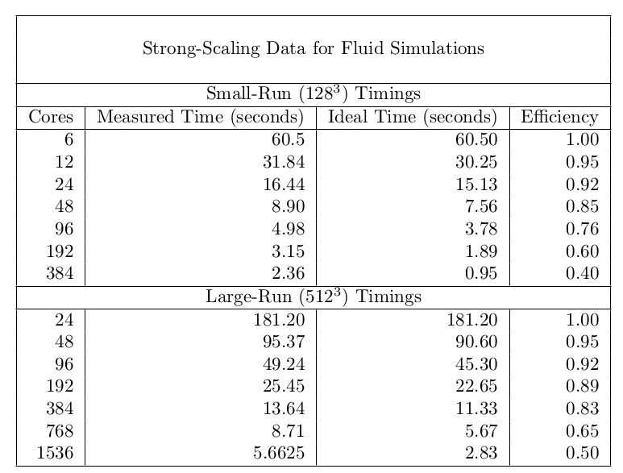
Sample Strong Scaling Data
Fixed problem size at different core counts.

Slide 25
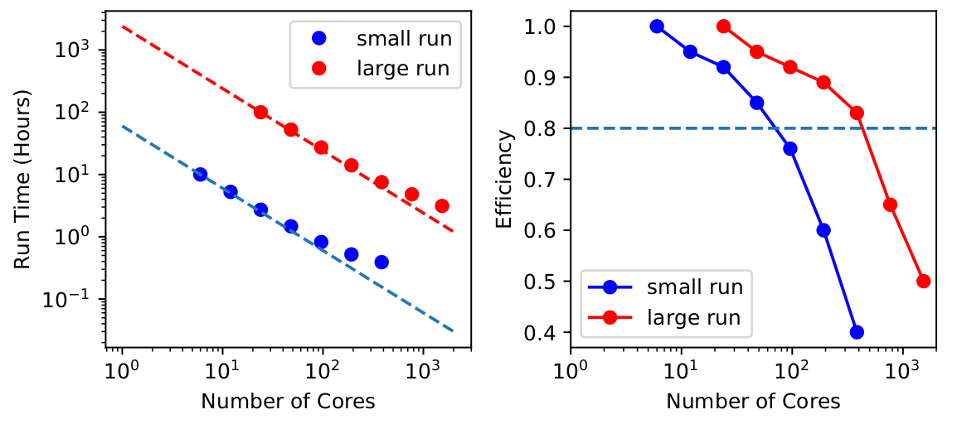
Strong Scaling Plots
Suggestion: Run with at least 80% efficiency

Slide 26
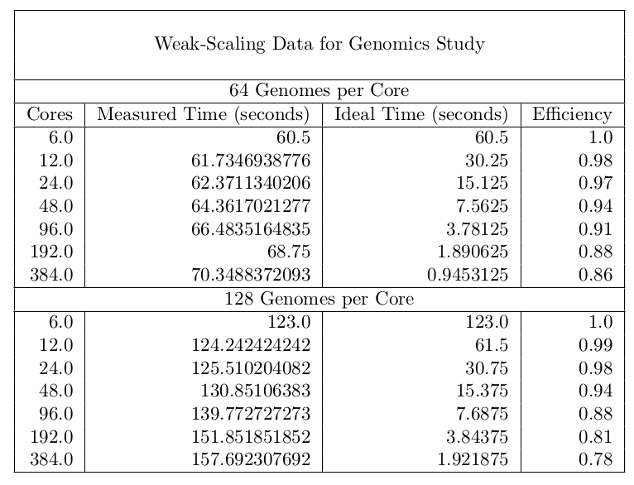

Sample Weak Scaling Data
Vary problem size in proportion to core count.

Slide 27
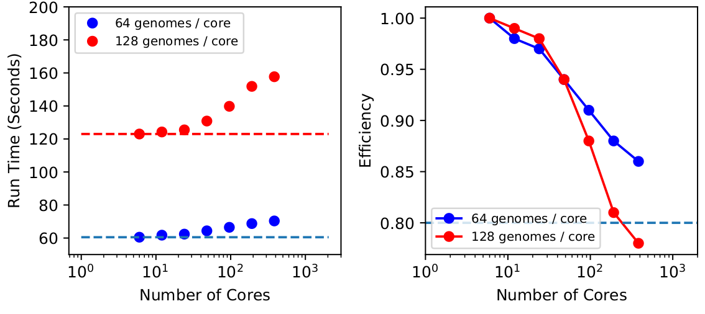
Weak Scaling Plots

Slide 28
Notes
Reusable tools provided:
Scaling Bash script (scaling_script.sh)
Python plotting program (scaling.py)
Submitting the job that runs scaling_script.sh:
sbatch job.sh
Code outputs: n_{cores}, time, nxglobal, nyglobal, niter
See sample outputs in ./sample_scaling_data directory

Slide 29
Thank you!
Survey: http://tinyurl.com/curc-survey19
Slides: https://github.com/ResearchComputing/Fundamentals_HPC_Spring_2019
Contact: Andrew.Monaghan@colorado.edu

