Slide 2
Economic Damages ($)
Total Damage
Marginal Damage
Particulate Matters Concentration (ug/m3)

Slide 3
Economic Benefit from
Reducing Pollution ($)
Marginal Benefit
Total Benefit
Reductions in
Particulate Matters (ug/m3)

Slide 4
Economic Costs to reduce pollution($)
Total Abatement Cost
Marginal Abatement Cost
Reduction in
Particulate Matters (ug/m3)

Slide 5
MSC: P=Q+10
Price ($)
MPC: P=Q
P*
P’
t=MEC
Demand: P=30-Q
Q*
Q’
Quantity (Unit of mining output)

Slide 6
 | Excludable | Non-Excludable
Rival | Private Goods Food, House, Car, Electronics, Private Forests | Open-access Goods Fisheries; Grasslands; Groundwater
Non-Rival | Club Goods Netflix; Sports Games | Public Goods Air; Water; National Park; Biodiversity

Slide 7
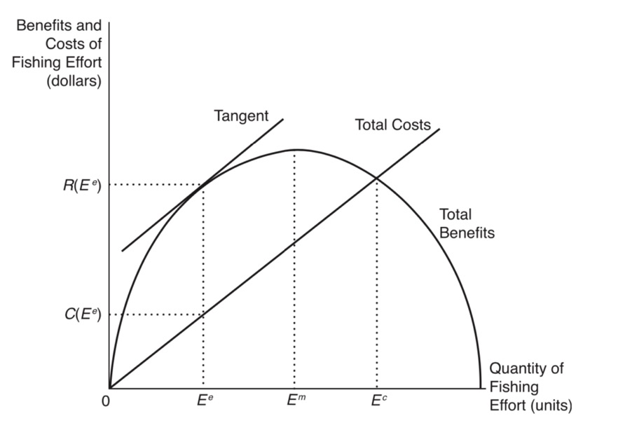
Optimal Quota
Optimal
Amount of Tax

Slide 8
Price ($)
Command-and-Control Standard
MACA
MACB
Tax
Cap-and-Trade
Quantity (Unit of pollution discharge)

Slide 9
Price ($)
100
70
MSC
50
MEC
20
MPC
60
100
160
200
Q

Slide 10

Climate Change
Air Pollution
Energy Security

