Slide 1
Cleaner bills, cleaner air: the environmental consequence of Renewable Portfolio Standards (RPS) policy design
Xinde James Ji, University of Florida
Qingran Li, Clarkson University
Filippo Mavrothalassitis, Yale University
Stephen Lee, Massachusetts Institute of Technology
Max Luke, the National Grid
SWEEEP @ GaTech

Slide 2
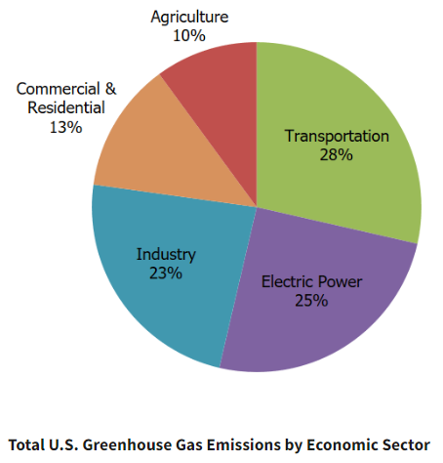
Motivation
Climate change is one of the most important challenges facing our future
US has been lacking a federal overarching climate policy (e.g. carbon tax) and instead implements sector-wise policies
Transportation: CAFE standards, LCFS
Buildings: energy efficiency policies, e.g. building codes, appliance standards
Power: Renewable Portfolio Standards (RPS)
The power sector decarbonization is essential for low-carbon economy.
25% of GHG emissions in 2021 (down from 32% in 2001)
Integrated with other sectors through electrifications (EVs, heating)
Source: EPA (2021) https://www.epa.gov/ghgemissions/sources-greenhouse-gas-emissions

Slide 3
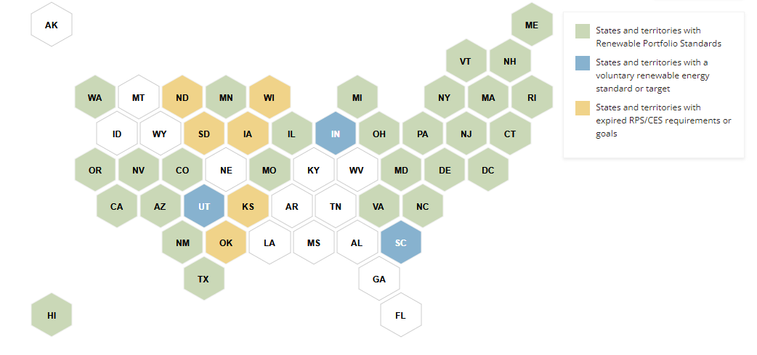
What is Renewable Portfolio Standards (RPS)?
RPS is a state-level policy that requires a specific percentage of electricity sales from renewable resources
36 states + DC have passed RPS policies as of 2021
Source: National Conference of State Legislatures (2021). https://www.ncsl.org/energy/state-renewable-portfolio-standards-and-goals
(WV repealed RPS in 2015, MT in 2021)

Slide 4
What is Renewable Portfolio Standards (RPS)?
RPS is a state-level policy that requires a specific percentage of electricity sales from renewable resources
36 states + DC have passed RPS policies as of 2021
RPS vs. Clean Energy Standard (CES)
“Clean Energy” can include nuclear which is non-renewable.
This study treats them as the same policy.
Policy goals of RPS:
Energy independence/diversification
Decarbonization
Non-GHG pollution is generally NOT part of the legislative intent for most RPS

Slide 5
Empirical evidence on the impact of RPS
Recent causal evidence suggests that RPS policy:
Increases retail electricity price by 2-11% (Upton and Snyder 2015; Greenstone and Nath, 2021; Wolverton et al. 2023)
Decreases carbon emission by 10-25% (Greenstone and Nath, 2021)
RPS is relatively cost-ineffective as a climate policy: $60-300 per ton of CO2 abatement
Small increases in renewable energy deployment (Greenstone and Nath 2023; Fullerton and Ta 2022; Feldman and Levinson 2023; Deschenes et al. 2023)
Large reductions of in-state and out-of-state coal generation (Hollingsworth and Rudik 2019)

Slide 6
Less clear in the literature: environmental effects of RPS
In theory renewable energy provides non-climate environmental benefits
Empirical evidence is scarce, many based on simulation (Johnson and Novacheck 2015; Barbose et al. 2016; Wiser et al. 2017)
Model potential change in energy mix – project corresponding change in flow pollution emission
Co-benefit ~$1.5 billion annually
Closest empirical evidence: Hollingsworth and Rudik (2019 JAERE):
Models REC demand at state/facility levels
Simulate pollution reduction, then monetize using Mueller et al. (2013)’s air pollution transport model
Co-benefits from $100,000 to over $100 million with 1% increase in nominal RPS target

Slide 7
Policy design matter: the role of policy stringency
RPS laws can differ widely from each other (Carley et al. 2012; Fischlein and Smith 2013; Bernstein and Hoffmann 2018; Carley et al. 2018) in a variety of ways:
Percentage requirement (nominal goal)
Design features: multipliers, exemptions, voluntary goals etc.
Limited evidence that systematically documents stringency and its impacts
Carley et al. (2018 Nature Energy): more stringent laws lead to higher renewable adoption with a mixed quantitative-qualitative scoring system
DSIRE database (NC State): a database on RPS stringency but does not enable structured comparisons of technology types
Hong et al. (2023 NBER WP): Exempted municipal generation facilities are less constrained financially compared to commercial counterparts

Slide 8
What’s this study about?
Construct a new, unified metric of RPS stringency
Provide causal estimates on the heterogenous environmental effects of RPS associated with policy design:
Pooled together, on average RPS mildly reduces SO₂ emission and has negative but insignificant effects on NOx emission or ambient air quality
The RPS effect differs widely by policy stringency:
States with “clean” RPS laws: Large reductions in SO₂ and NO_{x} emission, improvement in ambient air quality
States with “discrepant” RPS laws: Small reduction in SO₂, no reduction in NO_{x} emissions, no ambient air quality improvement
Effects driven by differential shifts in generation sources
States with clean RPS laws transit away from coal faster
Forgone co-benefits are estimated to be $12-22 billion in year 2016

Slide 9
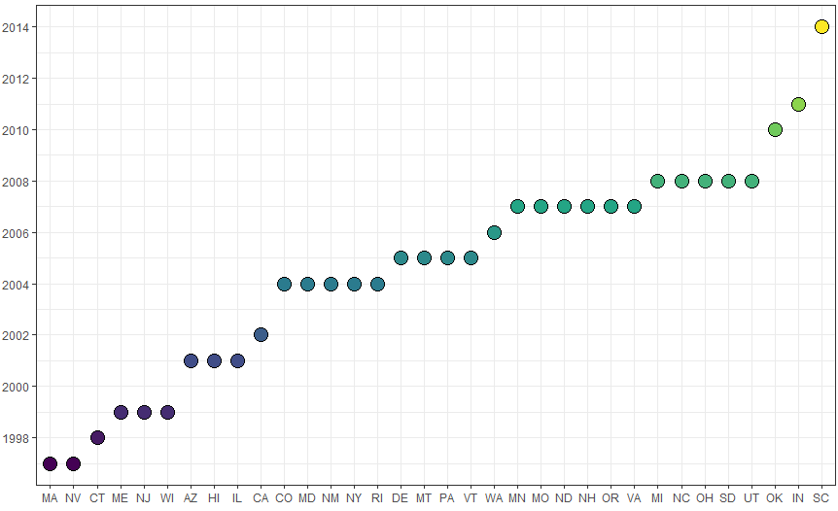
Method: DiD with Staggered Treatment
RPS states are defined as states that have passed RPS policies 1990-2018.
Our analyses exclude 4 states that had RPS between 1990-2012:
West Virginia repealed its RPS in 2015.
Iowa and Texas set RPS targets in terms of renewable capacity levels rather than % of retail electricity sales.
Kansas requires a percentage of peak electricity demand.
Treatment occurred in the RPS legislation year
34 RPS states
12 Control states

Slide 10
Method: Documenting discrepancy in policy design
Voluntary Goal: States set a voluntary renewable/clean energy goal instead of a mandatory standard.
Excluded Sales: RPS targets apply to only a subset of load serving entities (LSEs), and/or some obligated LSEs are allowed to exclude a portion of their load from determination of their annual procurement obligations.
Credit Multipliers: Many states allow the use of credit multipliers for certain types of resources and/or allow demand-side management resources to contribute to some portion of the RPS.
Carbon Exemption: States allow carbon-emitting technologies to be counted as “renewable” energy

Slide 11
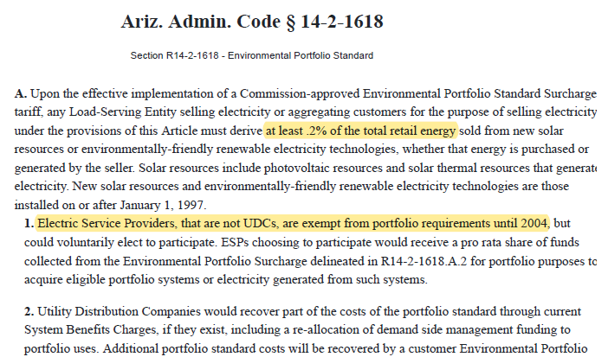
“Excluded Sales” example: Arizona (2001)

Slide 12
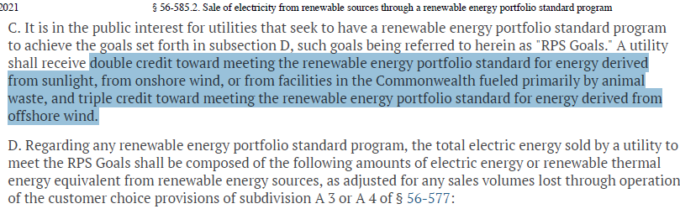
“Credit Multipliers” example: Virginia (2007)

Slide 13
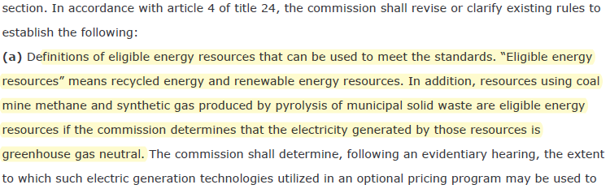
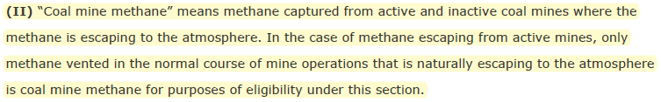
“Carbon Exemption” example: Colorado (2004)

Slide 14
Method: Creating the RPS Statues Database
We collect all RPS laws passed until 2018
Record the nominal goal and the target year
Quantify the minimum amount of renewable energy needed to achieve the nominal goal
Subtract four types of discrepancies from the nominal goal
Resulting in the binding minimum metric

Slide 15
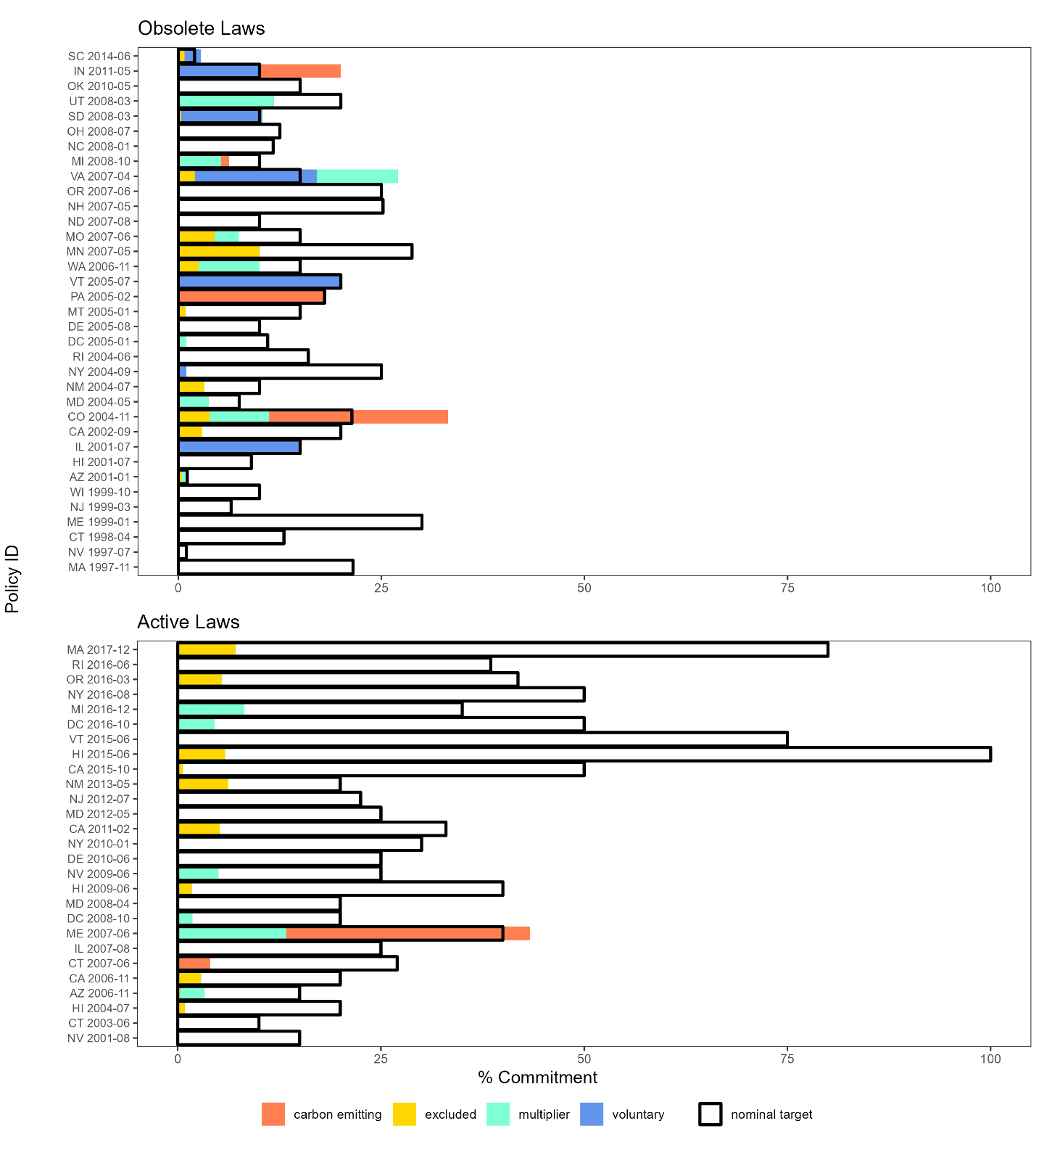

Slide 16
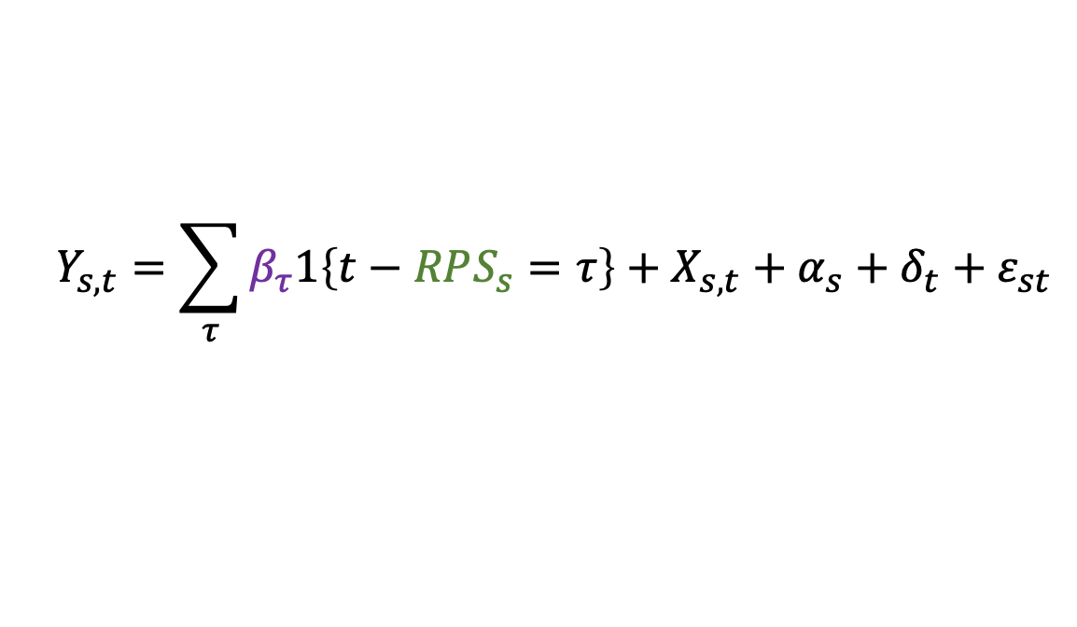
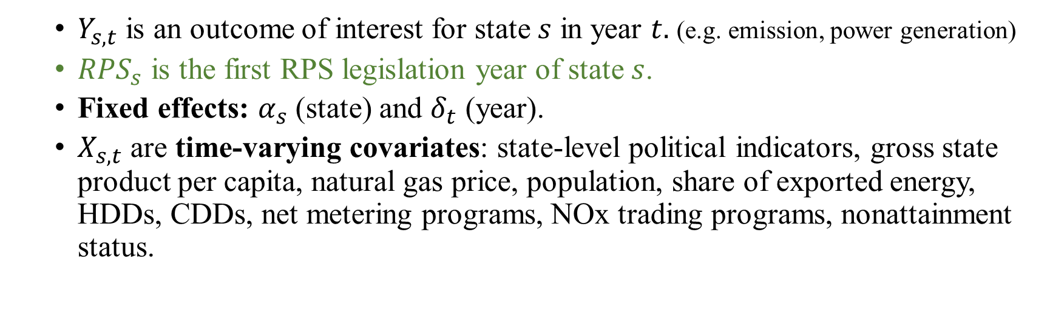
Empirical Strategy: Difference-in-Differences
$$Y_{s,t}=\sum_{τ}{β_{τ}1\left\{t−RPS_{s}=τ\right\}+X_{s,t}+α_{s}+δ_{t}+ε_{st}}$$
$Y_{s,t}$ is an outcome of interest for state $s$ in year $t.$ (e.g. emission, power generation)
$RPS_{s}$ is the first RPS legislation year of state $s$.
Fixed effects: $α_{s}$ (state) and $δ_{t}$ (year).
$X_{s,t}$ are time-varying covariates: state-level political indicators, gross state product per capita, natural gas price, population, share of exported energy, HDDs, CDDs, net metering programs, NOx trading programs, nonattainment status.

Slide 17
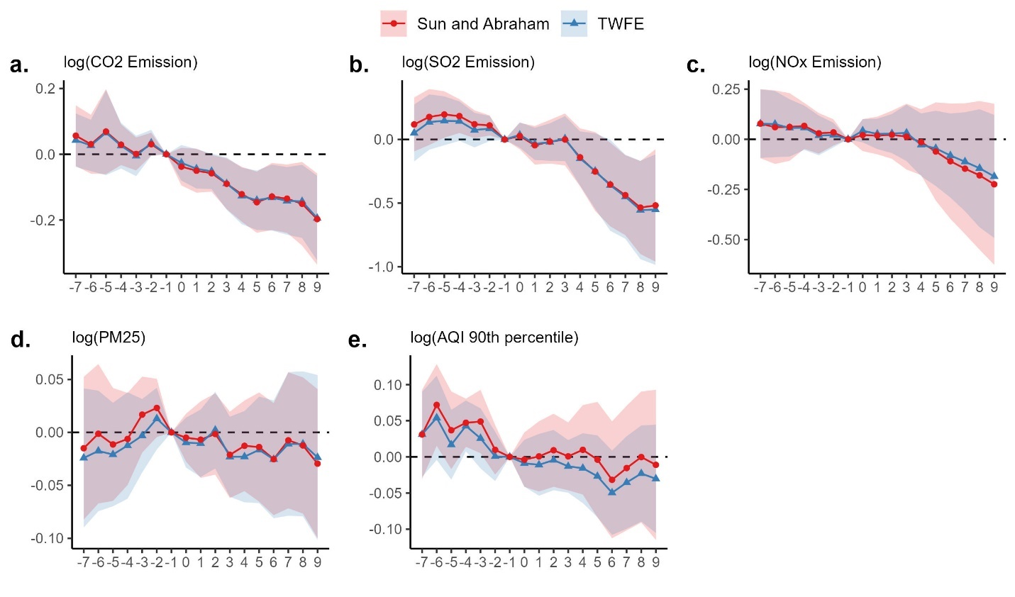
Two types of DD estimators are presented in the figure: (1) TWFE, two-way fixed effects estimated by OLS and (2) the robust DiD estimator proposed by Sun and Abraham (2021).

Slide 18
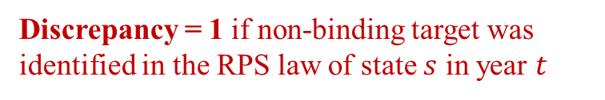
Impact of Policy Stringency in RPS Policy Design
Treatment effect of stringent RPS policy
Difference in the dynamic treatment effect due to existence of non-stringent policy design.
$$Y_{s,t}=\sum_{τ}{\left(β_{τ}+γ_{τ}×Discrepancy_{st})⋅1\left\{t−RPS_{s}=τ\right\}\right.}+X_{s,t}+α_{s}+δ_{t}+ε_{st}$$
Discrepancy = 1 if non-binding target was identified in the RPS law of state $s$ in year $t$
Discrepancy is due to any of the 4 policy designs: (1) voluntary commitment, (2) excluded sales, (3) credit multiplier, (4) carbon exemption

Slide 19
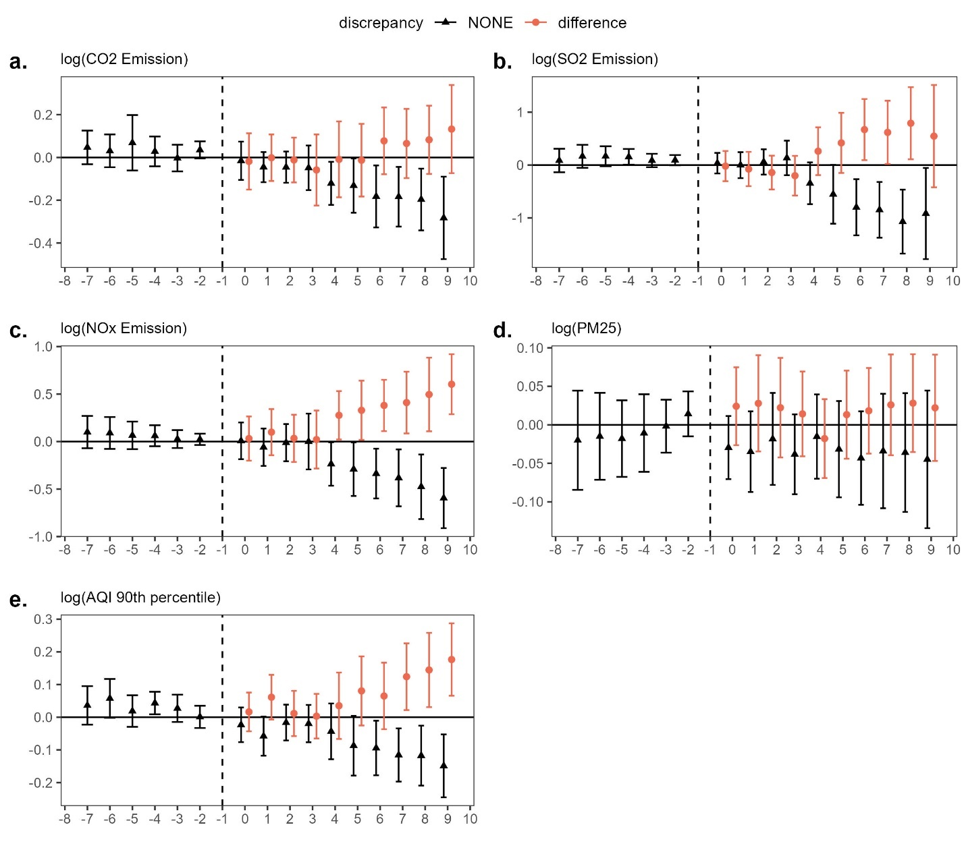
Difference in the dynamic treatment effect due to existence of non-stringent policy design.

Slide 20
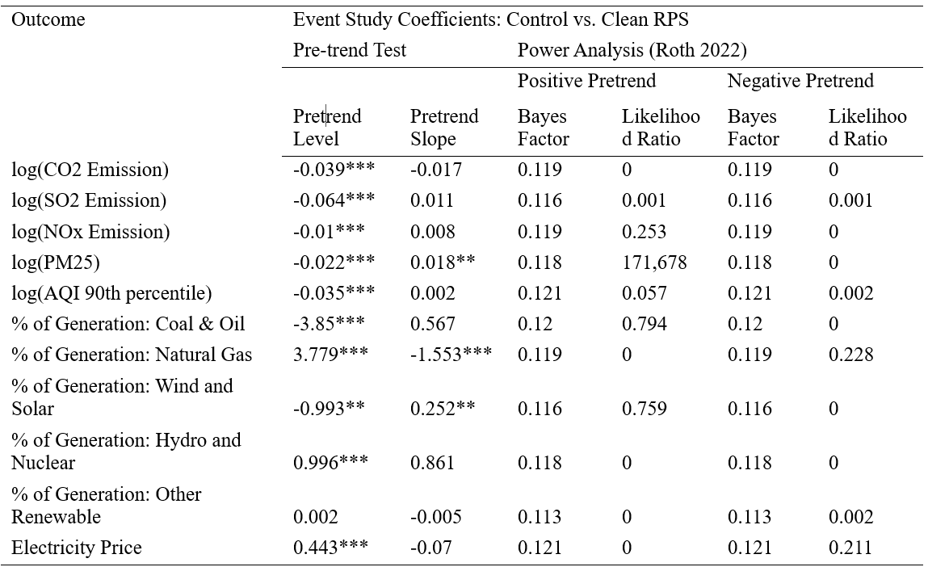
Pretrend check: clean vs. discrepant RPS (Roth 2022)

Slide 21
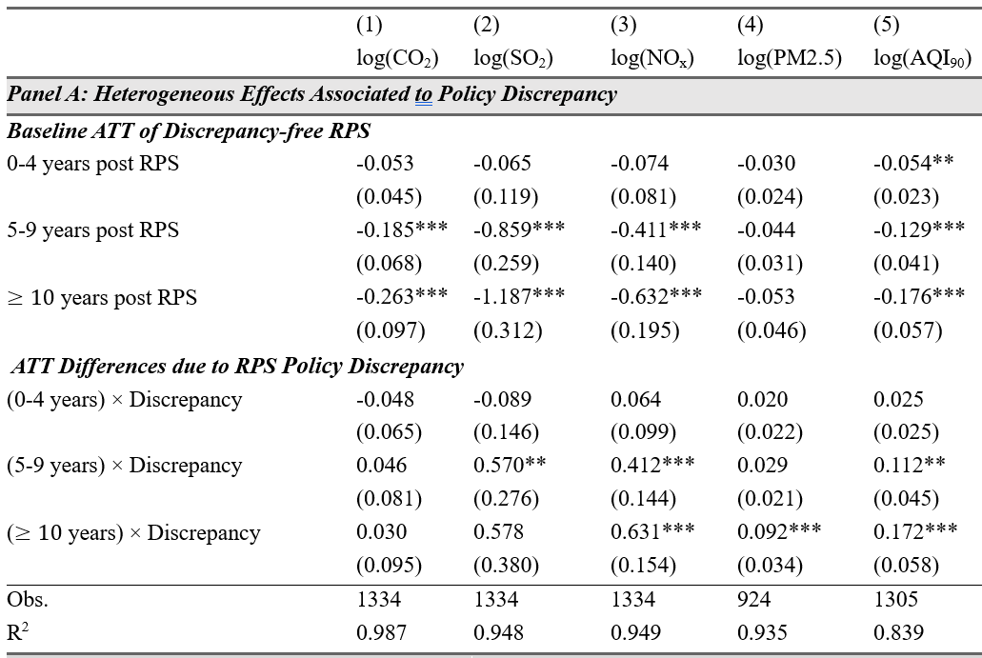
Impact of RPS Discrepancy on emission
For clean RPS laws, in the medium run (5-9 years):
CO₂ decreases by 16.9%
SO₂ decreases by 57.6%
NO_{x} decreases by 33.7%
AQI90 decreases by 12.1%
For dirty RPS laws:
CO₂ decreases by 12.5%
SO₂ decreases by 25.1%
NO_{x} decreases by 0.1%
AQI90 decrease by 1.7%
Standard errors are clustered at the state level. ***, **, * indicate statistical significance at 1%, 5% and 10%, respectively.

Slide 22
Monetizing air quality co-benefits
Medium-run estimate on foregone pollution reduction: 43.4% SO₂, 33.6% NO_{x} emission
Need an integrated assessment model that handles (1) pollution transport; (2) population exposure
EPA’s CO-Benefits Risk Assessment (COBRA) tool：
Integrates a pollutant fate and transport model with monetized exposure estimates;
Allows counterfactual analysis at the state/sector level
Results driven by SO₂ (precursor for O₃) and NO_{x} (precursor for PM_{2.5} and O₃)

Slide 23
Monetized benefit
Monetized foregone co-benefits due to discrepancy: $12-22 billion in 2016
Had the 22 discrepant states would have adopted clean RPS policy
Foregone benefits cluster around population centers in Northeast and Midwest
Large policy spillover: more than half of the foregone benefits come from out of state
Actual benefits from RPS: $17-34 billion
Some benchmark numbers:
Cost of compliance: $3-30 billion annually
Benefits from decarbonization: $33 billion using SSC=$185/ton CO₂

Slide 24
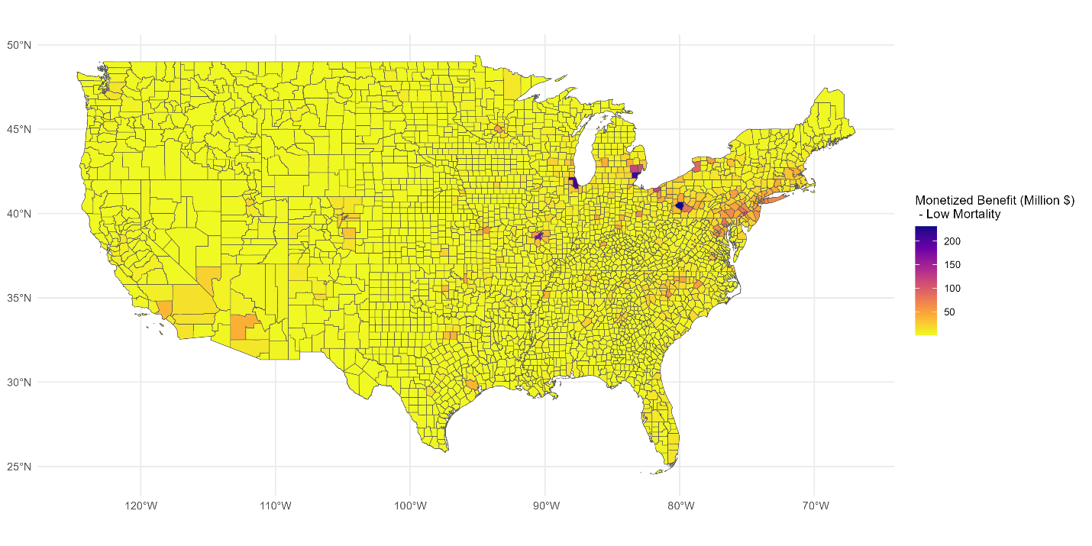

Slide 25
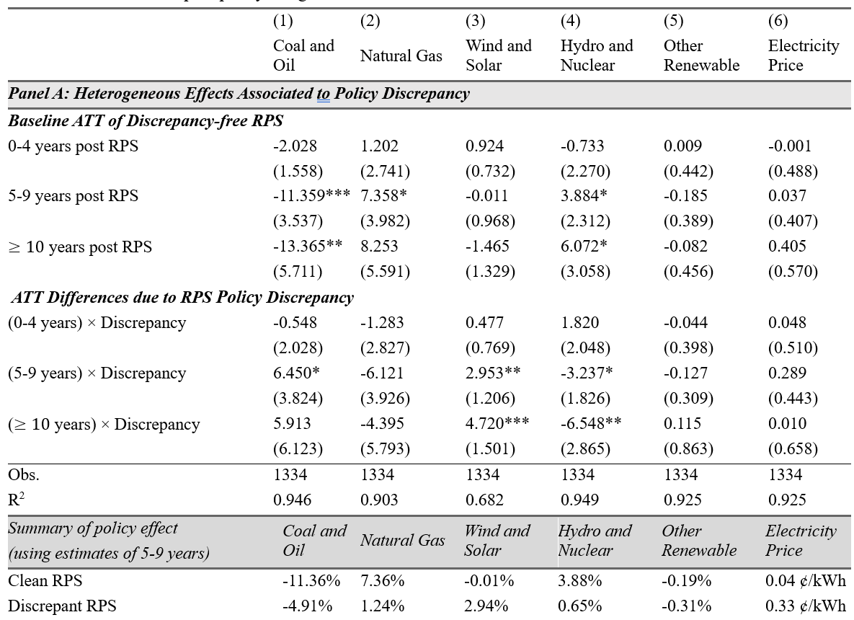
What is driving the observed divergence?
Standard errors are clustered at the state level. ***, **, * indicate statistical significance at 1%, 5% and 10%, respectively.

Slide 26
RPS discrepancy due to “excluded sales” is most influential
Standard errors are clustered at the state level. ***, **, * indicate statistical significance at 1%, 5% and 10%, respectively.
Excluded Sales: RPS targets apply to only a subset of load serving entities (LSEs), and/or some obligated LSEs are allowed to exclude a portion of their load from determination of their annual procurement obligations.
Voluntary Goal: States set a voluntary renewable/clean energy goal instead of a mandatory standard.
Credit Multipliers: Many states allow the use of credit multipliers for certain types of resources and/or allow demand-side management resources to contribute to some portion of the RPS.
Carbon Exemption: States allow carbon-emitting technologies to be counted as “renewable” energy

Slide 27
Conclusions
Stringency of the law could substantially affect the RPS policy outcomes → foregone co-benefits.
Discrepancies in RPS laws in general undermine the intended RPS policy effects.
Less reduction in non-CO2 pollutants (SO2, NOx)
Less improvement in air quality
Smaller cuts in coal & oil generation
Lower growth in natural gas
Less generation from hydro & nuclear, but more generation from wind.
The discrepancy policy design in “excluded sales” is most influential in altering the RPS effects.

Slide 28
Supplementary Slides

Slide 29
Contributions to Literature
On causal identification of the heterogenous impacts of RPS
Previous studies mostly focused on impacts of renewable adoption, GHG emission, and price effects (Upton and Snyder 2015; Carley et al. 2018; Greenstone and Nath, 2021, etc.)
We document the heterogenous environmental impact of RPS (Hollingsworth and Rudik, 2019)
Environmental federalism and policy stringency
We document the performance gap in policy design heterogeneity in RPS (Lyon and Yin 2010; Carley et al. 2012, 2018; Hong et al. 2023)
Compliment studies on hazardous wastes (Soberg and Xu 2018; Blundell et al. 2021); wetlands (Keiser et al. 2022; Aronoff and Rafey 2023); pollution monitoring and enforcement (Zhang 2018)
Co-benefits and unintended consequences of environmental policy
We document large non-carbon co-benefits generated from a renewable energy policy
Literature on co-benefits of sulfur cap-and-trade (Stavin and Schmalensee 2013); non-point-source water pollution (Keiser et al. 2019; Weng et al. 2023);

Slide 30
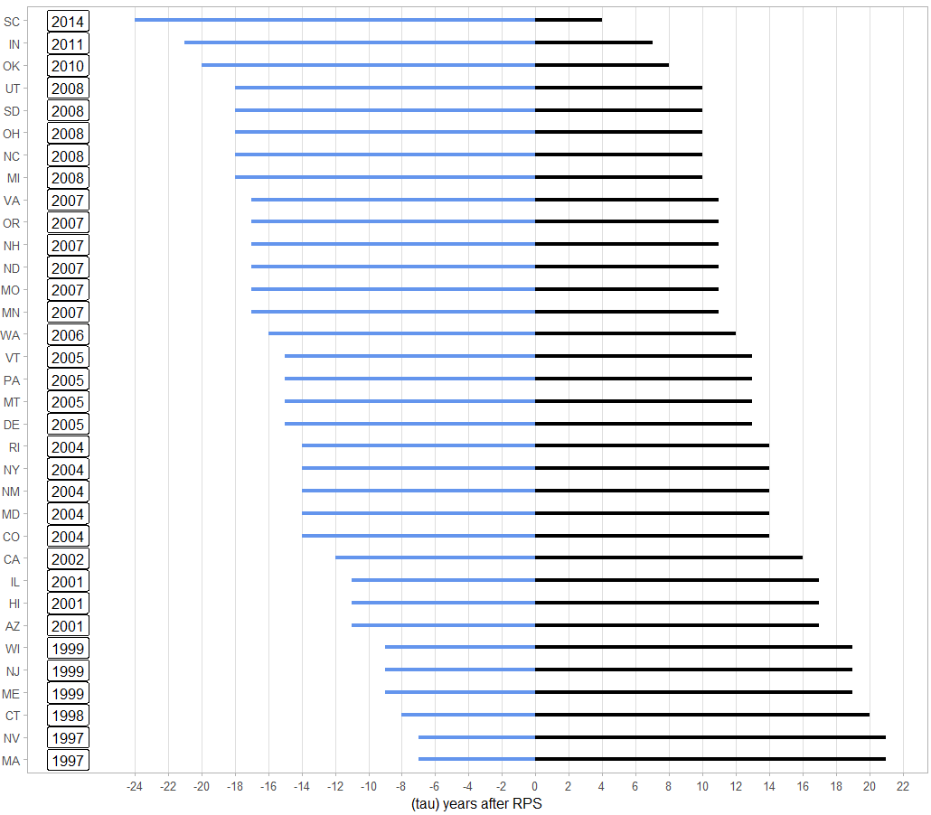
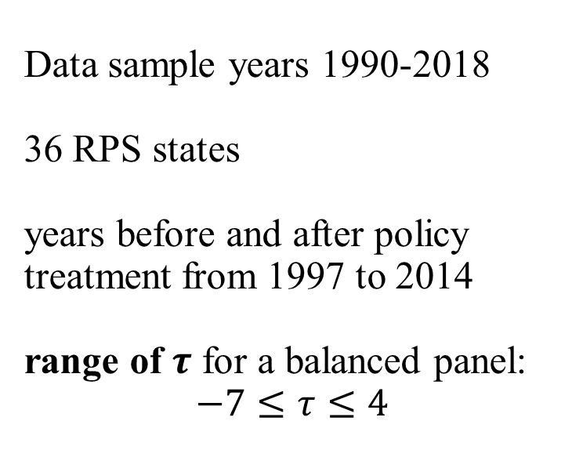
Data sample years 1990-2018 36 RPS states years before and after policy treatment from 1997 to 2014 range of $τ$ for a balanced panel: $$−7≤τ≤4$$

Slide 31
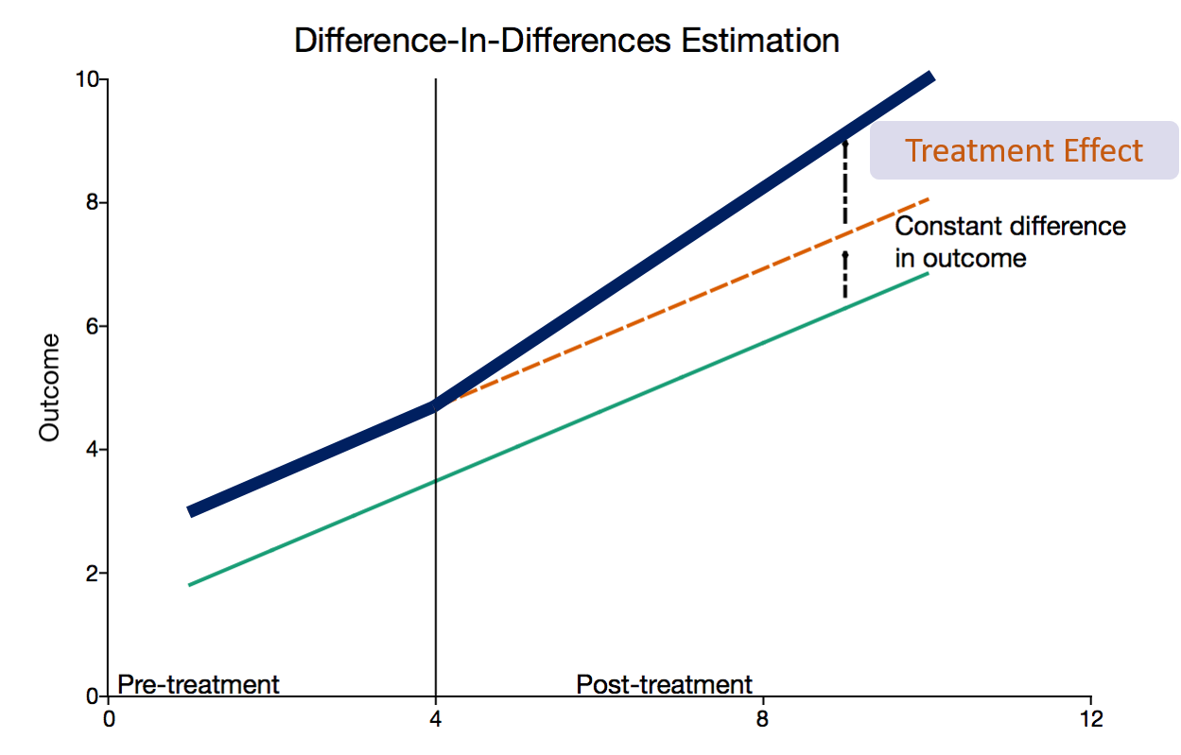
Difference-in-Differences to identify policy effect
Source: https://www.aptech.com/blog/introduction-to-difference-in-differences-estimation/

Slide 32
Panel A: Outcome Variables
 | RPS states |  |  | Control states
 | N | Mean (std dev) | Min-Max | N | Mean (std dev) | Min-Max
CO2 (1000 metric tons) | 957 | 37463.239 (32870.971) | 6.583 – 133416.545 | 377 | 46490.424 (32388.933) | 438.133 – 131543.37
SO2 (1000 metric tons) | 957 | 164.228 (283.856) | 0.009 – 2045.983 | 377 | 201.061 (224.377) | 2.559 – 892.347
NOx (1000 metric tons) | 957 | 78.616 (92.709) | 0.148 – 535.619 | 377 | 95.194 (87.313) | 1.931 – 353.547
Share of Polluted Days | 957 | 0.051 (0.056) | 0.000 – 0.369 | 348 | 0.033 (0.037) | 0.000 – 0.194
% of Generation: Coal and Oil | 957 | 46.141 (30.604) | 0.033 – 96.964 | 377 | 47.48 (27.229) | 0.112 – 97.564
% of Generation: Natural Gas | 957 | 18.866 (22.573) | 0.000 – 98.944 | 377 | 19.664 (21.824) | 0.028 – 79.666
% of Generation: Wind | 957 | 1.910 (4.551) | 0.000 – 32.230 | 377 | 0.815 (2.803) | 0.000 – 18.478
% of Generation: Solar | 957 | 0.239 (1.105) | 0.000 – 13.806 | 377 | 0.039 (0.248) | 0.000 – 3.059
% of Generation: Other Renewables | 957 | 14.663 (20.977) | 0.000 – 91.360 | 377 | 13.004 (21.678) | 1.258 – 98.284
Electricity Price (cents per kWh, 2015 USD) | 957 | 10.510 (3.563) | 5.098 – 34.040 | 377 | 8.442 (2.291) | 5.099 – 17.726

Slide 33
Panel B: State-level Time-varying Covariates
 | RPS states |  |  | Control states
 | N | Mean (std dev) | Min-Max | N | Mean (std dev) | Min-Max
Legislature control (DEM) | 957 | 0.417 (0.493) | 0 – 1 | 377 | 0.337 (0.473) | 0 – 1
Legislature control (GOP) | 957 | 0.336 (0.473) | 0 – 1 | 377 | 0.451 (0.498) | 0 – 1
State control (DEM) | 957 | 0.229 (0.42) | 0 – 1 | 377 | 0.172 (0.378) | 0 – 1
State control (GOP) | 957 | 0.231 (0.422) | 0 – 1 | 377 | 0.334 (0.472) | 0 – 1
Governing party (DEM) | 957 | 0.486 (0.495) | 0 – 1 | 377 | 0.377 (0.48) | 0 – 1
Log(Gross State Product) | 957 | 11.854 (1.139) | 9.351 – 14.817 | 377 | 11.546 (0.923) | 9.45 –13.737
Natural Gas Price ($ per 1000 ft3) | 957 | 6.126 (3.017) | 2.005 –32.39 | 377 | 5.433 (2.129) | 0.479 –11.428
Log(Population) | 957 | 15.132 (1.036) | 13.244 –17.491 | 377 | 14.931 (0.942) | 13.025 –16.872
Net Metering Program | 957 | 0.639 (0.48) | 0 – 1 | 377 | 0.342 (0.475) | 0 – 1
% of Energy Exported | 957 | 0.089 (0.447) | -0.840 – 2.737 | 377 | 0.169 (0.576) | -0.636 – 2.607
HDDs | 957 | 5642.92 (2019.611) | 0 – 10810 | 377 | 4317.859 (2757.045) | 430 – 11702
CDDs | 957 | 935.448 (896.818) | 42 – 5213 | 377 | 1550.968 (963.582) | 0 – 4156
NOx Trading Program | 957 | 0.088 (0.283) | 0 – 1 | 377 | 0.064 (0.244) | 0 – 1

Slide 34
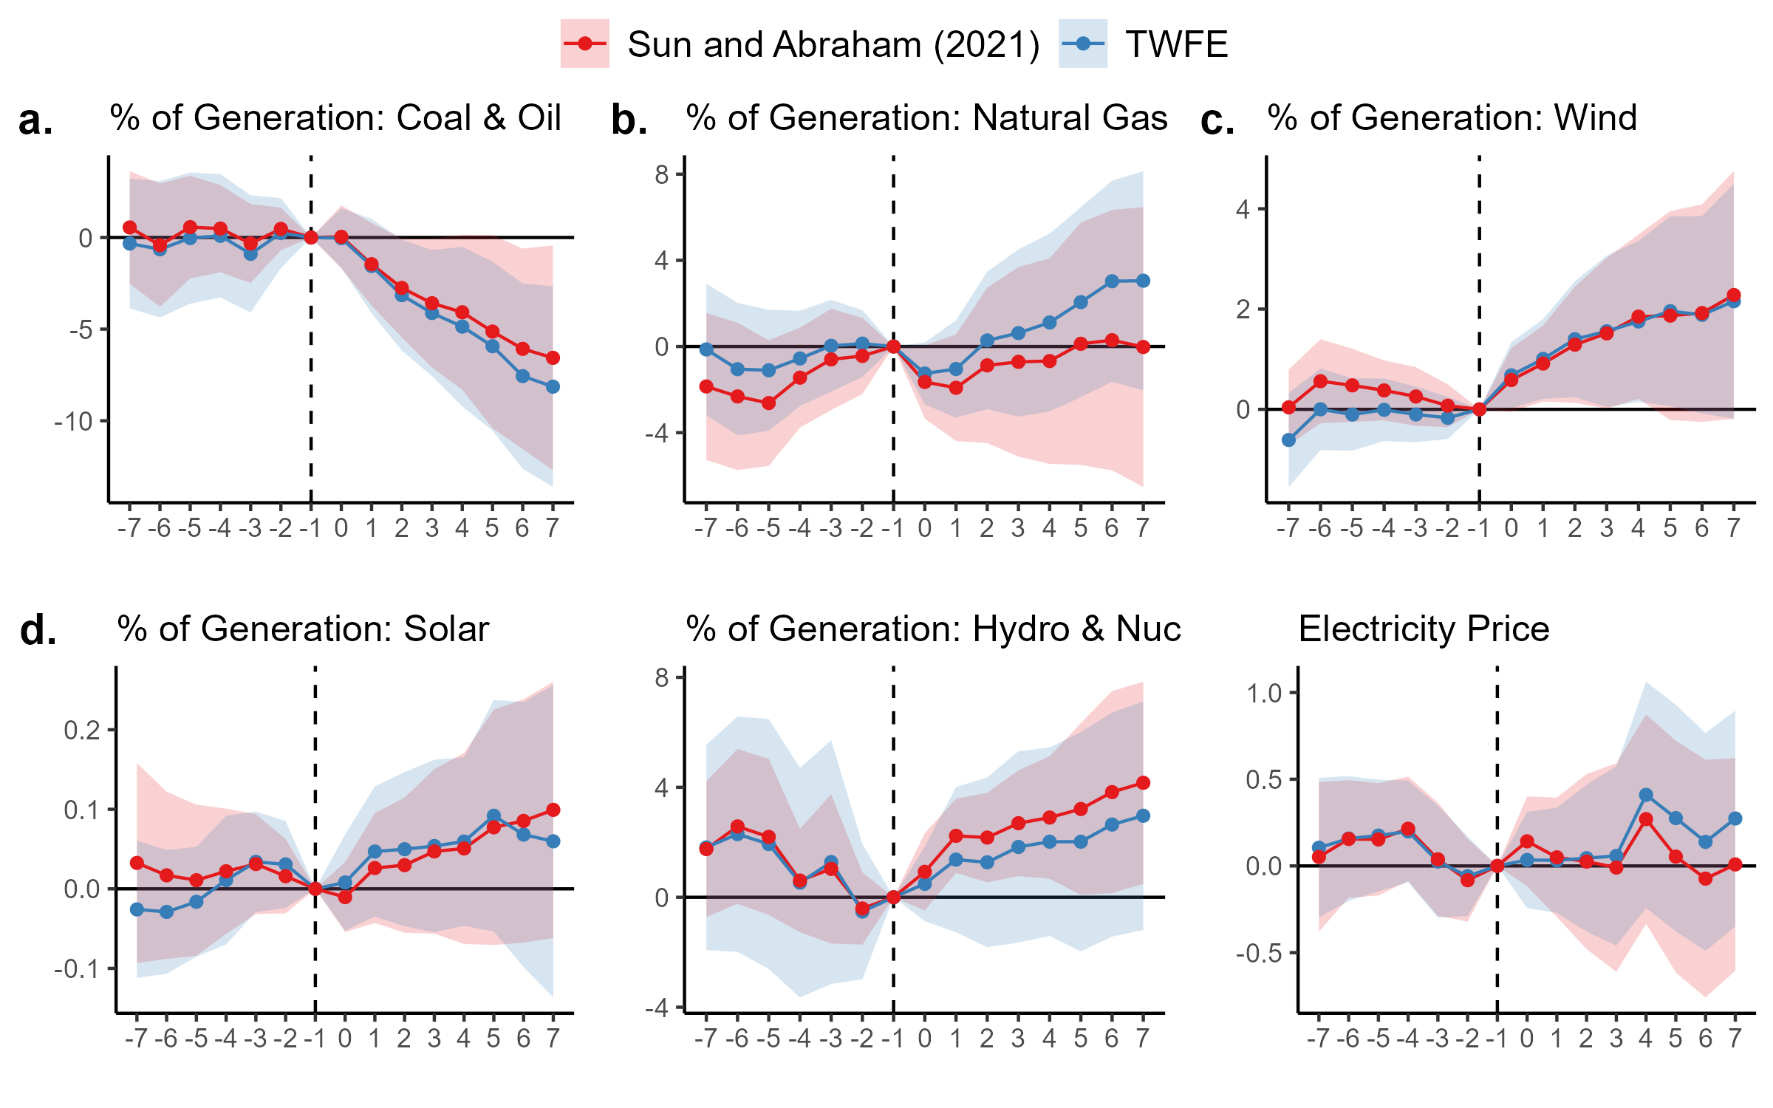

Slide 35
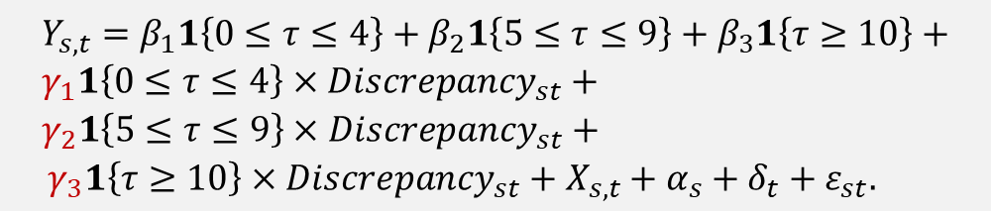
Impact of RPS Discrepancy: 5-year average
Following Greenstone and Nath (2022), we estimate the dynamic treatment effects summarized into 5-year periods: short-run (0-4 years), medium-run (5-9 years), long-run (>10 years).
Partially guided by the event study graph
RPS targets usually become tighter over time, some with built-in soft checks (Deschenes et al. 2023)
30% renewable by 2030. Interim goal of 15% by 2015, 18% by 2018, etc.
$$Y_{s,t}=β_{1}1\left\{0≤τ≤4\right\}+β_{2}1\left\{5≤τ≤9\right\}+β_{3}1\left\{τ≥10\right\}+ \\ γ_{1}1\left\{0≤τ≤4\right\}×Discrepancy_{st}+ \\ γ_{2}1\left\{5≤τ≤9\right\}×Discrepancy_{st}+$$ ${ γ}_{3}1\left\{τ≥10\right\}×Discrepancy_{st}+X_{s,t}+α_{s}+δ_{t}+ε_{st}.$

Slide 36
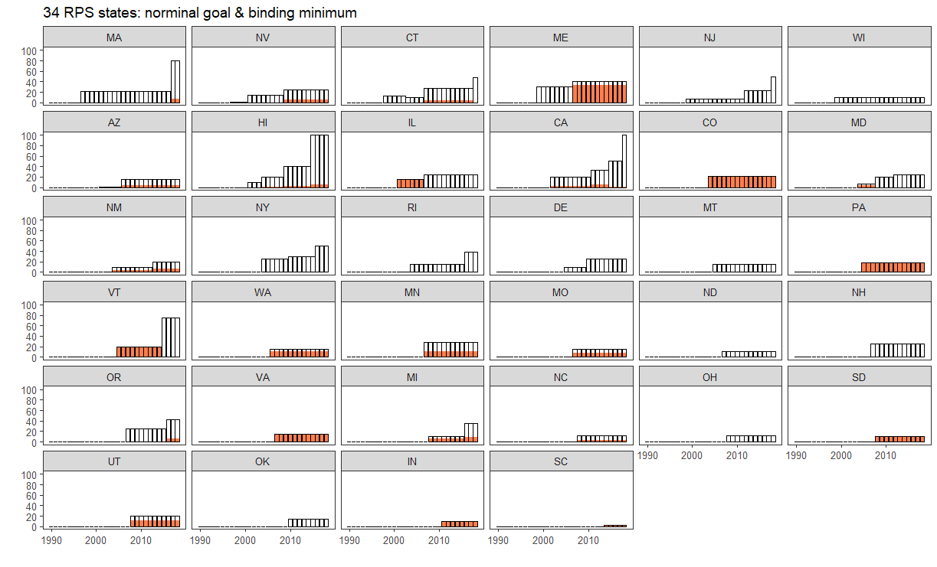
Binary “discrepancy” variable: binding minimum < nominal goal

Slide 37
Example
Arizona has discrepant RPS laws passed in 2001 and 2006
Counterfactual prediction: Clean RPS laws would have led to
44.6% lower SO₂ emission from electricity generation
33.1% lower NO₂ emission
With a 3% discount rate, this would lead to $171-385 million of foregone environmental co-benefit
Mostly from cost of mortality: $167-380 million

Slide 38
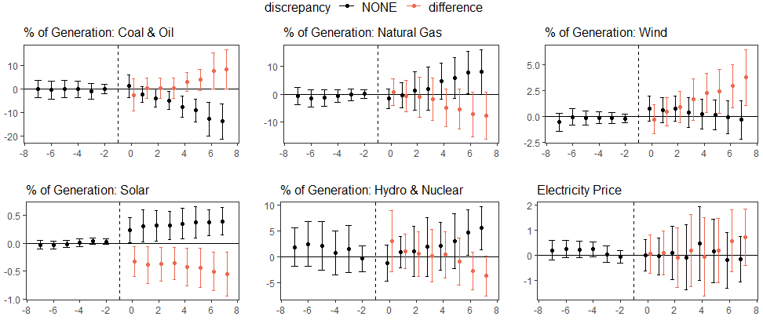
Difference in the dynamic treatment effect due to existence of non-stringent policy design.

Slide 39
What is driving the observed divergence?
Clean RPS laws lead to:
Quick transition away from coal and oil generation
Driving the environmental performance of the clean RPS laws
Partially compensated by faster growth in natural gas generation
Dirty RPS laws:
Slower transition away from coal and oil generation (but still faster than non-RPS states)
Small increase in wind generation

Slide 40
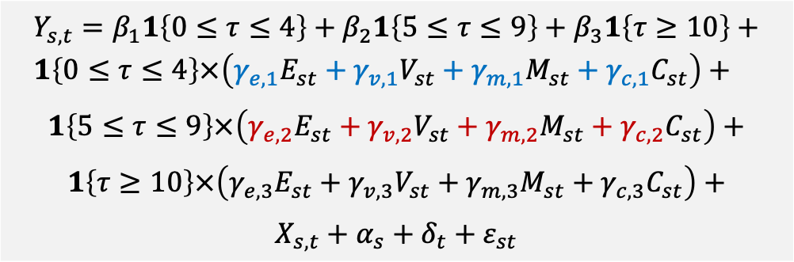
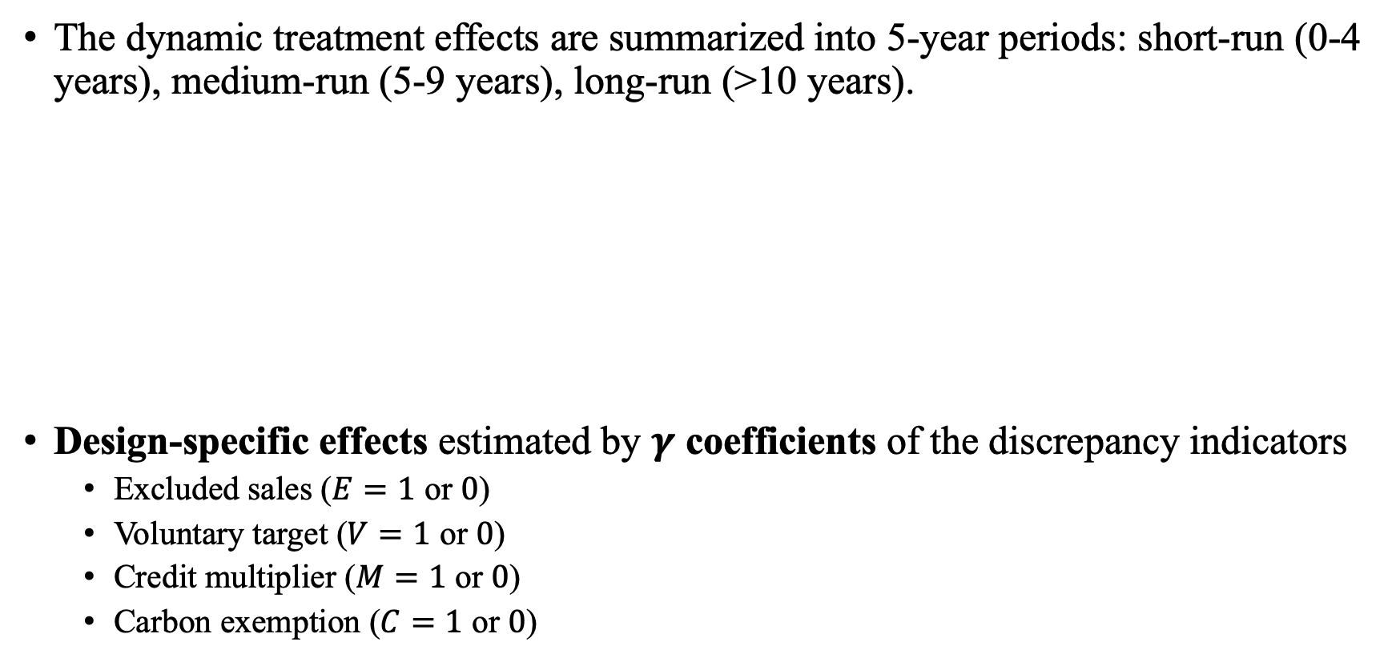
Decomposing “policy design” effect through 4 types of discrepancies
The dynamic treatment effects are summarized into 5-year periods: short-run (0-4 years), medium-run (5-9 years), long-run (>10 years).
Design-specific effects estimated by $γ$ coefficients of the discrepancy indicators
Excluded sales ($E=1$ or $0$)
Voluntary target ($V=1$ or $0$)
Credit multiplier ($M=1$ or $0$)
Carbon exemption ($C=1$ or $0$)
$$Y_{s,t}=β_{1}1\left\{0≤τ≤4\right\}+β_{2}1\left\{5≤τ≤9\right\}+β_{3}1\left\{τ≥10\right\}+ \\ 1\left\{0≤τ≤4\right\}×\left(γ_{e,1}E_{st}+γ_{v,1}V_{st}+γ_{m,1}M_{st}+γ_{c,1}C_{st}\right)+$$
$$1\left\{5≤τ≤9\right\}×\left(γ_{e,2}E_{st}+γ_{v,2}V_{st}+γ_{m,2}M_{st}+γ_{c,2}C_{st}\right)+$$
$$1\left\{τ≥10\right\}×\left(γ_{e,3}E_{st}+γ_{v,3}V_{st}+γ_{m,3}M_{st}+γ_{c,3}C_{st}\right)+$$
$$X_{s,t}+α_{s}+δ_{t}+ε_{st}$$

