Slide 1
Cleaner bills, cleaner air: the environmental consequence of Renewable Portfolio Standards (RPS) policy design
Xinde James Ji, University of Florida
Qingran Li, Clarkson University
Filippo Mavrothalassitis, Yale University
Max Luke, National Economic Research Associates

Slide 2
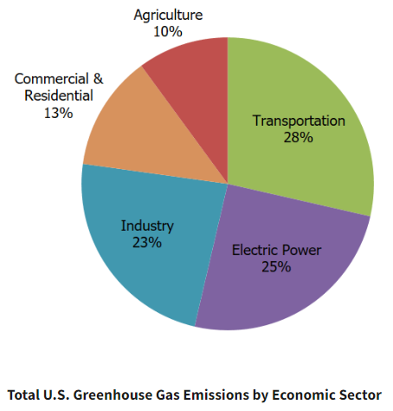
Motivation to study RPS policies
Climate change is one of the most important challenges facing our future
The US lacks a federal overarching climate policy (e.g. carbon tax) and instead implements sector-wise policies
Transportation: CAFE standards, LCFS
Buildings: energy efficiency policies, e.g. building codes, appliance standards
Power: Renewable Portfolio Standards (RPS)
The power sector decarbonization is essential for low-carbon economy.
25% of GHG emissions in 2021 (down from 32% in 2001)
Integrated with other sectors through electrifications (EVs, heating)
Source: EPA (2021) https://www.epa.gov/ghgemissions/sources-greenhouse-gas-emissions

Slide 3
What is Renewable Portfolio Standards (RPS)?
RPS is a state-level policy requiring a specific percentage of electricity sales from renewable resources
36 states + DC have passed RPS policies as of 2021

Slide 4
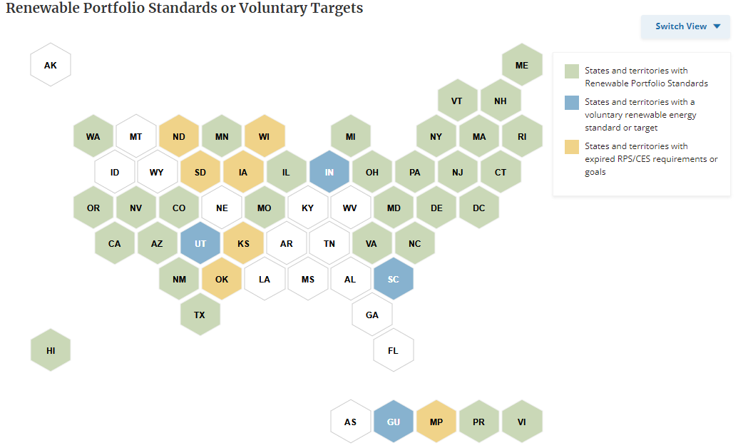
RPS policies: status quo (36 states + DC)
Source: National Conference of State Legislatures (2021). https://www.ncsl.org/energy/state-renewable-portfolio-standards-and-goals

Slide 5
What is Renewable Portfolio Standards (RPS)?
RPS is a state-level policy requiring a specific percentage of electricity sales from renewable resources
36 states + DC have passed RPS policies as of 2021
RPS vs. Clean Energy Standard (CES)
“Clean Energy” can include nuclear which is non-renewable.
This study treats them as the same policy.
Policy goals of RPS:
Energy independence/diversification
Carbon mitigation
Non-GHG pollution is NOT part of the legislative intent for most RPS

Slide 6
Empirical evidence on the impact of RPS
Recent causal evidence suggests that RPS policy:
Increases retail electricity price by 2-11% (Upton and Snyder 2015; Greenstone and Nath, 2021; Wolverton et al. 2023)
Decreases carbon emission by 10-25% (Greenstone and Nath, 2021)
RPS is relatively cost-ineffective as a climate policy: $60-300 per ton of CO2 abatement
Small increases in renewable energy deployment (Greenstone and Nath 2023; Fullerton and Ta 2022; Feldman and Levinson 2023; Deschenes et al. 2023)
Large reductions of in-state and out-of-state coal generation (Hollingsworth and Rudik 2019), with potential pollution-abatement benefits

Slide 7
Policy design matter: the role of policy stringency
RPS laws can differ widely from each other (Carley et al. 2012; Fischlein and Smith 2013; Bernstein and Hoffmann 2018; Carley et al. 2018) in a variety of ways:
Percentage requirement (nominal goal)
Design features: multipliers, exemptions, voluntary goals etc.
Limited evidence that systematically documents stringency and its impacts
Carley et al. (2018): more stringent laws lead to higher renewable adoption with a mixed quantitative-qualitative scoring system
DSIRE database (NC State): a database on RPS stringency but does not enable structured comparisons of technology types

Slide 8
What’s this study about?
Construct a new, unified metric of RPS stringency
Provide causal estimates on the heterogenous environmental effects of RPS:
Pooled together, on average RPS mildly reduces SO₂ emission and has negative but insignificant effects on NOx emission or ambient air quality
The RPS effect differs widely by policy stringency:
States with “clean” RPS laws: Large reductions in SO₂ and NO_{x} emission, improvement in ambient air quality
States with “dirty” RPS laws: No reduction in SO₂ and NO_{x} emissions or ambient air quality
Effects driven by differential shifts in generation sources
States with clean RPS laws transit away from coal faster

Slide 9
Contributions to Literature
On causal identification of the heterogenous impacts of RPS
Previous studies mostly focused on impacts of renewable adoption, GHG emission, and price effects (Upton and Snyder 2015; Carley et al. 2018; Greenstone and Nath, 2021, etc.)
We document the heterogenous environmental impact of RPS (Hollingsworth and Rudik, 2019)
Environmental federalism and policy stringency
We document the performance gap in policy design heterogeneity in RPS (Lyon and Yin 2010; Carley et al. 2012, 2018)
Compliment studies on hazardous wastes (Soberg and Xu 2018; Blundell et al. 2021); wetlands (Keiser et al. 2022; Aronoff and Rafey 2023); pollution monitoring and enforcement (Zhang 2018)
Co-benefits and unintended consequences of environmental policy
We document large non-carbon co-benefits generated from a renewable energy policy
Literature on co-benefits of sulfur cap-and-trade (Stavin and Schmalensee 2013); non-point-source water pollution (Keiser et al. 2019; Weng et al. 2023);

Slide 10
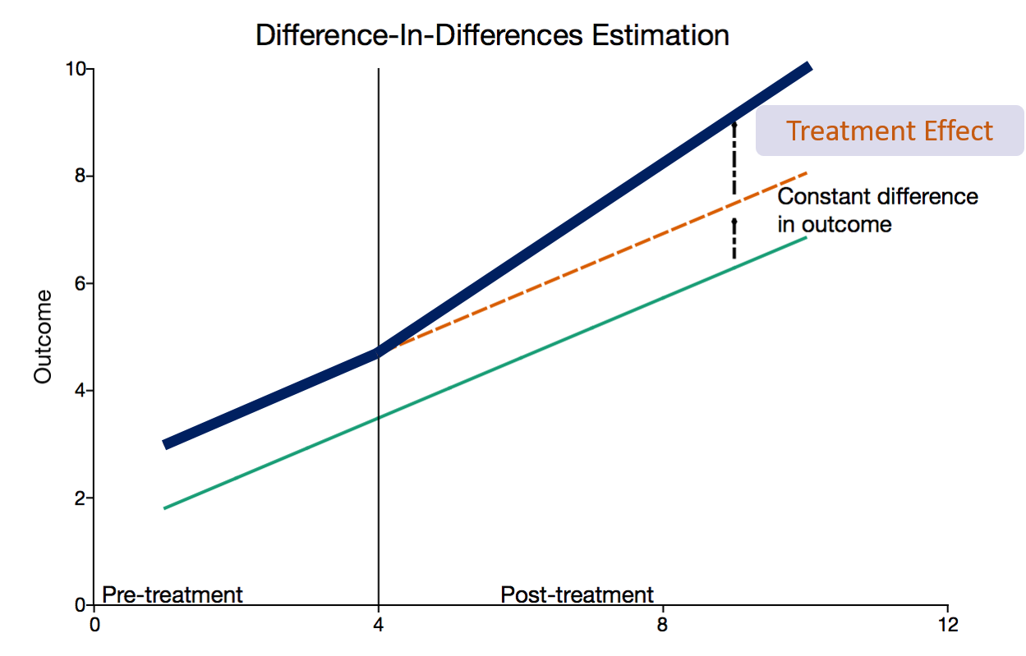
Difference-in-Differences to identify policy effect
Source: https://www.aptech.com/blog/introduction-to-difference-in-differences-estimation/

Slide 11
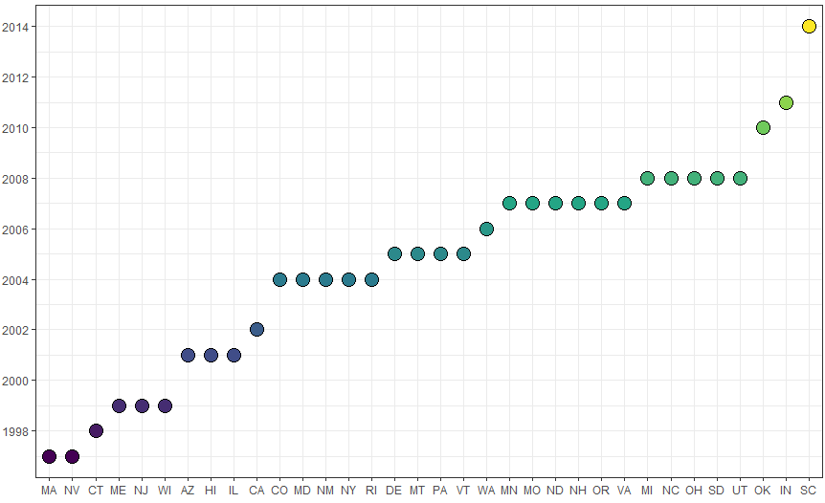
Staggered Treatment: RPS legislation years
RPS states are defined as states passed RPS policies before year 2012.
Our analyses exclude 4 states that had RPS between 1990-2012:
West Virginia repealed its RPS in 2015.
Iowa and Texas set RPS targets in terms of renewable capacity levels rather than % of retail electricity sales.
Kansas requires a percentage of peak electricity demand.

Slide 12
Policy designs affecting stringency
Voluntary Goal: States set a voluntary renewable/clean energy goal instead of a mandatory standard.
Excluded Sales: RPS targets apply to only a subset of load serving entities (LSEs), and/or some obligated LSEs are allowed to exclude a portion of their load from determination of their annual procurement obligations.
Credit Multipliers: Many states allow the use of credit multipliers for certain types of resources and/or allow demand-side management resources to contribute to some portion of the RPS.
Carbon Exemption: States allow carbon-emitting technologies to be counted as “renewable” energy.

Slide 13
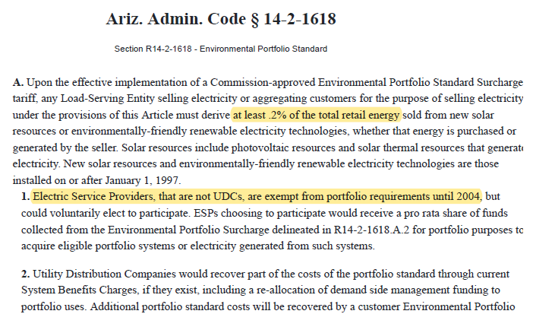
“Excluded Sales” example: AZ (2001)

Slide 14
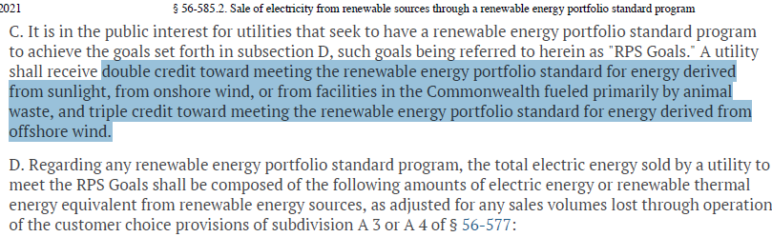
“Credit Multipliers” example: VA (2007)

Slide 15
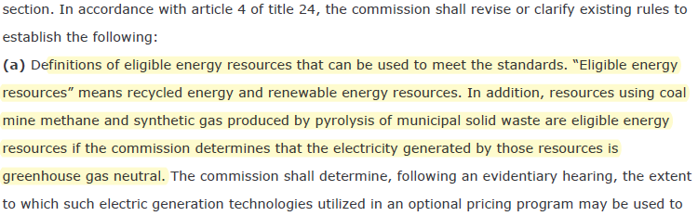
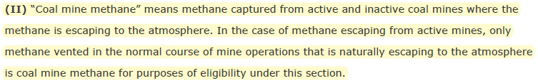
“Carbon Exemption” example: CO (2004)

Slide 16
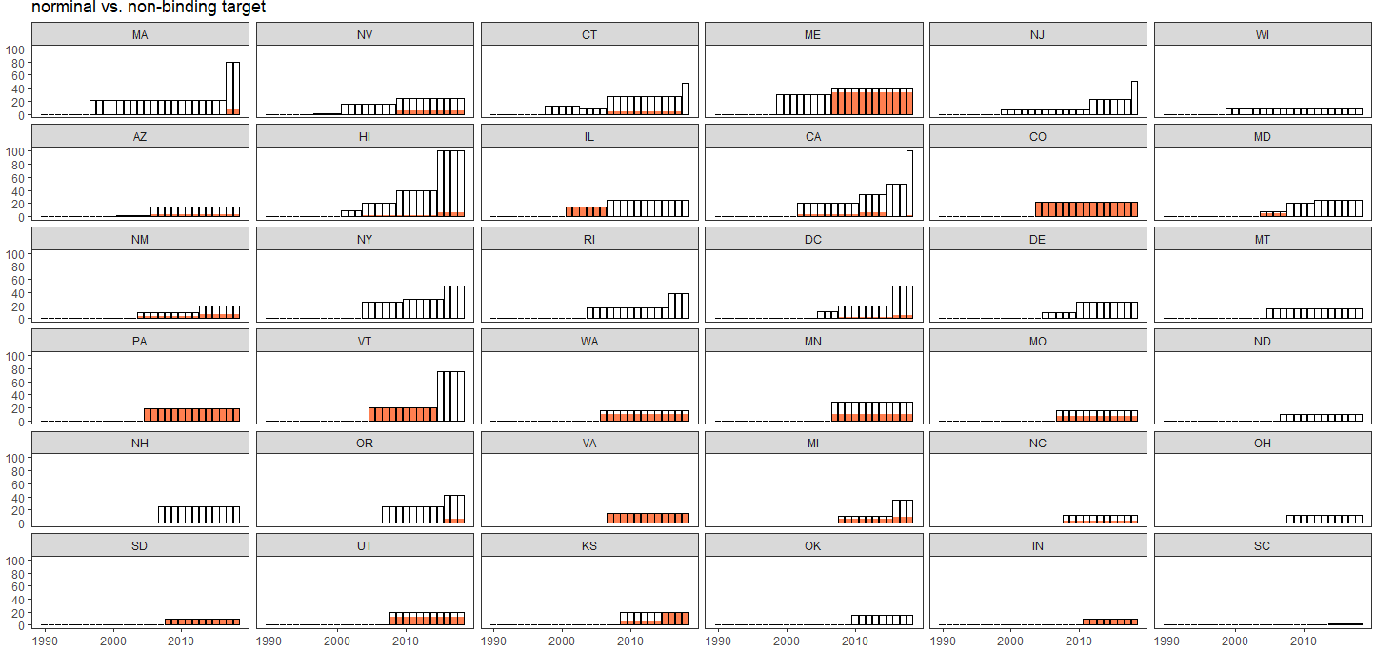
Policy discrepancy led to “non-binding” commitment

Slide 17
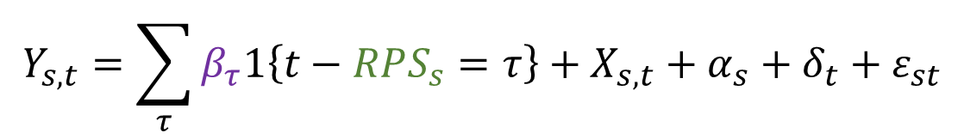
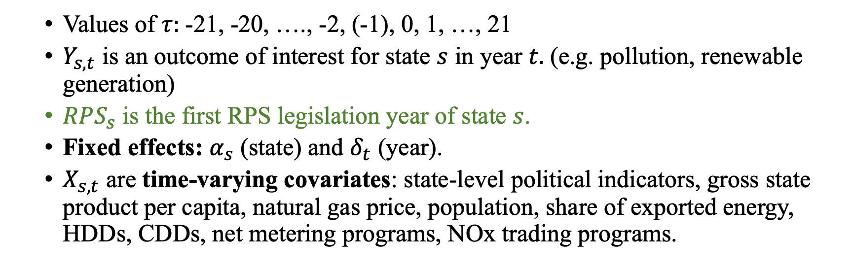
Empirical Strategy: Difference-in-Differences (DD)
$$Y_{s,t}=\sum_{τ}{β_{τ}1\left\{t−RPS_{s}=τ\right\}+X_{s,t}+α_{s}+δ_{t}+ε_{st}}$$
Values of $τ:$-21, -20, …., -2, (-1), 0, 1, …, 21
$Y_{s,t}$ is an outcome of interest for state $s$ in year $t.$ (e.g. pollution, renewable generation)
$RPS_{s}$ is the first RPS legislation year of state $s$.
Fixed effects: $α_{s}$ (state) and $δ_{t}$ (year).
$X_{s,t}$ are time-varying covariates: state-level political indicators, gross state product per capita, natural gas price, population, share of exported energy, HDDs, CDDs, net metering programs, NOx trading programs.

Slide 18
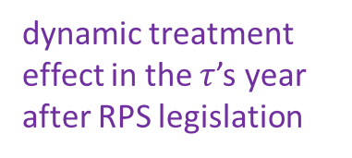
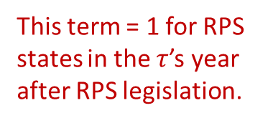
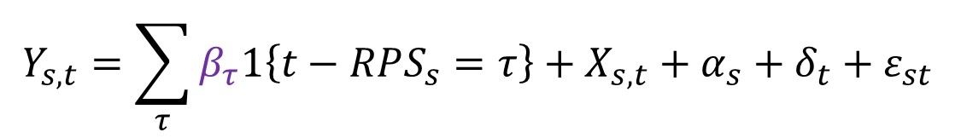
Empirical Strategy: Difference-in-Differences (DD)
This event-study specification can
estimate the longer-term patterns of policy treatment effect;
validate the parallel trend assumption for unbiased DD estimators.
$$Y_{s,t}=\sum_{τ}{β_{τ}1\left\{t−RPS_{s}=τ\right\}+X_{s,t}+α_{s}+δ_{t}+ε_{st}}$$
This term = 1 for RPS states in the $τ$’s year after RPS legislation.
dynamic treatment effect in the $τ$’s year after RPS legislation

Slide 19
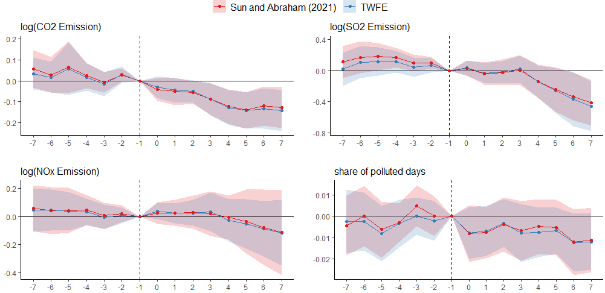
No significant differences in pre-trends between RPS and control states in the pollution outcomes.
Two types of DD estimators are presented in the figure: (1) TWFE, two-way fixed effects estimated by OLS and (2) the robust DD estimator proposed by Sun and Abraham (2021).

Slide 20
RPS policies lead to significant drop (> 10%) in CO2 emission starting ~3 years after legislation.
Two types of DD estimators are presented in the figure: (1) TWFE, two-way fixed effects estimated by OLS and (2) the robust DD estimator proposed by Sun and Abraham (2021).

Slide 21
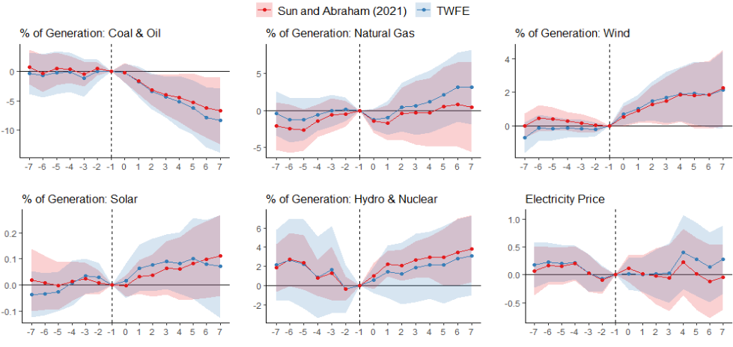
Dynamic effects in the power sector variables

Slide 22
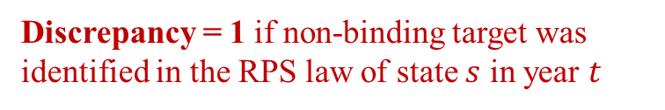
Impact of Policy Stringency in RPS Policy Design
Treatment effect of stringent RPS policy
Difference in the dynamic treatment effect due to existence of non-stringent policy design.
$$Y_{s,t}=\sum_{τ}{\left(β_{τ}+γ_{τ}×Discrepancy_{st})⋅1\left\{t−RPS_{s}=τ\right\}\right.}+X_{s,t}+α_{s}+δ_{t}+ε_{st}$$
Discrepancy = 1 if non-binding target was identified in the RPS law of state $s$ in year $t$
Discrepancy is due to any of the 4 policy designs: (1) voluntary commitment, (2) excluded sales, (3) credit multiplier, (4) carbon exemption

Slide 23
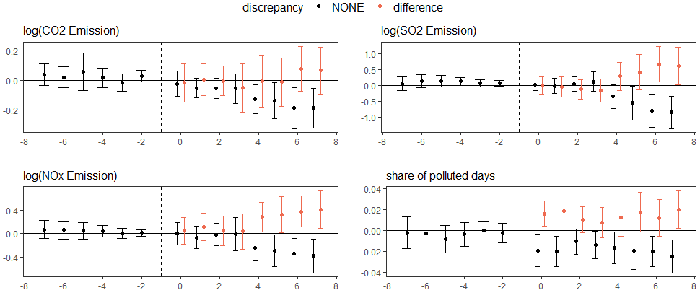
Difference in the dynamic treatment effect due to existence of non-stringent policy design.

Slide 24
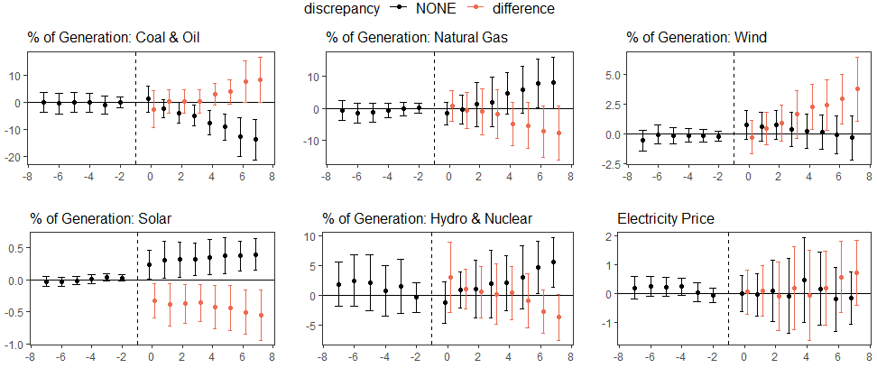
Difference in the dynamic treatment effect due to existence of non-stringent policy design.

Slide 25
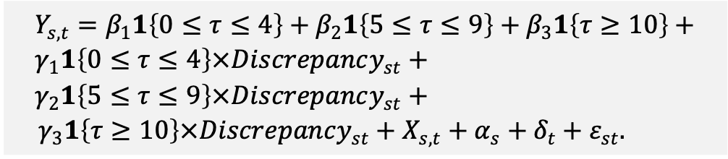
Impact of RPS Discrepancy
Following Greenstone and Nath (2022), we estimate the dynamic treatment effects summarized into 5-year periods: short-run (0-4 years), medium-run (5-9 years), long-run (>10 years).
Partially guided by the event study graph
RPS targets usually become tighter over time, some with built-in soft checks (Deschenes et al. 2023)
30% renewable by 2030. Interim goal of 15% by 2015, 18% by 2018, etc.
$$Y_{s,t}=β_{1}1\left\{0≤τ≤4\right\}+β_{2}1\left\{5≤τ≤9\right\}+β_{3}1\left\{τ≥10\right\}+ \\ γ_{1}1\left\{0≤τ≤4\right\}×Discrepancy_{st}+ \\ γ_{2}1\left\{5≤τ≤9\right\}×Discrepancy_{st}+$$ ${ γ}_{3}1\left\{τ≥10\right\}×Discrepancy_{st}+X_{s,t}+α_{s}+δ_{t}+ε_{st}.$

Slide 26
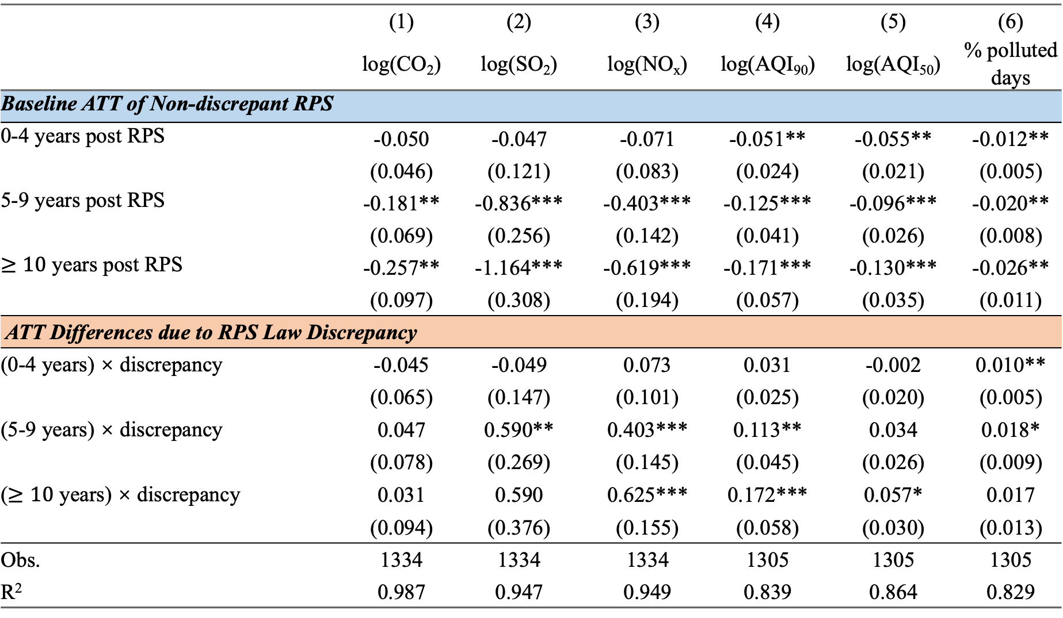
 | (1) | (2) | (3) | (4) | (5) | (6)
 | log(CO₂) | log(SO₂) | log(NO_{x}) | log(AQI₉₀) | log(AQI₅₀) | % polluted days
Baseline ATT of Non-discrepant RPS
0-4 years post RPS | -0.050 | -0.047 | -0.071 | -0.051** | -0.055** | -0.012**
 | (0.046) | (0.121) | (0.083) | (0.024) | (0.021) | (0.005)
5-9 years post RPS | -0.181** | -0.836*** | -0.403*** | -0.125*** | -0.096*** | -0.020**
 | (0.069) | (0.256) | (0.142) | (0.041) | (0.026) | (0.008)
$≥10$ years post RPS | -0.257** | -1.164*** | -0.619*** | -0.171*** | -0.130*** | -0.026**
 | (0.097) | (0.308) | (0.194) | (0.057) | (0.035) | (0.011)
ATT Differences due to RPS Law Discrepancy
(0-4 years) × discrepancy | -0.045 | -0.049 | 0.073 | 0.031 | -0.002 | 0.010**
 | (0.065) | (0.147) | (0.101) | (0.025) | (0.020) | (0.005)
(5-9 years) × discrepancy | 0.047 | 0.590** | 0.403*** | 0.113** | 0.034 | 0.018*
 | (0.078) | (0.269) | (0.145) | (0.045) | (0.026) | (0.009)
($≥10$ years) × discrepancy | 0.031 | 0.590 | 0.625*** | 0.172*** | 0.057* | 0.017
 | (0.094) | (0.376) | (0.155) | (0.058) | (0.030) | (0.013)
Obs. | 1334 | 1334 | 1334 | 1305 | 1305 | 1305
R² | 0.987 | 0.947 | 0.949 | 0.839 | 0.864 | 0.829

Slide 27
Headline Impact
For clean RPS laws, in the medium run (5-9 years):
CO₂ decreases by 16.6%
SO₂ decreases by 56.7%
NO_{x} decreases by 33.2%
% Polluted days decrease by 2.0 pp
For dirty RPS laws:
CO₂ decreases by 12.5%
SO₂ decreases by 21.8%
NO_{x} decreases by 0%
% Polluted days decrease by 0.2 pp

Slide 28
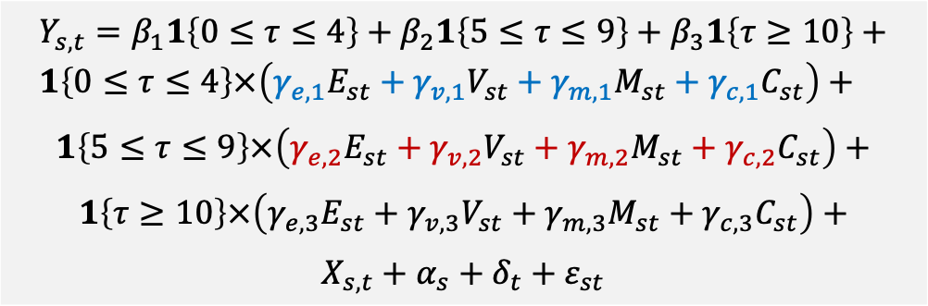
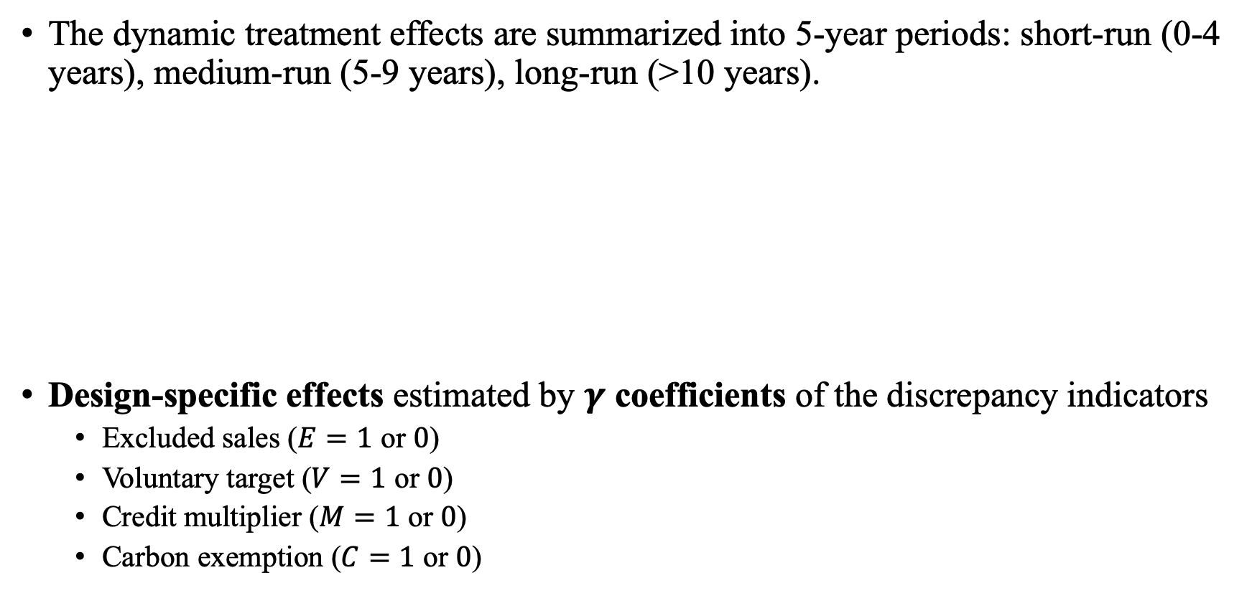
We decomposed the “policy design” effect through 4 types of discrepancies
The dynamic treatment effects are summarized into 5-year periods: short-run (0-4 years), medium-run (5-9 years), long-run (>10 years).
Design-specific effects estimated by $γ$ coefficients of the discrepancy indicators
Excluded sales ($E=1$ or $0$)
Voluntary target ($V=1$ or $0$)
Credit multiplier ($M=1$ or $0$)
Carbon exemption ($C=1$ or $0$)
$$Y_{s,t}=β_{1}1\left\{0≤τ≤4\right\}+β_{2}1\left\{5≤τ≤9\right\}+β_{3}1\left\{τ≥10\right\}+ \\ 1\left\{0≤τ≤4\right\}×\left(γ_{e,1}E_{st}+γ_{v,1}V_{st}+γ_{m,1}M_{st}+γ_{c,1}C_{st}\right)+$$
$$1\left\{5≤τ≤9\right\}×\left(γ_{e,2}E_{st}+γ_{v,2}V_{st}+γ_{m,2}M_{st}+γ_{c,2}C_{st}\right)+$$
$$1\left\{τ≥10\right\}×\left(γ_{e,3}E_{st}+γ_{v,3}V_{st}+γ_{m,3}M_{st}+γ_{c,3}C_{st}\right)+$$
$$X_{s,t}+α_{s}+δ_{t}+ε_{st}$$

Slide 29
 | log(CO₂) | log(SO₂) | log(NO_{x}) | % polluted days
0-4 years post RPS | -0.099* | -0.123 | -0.088 | -0.011**
 | (0.050) | (0.097) | (0.076) | (0.005)
5-9 years post RPS | -0.229*** | -0.819*** | -0.347*** | -0.021**
 | (0.063) | (0.242) | (0.126) | (0.008)
ATT Differences due to RPS Law Discrepancy: 0-4 years post RPS
(0-4 years) × exclude | 0.110 | 0.146 | 0.196* | 0.013**
 | (0.077) | (0.130) | (0.107) | (0.006)
(0-4 years) × voluntary | -0.224 | -0.255* | -0.008 | 0.000
 | (0.160) | (0.138) | (0.108) | (0.007)
(0-4 years) × multiplier | -0.017 | 0.024 | -0.087 | -0.005
 | (0.050) | (0.186) | (0.119) | (0.008)
(0-4 years) × carbon | 0.080 | 0.097 | -0.026 | 0.007
 | (0.109) | (0.163) | (0.106) | (0.009)
ATT Differences due to RPS Law Discrepancy: 5-9 years post RPS
(5-9 years) × exclude | 0.174** | 0.538* | 0.382** | 0.024*
 | (0.074) | (0.302) | (0.156) | (0.012)
(5-9 years) × voluntary | -0.194* | 0.013 | 0.022 | 0.002
 | (0.103) | (0.358) | (0.307) | (0.012)
(5-9 years) × multiplier | -0.006 | 0.310 | -0.053 | -0.003
 | (0.074) | (0.241) | (0.142) | (0.011)
(5-9 years) × carbon | 0.107 | 0.164 | 0.180 | 0.011
 | (0.089) | (0.220) | (0.136) | (0.011)
Obs. | 1334 | 1334 | 1334 | 1305
R² | 0.988 | 0.949 | 0.948 | 0.831
Standard errors are clustered at the state level. ***, **, * indicate statistical significance at 1%, 5% and 10%, respectively.

Slide 30
 | Coal & Oil | Natural Gas | Hydro & Nuclear | Wind | Solar | Electricity Price
0-4 years post RPS | -3.111** | 1.858 | 0.3210 | 0.475 | 0.028 | -0.038
 | (1.408) | (2.555) | (1.882) | (0.652) | (0.068) | (0.400)
5-9 years post RPS | -11.624*** | 8.026* | 4.695** | -1.173 | 0.117 | 0.023
 | (3.480) | (4.005) | (2.246) | (0.979) | (0.114) | (0.399)
ATT Differences due to RPS Law Discrepancy: 0-4 years post RPS
(0-4 years) × exclude | 2.097 | -3.574 | -1.301 | 2.931*** | -0.162 | 0.214
 | (1.789) | (2.569) | (2.240) | (0.909) | (0.162) | (0.505)
(0-4 years) × voluntary | -0.945 | -0.442 | 2.349 | -0.632 | 0.051 | 0.096
 | (1.913) | (2.760) | (1.949) | (1.273) | (0.089) | (0.439)
(0-4 years) × multiplier | -0.570 | 1.329 | 0.2979 | -1.664** | 0.082 | -0.627*
 | (1.677) | (2.184) | (1.494) | (0.739) | (0.167) | (0.357)
(0-4 years) × carbon | -3.081 | 0.644 | 1.746 | 1.207* | 0.142 | 0.083
 | (2.831) | (2.934) | (1.352) | (0.640) | (0.108) | (0.574)
ATT Differences due to RPS Law Discrepancy: 5-9 years post RPS
(5-9 years) × exclude | 7.728** | -8.774** | -5.976** | 7.058*** | -0.218 | 0.492
 | (3.817) | (3.678) | (2.600) | (1.889) | (0.227) | (0.541)
(5-9 years) × voluntary | 0.738 | -1.915 | 0.0241 | 1.644 | -0.260** | 0.052
 | (4.645) | (5.150) | (2.484) | (3.455) | (0.112) | (0.285)
(5-9 years) × multiplier | 2.198 | 0.568 | 1.141 | -4.910** | 0.171 | -0.831
 | (3.605) | (3.558) | (2.453) | (1.971) | (0.272) | (0.495)
(5-9 years) × carbon | -2.130 | -0.358 | -1.238 | 3.933** | 0.009 | 0.633
 | (3.742) | (3.996) | (1.682) | (1.760) | (0.126) | (0.635)
Obs. | 1334 | 1334 | 1334 | 1334 | 1334 | 1334
R² | 0.949 | 0.907 | 0.965 | 0.698 | 0.477 | 0.930
Standard errors are clustered at the state level. ***, **, * indicate statistical significance at 1%, 5% and 10%, respectively.

Slide 31
Next Steps
Quantify a dollar value for the environmental co-benefits
EPA’s COBRA tool
More robustness checks
Suggestions are welcome!

Slide 32
Conclusions
Stringency of the law could substantially affect the RPS policy outcomes.
Discrepancies in RPS laws in general undermine the intended RPS policy effects.
Less reduction in non-CO2 pollutants (SO2, NOx)
Less improvement in air quality
Smaller cuts in coal & oil generation
Lower growth in natural gas
Less generation from solar, but more generation from wind.
The discrepancy policy design in “excluded sales” is most influential in altering the RPS effects.

Slide 33
Supplementary Slides

Slide 34
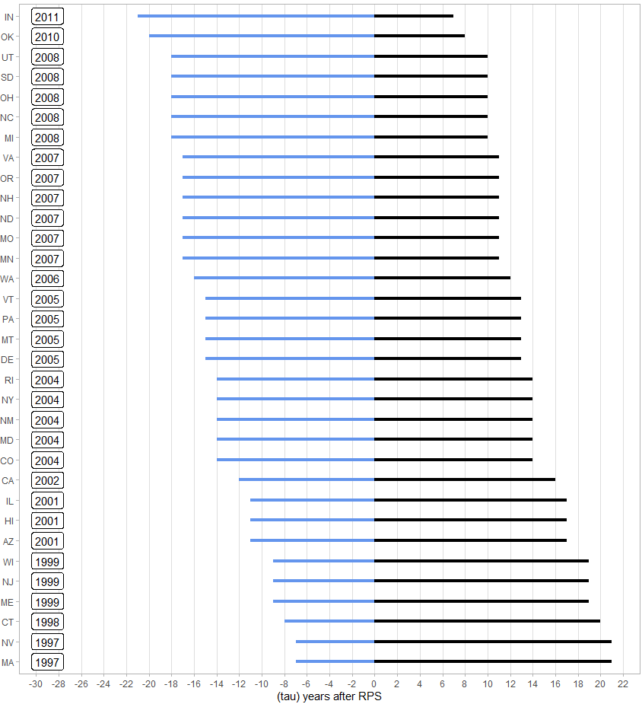
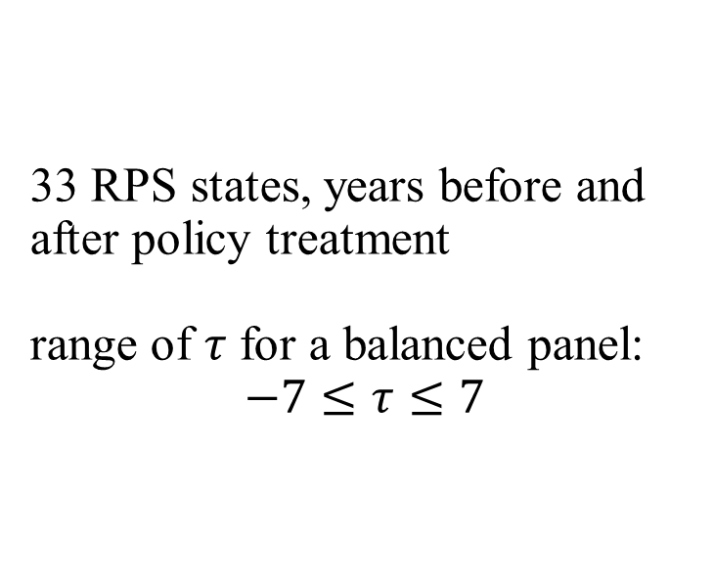
33 RPS states, years before and after policy treatment range of $τ$ for a balanced panel: $$−7≤τ≤7$$

Slide 35
Panel A: Outcome Variables
 | RPS states |  |  | Control states
 | N | Mean (std dev) | Min-Max | N | Mean (std dev) | Min-Max
CO2 (1000 metric tons) | 957 | 37463.239 (32870.971) | 6.583 – 133416.545 | 377 | 46490.424 (32388.933) | 438.133 – 131543.37
SO2 (1000 metric tons) | 957 | 164.228 (283.856) | 0.009 – 2045.983 | 377 | 201.061 (224.377) | 2.559 – 892.347
NOx (1000 metric tons) | 957 | 78.616 (92.709) | 0.148 – 535.619 | 377 | 95.194 (87.313) | 1.931 – 353.547
Share of Polluted Days | 957 | 0.051 (0.056) | 0.000 – 0.369 | 348 | 0.033 (0.037) | 0.000 – 0.194
% of Generation: Coal and Oil | 957 | 46.141 (30.604) | 0.033 – 96.964 | 377 | 47.48 (27.229) | 0.112 – 97.564
% of Generation: Natural Gas | 957 | 18.866 (22.573) | 0.000 – 98.944 | 377 | 19.664 (21.824) | 0.028 – 79.666
% of Generation: Wind | 957 | 1.910 (4.551) | 0.000 – 32.230 | 377 | 0.815 (2.803) | 0.000 – 18.478
% of Generation: Solar | 957 | 0.239 (1.105) | 0.000 – 13.806 | 377 | 0.039 (0.248) | 0.000 – 3.059
% of Generation: Other Renewables | 957 | 14.663 (20.977) | 0.000 – 91.360 | 377 | 13.004 (21.678) | 1.258 – 98.284
Electricity Price (cents per kWh, 2015 USD) | 957 | 10.510 (3.563) | 5.098 – 34.040 | 377 | 8.442 (2.291) | 5.099 – 17.726

Slide 36
Panel B: State-level Time-varying Covariates
 | RPS states |  |  | Control states
 | N | Mean (std dev) | Min-Max | N | Mean (std dev) | Min-Max
Legislature control (DEM) | 957 | 0.417 (0.493) | 0 – 1 | 377 | 0.337 (0.473) | 0 – 1
Legislature control (GOP) | 957 | 0.336 (0.473) | 0 – 1 | 377 | 0.451 (0.498) | 0 – 1
State control (DEM) | 957 | 0.229 (0.42) | 0 – 1 | 377 | 0.172 (0.378) | 0 – 1
State control (GOP) | 957 | 0.231 (0.422) | 0 – 1 | 377 | 0.334 (0.472) | 0 – 1
Governing party (DEM) | 957 | 0.486 (0.495) | 0 – 1 | 377 | 0.377 (0.48) | 0 – 1
Log(Gross State Product) | 957 | 11.854 (1.139) | 9.351 – 14.817 | 377 | 11.546 (0.923) | 9.45 –13.737
Natural Gas Price ($ per 1000 ft3) | 957 | 6.126 (3.017) | 2.005 –32.39 | 377 | 5.433 (2.129) | 0.479 –11.428
Log(Population) | 957 | 15.132 (1.036) | 13.244 –17.491 | 377 | 14.931 (0.942) | 13.025 –16.872
Net Metering Program | 957 | 0.639 (0.48) | 0 – 1 | 377 | 0.342 (0.475) | 0 – 1
% of Energy Exported | 957 | 0.089 (0.447) | -0.840 – 2.737 | 377 | 0.169 (0.576) | -0.636 – 2.607
HDDs | 957 | 5642.92 (2019.611) | 0 – 10810 | 377 | 4317.859 (2757.045) | 430 – 11702
CDDs | 957 | 935.448 (896.818) | 42 – 5213 | 377 | 1550.968 (963.582) | 0 – 4156
NOx Trading Program | 957 | 0.088 (0.283) | 0 – 1 | 377 | 0.064 (0.244) | 0 – 1

Slide 37
