Slide 1
A Time-Bound Hierarchical Key Assignment Cryptosystem with No Lifetime Limit
Jyh-haw Yeh
Dept. of Computer Science
Boise State University

Slide 2
Problem history
The problem was first proposed by Tzeng (2002).
Alternative schemes: Chien’s (2004), Huang and Chang’s (2004), Wang and Laih’s (2006).
Tzeng’s, Chien’s, Huang and Chang’s schemes were broken.
Wang and Laih’s scheme is secure but cannot assign keys on the fly.

Slide 3
Problem
A system is divided into n classes.
These n classes form a hierarchical structure.
Time is divided into periods.
Each user is assigned to a class C_i with a set of time periods T.
The system give the user a user key K_{I,T}.

Slide 4
Problem (cont…)
Each class C_j in each time period t encrypts its own data by a key K_{j,t}.
A user, in C_i with time periods T, is able to access data in C_j encrypted at time t iff C_i is higher than C_j and t is in T.
The problem becomes assigning keys so that K_{i,T} → K_{j,t} iff C_i is higher than C_j and t is in T.

Slide 5
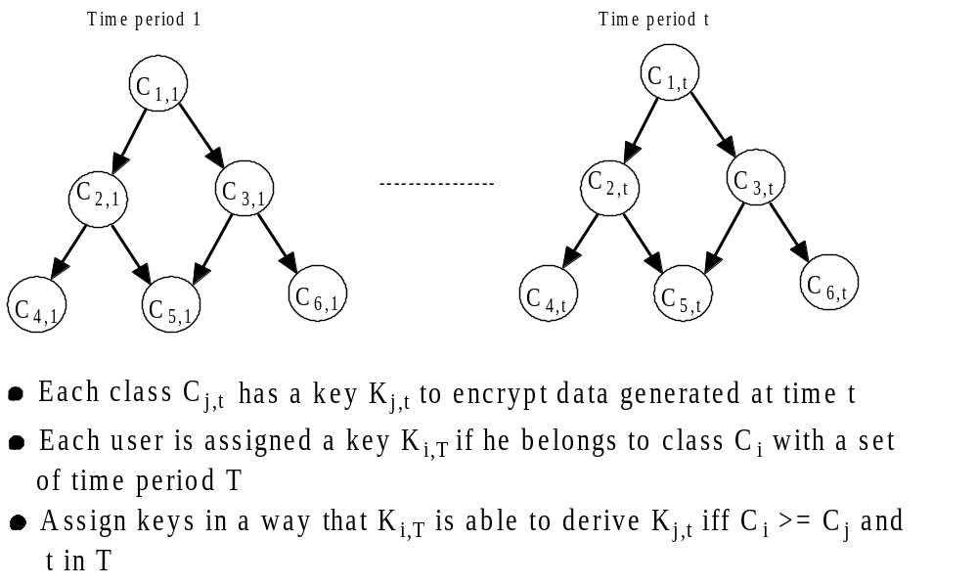
Problem (cont…)

Slide 6
Application
A publisher publishes journals periodically.
Different packages of journals for subscription.
Users subscribe packages for different time periods.
Only subscribed users can access the journals published in the time periods the users subscribed to.

Slide 7
Application (cont…)
The journals can be just posted online, but encrypted.
Each journal published in different time period is encrypted by a different key .
Each user has one user key.
The user key can decrypt only the journals the user are entitled to access.

Slide 8
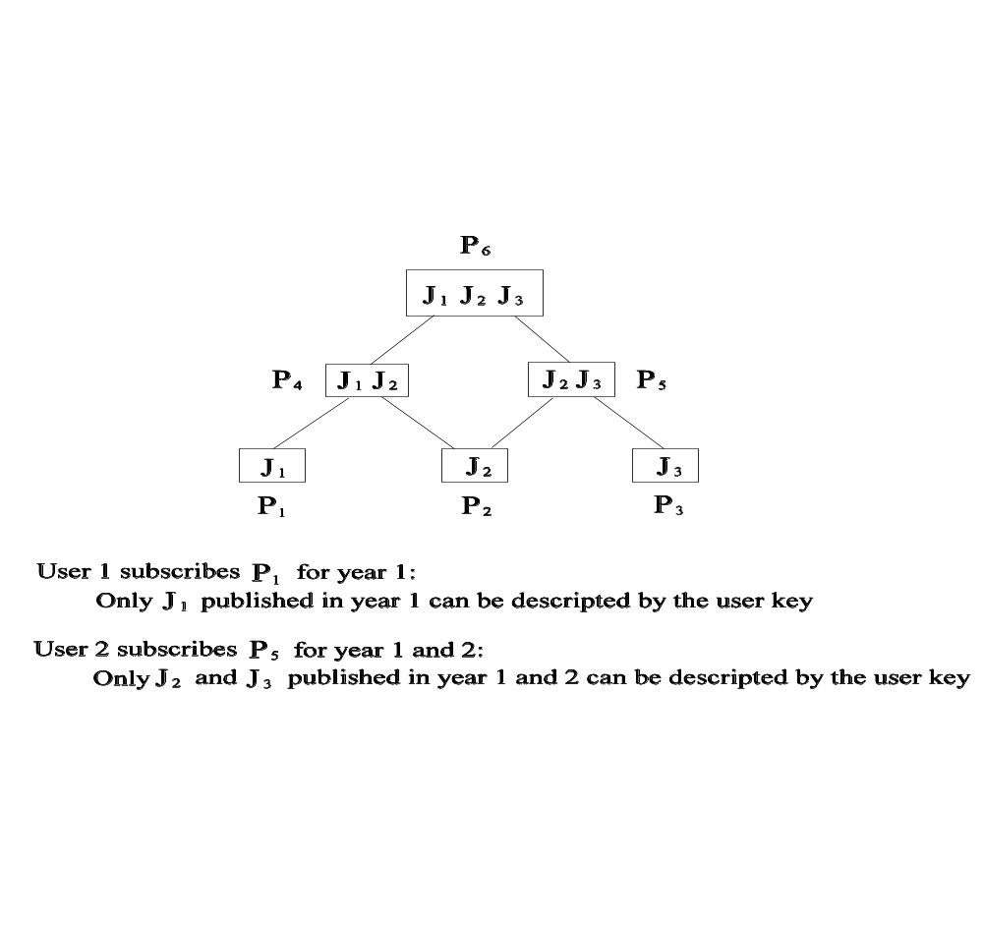
An Example

Slide 9
Key Assignment
Based on RSA algorithm.
4 processes:
  Initialization: compute parameters.
  Encryption key Generation: assign an encryption key for each class at each time period.
  User key generation:
  Key derivation: use a user key and some public parameters to derive an encryption.

Slide 10
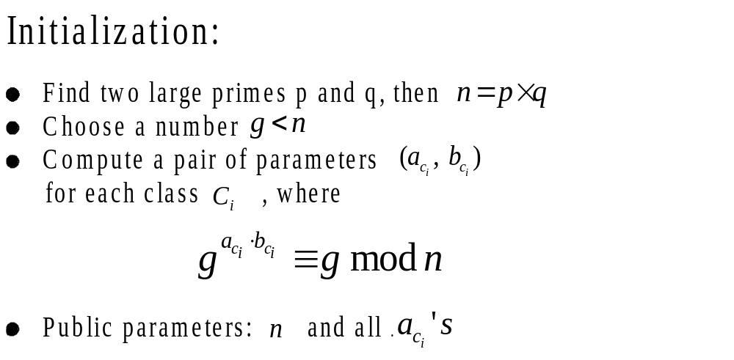
Key assignment (cont…)

Slide 11
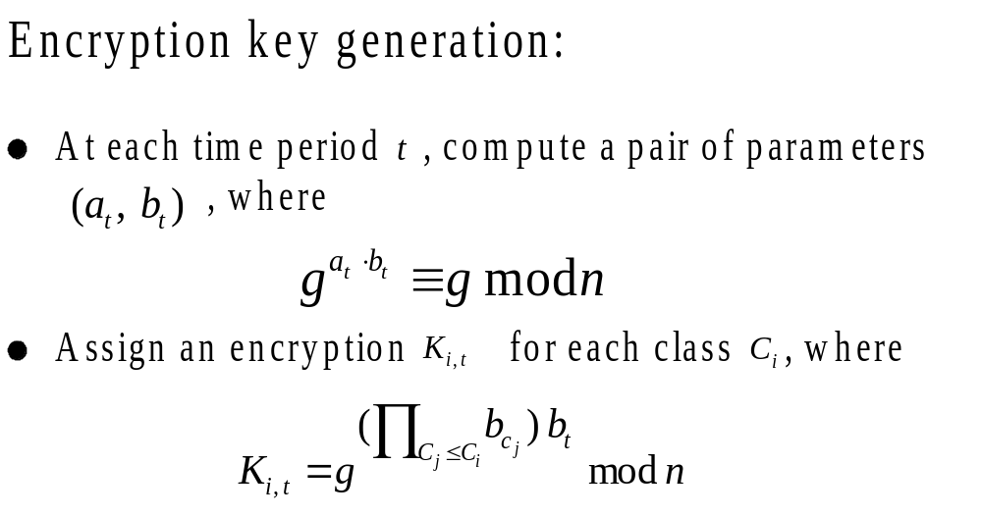
Key Assignment (cont…)

Slide 12
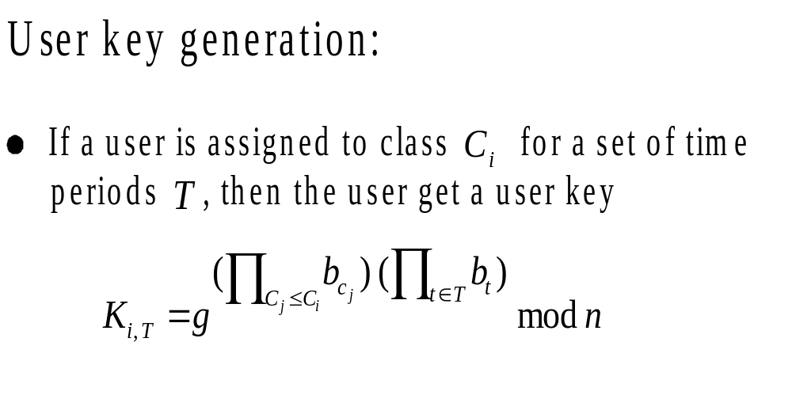
Key Assignment (cont…)

Slide 13
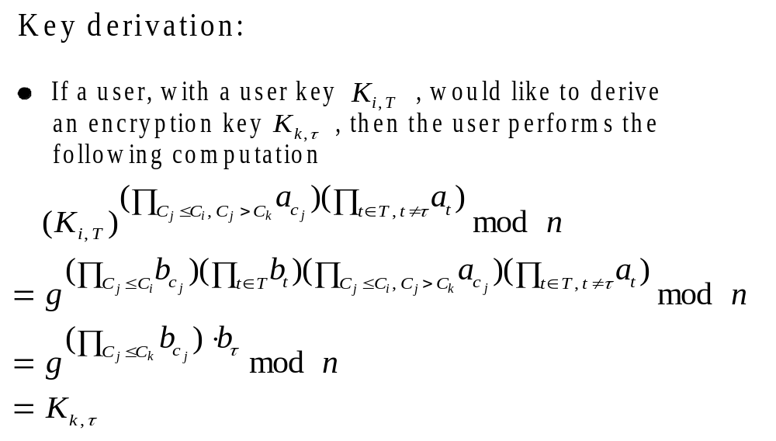
Key Assignment (cont…)

Slide 14
Comparison
Schemes | Tzeng | Chien | W & L | The Scheme
Security | Broken | Broken
# of public parameters | O(m) | O(m²) | O(m z) | O(m+z)
Assign non-consecutive time periods | No | No | Yes | Yes
System’s life | Limited | Limited | Unlimited, but with extra effort | Unlimited
Hardware support | No | Yes | No | No

Slide 15
Future Works
Develop dynamic management component of the scheme: add (delete) new classes, add (delete) users, add (delete) time periods to (from) users.
Comprehensive analysis of the efficiency of the scheme: storage, computation…
Formal proofs of the security.

