Slide 1
Machine Learning & Robotic Visions
Presented By:
Nikesh Balami & Suraj Bohara

Slide 2
What is Machine Learning?
“The goal of machine learning is to build computer systems that can adapt and learn from their experience.”
Machine Learning is arguably the greatest export from computing to other scientific fields.
Machine learning uses include:
  Security (Pattern recognition, face recognition)
  Business (Stocks, user behaviors)
  Medical (Research)

Slide 3
What Is Learning?
“Learning denotes changes in a system that ... enable a system to do the same task more efficiently the next time.” –Herbert Simon
“Learning is constructing or modifying representations of what is being experienced.”
–Ryszard Michalski
“Learning is making useful changes in our minds.” –Marvin Minsky

Slide 4
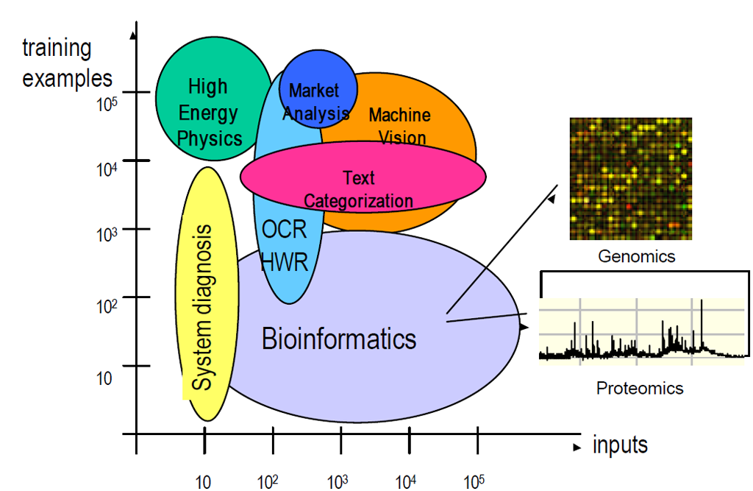
Machine Learning Application

Slide 5
Why Machine Learning Is Important?
Relationships and correlations can be hidden within large amounts of data. Machine Learning/Data Mining may be able to find these relationships.
Human designers often produce machines that do not work as well as desired in the environments in which they are used.

Slide 6
Why Machine Learning Is Important? Cont…
The amount of knowledge available about certain tasks might be too large for explicit encoding by humans (e.g., medical diagnostic).
New knowledge about tasks is constantly being discovered by humans. It may be difficult to continuously re-design systems “by hand”.

Slide 7
Some Success Stories Of Machine Learning
Data Mining, Lerner in Web
Analysis of astronomical data
Human Speech Recognition
Handwriting recognition
Fraudulent Use of Credit Cards
Drive Autonomous Vehicles
Predict Stock Rates
Robot Soccer
DNA Classification

Slide 8
Machine Learning Techniques
Decision tree learning
Artificial neural networks
Naive Bayes
Bayesian Net structures
Instance-based learning
Reinforcement learning
Genetic algorithms
Support vector machines
Explanation Based Learning
Inductive logic programming

Slide 9
Designing a Learning System:
An Example
1. Problem Description
2. Choosing the Training Experience
3. Choosing the Target Function
4. Choosing a Representation for the Target Function
5. Choosing a Function Approximation Algorithm
6. Final Design

Slide 10
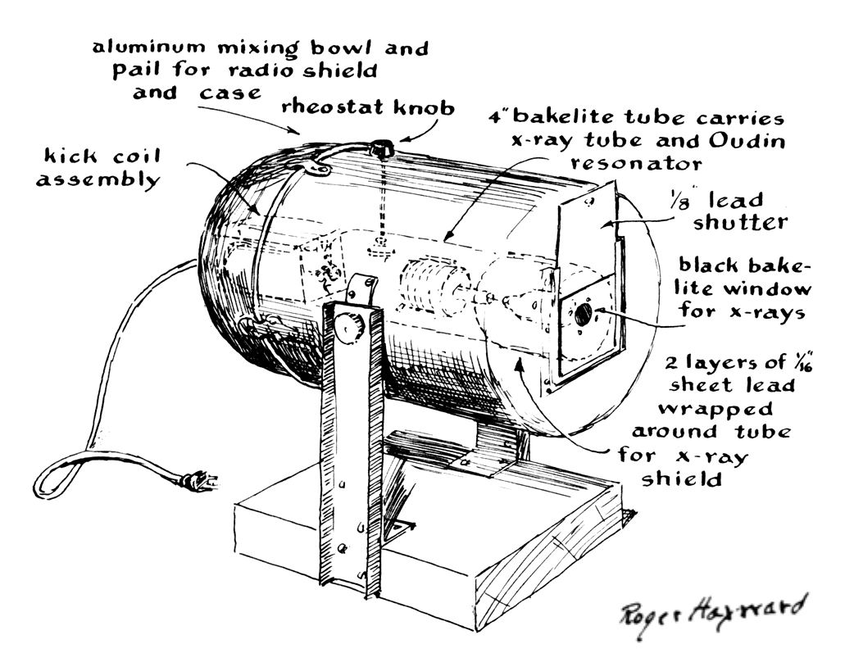
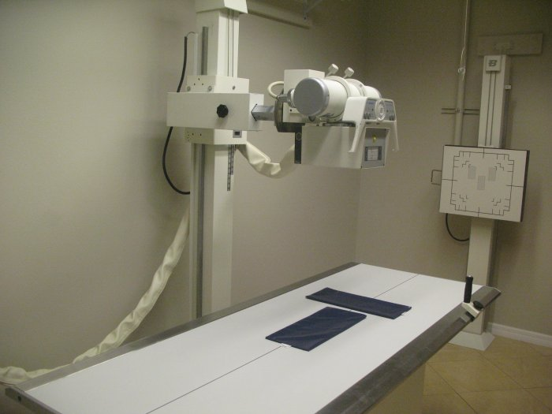
Example Of Machine Learning

Slide 11
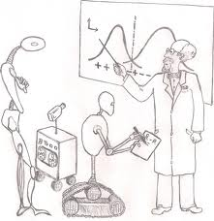
Finally!

Slide 12

Robotic Vision

Slide 13
What Is Vision?
Vision is our most powerful sense providing us with an enormous amount of information about our environment and enables us to interact intelligently with the environment
It is therefore not surprising that an enormous amount of effort has occurred to give machines a sense of vision
Vision is also our most complicated sense
  Whilst we can reconstruct views with high resolution on photographic paper, understanding how the brain processes the information from our eyes is still in its infancy

Slide 14
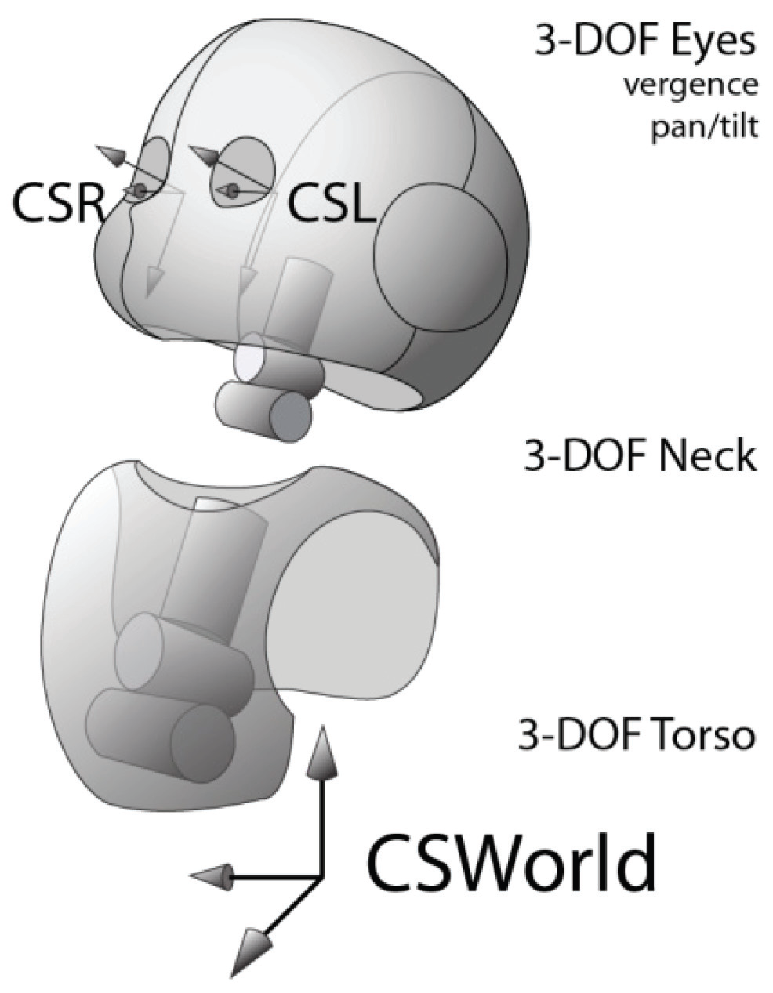
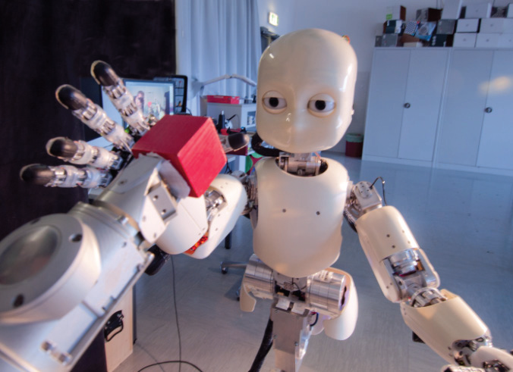
Output Example:

Slide 15
What Is Robot?
“A robot is a reprogrammable, multifunctional manipulator designed to move material, parts, tools, or specialized devices through variable programmed motions for the performance of a variety of tasks.” (Robot Institute of America)
“A robot is a one-armed, blind idiot with limited memory and which cannot speak, see, or hear.”

Slide 16
What Is Robot? Cont…
Robots are known to save costs, to improve quality and work conditions, and to minimize waste of resources.
Robot-based production increases product quality, improves work conditions and leads to an optimized use of resources.
Robots are expendable, so they can be deployed in disaster zones where it would be too dangerous for humans to go. They can be designed to cope with excessive heat, radiation and toxic chemicals.

Slide 17
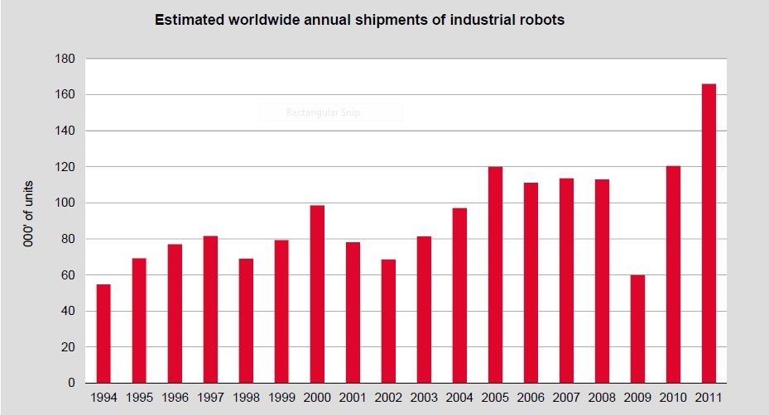
Graphical Representation

Slide 18
Advantage Of Robots
Robots may have better perception sensors than humans. Using camera, sonar or laser scanners, robots may be able to learn much more about their environment than a human ever could.
Robots may be more mobile than humans. For example, shoebox-sized robots can fit into places where humans can not, or aerial robots can explore an environment from heights.
Robots can be very intelligent. Intelligent agents and multi-agent systems have become a very active area of research, and it is conceivable that robots will be able to make decisions faster and more intelligently than humans in the near future.

Slide 19
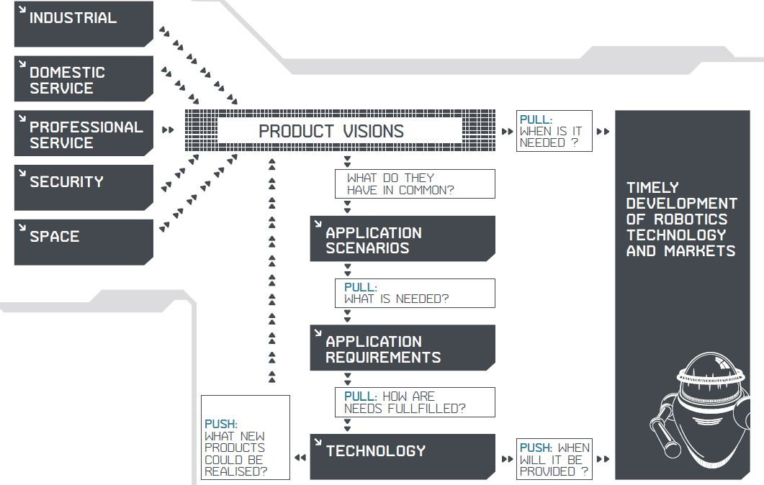
Development Of Robot

Slide 20
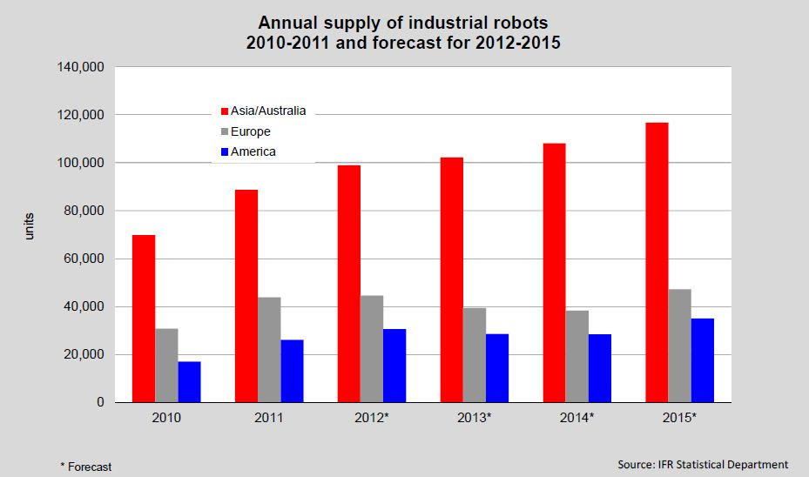
Forecast

Slide 21
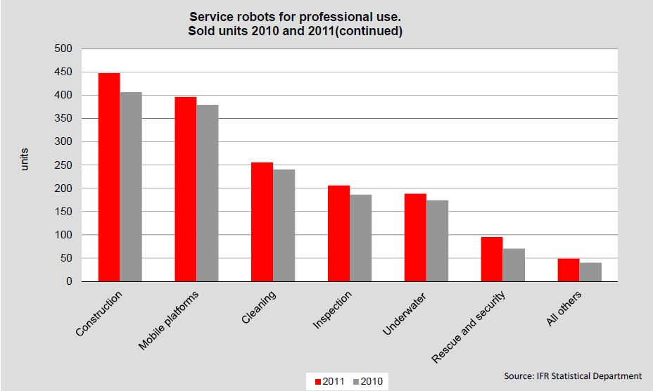
Professional Use

Slide 22
Processing Pictures:
Without the fluke board we can’t process pictures taken by the robot.
However we can process regular .jpg files.
Caution: Processing can take a long time so keep your pictures to 600 x 600 pixels. If you are just experimenting try to keep your pictures even smaller – 200x200 pixels.

Slide 23
Robot Vision
The robot and our program don’t see purple, they each see a combination of red, green and blue.
r,g,b = getColors(pixel)
Colors with low values of red, green and blue are generally dark and with high values, generally light.

Slide 24
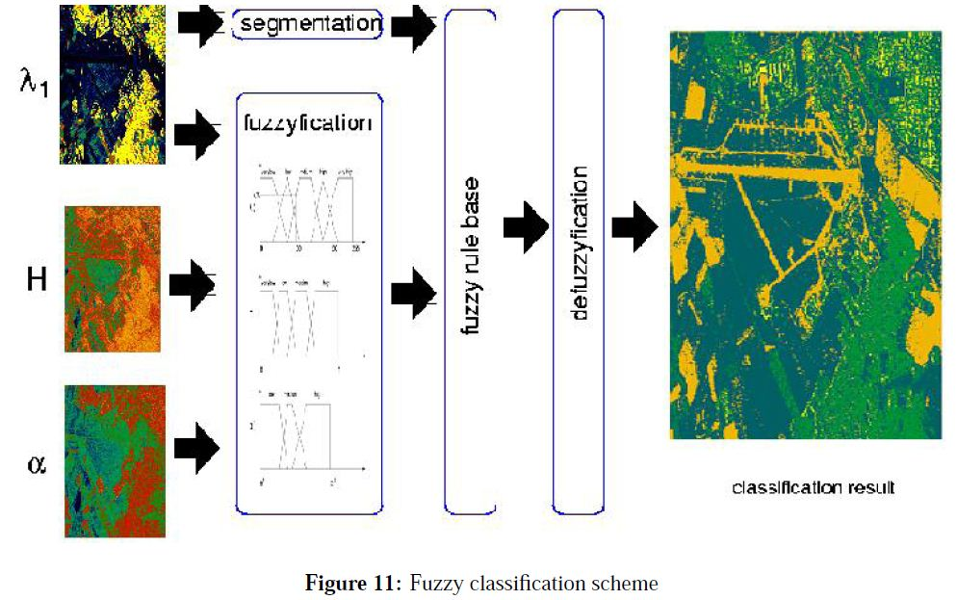
Fuzzy Logic

Slide 25
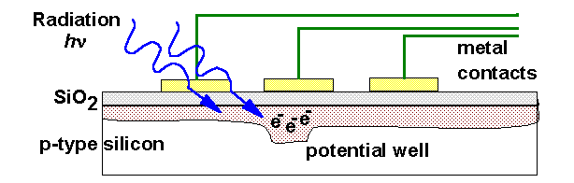
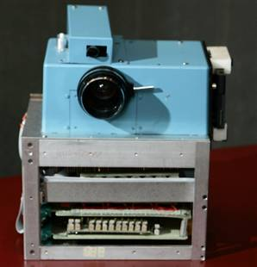
First Digital Cameras
Photoelectric effect (Hertz
1887; Einstein 1905)
Charge-coupled devices as storage (late 1960’s)
Light sensing, pixel row readout (early 1970’s)
First electronic CCD still- image camera (1975):
Fairchild CCD element
Resolution: 100 x 100 b&w
Image capture time: 23 sec.,
mostly writing cassette tape
Total weight: 8½ pounds

Slide 26
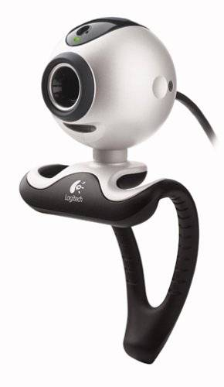
Modern Digital Cameras
Now days, Certain amount of money can buys a camera with:
  640 x 480 pixel resolution at 30Hz
  1280 x 960 still image resolution
  24-bit RGB pixels (8 bits per channel)
  Automatic gain control, color balancing
  On-chip lossy compression algorithms
  Uncompressed images if desired
  Integrated microphone, USB interface
  Limitations
    Narrow dynamic range
    Narrow FOV, with fixed spatial resolution
    No motion / active vision capabilities

Slide 27
Any Question?
?

Slide 28
Thank you

