Slide 1
Chapter 10

Slide 2
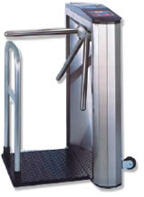
A Pay Turnstile System

Slide 3
State Machines
Very handy for simulating hardware and other stateful systems
A collection of states with transitions
Transitions determined by input and current state
Can be accompanied by output
Notes:
What examples can you think of in real life?

Slide 4
Coding a FSM
Each state must be tracked
Often use switch/case statements
Input + state = response
See Turnstile.java

Slide 5
Critique of the switch/case Approach
See any design liabilities?
M x N explosion
Must have a case for every combination of state and event
Changes will ripple, as usual

Slide 6
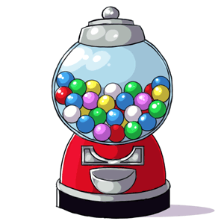
Gumball Machine
(see Old Gumballs folder)
P. 388- 396
(also: Sharpen your pencil)

Slide 7
Gumball Machine

Slide 8
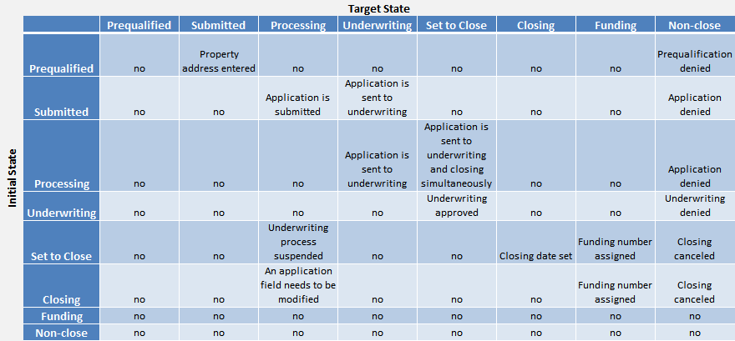
Another Approach
State Transition Tables
See StateTable.cpp
These are more flexible
But still are messy, and hard to understand and debug
Notes:
See also colossal cave (Adventure)

Slide 9
The State Pattern aka Objects for States
Creates a class hierarchy for the states
With an interface that models all input stimuli
The host object wraps a state object polymorphically
When state changes, it points to a different concrete object
You get the flexibility of static transition tables with more intuitive code.
But you write more code

Slide 10
The State Pattern
Intent:
Allow an object to alter its behavior when its internal state changes. The object will appear to change its class.
Context:
An object’s behavior depends on its runtime state. You have a large conditional statement with enumerated constant cases.
Solution:
Define concrete classes for each state. State classes implement a common interface reflecting possible inputs. State objects can call back to the controlling context if needed, and they can control state transitions as well.

Slide 11
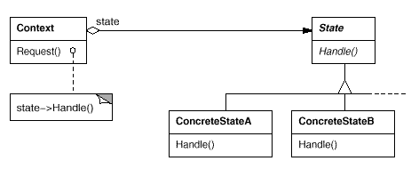
The State Pattern Class Sketch

Slide 12
The Turnstile with State
See TurnstileState.java, Turnstile2.java

Slide 13
Gumball Machine with State

Slide 14
From (state) Tables to Objects
Each state becomes a subclass
Each possible event becomes a method
(Alternate: single method to handle all events)
Decide how to manage state objects
Gumballs: Machine has its own set of objects
Can create them dynamically
Write methods to handle events
Can go to a different state (object)
Book: pp 399-401

Slide 15
Changing states!
That is what states are all about, anyway
The state object directs the transition to the next state. Options include:
Creates a new state object, returns it
Indirect: calls back to the context object and tells it to do something (see next slide)

Slide 16
State classes often have a link back to the context
So they* can change the state and call other context methods
See pp. 402-405
At least two options:
Have a link to the context when it is created
The action includes the context link

Slide 17
Sample Files
State.java
NoQuarterState.java
HasQuarterState.java
SoldState.java
SoldOutState.java
GumballMachine.java
GumballMachineTestDrive.java

Slide 18
State vs. Strategy
Their structure is the same; what is the difference?
See P. 407

Slide 19
Q&A
Page 412, Questions

Slide 20
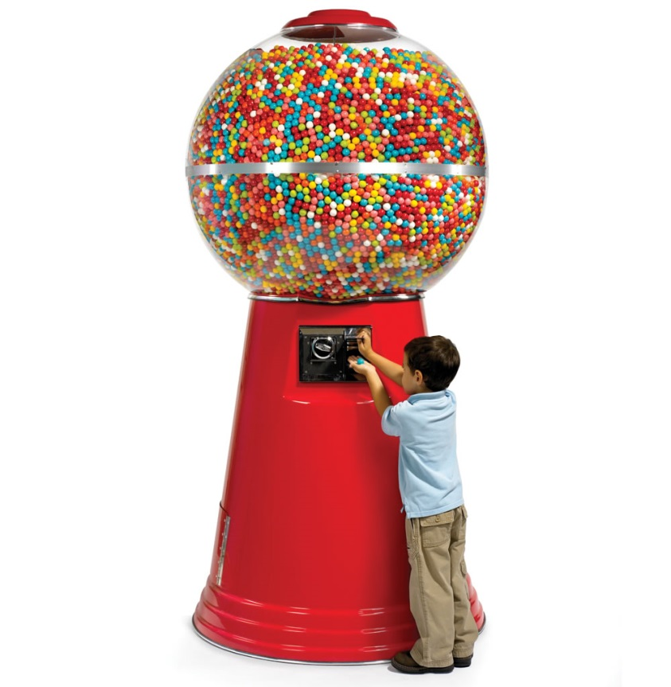
Adding a New State
Just add a new concrete class
And implement the methods, of course
Have to change a transition or two
Example: Winner
pp. 394-396, (BEFORE state!)
413-414

Slide 21
More Q&A
Page 416, Question 1
Page 417, Sanity check questions
Also: what do you think of GumballMachine.turnCrank() doing BOTH turn crank and dispense?
But can you come up with a better design?
Page 422
Design question: In HasQuarter state, we check to see if there are enough gumballs for a winner. If so, they go to Winner state, if not, to Sold State
Does this seem best to you?
Or should WinnerState check for the number of gumballs? (See State Gumballs Winner V2)?

Slide 22
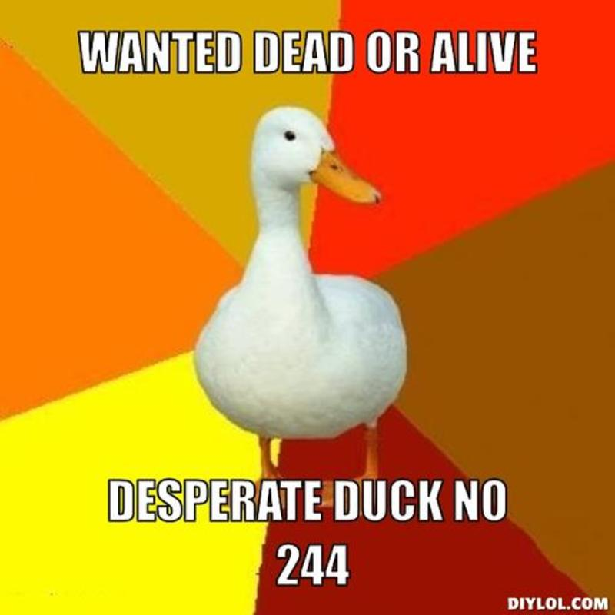
Duck Hunting
Those pesky ducks just won’t go away!
Let’s check out the state of the flock of ducks…
Single event handling method, instead of a separate method for each event:
Fewer methods
Easy to add new events (adheres better to OCP)
But you have if or switch in each State class
Therefore, best for sparse event handling
State Objects are Singletons
They are not bound to a specific Duck object (so you have to pass it in)
Can add a new Event (revive) or State (Hiding)
Could make the Events their own classes (worth the trouble?)

Slide 23
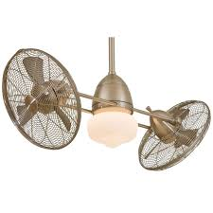
Remember the Ceiling Fan?
We Used it for Command (See old version)
The Fans have state: High, Medium Low, Off
Let’s add the State pattern!
What will have to change?
See old and new versions:
CeilingFan.java
Command.java, High, Medium, Low Commands
(Don’t look at State.java yet)

Slide 24
Ceiling Fans:
Now that we have states, we can factor much common behavior into the Command base class (change from an interface).
The execute() method can become a Template Method (not shown – how would it look?)
Undo() can move to the base class

Slide 25
Ceiling Fans: New Command
Cycle through the speeds: High, Medium, Low, Off, High, etc.
Key question: what does the next state depend on?
The current state. This is different – in all the other commands, the next state depends on the command type (it’s fixed)
With States it is easy!
(see old version of CycleCommand)
Create a CycleCommand class
In all the States, create a nextState method
That’s pretty much it!

Slide 26
Transition Control
In Ceiling Fan, where is the control of the transition to the next state?
It is in the COMMAND object (part of the surrounding context)
In the Gumball Machine, where is the control of the transition to the next state?
It is in the STATE object
What are the advantages and disadvantages of each?

Slide 27

Fireside Chat
Pages 418-419

