Slide 1
Design Patterns
Chapter 5

Slide 2


Slide 3
One and Only One Object?
Can you give examples where this is important?

Slide 4
One and Only One Object?
If it’s so useful, how do you enforce it?
Can you allow one object, but not more than one?

Slide 5
Introduction: A Dialog
P. 170
P. 171

Slide 6
More on Object Creation
Enforcing one and only one object
Print servers, logging objects, a cache, etc.
“Singleton”
Must not have public constructors
Duh
There are interesting variations
And some nasty “gotchas”

Slide 7
Example: Class Objects
Class objects are singletons
Java, Python, SmallTalk, etc.
Enforced by the language:
Class c = o.getClass( );
Class c = Integer.class
Class c = Class.forName(“MyClass”);
In Python they are also factories:
f = Foo(“stuff”)
>>> Foo
<class __main__.Foo at 0x009E2750>
>>> type(Foo)
<type 'classobj'>

Slide 8
Singleton The Basics
Use a static method to return the one and only (static) object
If it hasn’t been created yet, do so
You must return it by pointer/reference
Of course (can’t copy)
And disallow copying/cloning and assignment (latter applies to C++ & C#)

Slide 9
Singleton.java
class Singleton {
private static Singleton theInstance;
private int theData = 2;
public int getData() {
return theData;
}
private Singleton() {}
public static Singleton getInstance() {
if (theInstance == null)
theInstance = new Singleton();
return theInstance;
}
}

Slide 10
Observations
Just call Singleton.getInstance( ) to get a reference to the object
This is a kind of static factory, no?
Note that this function uses lazy instantiation:
If it is never called, the object is never created
So cool!

Slide 11
See Singleton Original

Slide 12

Dr. Frankenstein?
What have we created? Is it good?
Is it useful to have a single copy of an object?
Is it useful to enforce the use of one copy?
There is at least one other benefit; covered later.
Or is it bad?
Many people think Singleton is a Bad Thing
Isn’t it just a global variable? Why are globals bad?
Aren’t we hiding the “globalness?” Why is this bad?

Slide 13


Slide 14

Pattern Philosophy
Alexander’s view is that patterns should make the world a better place.
Does Singleton do so?
Is it a Pattern?
Or is it a programming hack?

Slide 15
Wouldn’t it be easier to…
… just create static objects?
Well, yes.
But what are the problems?

Slide 16
Object Dependencies
What if static object A depends on static object B?
Well, we could put them in the same file, with A after B
Or can we always?
Note: in C++, the order of instantiation of global variables found in different files is undefined.

Slide 17
Singleton to the Rescue
If A depends on B, and both A and B are Singletons, then:
When A is created, it can access B through its Instance method
If B didn’t exist before, it is created now.
And Everyone is happy!
See SingleDependent
What if A depends on B, and B depends on A? Does Singleton take care of it too?
No, you ninny! You have a circular dependency! Go redesign your code!
Notes:
SingleDependent

Slide 18
C++ Variation #1
Unlike Java, C++ allows local static variables
They are initialized only once
We can make the singleton a local static and dispense with the if-statement
We return it by reference (we don’t have to, but we can)

Slide 19
C++ Variation #1
class Singleton {
int theData;
Singleton() {
theData = 2;
}
public:
static Singleton& getInstance() {
static Singleton theInstance;
return theInstance;
}
int getData() const {
return theData;
}
};
Notes:
SingleC++ LocalStatic

Slide 20
Using C++ Variation #1
int main() {
Singleton& s = Singleton::getInstance();
cout << s.getData() << endl;
}

Slide 21
C++ Variation 1 (local Static) Advantages
Easier to code
(No external static definition needed)
Reference syntax
Easier to read than pointer syntax
Automatic destruction
Can be way important!!! (see example)

Slide 22
Singleton’s Secret
Sure it’s useful for enforcing one and only one object, but:
Its greatest benefit may be that it is an easy way to implement lazy instantiation
There are non-lazy Singletons, however…

Slide 23
C++ Variation #2
To make a class a singleton, we have to do a bit of surgery:
Insert a static data member for the singleton
Insert a static factory method
What if we could somehow “inherit” singleton-ness?
With a minimum of intrusion?

Slide 24
Inheriting “Singleton-ness” doesn’t work!
Two problems:
The same singleton object is shared by everybody
That singleton object is the same type (whatever type it is!)
Non-CRTP shows how a counter is shared by different subclasses
So we need an automatically-generated singleton object (or pointer)
That is unique
C++ has a cool, but arcane solution:

Slide 25
CRTP
The “Curiously Recurring Template Pattern”
A special combination of templates (parametric polymorphism) and inheritance
A class, A, inherits from a template base parameterized on A itself!
class A : public Base<A> { … };
See crtp.cpp

Slide 26
CRTP
Why does it work?
Because the size of Base is not dependent on its template parameter T
Its size can be computed once and for all (0)
So let’s make a base class that provides singleton-ness instead of counting!
See CuriousSingleton.cpp

Slide 27
Making A a Singleton via CRTP
Make its constructor non-public
Make Singleton<A> a friend of A
So Singleton<A> can instantiate a singleton of type A
Don’t instantiate A anywhere inside A
A has access to all constructors, of course

Slide 28
Consequences of Singleton
Benefits:
Enforces a single object
Lazy instantiation (when it works!)
Downsides:
Repeated evaluation of if is inefficient
Users know they’re using a singleton (can’t hide it)
Destruction is problematic (When? Don’t want a dangling reference)

Slide 29
Problems with Lazy Instantiation
With multiple threads, it is possible to get two objects created
See page 178, 179

Slide 30
Eager Instantiation
public class Singleton {
private static Singleton uniqueInstance =
new Singleton();
private Singleton() {}
public static Singleton getInstance() {
return uniqueInstance;
}
}
But this creates an object whether you need it or not.
What if you need lazy instantiation?

Slide 31
Solution
Can make the instance method synchronized (P. 180)
But synchronization is expensive
… which defeats the purpose of lazy instantiation (efficiency)
Alternatives: (Page 181)
Do nothing if performance isn’t an issue
Go back to Eager Instantiation
Or synchronize only when needed

Slide 32
Synchronized
public class Singleton {
private static Singleton uniqueInstance;
private Singleton() {}
public static synchronized Singleton getInstance()
{
if (uniqueInstance == null) {
uniqueInstance = new Singleton();
}
return uniqueInstance;
}
}
But locking is expensive! Every time you call getInstance() it costs time.

Slide 33
Alternative 3: double-checked-locking

Slide 34
The volatile keyword
Has a different meaning than in C++
Has to do with immediate updates of memory in Java
Non-volatile objects are cached by each thread
Volatile objects act as if not cached

Slide 35
Double-Checked Locking
public class Singleton {
private volatile static Singleton uniqueInstance;
private Singleton() {}
public static Singleton getInstance() {
if (uniqueInstance == null) {
synchronized (Singleton.class) {
if (uniqueInstance == null)
uniqueInstance = new Singleton();
}
}
return uniqueInstance;
}
}

Slide 36
The General Pattern: Double-Checked Locking
A common way of avoiding race conditions … is to serialize access to its critical sections. … This design, however, can incur excessive locking overhead if the object’s critical section is entered frequently but is executed conditionally only once.
Therefore:
Provide the shared object with a ‘hint’ as to whether execution of a particular critical section is necessary. Check this hint before and after acquiring the lock that guards this critical section.
It’s NOT just for Singleton.

Slide 37
Another Java Variation
public class BillPughSingleton {
private BillPughSingleton(){}
private static class SingletonHelper{
private static final BillPughSingleton INSTANCE =
new BillPughSingleton();
}
public static BillPughSingleton getInstance(){
return SingletonHelper.INSTANCE;
}
}

Slide 38
C++: The local static variable approach does NOT need double-checked locking
Java: the private local static class approach does NOT need double-checked locking
So use them. They are easier anyway.

Slide 39
No Dumb Questions
P. 184

Slide 40
Singletons and Subclassing
What if a class derives from a Singleton?
Singleton’s constructor must be protected
Therefore, each derived object will have its own copy!
Maybe that’s okay, maybe not
And the derived class is not a singleton
Know what you’re doing!

Slide 41
Another Approach
Why not just use static variables?
That’s fine, but you may want to treat it as an object
To allow polymorphism
This is the Monostate Pattern
See monostate.cpp

Slide 42
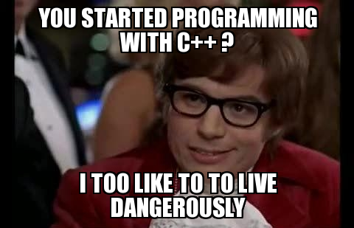

Slide 43
A Monostate “Factory”
Monostate is a single class
We may want multiple singletons
Printer, database, …
CRTP to the rescue
We need separate classes
We’ll use templates and CRTP

Slide 44
Consequences of Monostate
Benefits:
Users don’t know they’re using a singleton
Subclasses are automatically singletons
Polymorphism (methods can be overridden)
Well-defined creation and destruction times
Downsides:
Multiple (albeit small) objects get created
Space is used even if users don’t use any objects

Slide 45
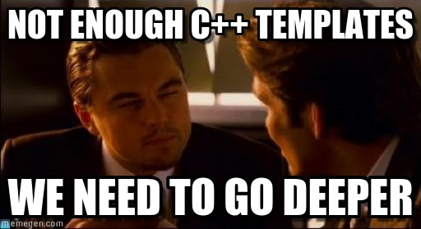

Slide 46
C++ Variation
Named Expanding Monostate
Uses member templates to allow automatic expansion of class attributes
Each data attribute has its own function that it is local to
It is identified by its type and an arbitrary number
These are encapsulated in a Name class template
See namedmono.cpp

Slide 47
How do you Kill a Singleton?
In C++, using pointers, you may have a dangling object. How do you ensure it is cleaned up?
Or: you want to destroy it at a certain time
E.g., when all users are gone
You write a Destroyer class
Or use reference counting

Slide 48
Multi-Singleton?
Suppose you want exactly N objects, not just a Single one?
Easiest: Wrap an array of the objects with a Singleton
But you lose some lazy instantiation – all objects in the array are created together
In C++, you can write a multi-singleton template
Pick whatever approach is best for you

Slide 49
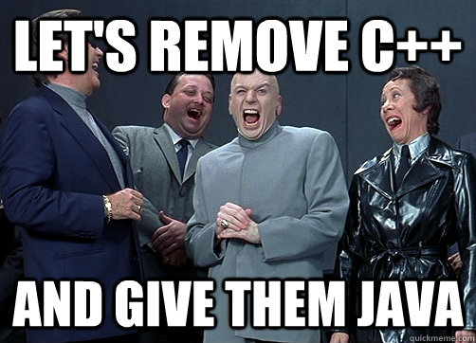

Slide 50
Summary
Patterns
Singleton
Double-Checked Locking
DCL is NOT part of the Singleton Pattern!!!!!
It’s a separate pattern!
(CRTP – the Curiously Recurring Template Pattern) (For C++ nerds)

Slide 51
Principles of Performance
Computers are fast these days!
We don’t need to worry about performance any more, right?

Slide 52
You need to worry sometimes
Under what conditions is performance important?
Give some specific examples

Slide 53
Performance Proverbs
“Premature optimization is the root of all evil”
“Make it, make it right, make it fast”
True or false?

Slide 54
What is the difference?
Optimization
High-performance design

Slide 55
Tradeoffs
Designing for performance usually involves tradeoffs
Time
Space
Usability
Flexibility
Understandability (of the code, for example)
Maintainability
Optimizations also often involve tradeoffs
Fast code can be hard to understand

Slide 56
First Decision
What is performance for the system we are designing?
Speed, response time, space, reliability, availability, etc.
Understand what it is most important
You usually get only one, but may have several that are very important.
That dictates the tradeoffs you have to make

Slide 57
Circling back …
“Premature optimization is the root of all evil”
Optimization is tuning after the fact, so it should be done late.
But:
You can write efficient code that is not (premature) optimization.
Premature optimization is bad when it is premature (tautology alert!)
“Make it, Make it Right, Make it Fast”
But you sometimes need to design it to be fast, all the optimization in the world won’t save you.
Actually, sometimes (always) you need to design it.
Then you can make it right the first time

Slide 58
And back to the patterns …
Singleton
Performance aspects:
Is it design or optimization?
Double-Checked Locking
Performance aspects:
Is it design or optimization?

