Slide 1
Design Patterns
Chapter 7

Slide 2
Situation
A thoroughly tested application uses a particular class library
A new, competing product comes along that beats the snot out of the library they were using
  They’d love to just “plug it in”
But the new library’s interface is different
  And folks don’t want to have to change all their existing, working code
What’s the solution?

Slide 3
Adapting an Interface
Once again, the “create a new, intermediary abstraction” principle saves the day
Create a class that acts as a go-between:
  Rename methods
  Combine methods as needed to match old calls
  Whatever…
Think of electric plug adapters (pp. 238-239)
  They may just change the prong configuration
  Or they may convert voltage as well

Slide 4

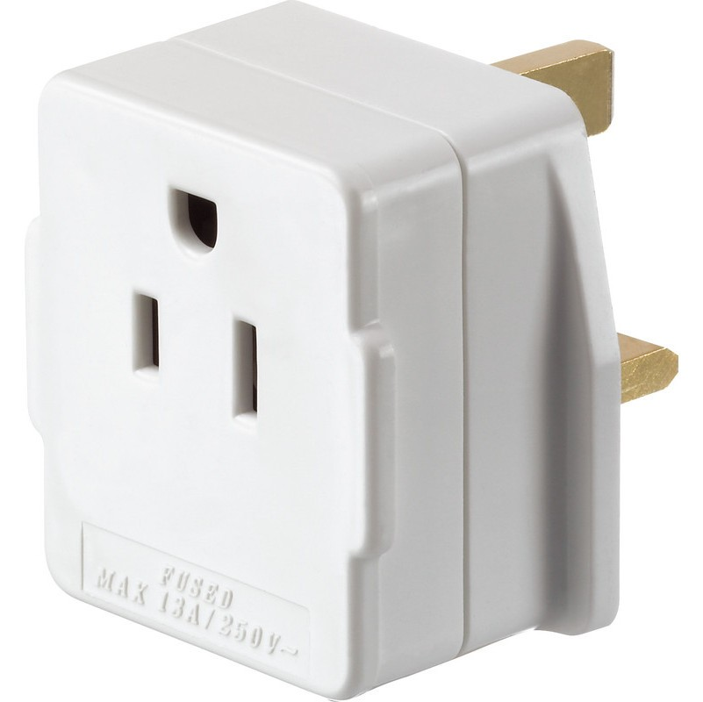
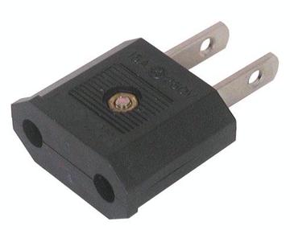
Electric Plug Adapters
Notes:
Book, Page 236 -

Slide 5
The Adapter Pattern
Intent:
  Convert the interface of a class into another interface that clients expect. Let otherwise incompatible classes work together.
Context:
  You want to replace an existing server class with another (or a set of others), but its interface is different. You can’t or don’t want to change existing client code. You want disparate client and server classes to work together.
Solution:
  Create a class that implements the expected interface but translates client calls into the interface of the new server class. Clients call through this class to use the new service.

Slide 6
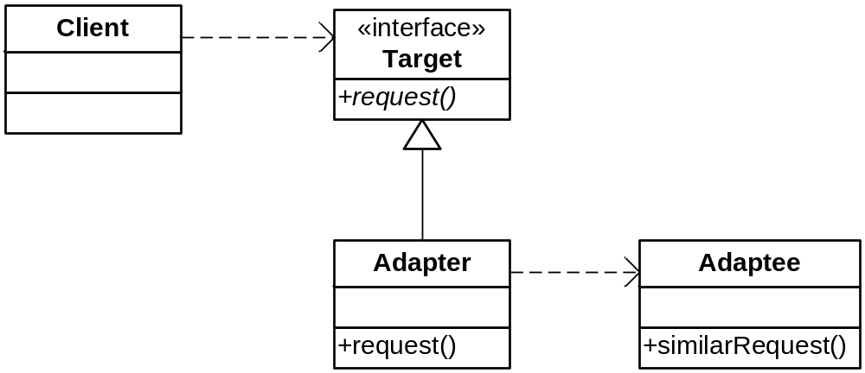
The Adapter Pattern
Class Sketch

Slide 7
Turkeys and Ducks
Turkeys gobble instead of quack, and only fly short distances
  But if all you have is a turkey when you want a duck, you’ll have to make do
Translate Duck.quack( ) into Turkey.gobble( )
Translate Duck.fly( ) into lots of Turkey.fly( ) segments…

Slide 8
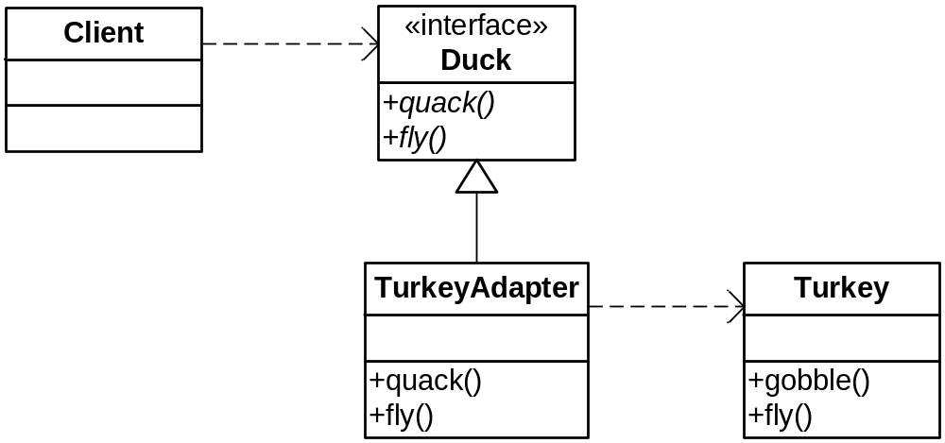
Ducks from Turkeys

Slide 9
Ducks from Turkeys
Code
public class TurkeyAdapter implements Duck {
Turkey turkey;
public TurkeyAdapter(Turkey turkey) {
this.turkey = turkey;
}
public void quack() {
turkey.gobble();
}
public void fly() {
for(int i=0; i < 5; i++) {
turkey.fly();
}
}
}

Slide 10
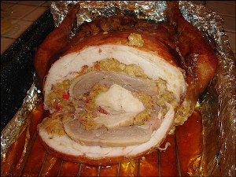
Real Life Application

Slide 11
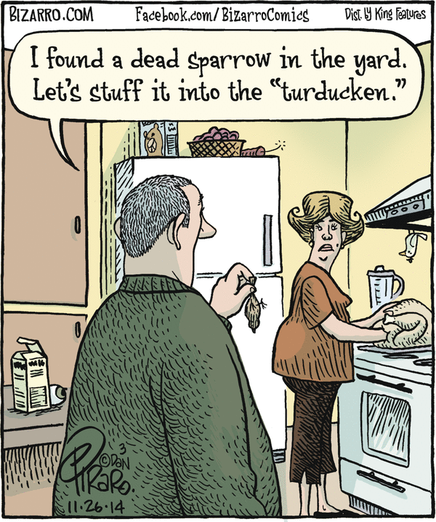
Adapting
Adapters

Slide 12
Variation
You can also use multiple inheritance instead of composition
  Need SmallTalk, C++, Eiffel, or Python
  Private inheritance in C++!
Why would you want to do this?
You lose flexibility, but you gain efficiency
  The usual trade-off
See next slide, also pp. 246 - 249

Slide 13
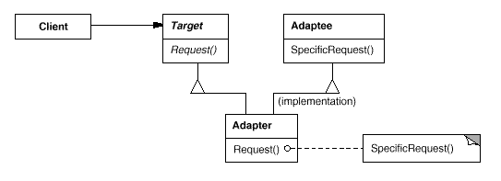
Class (vs. Object) Adapter

Slide 14
Object vs. Class Adapter
Let’s see them in turkey code…

Slide 15
Comments
What if there are multiple kinds of Turkeys?
  Not a problem: the adaptor binds to the base class; could use any Turkey subclass – cool!
The Target can be an interface, rather than a base class – then you can use the class adaptor in Java
  … IF you have an interface and not a class
A couple of additional comments: No Dumb Questions, p. 242
How well does it fit with our use of Duck Behaviors (strategy)?
  Not very…

Slide 16
A Java Example
You know that iterators have replaced enumerations in Java
But what if you have old code that you want to use with modern iterators
  You want to adapt enumerations to behave like iterators
See pages 250 - 252

Slide 17
Adapters vs. Decorators
Decorators don’t change the interface
  And they add new behavior
    (not a simple pass-through)
  And they allow layering
  Structure: wrap the same base type you inherit from
Adapters change the interface
  And can adapt multiple classes at once
  Structure: wrap a different type than you inherit from
P. 254-255, 256

Slide 18
External Polymorphism
A Variation of Adapter
Suppose you have totally unrelated classes, but you want to treat them polymorphically
  e.g., you want to dump the contents of objects
You can force them to be in the same hierarchy
  Just create wrappers that inherit from a common interface

Slide 19
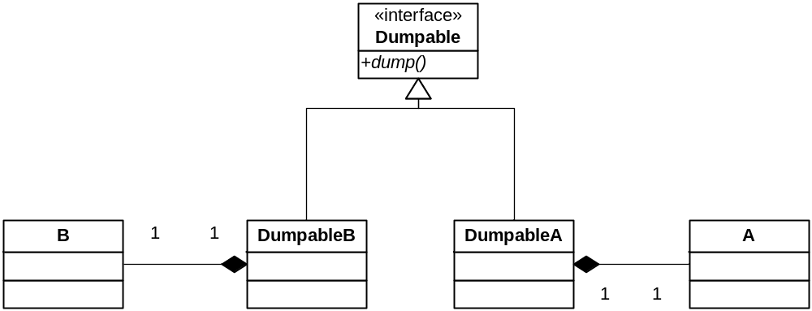
External Polymorphism
See externalpoly.cpp

Slide 20
Fat Interfaces
This attractive term refers to large interfaces
They tend not to be cohesive
  They try to do too much at once
  And confuse clients
  Not every subclass needs everything
This may be unavoidable in practice
  So just “segregate” them (break them apart)

Slide 21
ISP
The Interface Segregation Principle
  (Not in the book)
Clients should not be forced to depend on methods they do not use.
  Interfaces belong to clients, not implementations.
Give clients a thin interface!

Slide 22
A Security System
We have a Door hierarchy of objects that lock and unlock
  Door is an abstract class
Suppose we want to implement a TimedDoor
  Sounds an alarm when a door is left open too long
TimedDoor needs to be informed of a timeout
  So it registers with a Timer
    A server, which communicates with TimerClients
What is the relationship between these classes?

Slide 23
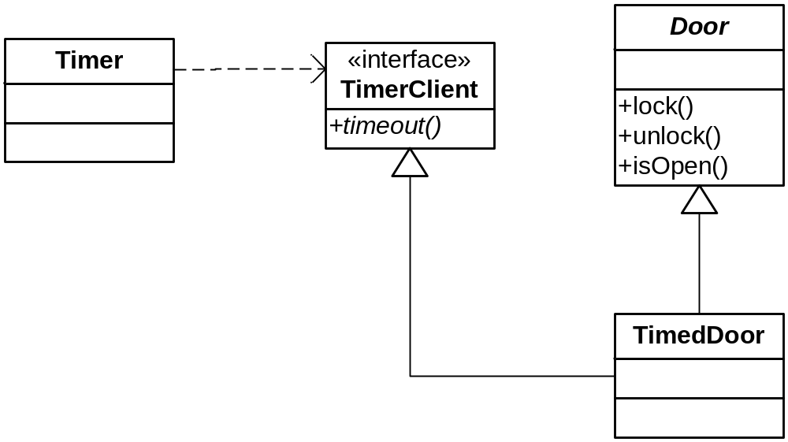
One Solution
Adheres to ISP

Slide 24
An Adaptive Alternative
What if TimerClient is an abstract class?
  And multiple inheritance is not an option?
We can create an object adapter that adapts TimedDoor to TimerClient
Next Slide

Slide 25
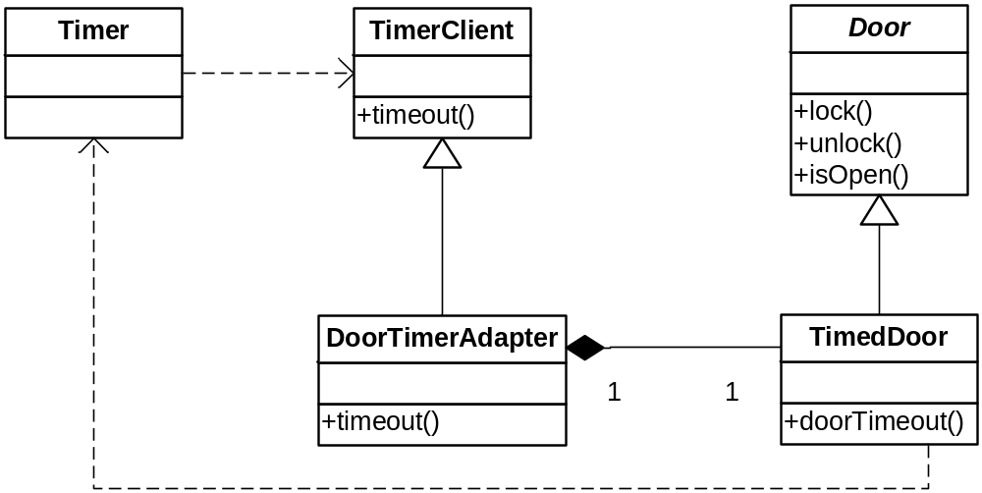
An Adaptive Alternative
TimedDoor creates its own DoorTimerAdapter.
The latter enables TimedDoor to be a callback.

Slide 26
Lesson
Separate Clients means Separate Interfaces
Don’t mess with Door
  e.g., don’t make it a TimerClient
Don’t mess with TimerClient
  Don’t make it know about doors
Don’t create a monster object that acts like both

Slide 27
Built-in adapters
Some languages provide adapters
  Such as for functions, etc.
  See ByName example

Slide 28
Time for a New Pattern
It’s related to Adapter…

Slide 29
A Twist
What if you have bunch of classes that weren’t made to work together, but now you have to use them in concert
Example: home entertainment system
  Receiver
  VCR
  DVD Player
  Speakers
  TV, Screen, etc.
Made by different vendors (see page 255-256)
  Can these components work together?

Slide 30
The Universal Remote
Know what I’m talking about?
I use one remote for three components
  TV, VCR, DVD Player
  Speaker remote is separate
The Universal Remote simplifies the interface for me
Many systems evolve this way
  You build a component, then another, then another, and you grow weary of invoking and combining them separately… so you build a “front end”

Slide 31
The Façade Pattern
Structural
Intent:
  Provide a unified interface to a set of interfaces in a subsystem. Facade defines a higher-level interface that makes the subsystem easier to use.
Context:
  You have a lot of existing classes that aren’t tied together by a single interface, but you want to use them together. You want a single interface to this collection of classes.
Solution:
  Provide a single, higher-level interface for clients that coordinates the use of the classes behind the scenes. Advanced clients with special needs can still dig deeper to the existing component classes if they need to, but the default user is shielded from all the complexity.

Slide 32
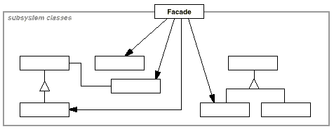
The Façade Pattern
Class Sketch
See page 266…

Slide 33

Onion Boy Redux
Systems can have layers of complexity
Introduce a façade for each layer, as needed
Such a deal!

Slide 34
Façade at the Architectural Level
The Layers Architectural Pattern
Each layer is a façade that covers the functionality below it
Each successive layer:
  Specializes the layer below it
  Simplifies
  Adds context (e.g., business logic)

Slide 35
Façade vs. Adapter
Very similar
But as always, they differ in intent
Façade gives a complex subsystem a single, simple interface
  Decouples client from the various components of the subsystem
So Façade simplifies, Adapter converts
Also: Adapter converts to a existing interface, Façade makes a new one (usually)
See page 262

Slide 36
The Principle of Least Knowledge
Law of Demeter
“Don’t talk to strangers!”
Objects should only invoke methods that belong to:
  The object itself
  Objects passed in as parameters to the method
  Any object it creates
  Any components of the objects (think: instance variables)
Don’t penetrate layers
See pages 267-269 (hard copy book)
www.ccs.neu.edu/home/lieber/LoD.html
https://www.youtube.com/watch?v=RlfLCWKxHJ0
  Really good talk (“The Clean Code Talks – Don’t Look for Things!”)

Slide 37
Summary
Principles:
  Interface Segregation Principle
  Principle of Least Knowledge (Law of Demeter)
Patterns
  Adapter
  Façade

Slide 38
Lieberherr talk: LoD
Parnas: The modular structure of Complex systems (especially the goals of modular structure)

