Slide 1
Design Patterns
Chapter 0

Slide 2
General Stuff
Class is In Person
Come to class
Office Hours:
MW, morning and afternoon
Outside of office hours, if I’m in the office I can usually see you
But T, Th, I’m slammed (little available time)
Can meet via Teams or Zoom
Contact me:
Email: Neil.Harrison@uvu.edu
Canvas mail: I see them about once a month (avoid)
Teams messages: I see them about once a year (AVOID!)

Slide 3
More General Stuff
Homework:
Small programs or problems
H1-6 are all described on one document
Last one is a separate document

Slide 4
More General Stuff
Programs:
Large programs: focus on using one or two patterns, but in the context of a large problem.
Use any language you want, but clear it with me if not a common one
You may turn them in early for possible early feedback
Turn in source code, an executable (NOT MSVS project folder)

Slide 5
Exams
One midterm, one final
In person

Slide 6
Attending Class
Do it.
Note that some material is covered in class that does not appear in the textbook.
And it could appear in the exams

Slide 7
Working Together
… is a good thing
… until you start to write code
Share ideas
Don’t share code

Slide 8
Learning Objectives
Explain what a pattern is
Explain the different parts of a pattern
Write a pattern

Slide 9
What is a Pattern?
A solution to a problem in a context
A three-part rule: a problem, a system of forces, and a solution that balances the forces
“Both the thing, and the instructions to make the thing”
All of the above
But it’s deeper than that!

Slide 10
Examples?
Can you give examples of typical patterns in the everyday world?

Slide 11
Real-world Examples
Patterns to make clothes
Recipes (?) (probably not)
Code of Conduct (?) (no)
House Plan (?) (perhaps)
How do these relate to software?
We’ll get to that later

Slide 12
What a Pattern is … and isn’t
A Pattern is a Thing
Therefore, the result of applying a pattern is some Thing
A Pattern is not a Process
A Pattern is not a set of Rules
especially one that doesn’t vary!

Slide 13
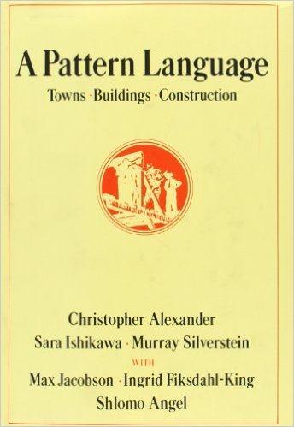
Christopher Alexander
Building Architect
1977: “A Pattern Language”
Over 200 patterns
His Definition:
A Problem
A System of Forces
A Solution

Slide 14
Examples from Alexander
Light on Two Sides of Every Room
Alcoves (179)
Waist-high Shelf (201)
Entrance Transition (112)
T Junctions (50)

Slide 15

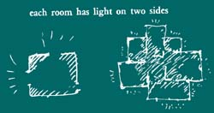

Light on two sides of every room

Slide 16
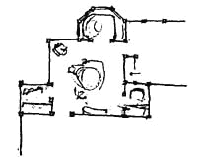
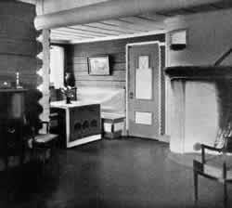
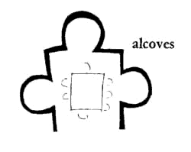
Alcoves

Slide 17
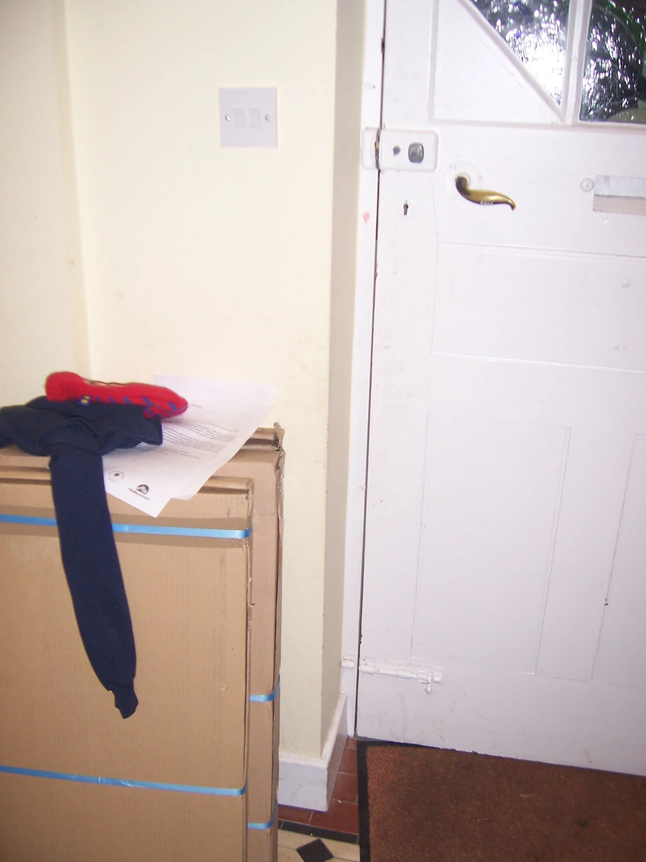
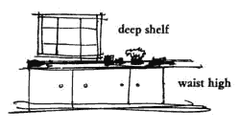
Waist-high Shelf

Slide 18

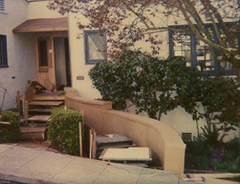
Entrance Transition

Slide 19
From Alexander to Software
… it’s a long story …

Slide 20
Patterns in Software
OO Designs (Most famous)
Language-Specific (Idioms)
C++: Copy constructor and = operator
Copy-on-Write (CoW)
Architecture
People, organizations, project management (Scrum)
Security
User interface
Many others
Differences in Scale

Slide 21
A Detailed Form: Coplien Form
Name
Context
Problem
Forces
Solution
Sketch (optional)
Resulting Context (or Consequences)
Author
Examples (optional, but recommended)

Slide 22
The Name
Crucial, because it is what the pattern is remembered by
CRTP
Buffalo Mountain
Choose like you choose the names of your children
Should be memorable
Should evoke the solution

Slide 23
Context
Describes where the pattern is useful
Generally describes the situation before the pattern is applied
Try to be as specific as possible
This is a common problem with patterns (context is too broad)

Slide 24
Problem
Describes something that is wrong
Best: a statement that something is wrong
(which will be fixed by the solution)
Inferior: a question of the form “How do you do … ?”
(leads to poor, trivial, patterns)

Slide 25
Forces
Elucidation of the problem
Describes what makes the problem hard
Why the obvious solution won’t work
Almost always have multiple forces
That conflict with each other
Example: space vs. time requirements

Slide 26
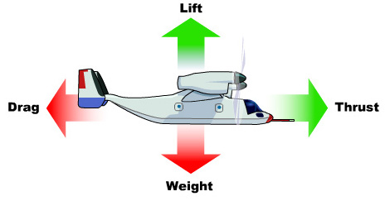
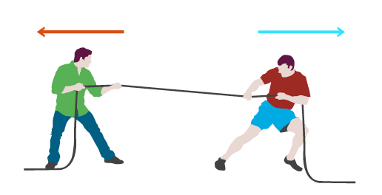
Forces

Slide 27
Forces: examples from Patterns
Alexander: Accessible Green (60)
PLoPD4: Secure Access Layer (p. 329)
OrgPats: Engage Customers (p. 113)
Scrum Pattern: Happiness Metric

Slide 28
The Solution
Usually the first part written
Usually not obvious
Until you look back on it!
The “Aha” moment!
Best:
One or two sentences that capture the essence
Followed by paragraphs that give details
Best solutions are emergent

Slide 29
Sketch
Try to have some visual representation – it helps
Patterns are essentially structural and geometric
Therefore, there should be a way to draw them
A sketch is better than a photo
Emphasizes that it can be used many ways
Optional, but strongly encouraged
Alexander: if you can’t draw it, it’s not a pattern

Slide 30
Resulting context
How the world has changed by the application of the pattern
Problems left to be resolved
Or new ones created
Setting the stage for other patterns
A pattern language! (sequences of patterns)

Slide 31
The Alexanderian Form
Form used by Christopher Alexander
Name
Sketch
Text describing the context
* * *
Problem summary statement in bold
Text explaining the problem, including the forces
Therefore:
Solution summary in bold
Stuff explaining the solution, including sketches and pictures
* * *
Conclusion text
More free form, therefore, it is a more advanced form.

Slide 32
The GoF Form
A really bad form, but we have to live with it
Pieces:
Name
Intent
Motivation
Applicability
Structure
Participants
Collaborations
Consequences
Implementation
Sample Code
Known Uses
Related Patterns

Slide 33

Let’s Write a Pattern!
Playing T-Ball

Slide 34
Typical order of writing
Solution
Problem
Example
Context
Name
Forces
Resulting context
(Lots of iterating loops …)
First, because that’s what we think of first!

Slide 35
Second lecture
Read patterns together
Writer’s Workshop, if time
Discuss forces in depth
Discuss names

Slide 36
Writer’s Workshop
Used to improve pattern writing
The writing is important!

Slide 37
The Flow (Quick Summary)
Moderator introduces the workshop
Author reads a section,
Then has no more direct communication
Group:
Summarizes
Positive points
Ways to improve the paper
Author returns, asks for clarification if needed

Slide 38
Writers’ Workshop Debrief
What did you think of the pattern writing and WW experiences?
Good things?
Bad things?
What did you learn?
How did it help you improve your writing?
How does this apply to software?

