Slide 1
Design Patterns
Chapter 6

Slide 2
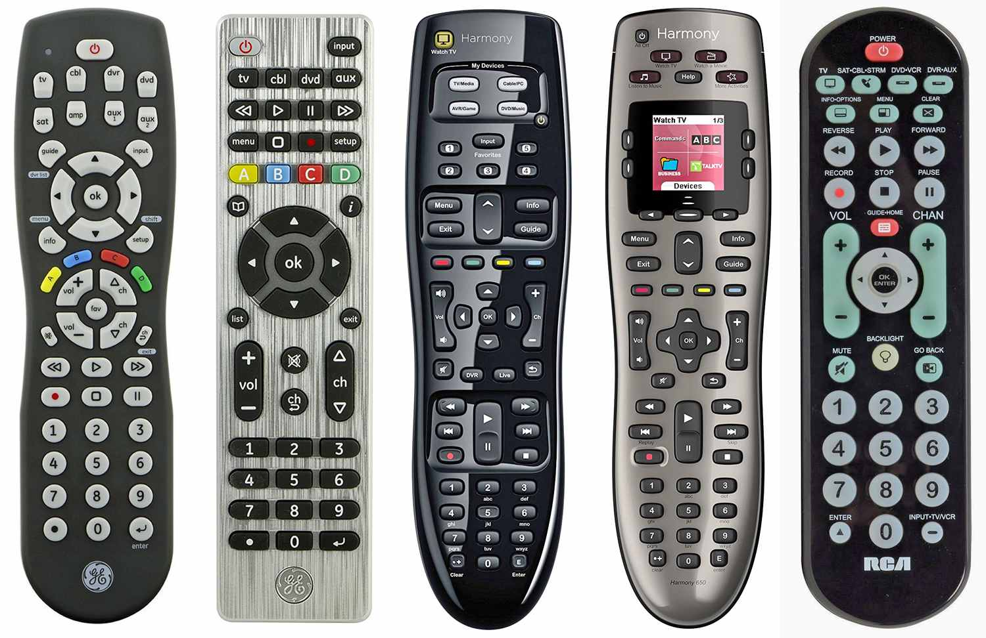
Design Problem
How many remote controls do you have at your house?
They are all similar, but different.

Slide 3
P. 194
Do you see commonalities that we can take advantage of?
And what are the differences?
What is the ONE thing that is common to EVERY one?

Slide 4

Thoughtful Query
Have you ever known anyone who likes to tell others what to do, but has no clue how to do the job themselves? (Don’t answer, we’re all programmers)

Slide 5
Master and Commander
Don’t be too hard on him/her
Nobody knows it all
But things still need to get done
Separating command invocation from knowledge of command internals is yet another good example of decoupling

Slide 6
Invokers vs. Invokees
Functions know what to do
But they don’t know when to do it
They must be called from a “larger” (more informed) context
They resemble exceptions in this regard
throw isn’t “informed”
Consider GUIs:
The controller generates events
But doesn’t know event handler internals
There are many different types of handlers

Slide 7

Responding to an Event
Consider a button press
How does an action get performed in response?

Slide 8
When Will You Ever Learn?

Slide 9
Callbacks
Instead, give the button a function to call
Each button gets its own response function
All callbacks must implement the same interface
Whether implicit or explicit

Slide 10
Encapsulating An Event Response

Slide 11
The Command Pattern A Little Foreshadowing
The canonical example of the Command Pattern is a menu
Each menu item is associated with an independent action
It is also nice to be able to change those associations at runtime

Slide 12
Examples
We will see 5 versions of a menu implementation:
1) C-style function pointers
2) Callback functions attached to menu items
3) Encapsulating Functions as Objects
4) The Command Pattern
5) Adding the Null Object Pattern

Slide 13
C++ Example Version 1
Holds function pointers in an array
Associates an index with each menu item
This holds throughout all versions
This is what GUIs do behind the scenes
See menu1.cpp
97 source lines

Slide 14
C++ Example Version 2
Introduces two classes:
MenuItem, Menu
MenuItem holds a callback
Still just a function pointer
Menu has a vector of MenuItem*
See menu2.cpp
124 source lines

Slide 15
Variation: initialize with a command
See menu2a.cpp
Advantages
Bind command name to command
Dynamic menus
See menu2b.cpp

Slide 16
Encapsulating Invocation
Use objects instead of functions as callbacks
Can track state
Such “command” objects can be passed around where needed
As long as they implement an expected interface

Slide 17
Encapsulating Invocation

Slide 18
C# Example Version 3
Implements previous slide
Interchanges them at runtime
Can undo
Tracks state

Slide 19
Advantage: First class objects can do more than function pointers can
Such as having state (and other things – more later)
See menu3a.cpp
can be global objects (or Singletons)
menu3b.cpp

Slide 20
Boring Commands
Notice that our commands are static
They are not parameterized in any way
We could make them more flexible
Separate what we want to change
We could have families of file commands
Move this outside the command
The new file command abstraction is a receiver of the invocation
It carries out the action
So the command is sort of an intermediary

Slide 21
In more detail
What do you do with a file?
Open it, close it, save it, print it
So a file should have those objects available to it
Different types of files do those actions differently
Text files, binary files, image files, etc.
So when you print a file, for example:
You ask the file to print itself (however it does that)
Therefore, the action (like print) receives the object that it operates on

Slide 22
The Command Pattern Object Behavioral
Intent:
Encapsulate a request as an object, thereby letting you parameterize clients with different requests, queue or log requests, and support undoable operations.
Context:
You need to issue requests without knowing the details of each request. You want to decouple invokers from command details. You want to replace commands dynamically.
Solution:
Define an interface for all commands. Concrete commands implement the interface to provide specific functionality. Commands can be parameterized by a server (receiver) that actually carries out the commands. (Command is an OO callback)

Slide 23
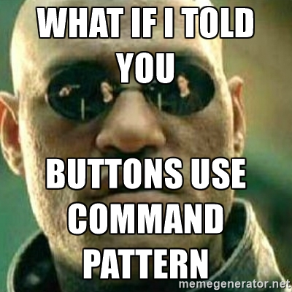

Slide 24
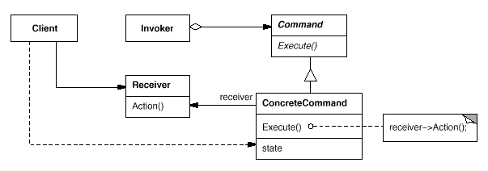
The Command Pattern Class Sketch

Slide 25
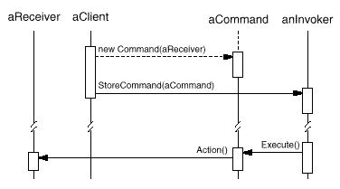
The Command Pattern Sequence Diagram

Slide 26
Commands and Receivers

Slide 27
C++ Example Version 4
Encapsulate families of file commands into a hierarchy of command receivers
File1 and File2
MenuItems now encapsulate the action and the receiver that performs the action
New1 + New2 => New (etc.)
See next slide and menu4.cpp
200 lines
Still no change to Menu or MenuItem

Slide 28
Different Types of Receivers
We have instances of different types of receivers
That’s not completely necessary
See menu4a.cpp for two receivers of the same type
Names in menu4a.cpp may help make the different types obvious

Slide 29
Something For Nothing
What if we want nothing to happen
A no-op
Right now we’re checking for null pointers
We have if’s all over the place
Suppose our selection device was hardware
Buttons or sensors
It’s not typical to have conditional logic there
And its even less likely that we’d want to rewire things

Slide 30
The Null Object Pattern
“Something for Nothing”
Applies when you always check before invocation
And the default is to do nothing or some constant action (see page 214)
Just override execute with an empty body
And replace if’s with asserts
Or use references in C++ (loses flexibility)
See Null Object examples

Slide 31

The Null Object Pattern
I’m SUPPOSED to be doing nothing!

Slide 32
C# Example Version 5
Let’s code it up
Just to show that it can apply in both cases
In C++, we can change pointers to references
Can’t have a null reference
See menu5.cpp

Slide 33
Command Objects in “Real Life” The Objectville Diner
Customer gives his order to the Waitress
Forgive the non-PC terms :-)
The Waitress delivers the order to the Cook
“Order up!”
The Cook responds
Carries out the command
See page 197-202

Slide 34
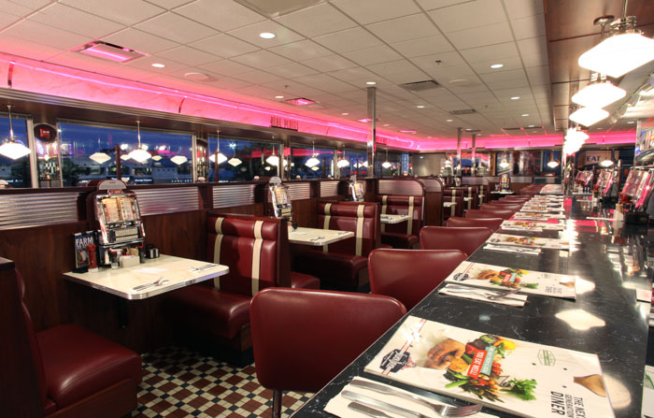
Command Objects in “Real Life” The Objectville Diner
Customer = Client
Presses the “button”
Waitress = Controller
The “invoker”
Like a GUI event thread
Cook = Receiver
Executes the command in response

Slide 35
Encapsulating an Order
The Order Slip has the instructions
makeBurger( ), makeShake( ), whatever
The Waitress gives it to the Cook
The Cook “receives” the command
The invocation interface is “orderUp( )”
See Restaurant.java, .cpp
Restaurant2.cpp shows different Cooks
Restaurant3.cpp shows dynamic Receivers (Cooks)

Slide 36

Programming a Remote Control
Buttons result in actions
Or not (use Null Object)
But buttons are “single-valued”
They emit a voltage surge
Therefore we can have only one result
“execute”
Need different command for different buttons
See pages 193-194, 209, 214 (NoCommand), 215

Slide 37
Variations
Undo
Macro Commands

Slide 38
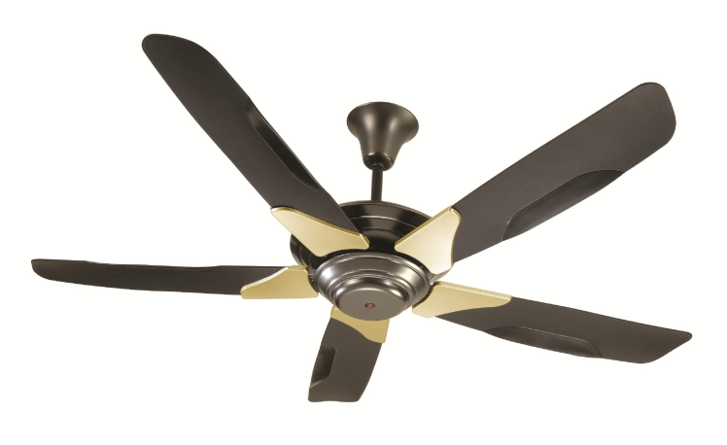
Undoing Commands
The command must store the previous state of the receiver
And provide an undo( ) method to restore that state
This new method is in the Command interface
Example: CeilingFan*.java

Slide 39
Multiple Do/Undo
How can you do/undo a history of commands?
How can you implement a redo?
Notes:
Undoing a history requires keeping a stack of commands. Undo will undo the command at the top of the stack and pop it. A redo requires keeping a sequence (vector) of all commands, so you can reapply commands, moving forward in the sequence.

Slide 40
Macros
A special command which holds other commands
Can nest arbitrarily deep (the Composite pattern)
See next slide

Slide 41
Macro Commands

Slide 42
Other Uses of Command
Batch Processing
Save up commands and run in sequence
Overnight, say
Recovery
Save a log of all commands executed
Can rollback or restore as needed

