Slide 1
Design Patterns
Chapter 9

Slide 2
Traversing Containers
How to visit some (or each) element
What’s the best way?

Slide 3
Container Owns The Traversal
You call some first-next scheme directly from the container
Consequences:
Can have only one traversal
Lasts the whole lifetime of the container
More importantly: The container is really two abstractions
An object that holds stuff
An object that visits what it holds (tracks “current element”)
These can change independently

Slide 4
Single Responsibility Principle
“A class should have only one reason to change”
Therefore it should be only one abstraction
Admittedly, if you dig deeper, it may appear to have multiple responsibilities
It’s a perspective thing
In other words, mind the cohesion thing

Slide 5

Early Programming: A Linked List
Write the code
What’s wrong with it?
It breaks the SRP: it’s TWO things at once
The data
The list

Slide 6
Reification
“Reification is a term used in computer science to describe the act of making a data model for a previously abstract concept. Reification allows a computer to process an abstraction as if it were any other data.” (Wikipedia)
What did we reify in the Strategy pattern?
We will reify traversal

Slide 7
External Iteration
Encapsulate the traversal of a container in a separate abstraction
Concrete containers return a concrete object that implements a universal iterator interface
Consequences:
Can have multiple, concurrent iterators
But that has its own set of problems
So the implementation of traversal is separated from containership
They can vary independently
Can do different kinds of traversals
Reverse, filter, etc.

Slide 8
The Iterator Pattern
Intent:
Provide a way to access the elements of an aggregate object sequentially without exposing its underlying representation.
Context:
You want to traverse a container, possibly in different ways, but you don’t want to bloat to container’s interface. You want to have a single interface for traversing distinct families of container types.
Solution:
Create an Iterator abstraction that defines an interface for accessing the container's elements. An iterator object is responsible for keeping track of the current element; that is, it knows which elements have been traversed already.

Slide 9
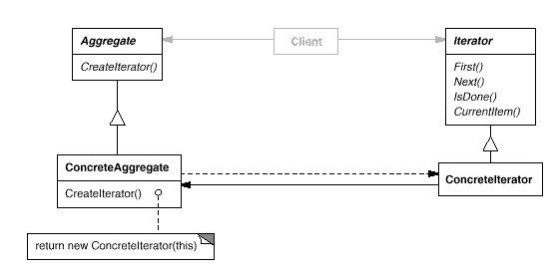
The Iterator Pattern Class Sketch

Slide 10

4 Keys to an Iterator
An Iterator object is associated with a particular container object
Almost always when the iterator is created
It knows what the current element is
We can get to the current element through the iterator
It can find the next element
It knows if there are more elements
Various Iterators may do more; this is the basic list

Slide 11
Notes on Iterator-Container
The container almost always creates its associated iterator object
The Iterator accesses the container’s internal data
Somehow (many possible ways)
Does NOT make a copy

Slide 12
Traversing via an Iterator (example only)
Iterator it = container.createIterator();
Object obj = it.First();
while (!it.isDone()) {
// Use object, then:
obj = it.Next(); // combines getting and next
}

Slide 13
Writing an Iterator
Let’s write an iterator for an array, using pictures and pseudo-code

Slide 14
Why Use an Iterator Instead of the Array Itself?
We can just use [n] with an array!
But a linked list would be different
The Iterator interface hides the implementation of the container
Actually, it hides the whole container
So the client doesn’t have to care about the container type
So you can pass the iterator, not the container
So you can have multiple simultaneous iterations (maybe)
And so you can have different modes of iteration
Reverse
Skipping some elements
Starting or ending in the middle (maybe)
Etc.

Slide 15
Iterators in Java
Iterator interface:
hasNext, next, remove
Next combines First & Next & CurrentItem
SubInterface:
ListIterator
Bi-directional
Mutating (set method)

Slide 16
Using Java Iterators
import java.util.*;
class Iterator1 {
public static void traverse(Collection c) {
Iterator it = c.iterator();
while (it.hasNext()) {
Object obj = it.next();
System.out.println(obj);
}
}
public static void main(String[] args) {
ArrayList stuff = new ArrayList();
stuff.add("one");
stuff.add("two");
stuff.add("three");
traverse(stuff);
}
}

Slide 17
Implementing Java Iterators
Must implement hasNext, next, and remove
The latter can throw an exception
It can only be called right after a next call
Otherwise an exception must occur
There must be something to remove!

Slide 18
Iterators in C++
An abstraction of raw pointers
Provides *, ++, and other operators
Forward (*, ++, ==, !=)
Bi-directional (--)
Random-access (+, -, +=, -=, [ ], <, <=, >, >=)
Preserves classical pointer idioms
*p++, etc.
The interface is therefore implicit
Covered in detail in CS3370

Slide 19
Iterators in ObjectVille
The Diner and the Pancake House have merged
The waitress needs to traverse both menus
But they’re implemented differently
The breakfast menu uses an Arraylist
Can expand
The lunch menu uses an array
What to do?
Want to minimize changes to existing classes.
Want to shield users from the details of the two classes
See pages 318-337, 344-352

Slide 20
Compound Iterators
For traversing compound data structures
Java example: A priority queue
Implemented as an array of linked lists
To traverse the whole thing, need to traverse the individual lists
But some might be empty!
A little tricky (see PriorityQueue.iterator( ))
(PriorityQueue.java, ToDoList.java)

Slide 21
Internal Iteration aka Enumeration Method
A “for-each”
You provide a function (or a Command) to (possibly conditionally) apply to each element
You don’t access elements directly
Could be a method or a stand-alone function
Handy for structures that are hard to iterate
Binary search trees
Notes:
See code examples

Slide 22
Iterator Invalidation
What if the underlying collection changes in the middle of an iteration?
How should the current iterator respond?
Depends:
Adding an element at the end shouldn’t hurt anything
Deleting the current element could be okay too
But shrinking the size of the structure below the index of the current element would not be good!
Java throws up its hands (fail fast)
C++ specifies when an iterator is invalidated

Slide 23
Program 5
Write an iterator
And then write decorators to do fancy iteration!
(Probably not done this way in practice!)

Slide 24
Another Change at the Diner
Add a dessert menu
But it’s only available through the Dinner menu
Not Breakfast or the Café
It’s a nested menu
How can a menu hold another menu?
It holds menu items, not other menus
Hint: recall nested Macro Commands

Slide 25
The Composite Pattern
A generalization of a macro command
A “recursive container” (like one big macro)
A collection can hold a concrete item (leaf) or another collection (composite)
Nested arbitrarily deep
Results in a tree structure
Like a directory tree
See page 357

Slide 26
The Composite Pattern
Intent:
Compose objects into tree structures to represent part-whole hierarchies. Lets clients treat sub-hierarchies and leaf objects uniformly
Context:
You want to represent part-whole hierarchies (like a bill of materials or a directory tree), and want to process them through a uniform interface, ignoring their differences.
Solution:
Derive both primitive objects and container objects from a common interface. Container objects forward requests to their children recursively until leaves are found.

Slide 27
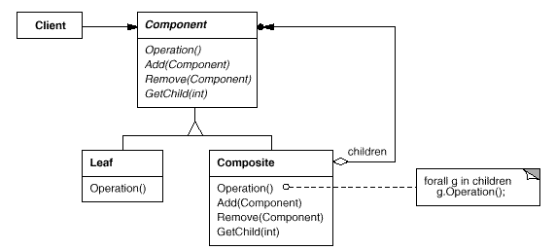
The Composite Pattern Class Sketch

Slide 28
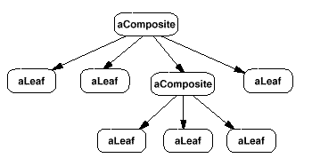
The Composite Pattern Example Object Sketch (not UML)

Slide 29
SRP/ISP Violation?
Single Responsibility Principle
Interface Segregation Principle
The Component interface serves both containers and containees
Child operations are no-ops for leaves
Or they throw an exception
So be it –
It’s the price we pay for transparent tree processing
There is often a tension between multiple principles

Slide 30
Traversing a Composite
Internal Iteration is easy
Recall DBCommand methods
From Program 4
See pages 359-366
External iteration is tricky!
(removed from 2nd edition of the book!)

Slide 31
External Iterators for Composites
Must iterate over the Component interface for transparency
Leaves don’t iterate, though!
And how do we iterate recursively into subtrees?

Slide 32
Leaves and Iterators
Leaves act as empty containers
So just return whatever you normally do when a container is empty
Like false for hasNext in Java
Or the end( ) iterator value in C++
This is an example of Null Object

Slide 33
Iterator Interface for Composite

Slide 34
Recursive Iteration into Composites
Must keep track of where you are
Start with the root of the tree
Most likely itself a composite, of course
If contained element is a leaf, return it and “advance”
If not, put the current iterator “on hold”, and start using the iterator of the contained composite
Need a stack for LIFO handling of iterators
See CompositeTest.java

Slide 35
Parent Links
Allow traversing back from a component to its parent
Nice to be able to go backwards sometimes
Issues:
When should the parent link be set/changed?
During Composite.add/remove
Where should the parent attribute reside?
In Component
See CompositeTest2.java

Slide 36
Program 6

Slide 37
Composite: Internal vs. External Iteration
Whenever possible, use internal iteration
It’s nearly trivial!
External iteration:
Complex
Have to know the type: composite/leaf (inside the iterator)
Use it when you need to see each element individually during iteration.
Consider using the Visitor pattern instead

Slide 38
OCP Redux
The Open/Closed Principle
Add functionality without changing code
We did this before with Decorator
A wrapper which programmed to the interface
But now we have to distinguish between leaves and composites
How can we add functionality to a closed hierarchy?
Such that behavior can vary across concrete types

Slide 39
External Iteration Revisited
Why might you need it?
Different kinds of iteration; different things you do when iterating
Because you might want to add functionality to a closed composite hierarchy

Slide 40
What Principles apply?
Separate things that change from things that stay the same
Single Responsibility Principle
Interface Segregation Principle

Slide 41
The Visitor Pattern
Separate Visiting into its own Class (hierarchy)
Provide a visiting method for derived class of the visited hierarchy
Can have different kinds of visiting
The visited hierarchy provides an accept method
It takes a visitor
It calls back to the visitor with the visit method that it corresponds to.

Slide 42
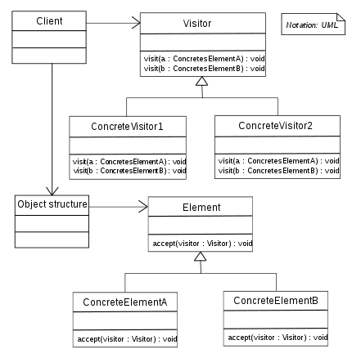

Slide 43
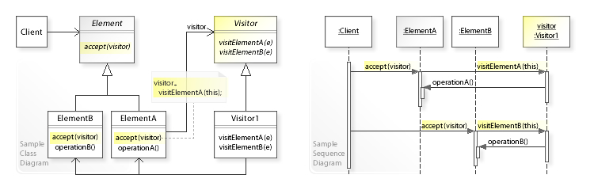

Slide 44
VisitorTest.java
CompositeTest3.java

Slide 45
Visitor Benefits
Allows you to add operations to a Composite structure without changing the structure itself.
Adding new operations is relatively easy
The code for operations performed by the Visitor is centralized.

Slide 46
Drawbacks
The Composite classes’ encapsulation is broken when the Visitor is used.
Because the traversal function is involved, changes to the Composite structure are more difficult.
In particular, if you add a new type to the Composite hierarchy, you need a corresponding method in the Visitor hierarchy

Slide 47
Why Should you Care?
Useful in visiting elements of an Abstract Syntax Tree (which you will have to do in the Compiler class!)
Cuz you have to do it for an assignment in this class!

Slide 48
Lab 6: Directory Structure
Several methods of traversing the Composite structure
Count, countall, list, listall
The Composite hierarchy gets cluttered with these traversal methods
So factor them out into a Visitor hierarchy!
The Composite structure doesn’t have to worry about traversal
And add a couple of new traversals while you are at it!
Countroots, listroots, find (a directory)

