Slide 1
Secure data hiding in images using steganography
CAPSTONE PROJECT
Presented By : Shayaan Ahmed
Student Name : Shayaan Ahmed
College Name & Department : DRK College of Engineering and Technology (CSE-CS)

Slide 2
OUTLINE
Problem Statement
Technology used
Wow factor
End users
Result
Conclusion
Git-hub Link
Future scope

Slide 3
Problem Statement
In today’s digital world, secure communication is essential to prevent data breaches and unauthorized access. Traditional encryption methods may raise suspicion, making it necessary to use covert ways of transmitting confidential information. This project implements image steganography, where secret messages are hidden inside images without altering their visible appearance. The challenge is to develop an efficient method that ensures data security and accessibility while keeping the process user-friendly. Our solution encrypts text within images and allows decryption only with the correct passcode, making it a robust and practical approach to secure communication.
With the increasing use of digital communication, securing sensitive information has become a major challenge.
Traditional encryption techniques are easily detectable, making them a target for cyber threats.
Steganography provides an alternative approach by hiding messages within images, ensuring privacy without raising suspicion.
This project enables users to embed and retrieve secret messages in images using a passcode-protected system, making data transmission secure and discreet.

Slide 4
Technology used
The project is developed using Python and relies on key libraries such as OpenCV, NumPy, and Tkinter. OpenCV handles image processing, allowing messages to be embedded in image pixels without noticeable distortion. NumPy is used for efficient array manipulation during encoding and decoding. Tkinter provides a Graphical User Interface (GUI) to make the encryption and decryption process accessible to non-technical users. The program also incorporates file handling to securely store the passcode and encrypted image, ensuring that only authorized users can retrieve the hidden message.
Python – The core programming language for development.
OpenCV – Used for image processing and manipulation.
NumPy – Helps in handling pixel-level data efficiently.
Tkinter – Provides an easy-to-use GUI for encryption and decryption.
File Handling – Securely manages passcode storage and retrieval.

Slide 5
Wow factors
What makes this project unique is its seamless and invisible encryption mechanism, ensuring that the image appears unchanged to an ordinary viewer. The tool features an intuitive GUI, making it easy for anyone to hide and retrieve messages without programming knowledge. Additionally, the passcode-protected decryption enhances security, preventing unauthorized access. Unlike conventional encryption methods, which may attract attention, this method allows information to be transmitted discreetly. The ability to use any image format ensures flexibility, making it suitable for multiple real-world applications, from confidential messaging to watermarking.
Stealthy Communication: Unlike traditional encryption, hidden messages are undetectable to the naked eye.
Passcode Protection: Adds an extra layer of security to prevent unauthorized access.
Minimal Data Distortion: The image remains visually unchanged even after encryption.
User-Friendly Interface: The Tkinter-based GUI makes encryption and decryption effortless.
Lightweight & Fast: The entire process of embedding and extracting messages is quick and efficient.

Slide 6
End users
This project is beneficial for cybersecurity professionals, journalists, intelligence agencies, and individuals needing secure and untraceable communication. It can be used in corporate environments to share confidential data or by investigative reporters who need to exchange sensitive information discreetly. Ethical hackers and forensic investigators can leverage this tool for secure data storage. Moreover, students and researchers in the field of cybersecurity and digital forensics can use this project as a foundation to explore advanced steganographic techniques.
Cybersecurity Professionals: Can use this method for covert communication.
Journalists & Whistleblowers: Ensures secure message transmission without detection.
Government & Intelligence Agencies: Aids in secure communication for confidential operations.
General Users: Provides an additional privacy layer for personal messages.
Developers & Researchers: A great project to learn and extend steganography techniques.

Slide 7
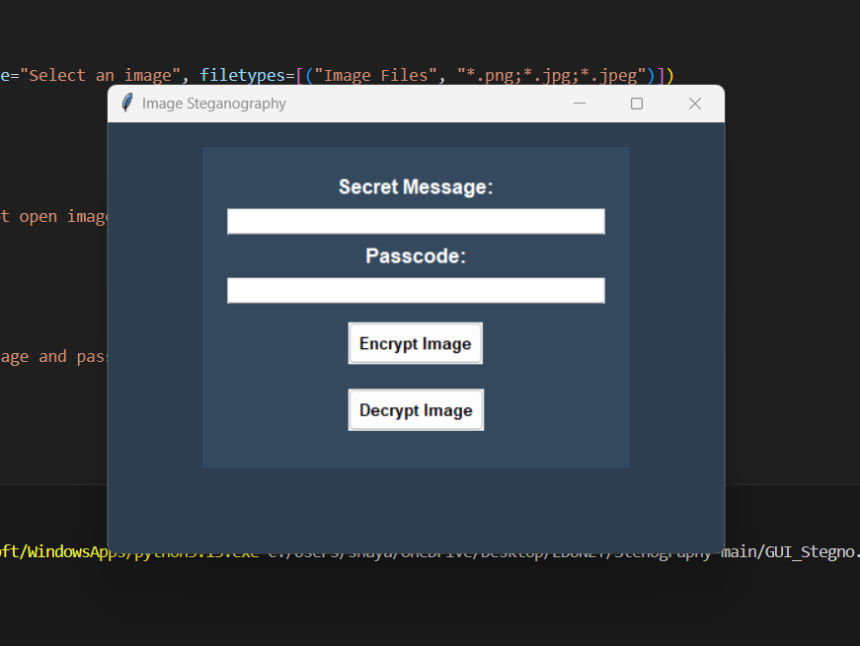
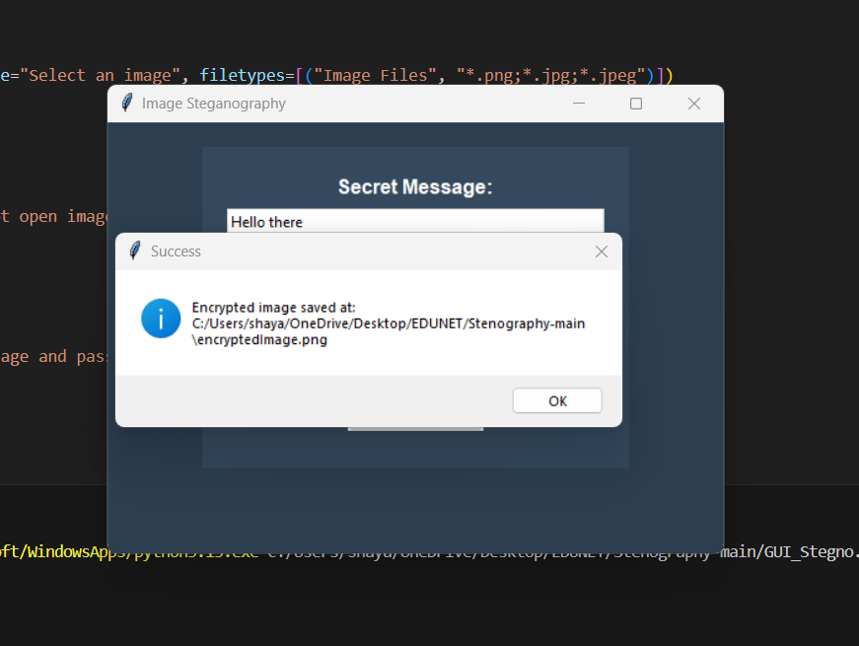
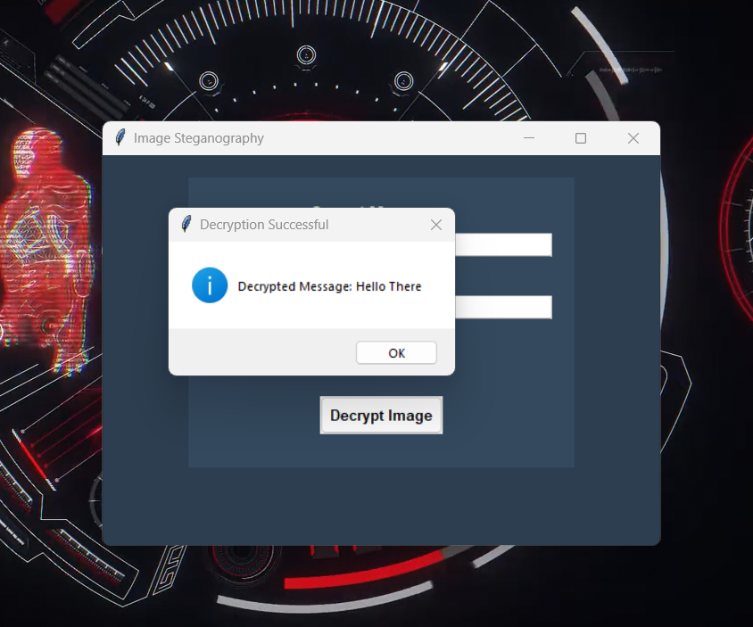
Results
Successfully encrypted and decrypted messages within images while ensuring data security using a passcode-based authentication system.

Slide 8
Conclusion
This project demonstrates the effectiveness of image steganography as a covert and reliable method of secure communication. By embedding messages in image pixels and ensuring passcode-protected decryption, the system prevents unauthorized access while keeping the encryption undetectable. The user-friendly GUI makes it accessible to a wider audience, allowing easy encryption without coding knowledge. Compared to traditional encryption, steganography adds an extra layer of secrecy by hiding messages in plain sight. This project can serve as a stepping stone for advanced security applications, including AI-powered steganographic techniques.

Slide 9
GitHub Link AND CONTACT
GitHub Link :- https://github.com/f1x1t007/AICTE_PROJECT
LinkedIn :- https://www.linkedin.com/in/shayaan-ahmed-f1x

Slide 10
Future scope(optional)
In the future, this project can be enhanced by integrating advanced cryptographic techniques such as AES encryption alongside steganography for dual-layer security. The tool can be improved to support video and audio steganography, making it even more versatile. Adding AI-based pattern recognition can help in detecting and preventing unauthorized steganographic attempts. The project can be extended into mobile applications and cloud-based platforms, enabling secure communication from any device. Additionally, an automated steganography detection system can be developed to analyze images for hidden data, making it useful for forensic investigations.

Slide 11
THANK YOU

