Slide 1
Assignment – Rohit Garg
Zip code analysis – distribution between Land, Multi Family & Single Family and distribution of count
Bin analysis - #bedroom vs #bathrooms and house size vs #beds+baths
Amount analysis (1) – distribution of listing price and distribution of sold price
Amount analysis (2) – distribution of listing price and distribution of sold price

Slide 2
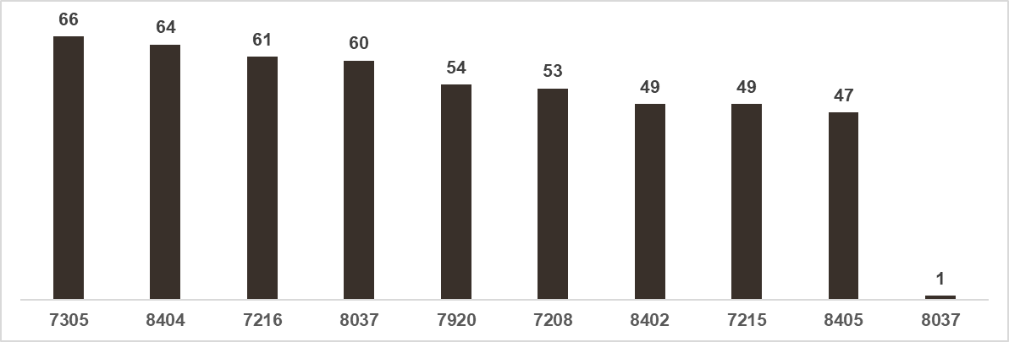
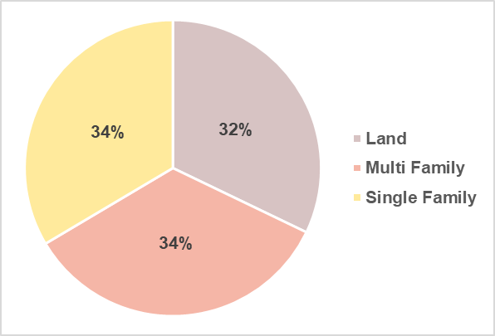
Zip Code Analysis
There are 504 observations in the dataset
Elizabeth has lowest population but 61 properties are listed
Atlantic City has highest population but 47 properties are listed
Hudson County only 1 property is listed
Equal distribution between Land, Multi Family and Single Family

Slide 3
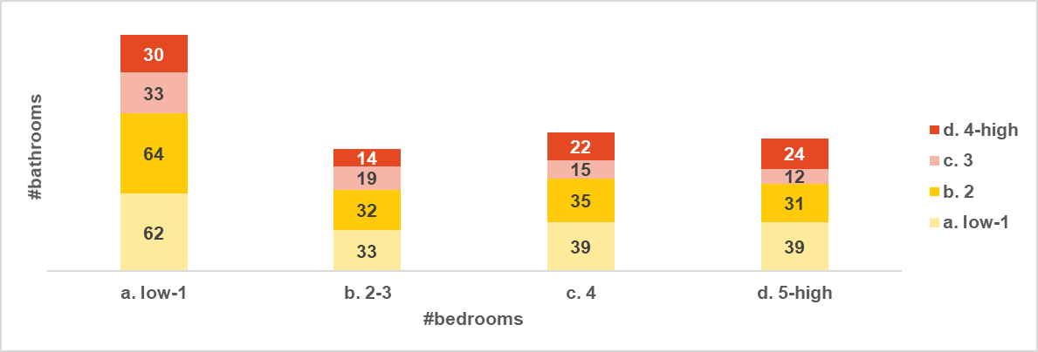
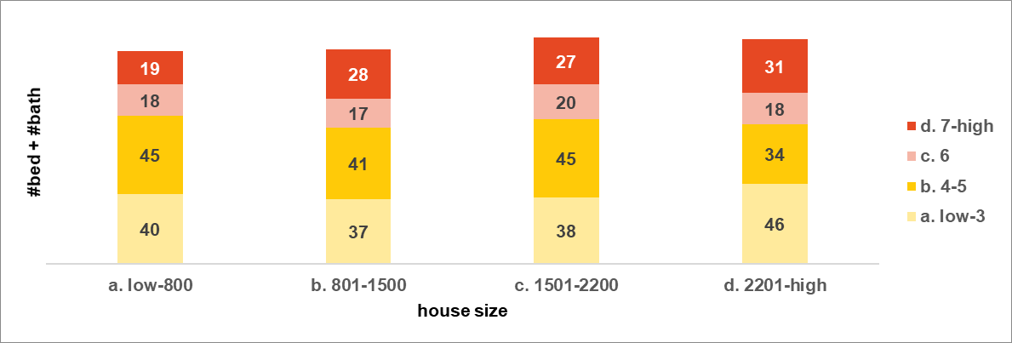
Bin Analysis
Y axis - #bathrooms
X axis - #bedrooms
Most of the properties have 1 bedroom
Equal distribution of properties that have 2-3 bedrooms, 4 bedrooms and 5+ bedrooms
Y axis – house size
X axis - #bed + #bath
Equal distribution of properties that have low-800 size, 801-1500 size, 1501-2200 size and 2201-high size

Slide 4
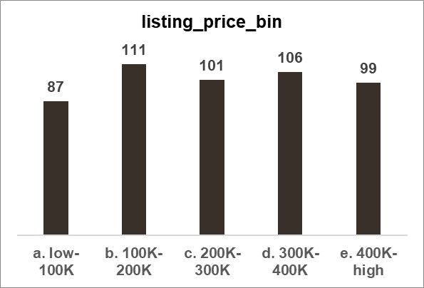
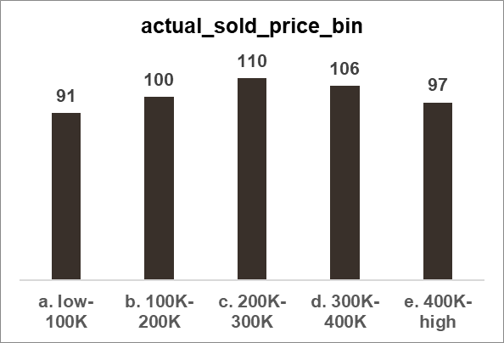
Amount Analysis (1)
Out of 504 properties, only 249 are sold
For listing and sold price all the properties are considered
Listing price (min = 12K, avg = 254K and max = 500K)
Actual sold price (min = 11K, avg = 256K and max = 500K)

Slide 5
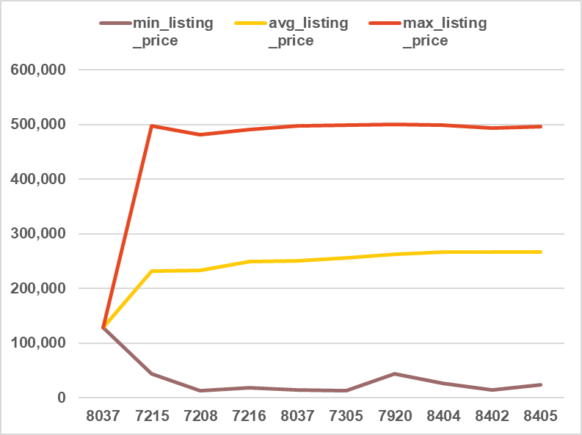
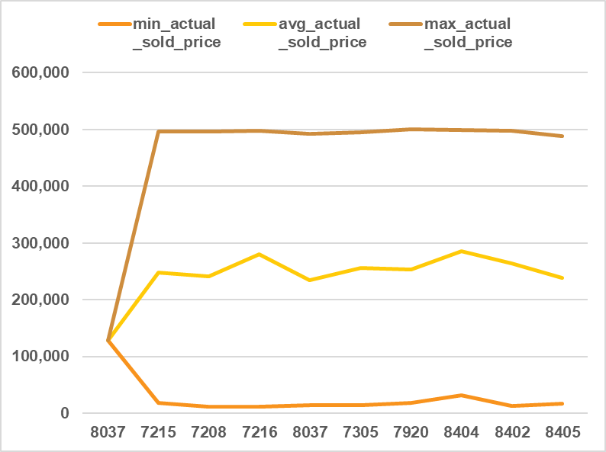
Amount Analysis (2)
Avg sold price >>> avg list price: Elizabeth (7215), Elizabeth (7208). Elizabeth (7216) and Atlantic City (8404)
Avg sold price <<< avg list price: Hammonton (8037), Basking Ridge (7920) and Atlantic City (8405)

