Slide 1
Proposals
stage transition model
Pricing model

Slide 2
stage Transition Model
Proposal:
stage transition models are developed to predict intermediate transitions (Stage 1 to Stage 2) as well as the terminal event (default).
stage transitions models can be built using loan-level panel data and achieve the granularity required for handling changes in customer, product and economic risk drivers.
Markov approach is used to implement the transition probability equations and iterate the transition matrix probabilities period to period throughout the forecast horizon.
 |  | To Time (T+1)
 |  | Stage 1 | Stage 2 | Stage 3 | Default | Total
From T | Stage 1 | 1 to 1 % | 1 to 2 % | 1 to 3 % | 1 to D % | 100%
 | Stage 2 | 2 to 1 % | 2 to 2 % | 2 to 3 % | 2 to D % | 100%
 | Stage 3 | 3 to 1 % | 3 to 2 % | 3 to 3 % | 3 to D % | 100%
Data:
Portfolio data:
borrower and account characteristics
product and collateral attributes
historical performance
other information required to assemble the model development dataset.
Example: Securitized Flag, Account Status, Interest Rate Type, Debt to Income Percentage, Net Recoveries, Original Principal Amount, Original FICO or Equivalent Score, Interest Rate Spread, Unpaid Principal Balance, etc.
Macroeconomic data:
historical macroeconomic data
macro-economic scenarios
Example: HPI, Mortgage Rate, GDP, Interest rates such as Bond Yields and Spreads, Unemployment Rate, etc
Modeling Methodology:
Deteriorating and Improving model:
Deteriorating models are transition from Stage 1 to Stage 2 (D1) and from Stage 2 to Stage 3 (D2), etc. Improving models are transition from Stage 2 to Stage 1 (I1) and from Stage 3 to Stage 2 (I2), etc.
We can use logistic regression model for each of the transition.
Example: For D1 the base is accounts in Stage 1 in time T, 0 is defined as the accounts that remain in Stage 1 in time T+1 and 1 is defined as the accounts that move to Stage 2 in time T+1
Implementation:
The probability models are tied together such that the sum of the row is 100%.

Slide 3
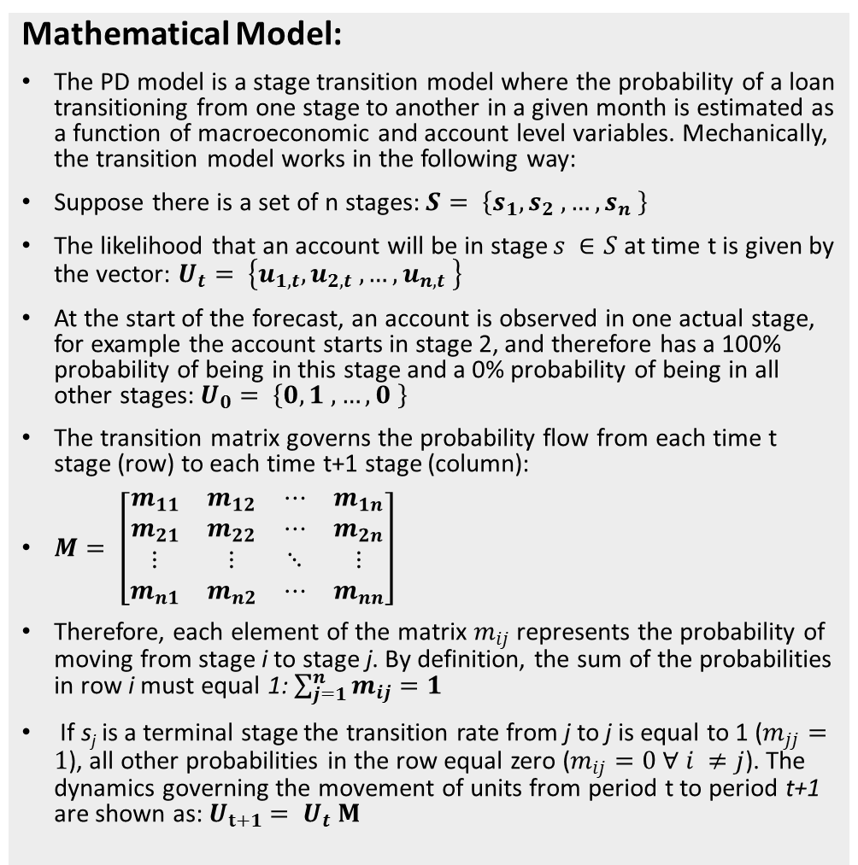
stage Transition Model
Mathematical Model:
The PD model is a stage transition model where the probability of a loan transitioning from one stage to another in a given month is estimated as a function of macroeconomic and account level variables. Mechanically, the transition model works in the following way:
Suppose there is a set of n stages: $S= \left\{s_{1}, s_{2} , …, s_{n} \right\}$
The likelihood that an account will be in stage $s ∈S$ at time t is given by the vector: $U_{t}= \left\{u_{1,t}, u_{2,t} , …, u_{n,t} \right\}$
At the start of the forecast, an account is observed in one actual stage, for example the account starts in stage 2, and therefore has a 100% probability of being in this stage and a 0% probability of being in all other stages: $U_{0}= \left\{0, 1 , …, 0 \right\}$
The transition matrix governs the probability flow from each time t stage (row) to each time t+1 stage (column):
$M= \left[\begin{matrix}\begin{matrix}m_{11} & m_{12} \\ m_{21} & m_{22}\end{matrix} & \begin{matrix}⋯ & m_{1n} \\ ⋯ & m_{2n}\end{matrix} \\ \begin{matrix}⋮ & ⋮ \\ m_{n1} & m_{n2}\end{matrix} & \begin{matrix}⋱ & ⋮ \\ ⋯ & m_{nn}\end{matrix}\end{matrix}\right]$
Therefore, each element of the matrix $m_{ij}$ represents the probability of moving from stage i to stage j. By definition, the sum of the probabilities in row i must equal 1: $\sum_{j=1}^{n}{m_{ij}=1}$
If s_{j} is a terminal stage the transition rate from j to j is equal to 1 ($m_{jj}=1$), all other probabilities in the row equal zero ($m_{ij}=0 ∀ i ≠j$). The dynamics governing the movement of units from period t to period t+1 are shown as: $U_{t+1}= U_{t} M$
Model Validation:
Average Error: The average error (or Bias) is calculated by averaging the error for individual units of measure. The smaller the average error the more accurate the model.
Avg Error= (∑(P_t- A_t )⁄A_t )/n
Where, P_t is the predicted value for group and A_t is the actual value for group t
MAPE: MAPE provides an absolute average model percent error. The smaller the MAPE, the smaller the absolute percent error. A weakness of MAPE is as A_t →0 the value of the MAPE becomes large.
MAPE=1/n ∑|(A_t-P_t)/A_t |
MASE: MASE is calculated as follows
MASE=(∑|P_t-A_t |) / (T/(T-1) ∑|A_t-A_(t-1)|)
MASE has the following desired properties vs. MAPE: Can be used to compare forecast across data sets with different scales, Non-explosive behavior as A_t -> 0, and Similar to MAPE, MASE is used as a relative measure of model error.
C-Statistic: The C-statistic is equivalent to the area under the Receiver Operating Characteristic Curve (ROC), which is often denoted by AUC. The C-statistic ranges from 0.5 to 1.
A value of 0.5 corresponds to a model equivalent to purely random classification of the response variable (the account transitions, or not, in month t).
A value of 1.0 corresponds to a model with perfect ability to classify the response variable. C-statistic and Gini coefficient can be derived from one another using a simple linear transformation.

Slide 4
Pricing Model
Proposal:
Adjusting the price of the product based on the Stage (the account is in)
This will help to incentivize the accounts to move from Stages 2/3 (high risk) to Stage 1
Example Table | Spread (With respect to LIBOR)
Base Rate | 0% (Same as LIBOR)
Stage 1 | 0.0-1.0% (Low risk – Low spread)
Stage 2 | 1.1-3.0% (Medium risk – Medium spread)
Stage 3 | 3.1-5.0% (High risk – High spread)
Modeling Methodology:
Ordinary Least Squares regression to determine the coefficients that best explain the relationship between observed log-spreads and rating, firm and contract details.
Log(Spread) =
Piecewise linear function of internal rating (on a numeric scale) +
Loan level information +
Macro economic information
Model made more robust through use of Bayesian prior on the model parameters
Create an appropriate balance between continuity to past data and fidelity to current data. If today’s data are few, then rely to some degree on previous day’s results.
Let historical relationship between parameters have some influence on how today’s parameters relate to each other
Data:
Portfolio data:
borrower and account characteristics
product and collateral attributes
historical performance
other information required to assemble the model development dataset.
Example: Securitized Flag, Account Status, Interest Rate Type, Debt to Income Percentage, Net Recoveries, Original Principal Amount, Original FICO or Equivalent Score, Interest Rate Spread, Unpaid Principal Balance, etc.
Macroeconomic data:
historical macroeconomic data
macro-economic scenarios
Example: HPI, Mortgage Rate, GDP, Interest rates such as Bond Yields and Spreads, Unemployment Rate, etc

