Slide 1
Time Series Analysis and Forecasting ROHIT GARG
Rohit Garg

Slide 2
Business Analytics
Business analytics (BA) refers to the skills, technologies, practices for continuous iterative exploration and investigation of past business performance to gain insight and drive business planning
Examples of application
Banks, such as Capital One, use data analysis, to differentiate among customers based on credit risk, usage and other characteristics and then to match customer characteristics with appropriate product offerings.
E & J Gallo Winery quantitatively analyses and predicts the appeal of its wines.
Deere & Company saved more than $1 billion (between 2002 and 2005) by employing a new analytical tool to better optimize inventory.
Types of analytics
Decision Analytics: supports human decisions with visual analytics that the user models to reflect reasoning (Budgeting decisions).
Descriptive Analytics: gains insight from historical data with reporting, scorecards, clustering etc. (Capital One - Customer segmentation)
Predictive Analytics: employs predictive modelling using statistical and machine learning techniques (Probability of major disease outbreak in Asia)
Prescriptive Analytics: recommends decisions using optimisation, simulation, etc. (Netflix – Movie recommendation)

Slide 3
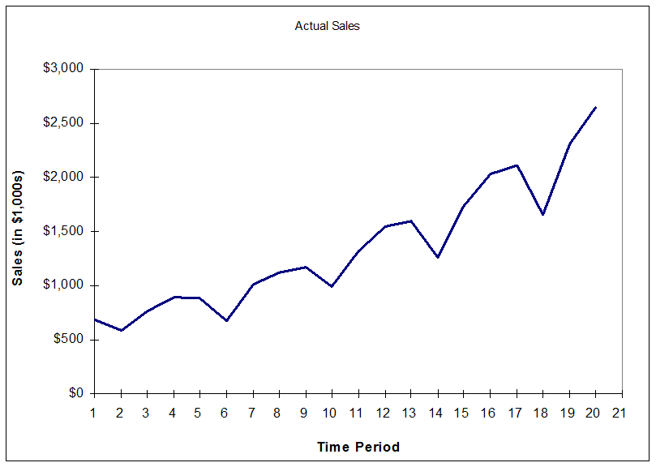
Introduction to Time Series Analysis
A time-series is a set of observations on a quantitative variable collected over time.
Examples
Sensex
Historical data on sales, inventory, customer counts, etc
Businesses are often very interested in forecasting time series variables.
In time series analysis, we analyze the past behavior of a variable in order to predict its future behavior.
Some Time Series Terms
Stationary Data - a time series variable exhibiting no significant upward or downward trend over time.
Nonstationary Data - a time series variable exhibiting a significant upward or downward trend over time.
Seasonal Data - a time series variable exhibiting a repeating patterns at regular intervals over time.

Slide 4
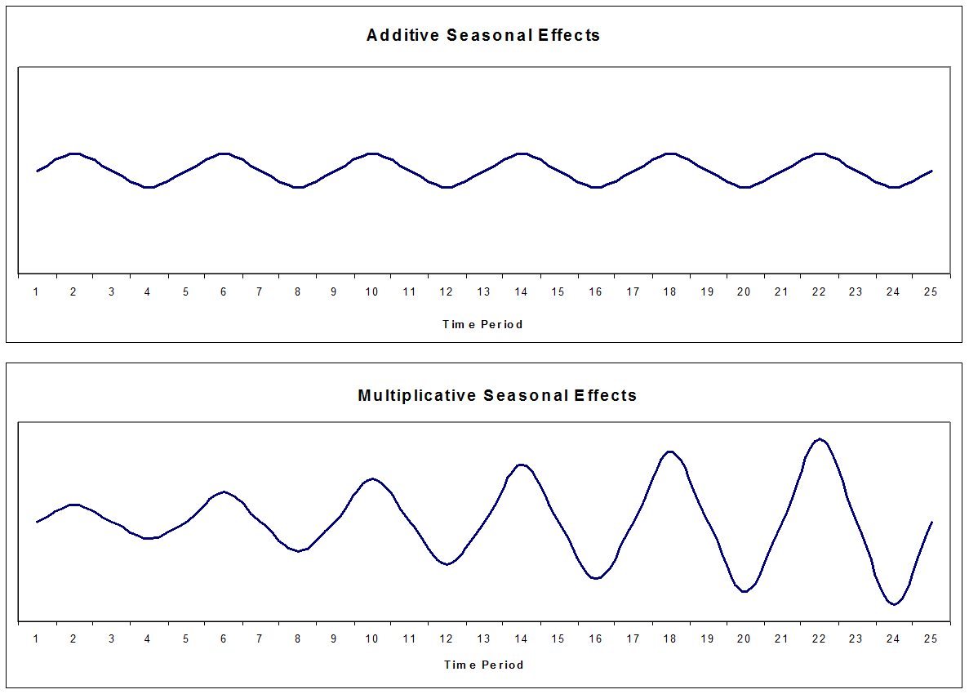
Components of TSA
Trend
Gradual, long-term movement (up or down) of demand. Easiest to detect
Seasonal Variation
An up-and-down repetitive movement within a trend occurring periodically.
Often weather related but could be daily or weekly occurrence
Random Variations
Erratic movements that are not predictable because they do not follow a pattern
Seasonality
Seasonality is a regular, repeating pattern in time series data.
May be additive or multiplicative in nature
Additive: Y = T + S + R
Multiplicative: Y = T * S + R

Slide 5
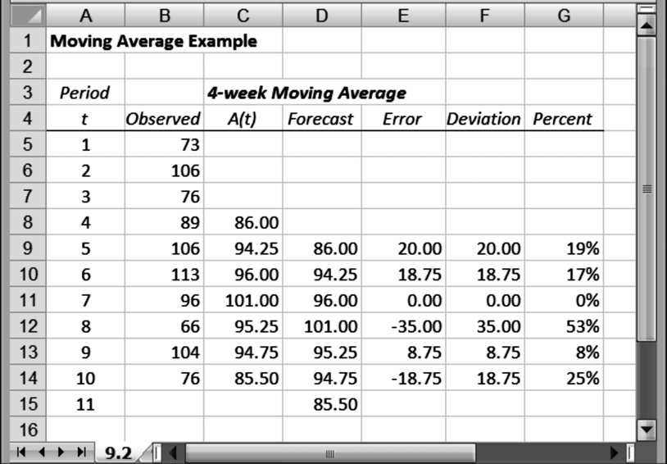
Moving Average
The n-period moving average builds a forecast by averaging the observations in the most recent n periods:
where x_{t} represents the observation made in period t, and A_{t} denotes the moving average calculated after making the observation in period t.
What is the number of periods to be included
There is no definitive answer, but there is a trade-off to consider.
If we include very few data points, then the moving average exhibits more variability than if we include a larger number of data points.
If we include very few data points, our moving average will tend to track the changed process more closely than if we include a larger number of data points.

Slide 6
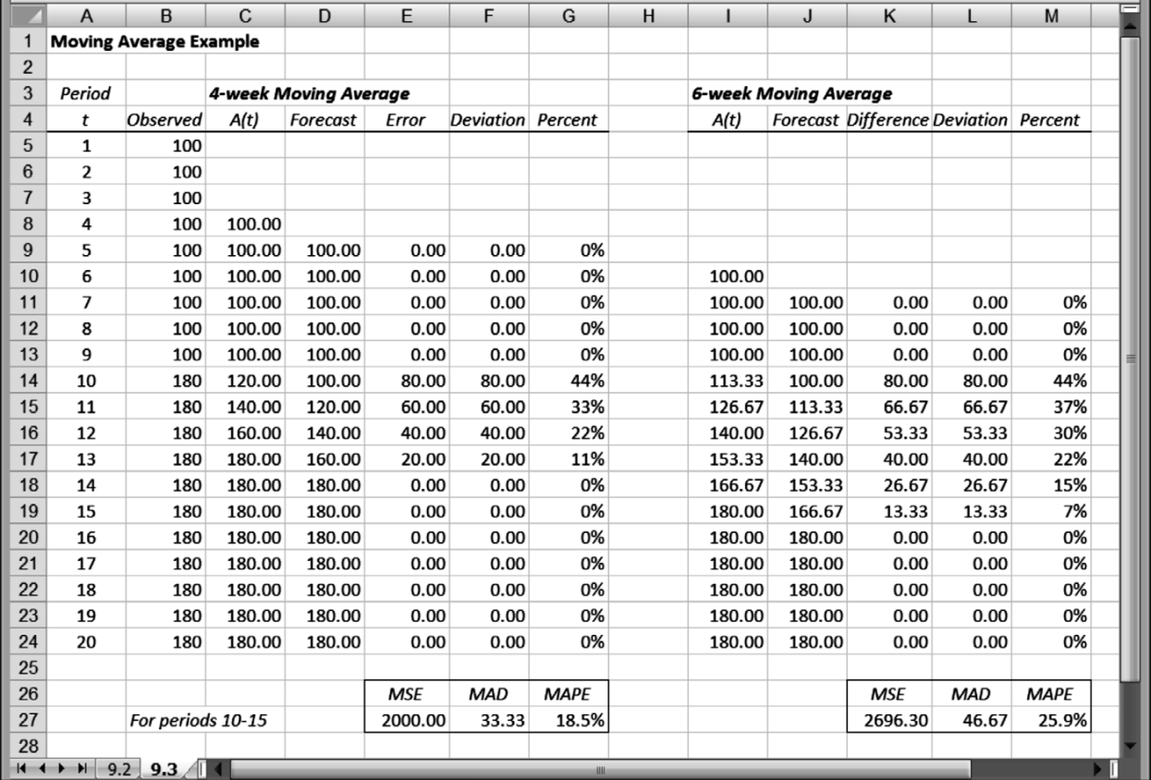
Measures of Forecast Accuracy
MSE: the Mean Squared Error between forecast and actual
MAD: the Mean Absolute Deviation between forecast and actual
MAPE: the Mean Absolute Percent Error between forecast and actual
Notes:
The MAD calculation and the MAPE calculation are similar: one is absolute, the other is relative.
MAPE is usually reserved for comparisons in which the magnitudes of two cases are different.

Slide 7
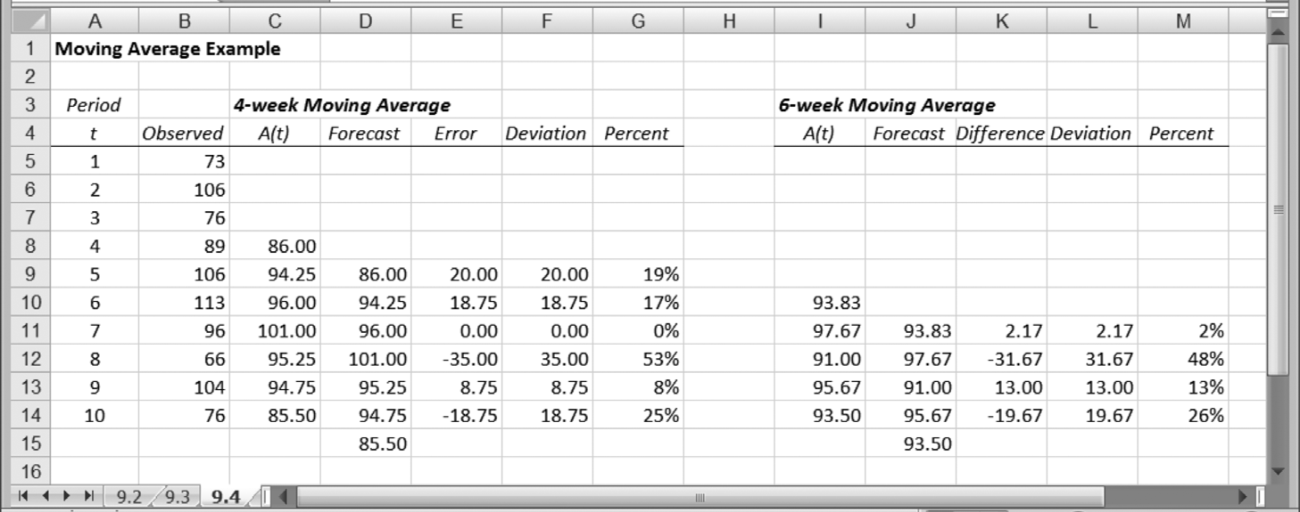
Comparison of 4-week and 6-week Moving Averages
Excel Tip: Moving Average Calculations
Excel’s Data Analysis tool (Data►Analysis►Data Analysis►Moving Average) contains an option for calculating moving averages.
Excel assumes that the data appear in a single column, and the tool provides an option of recognizing a title for this column, if it is included in the data range.
Other options include a graphical display of the actual and forecast data and a calculation of the standard error after each forecast.

