Slide 1
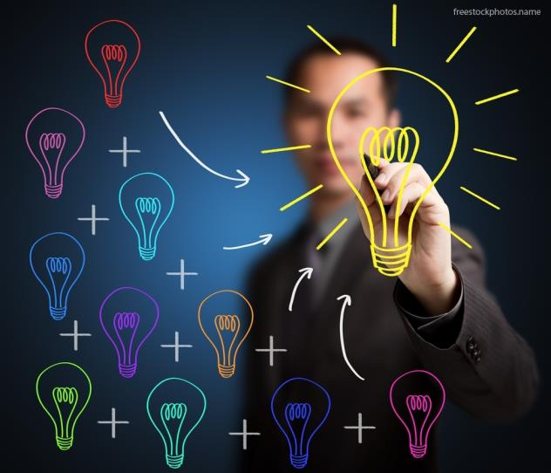
Machine
Learning
1: NLP………... | A
2: DNLP………. | B
3: SEQ2SEQ (RNN’S) ……………. | C

Slide 2
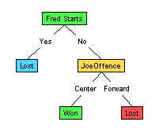


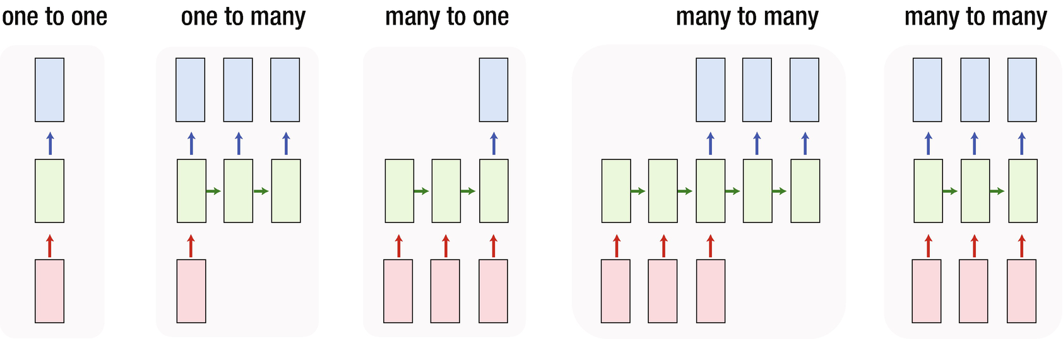
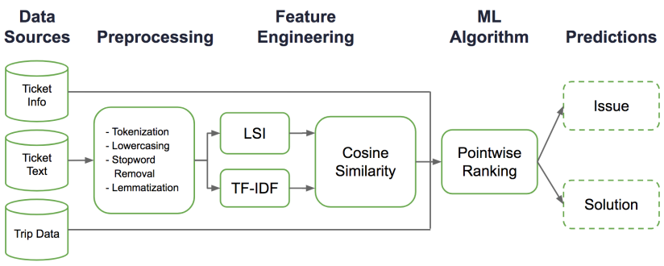

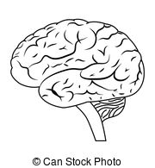
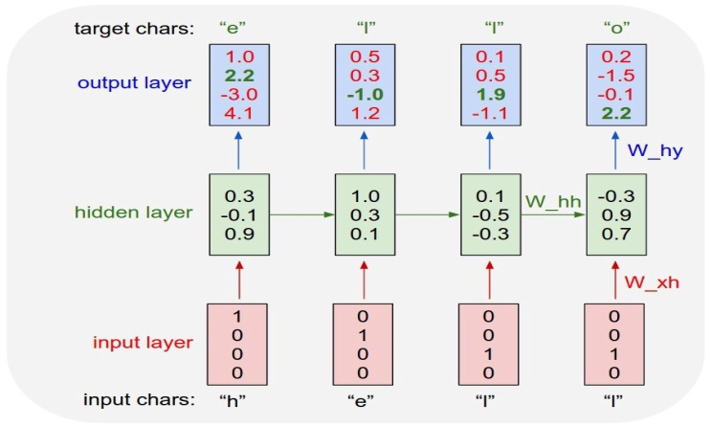
Requirements and Scenarios
Scenario 1
Scenario 2
CX1
UI
CX2
UI
Scenario 3
CX3
UI
This diagram depicts the position each of the models mentioned above occupies in the Venn diagram
NLP
DNLP
DL
seq2seq

Slide 3
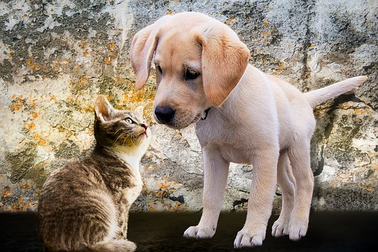

Limitations of NLP and DNLP
Natural language processing does not consider the order of the words into account just looking at the words in the sentence and further tokenizing , lemmatizing and also looking at the frequency of significant words it will try to predict an answer e.g. lets consider sentences ‘the dog is bigger than cat’ and ‘the cat is bigger than dog’. In both of them significant words are ‘dog ‘and ‘cat’ and since the mechanism is not using brain so might give same answer say ‘yes’ looking at the frequency of significant words in both cases.
This calls for a need to move on to deep learning and bring brain in form of neural networks in picture. Now it will use its knowledge to give an answer but still it will be confined to fixed length approach i.e.
Every input has to be a vector of same length according to dictionary of words and even every output should also be a vector of same length .
So there is a need to add more to it and hence a requirement to bring recurrent neural networks in picture as the name suggest re-occurring (repeating) neural networks which completely vanishes the requirement of fixed length input and output .
Input : [1, 2, 3, 4, 5, 5, 6, 7, 0, 0, 0]
Output : [12, 5, 11, 54, 12, .. 13, .. 0, 0, 0, 0, 0]

