Slide 1
Data Science – Skills Assessment
Quick questions addressed in this analysis:
Provide details about the data and what are the most reported issues? (Slide 2)
What is the distribution of complaints by Product type, Region, Country, Contact type, Repeat complaints and Outside contract, Diagnostics, Repair type and Contact manager? (Slides 3, 4 and 5)
Provide comments on code (Slide 6)

Slide 2
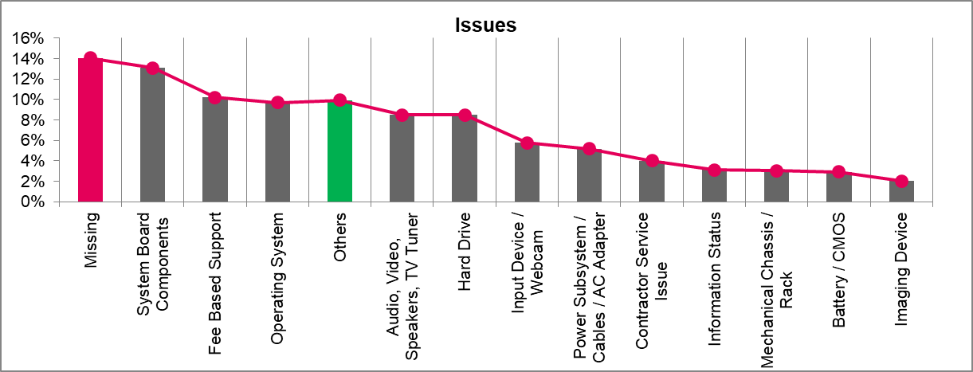
Log and Issues
In this slide the Log and Issues are analyzed
Action Items: There were 100,000 complaints in the week of 201804. Significant percentage of complaints comes from issue System Board Components.
Log | Top Issue Types
Count of complaints: 100,000 Count of unique assets: 82,442 Complaint week: 201840
Insight: There were 100,000 complaints in the week of 201840. | Insights: 50% of the total issues come from 5 items – ‘System Board Components’, ‘Fee Based Support’, ‘Operating System’, ‘Audio, Video, Speakers, TV Tuner’ and ‘Hard Drive’
Footnote (Issues): Missing (red bar) indicates that the issue was not captured. Others (green bar) indicate rest of the issues. Top 12 issues (gray bars) based on count are shown in the chart (Pareto’s law)

Slide 3
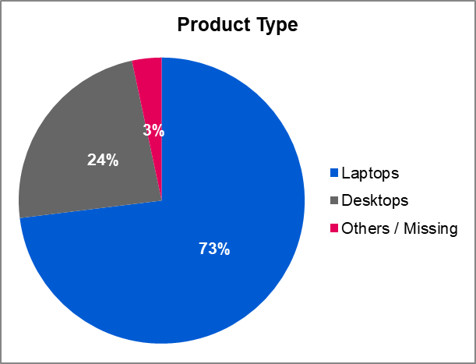
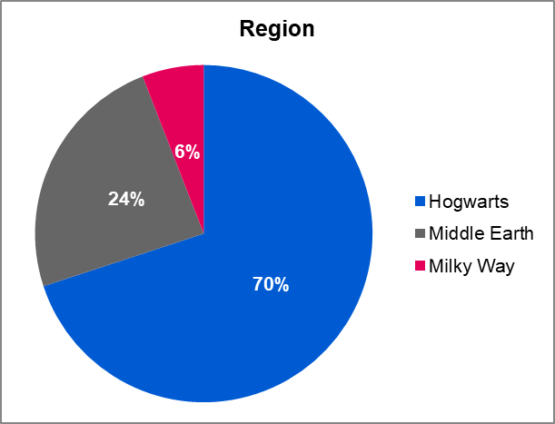
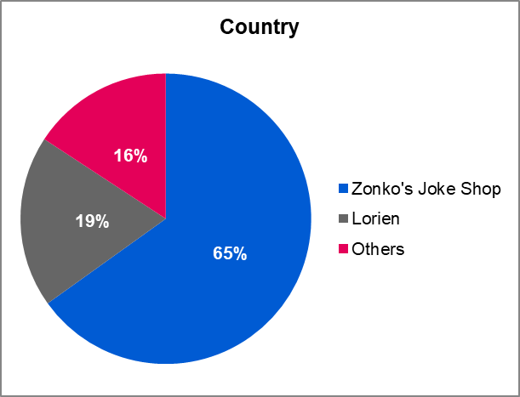
Product type, Region and Country
In this slide the complains are analyzed by product type, region and country
Action Items: Significant percentage of complaints come from product type Laptops, region Hogwarts and country Zonko's Joke Shop
Product Type | Region | Country
Insight: Out of 100,000 complaints, 73% of the complaints came from laptop users. | Insights: Out of 100,000 complaints, 70% of the complaints came from Hogwarts | Insights: Out of 100,000 complaints, 65% of the complaints came from Zonko's Joke Shop
Footnote (Product Type): Missing (count = 19) is added with Other Electronics (count = 3,327)
Footnote (Region): Missing (count = 3) is added with Milky Way (count = 5,898)

Slide 4
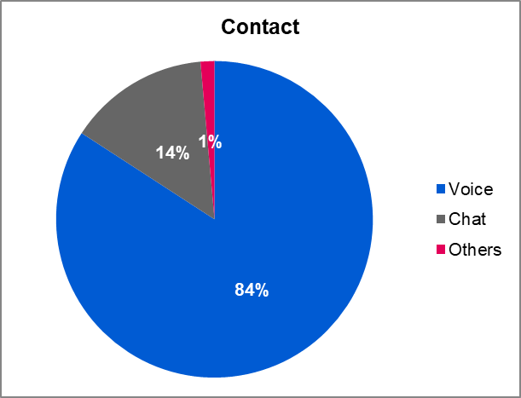
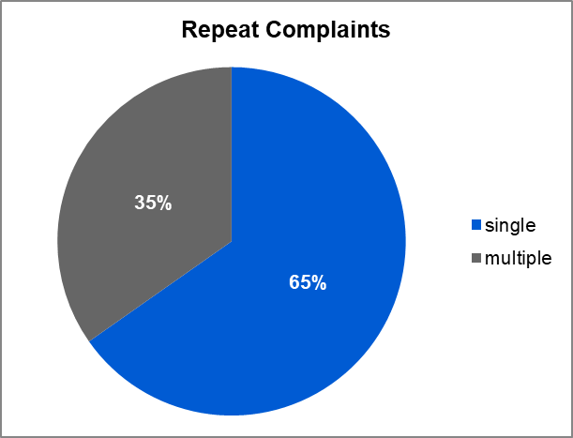
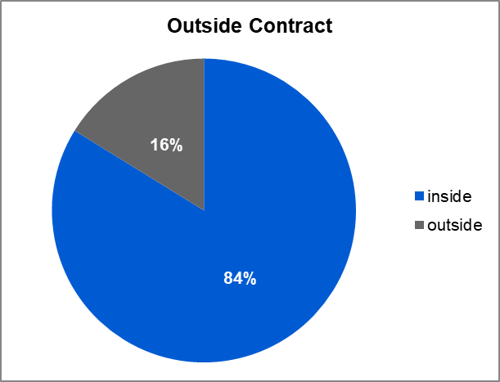
Contact type, Repeat complaints and Outside contract
In this slide the complains are analyzed by contact type, repeat complaints (more than one complaints were raised per asset id) and outside contract (complaint week is either before the contract start week or after the contract end week)
Action Items: One third (35%) of total complaints are repeat complaints indicating that multiple issues occurred for an asset. One sixth (16%) of total complaints are raised outside the contract window indicating that warranty is not applicable.
Contact Type | Repeat Complaints | Outside Contract
Insight: Out of 100,000 complaints, 84% of the complaints were raised through voice. | Insights: Out of 100,000 complaints, 35% of the complaints were repeated. | Insights: Out of 100,000 complaints, 84% of the complaints came during the contract period
Footnote (Contact Type): Others include email (count=1,281), unknown (count=118) and missing (count=14)

Slide 5
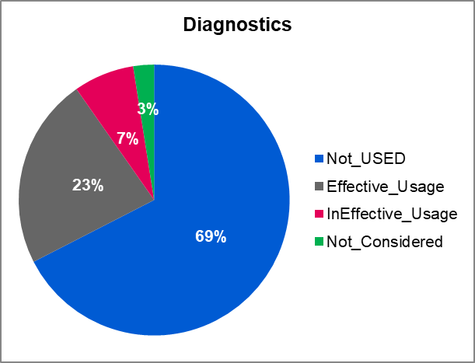
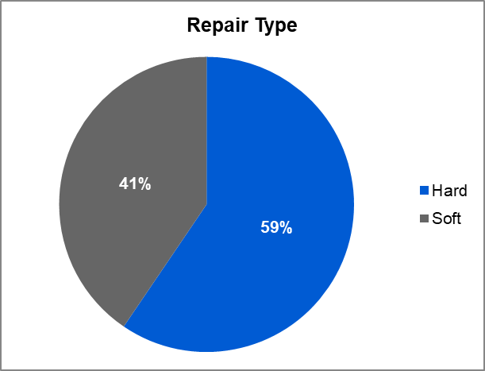
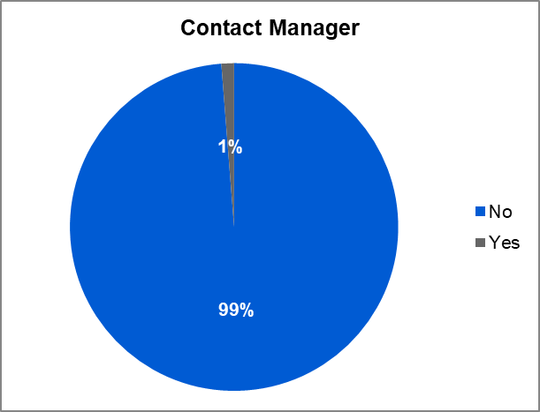
Diagnostics, Repair type and Contact manager
In this slide the complains are analyzed by diagnostics, repair type and contact manager
Action Items: Diagnostics is not used for significant number of complaints. Majority of the repairs are hard repairs. Only in 1% of the cases the tech support agent has to bring in a manager to solve the problem.
Diagnostics | Repair Type | Contact Manager
Insight: Out of 100,000 complaints, 67% of the complaints diagnostics was not used. | Insights: Out of 100,000 complaints, 59% of the complaints were hard repairs. | Insights: Out of 100,000 complaints, only for 1% of the complaints the manager was contacted
Footnote (Contact Manager): Diagnostics (Effective_Usage and InEffective_Usage) is preformed whenever the contact manager flag is 1

Slide 6
Appendix – Data Cleaning Steps
Step | Details
Missing product type | Against few asset ids it was observed that the product type is missing. There are 82,423 unique asset ids where the product type is present
Missing region and country | There are 82,439 unique asset ids where the region is present. There are 75,910 unique asset ids where the country is present.
Log and Issues | The count of rows is 100,000 and count of unique asset id is 82,442. The data is rolled up at Issues and count of asset id is taken (the sum of count of asset id is 100,000).
Product type, Region and Country | The data is rolled up at Product type and count of asset id is taken (the sum of count of asset id is 100,000). The data is rolled up at Region and count of asset id is taken (the sum of count of asset id is 100,000). The data is rolled up at Country and count of asset id is taken (the sum of count of asset id is 100,000).
Contact type, Repeat complaints and Outside contract | The data is rolled up at Contact type and count of asset id is taken (the sum of count of asset id is 100,000). The data is rolled up at Repeat complaints and count of asset id is taken (the sum of count of asset id is 100,000). The data is rolled up at Outside contract and count of asset id is taken (the sum of count of asset id is 100,000).
Diagnostics, Repair type and Contact manager | The data is rolled up at Diagnostics and count of asset id is taken (the sum of count of asset id is 100,000). The data is rolled up at Repair type and count of asset id is taken (the sum of count of asset id is 100,000). The data is rolled up at Contact manager and count of asset id is taken (the sum of count of asset id is 100,000).

Slide 7
Thank You
Rohit Garg

