Slide 1
Detecting Pattern in Purchase History: Given a dataset on order history, explore association rules learning methods for pattern recognition
Faculty of Computer Science
Master of Data Science
Moscow 2023
Student: Siddharth Kumar Shukla
Supervisor: Maksimovskaya Anastasia Maksimovna HSE Lecturer

Slide 2

Pattern Detection
Master of Data Science
Detecting Pattern in Purchase History
Introduction
Process of identifying and understanding patterns and association rules within data representing customers’ purchasing behaviour.
Extract useful information from the transaction dataset.
Aims to discover the relationship and dependencies among items such as frequently co-purchased items, sequential purchase patterns, association between customer and items.
Association rule mining techniques such as Apriori Algorithm & FP-growth algorithm are used to analyze the dataset to generate rules that describe the relationship between two items.
My research evaluates the performance of these algorithms in terms of the quality of the discovered patterns and discover the hidden patterns.

Slide 3
Why is Pattern Analysis needed?
Master of Data Science
Detecting Pattern in Purchase History
Why is Pattern Analysis Useful
Understanding Customer Behavior Understand customer purchase habits & preferences, frequent purchases, factors affecting buying decisions, etc.
Enhancing Marketing Strategies Run promotions based on the discovered association rules like creating bundled offers or recommend related products.
Personalized Recommendations Understanding individual customer and giving personalized recommendation improves customer experience.
Inventory Management Identify the frequently purchased products, seasonal demand products, business can make better forecast of their inventories. This leads to better stock management, reduced cost, and customer satisfaction
Customer Segmentation By grouping customers with similar interests, business can create marketing campaigns, loyalty programs, etc. for each segment . Helps in understanding diversity, identify high-valued customers and tailor their strategies to meet specific needs.

Slide 4
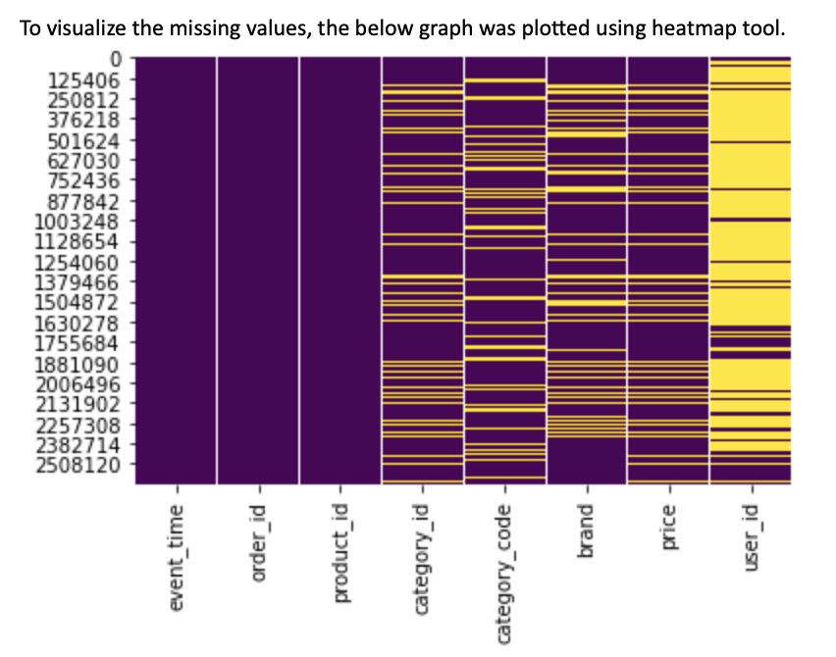
Master of Data Science
Detecting Pattern in Purchase History
Exploratory Data Analysis
Exploratory Data Analysis
Involves exploring the dataset and summarizing the main characteristics in the dataset.
Primary goal is to discover hidden insights and formulate initial hypotheses.
EDA allows initial assessment of data quality.

Slide 5
Observations
Master of Data Science
Detecting Pattern in Purchase History
Exploratory Data Analysis
The maximum value of order placed is $ 52295.243. In this order, 3 products were purchased out of which, 2 products belong to Samsung brand.
The product which is most frequently bought lies close to the median price whereas the less frequent items are either too left or too right to the median.
Every product is associated with only 1 category_id. Hence, there is a one-to-one mapping between product_id and category_id.
The most frequently bought product generates the maximum revenue.
Samsung is the brand which has maximum sales.

Slide 6
Apriori Algorithm
Master of Data Science
Detecting Pattern in Purchase History
Apriori Algorithm
Designed to discover frequent item-sets from large transactional dataset .
Follows a breadth-first search approach
Apriori property states that if an itemset is frequent, then its subsets must also be frequent. Using this idea, we eliminate the candidate item-sets that contain infrequent subsets.
Minimum Support and Confidence levels are user-defined thresholds that control the generation and evaluation of frequent item-sets and association rules, respectively.
Minimum Support refers to the proportion of transactions in the dataset that contain a particular itemset.
Confidence measures the strength of the relationship between the premise and conclusion in an association rule.
Confidence({A} -> {B}) = Support({A, B}) / Support({A})

Slide 7
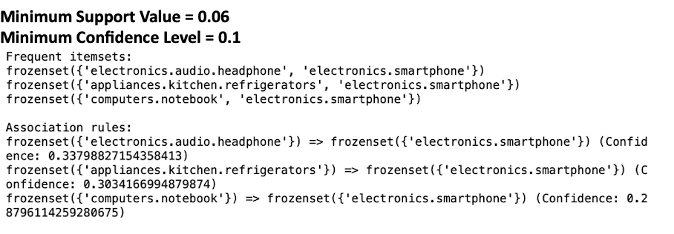
Generating Frequent Itemset using Apriori Algorithm
Master of Data Science
Detecting Pattern in Purchase History
Apriori Algorithm
Dataset is scanned to generate frequency of the item-sets. Items that don’t meet the minimum support threshold are eliminated and we are left with frequent 1-item-sets.
Item-sets of length 2 are generated. Candidates are formed by taking union of two frequent 1-itemsets.
The frequency of 2-itemsets is calculated and item-sets which don’t meet the minimum support threshold are pruned.
The above steps are repeated generating candidate item-sets of increasing length until no frequent item-sets can be generated.
After identification of all frequent item-sets, algorithm generates association rules from these item-sets.
Confidence of a rule is calculated by dividing support of rule’s itemset by support of rule’s antecedent. Rules that meet minimum confidence threshold are significant.

Slide 8
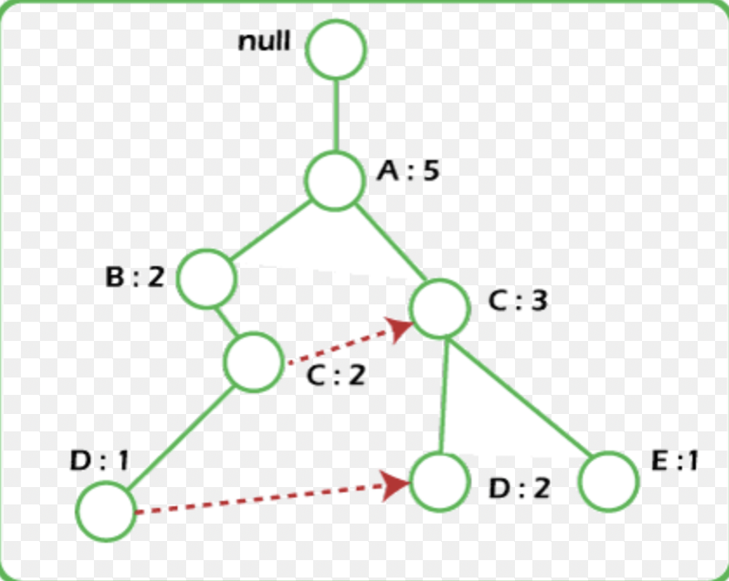
FP-Tree Algorithm
Master of Data Science
Detecting Pattern in Purchase History
FP-Tree Algorithm
Used for mining frequent item-sets in large transactional datasets.
Utilizing a tree-based data structures called FP-Tree which enables more efficient mining of frequent item-sets.
FP-Tree constructed by scanning the dataset twice.
In the first scan, the algorithm counts the support of each item in the dataset.
In the second scan, it builds the FP-tree by linking items that share common prefixes.
The construction of the FP-tree eliminates the need for multiple database scans, making the algorithm more efficient than the Apriori algorithm for large datasets.

Slide 9
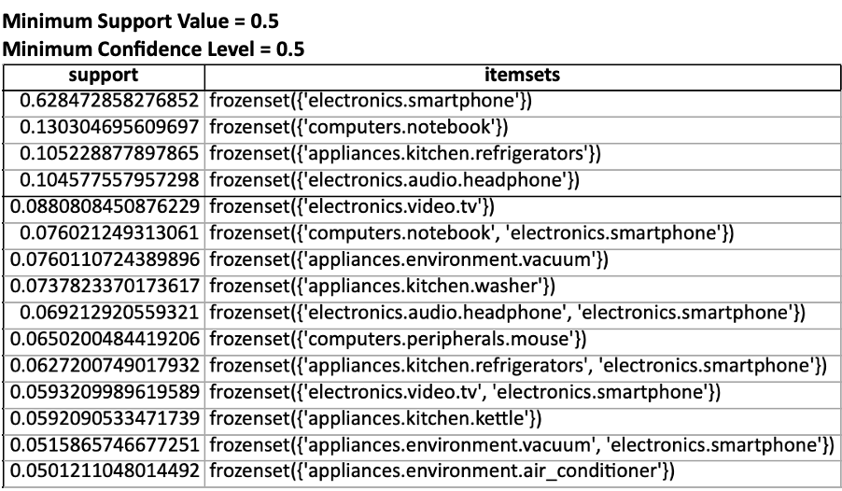
Generating Frequent item-sets using FP-Tree Algorithm
Master of Data Science
Detecting Pattern in Purchase History
FP-Tree Algorithm
FP-Tree consists of nodes representing item-sets, linked together to form item-sets based on the occurrence in transactions. Each node contains item name, count of its occurrence and links to its child nodes.
Remove infrequent items from the dataset. This results in lesser memory consumption and speeds up the algorithm.
Sort items in descending order based on their frequencies.
For each transaction, insert sorted items into the FP-Tree. If item already exists, increment its count otherwise create a new branch from root node and add item as a child node
Repeat the above steps for all transactions.
Starting from least frequent item, recursively mine frequent item-sets from the FP-Tree.
From frequent item-sets obtained, association rules can be generated. Based upon the minimum confidence threshold criteria, relevant rules are filtered out.

Slide 10

Frequent item-sets
Master of Data Science
Detecting Pattern in Purchase History
Results
1. Headphone & Smartphone 2. Computer notebook & Smartphone 3. Television set & Smartphone 4. Refrigerator & Smartphone 5. Vacuum Cleaner & Smartphone
Possible Conclusion - customers who come for buying expensive products such as Computer, Television set, Vacuum Cleaner, etc. also end up buying Smartphones. The reason behind this can be that the shop offers some discount on Smartphones who buy expensive items.

Slide 11
Apriori Vs FP-Tree Algorithm
Master of Data Science
Detecting Pattern in Purchase History
Apriori Vs FP-Tree Algorithm
Data Structure: FP-Tree Algorithm uses tree structure for mining frequent items whereas Apriori Algorithm relies on itemset lattice.
Memory Usage: FP-Tree Algorithm eliminates the need to store the entire database. Apriori Algorithm needs to maintain item-sets and support value for each iteration and hence Apriori Algorithm requires more memory.
Runtime Efficiency: FP-Tree algorithm generally takes less computational time because it constructs tree in a single dataset scan whereas Apriori Algorithm scans the dataset multiple times and generates large item-sets which results in more computational time.
Implementation Complexity: FP-Tree Algorithm is relatively complex to implement due to construction and transversal of FP-Tree structure.

Slide 12
Conclusion
Master of Data Science
Detecting Pattern in Purchase History
Conclusion
Association Rule mining plays an important role in extracting valuable insights from the transactional dataset of customers.
The research begins by providing overview of two famous association rule mining algorithms that is Apriori Algorithm & FP-Tree Algorithm.
Association rules are discovered using both these algorithms using different set of parameters.
Various performance metrics such as execution time, memory consumption is measured to make comparison between these two algorithms.
Overall this study provides an understanding of strengths and limitations of the FP-Tree algorithm & Apriori algorithm for association rule mining.

Slide 13

Thanks for being a wonderful audience!!
Master of Data Science
Detecting Pattern in Purchase History
Thanks

Slide 14

Questions?
Master of Data Science
Detecting Pattern in Purchase History
Question Session

