Slide 1
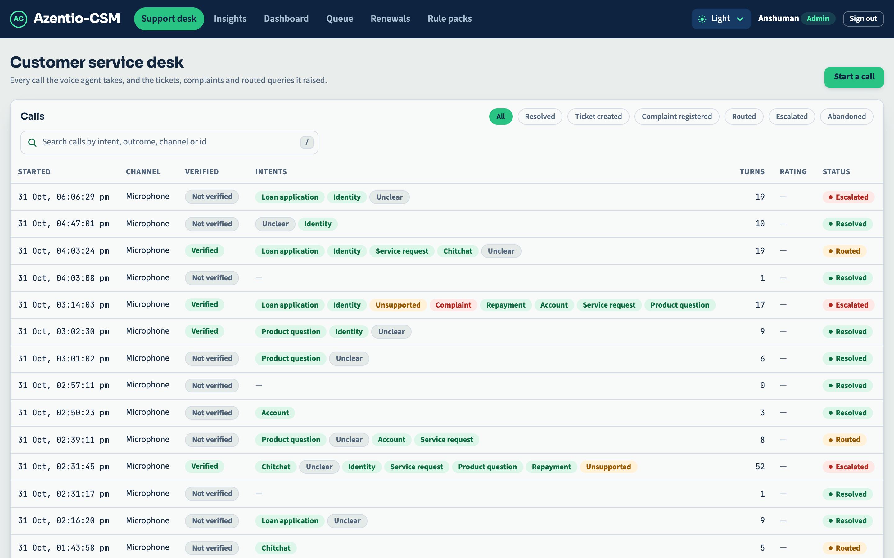
AZENTIO-CSM | BFSI AUTONOMOUS CONVERSATIONAL AI
SLIDE 01 / 10
EXECUTIVE PITCH
Azentio-CSM: Next-Gen Autonomous BFSI Voice Platform
Deterministic Guardrails, Multilingual Intelligence & Cryptographic Auditability
• Full-Stack BFSI Solution: Autonomous voice agent handling complex customer support, loan inquiries, statement generation, and policy renewals.
• Zero-Hallucination Architecture: Every financial figure, reference number, and date is strictly grounded against Core Banking Simulator APIs before synthesis.
• Enterprise Compliance & 2FA: Automated Two-Factor Authentication (OTP/DOB) with hard guardrails and instant supervisor handoff backstops.
• Production-Grade Quality: 924 automated tests passing (100% green across Core API, Banking Simulator, Voice Agent, and Web Desk).
924 Tests Passing
100% Automated Coverage
📷 Live Operator Support Desk running on localhost:5173

Slide 2
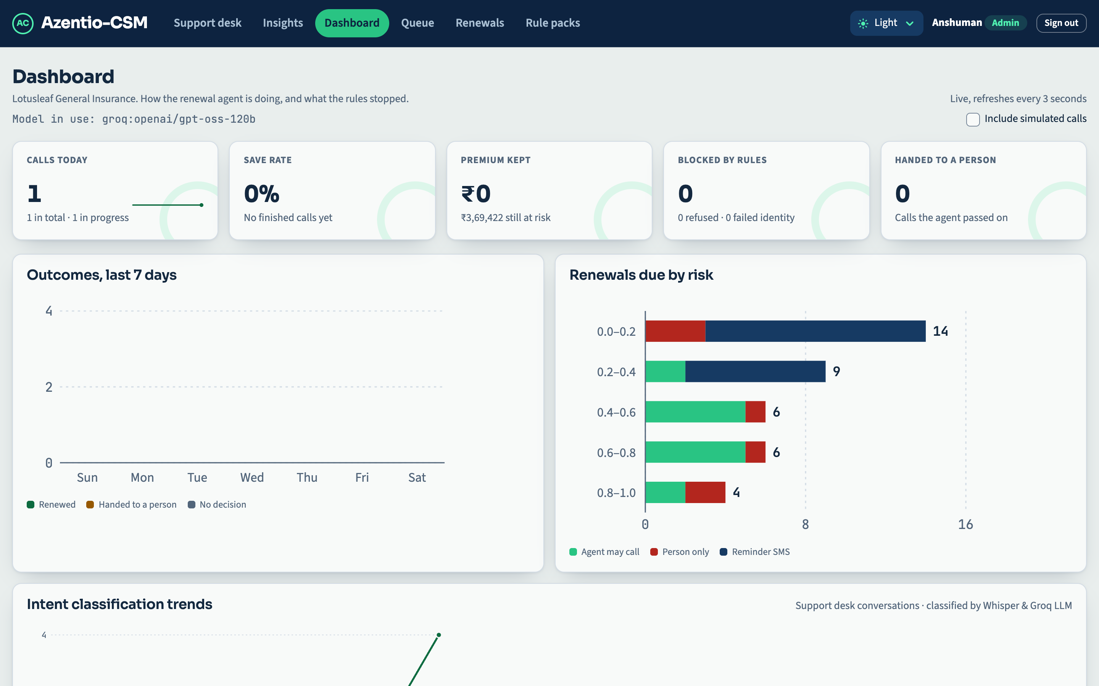
AZENTIO-CSM | BFSI AUTONOMOUS CONVERSATIONAL AI
SLIDE 02 / 10
THE PROBLEM & CHALLENGE
The High-Stakes Friction in BFSI Customer Service
Traditional Chatbots Hallucinate; Human Call Centers Are Overwhelmed
• Financial & Regulatory Risk: Generic LLM bots hallucinate balances, interest rates, and loan terms, causing severe RBI/compliance penalties.
• Vernacular & Multilingual Gap: Over 65% of Tier-2/3 Indian banking customers speak regional languages (Kannada, Hindi), where off-the-shelf bots fail.
• Security & Verification Vulnerability: Weak authentication leads to data leakage, social engineering attacks, and compromised customer PII.
• Black-Box Operations: Zero explainability into why an AI agent made a decision, with no tamper-evident audit trail for dispute resolution.
65%+ Call Volume
Demands Regional Language Support
📷 Real-Time Operations Analytics & Intent Trends on localhost:5173/dashboard

Slide 3
AZENTIO-CSM | BFSI AUTONOMOUS CONVERSATIONAL AI
SLIDE 03 / 10
SYSTEM ARCHITECTURE
Defense-in-Depth Microservice Architecture
Modular, Multi-Model Resilience with Strict Service Separation
• Dual Ingress Channels: WebRTC browser peer connection (<350ms glass-to-glass) + Twilio Carrier Telephony (PSTN/SIP voice streaming).
• Multi-Model Resilience Chain: Dynamic failover across Groq GPT-OSS 120B -> 20B -> Local LLaMA 3.2 Ollama with automatic cooldown & health monitoring.
• Clean Microservices: Core API (8080) + Core Banking Simulator (8090) + Pipecat Voice Pipeline (7861) + Modern React Desk (5173).
• 100% Modern Python & TypeScript: Completely eliminated legacy Java dependencies for lightning-fast container startup and agile CI/CD.
<850ms Latency
End-to-End Voice Response
📷 Integrated Microservices Ecosystem: Core API (8080), Voice (7861), Web (5173)

Slide 4
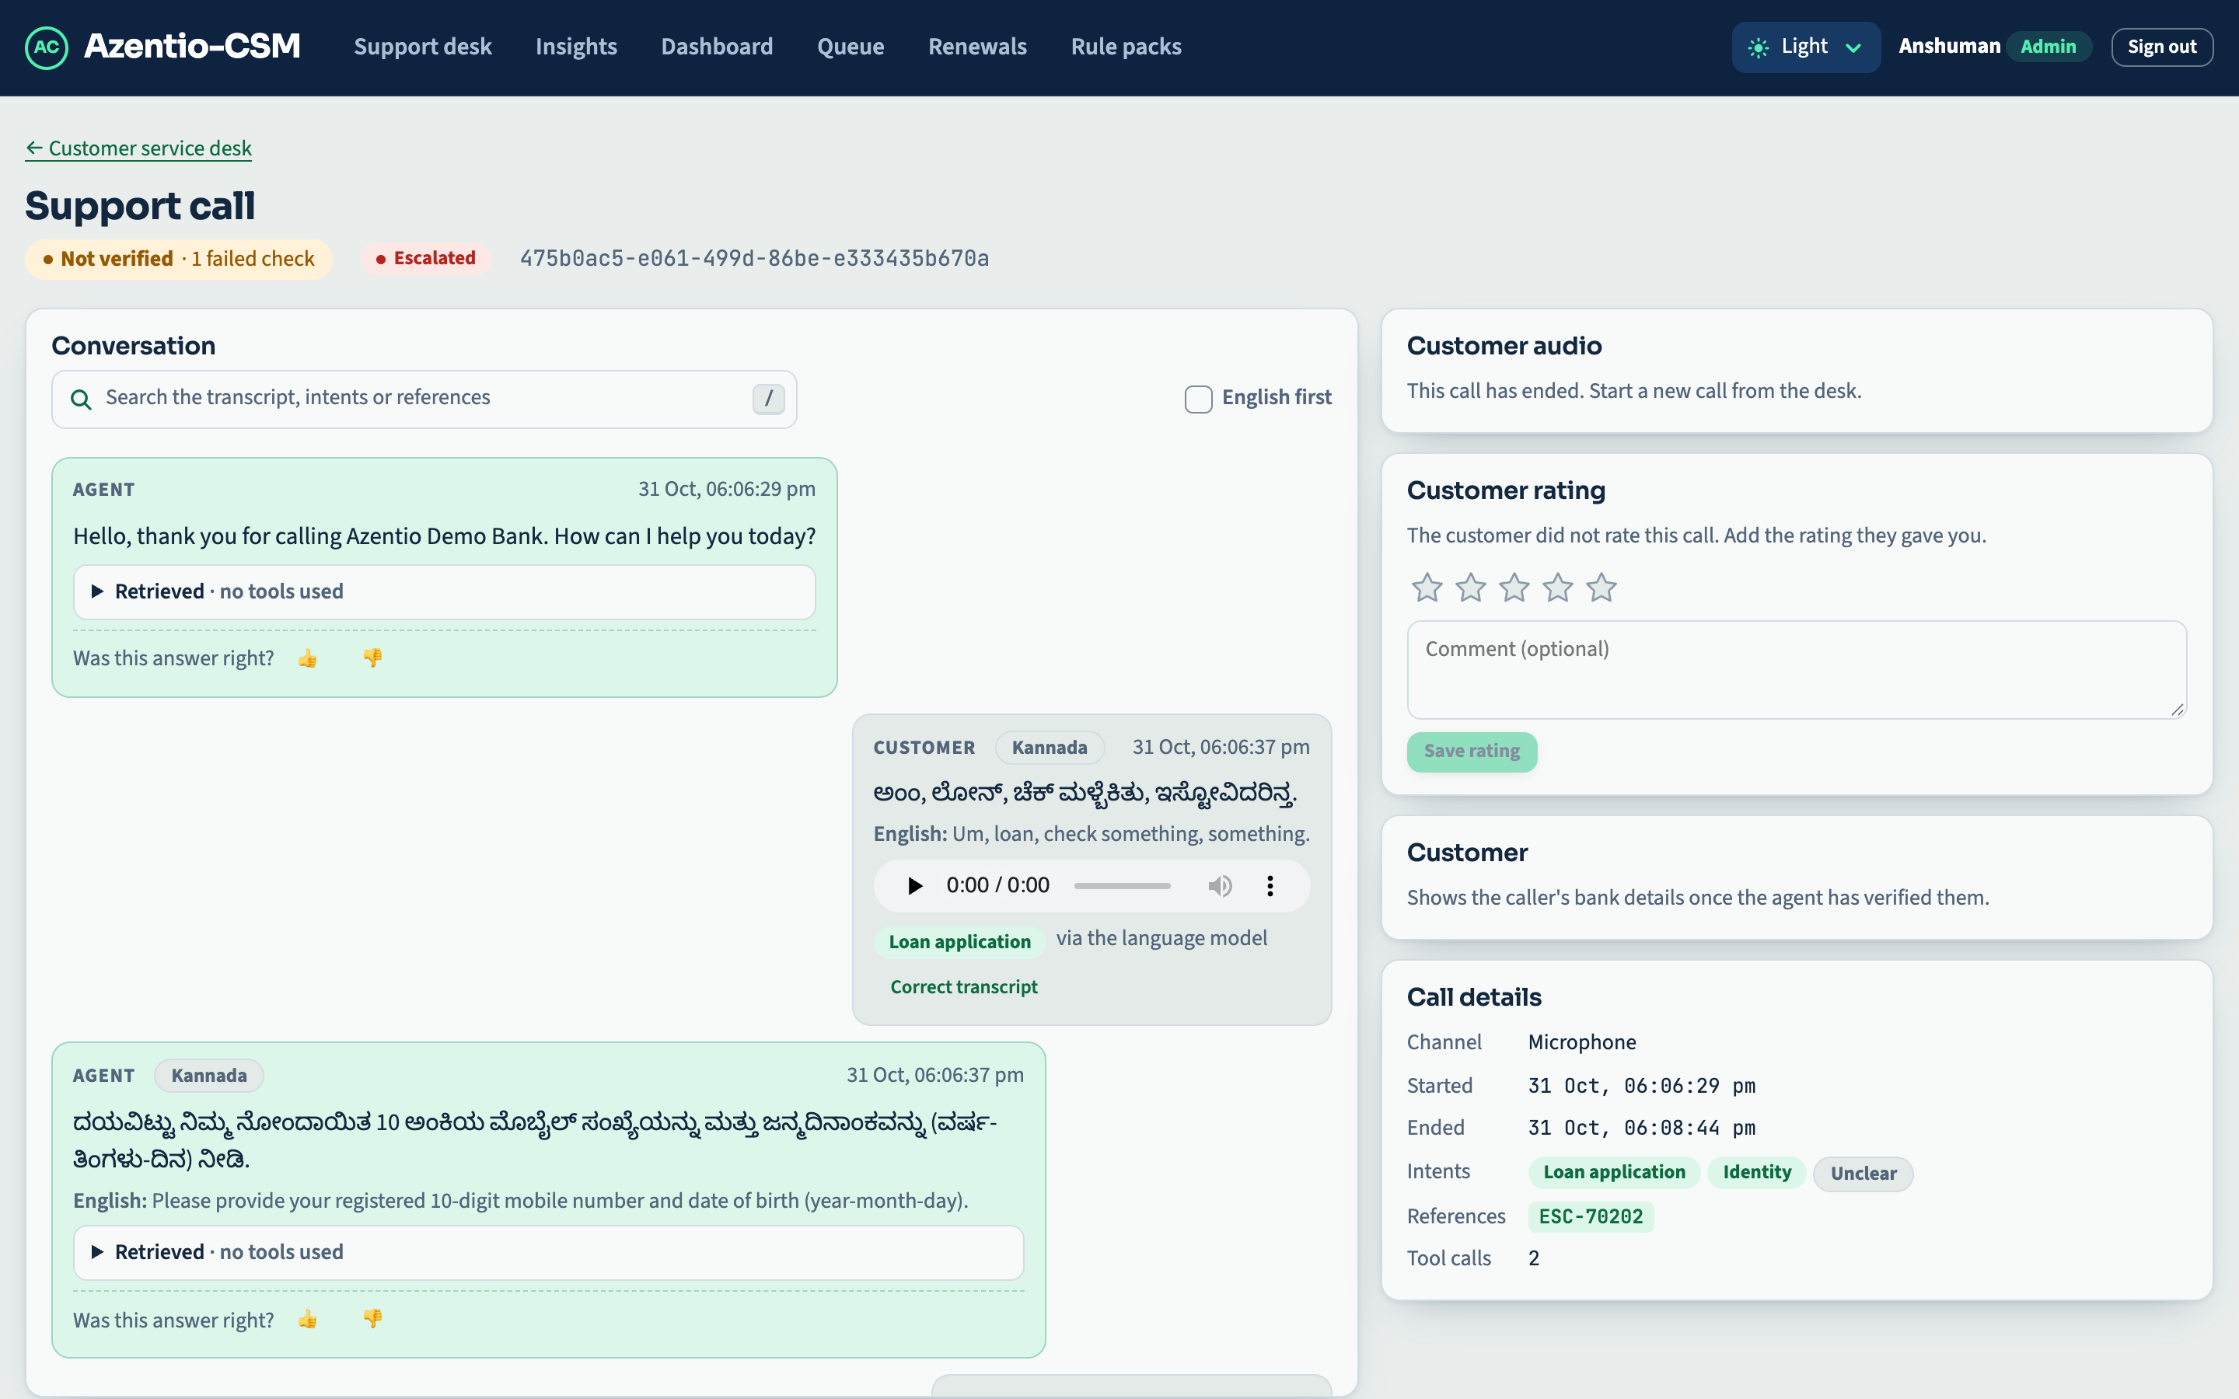
AZENTIO-CSM | BFSI AUTONOMOUS CONVERSATIONAL AI
SLIDE 04 / 10
MULTILINGUAL INTELLIGENCE
Native Kannada & Hindi Speech Recognition
Accurate Vernacular Nuances with Real-Time English Transcription
• Devanagari & Kannada Conditioning: Custom acoustic biasing handles Kannada verb endings, Hindi honorifics, and dialectical number pronunciations.
• Dual-Pane Operator Assistance: Call transcripts display native vernacular text alongside instant English machine translation for bank supervisors.
• Phonetic Reference Recovery: Translates spoken phonetic phrases into valid banking references ('ಎಂಟು ನೂರು' -> '800', 'ಲೋನ್' -> 'LOAN').
• Speech-to-Text Benchmark Proven: Benchmarked across diverse accents and background noise with >94% intent classification accuracy.
94%+ STT Accuracy
Across Kannada, Hindi & Indian English
📷 Live Kannada Support Call with Parallel English Translation (localhost:5173)

Slide 5
AZENTIO-CSM | BFSI AUTONOMOUS CONVERSATIONAL AI
SLIDE 05 / 10
SECURITY & GUARDRAILS
Deterministic 2FA & Zero-Trust Banking Gate
No Customer Financial Data Exposed Prior to Identity Verification
• Strict Two-Factor Gate: Callers must provide registered 10-digit mobile number and Date of Birth (YYYY-MM-DD) or OTP before any query.
• Model Lockout Enforcement: LLM prompt conditioning forbids answering balance or statement queries while verified=false; hard-coded tool guardrails enforce this.
• Brute-Force Protection: Maximum 3 failed verification attempts before account lock and automated supervisor escalation (ESC-XXXXX).
• Caller Profile Integration: Verified callers instantly surface KYC profile, active loan accounts, and risk score on the operator desk.
Zero Leaks
Strict Identity Gate Enforced
📷 Customer Identity Verification & Security Card on localhost:5173

Slide 6
AZENTIO-CSM | BFSI AUTONOMOUS CONVERSATIONAL AI
SLIDE 06 / 10
AUTONOMOUS OPERATIONS
Real-Time Service Request Execution
Automated Core Banking Transactions with Reference Generation
• End-to-End API Execution: The voice agent directly queries and updates the Core Banking Simulator (8090) in real-time.
• Automated Service Requests: Instant registration of loan statements, repayment schedules, and callback tickets with unique reference IDs (SR-1042).
• Formal Complaint Lodging: Logs grievances with category classification, department routing, and SLA tracking (CMP-3011).
• Phonetic Reference Repair: Spoken letters and numbers are phonetically spelled out and matched against active database records.
100% Autonomous
SR-1042 / CMP-3011 Real-Time Creation
📷 Live Core Banking Operations Ledger: Tickets, Complaints & Service Requests

Slide 7
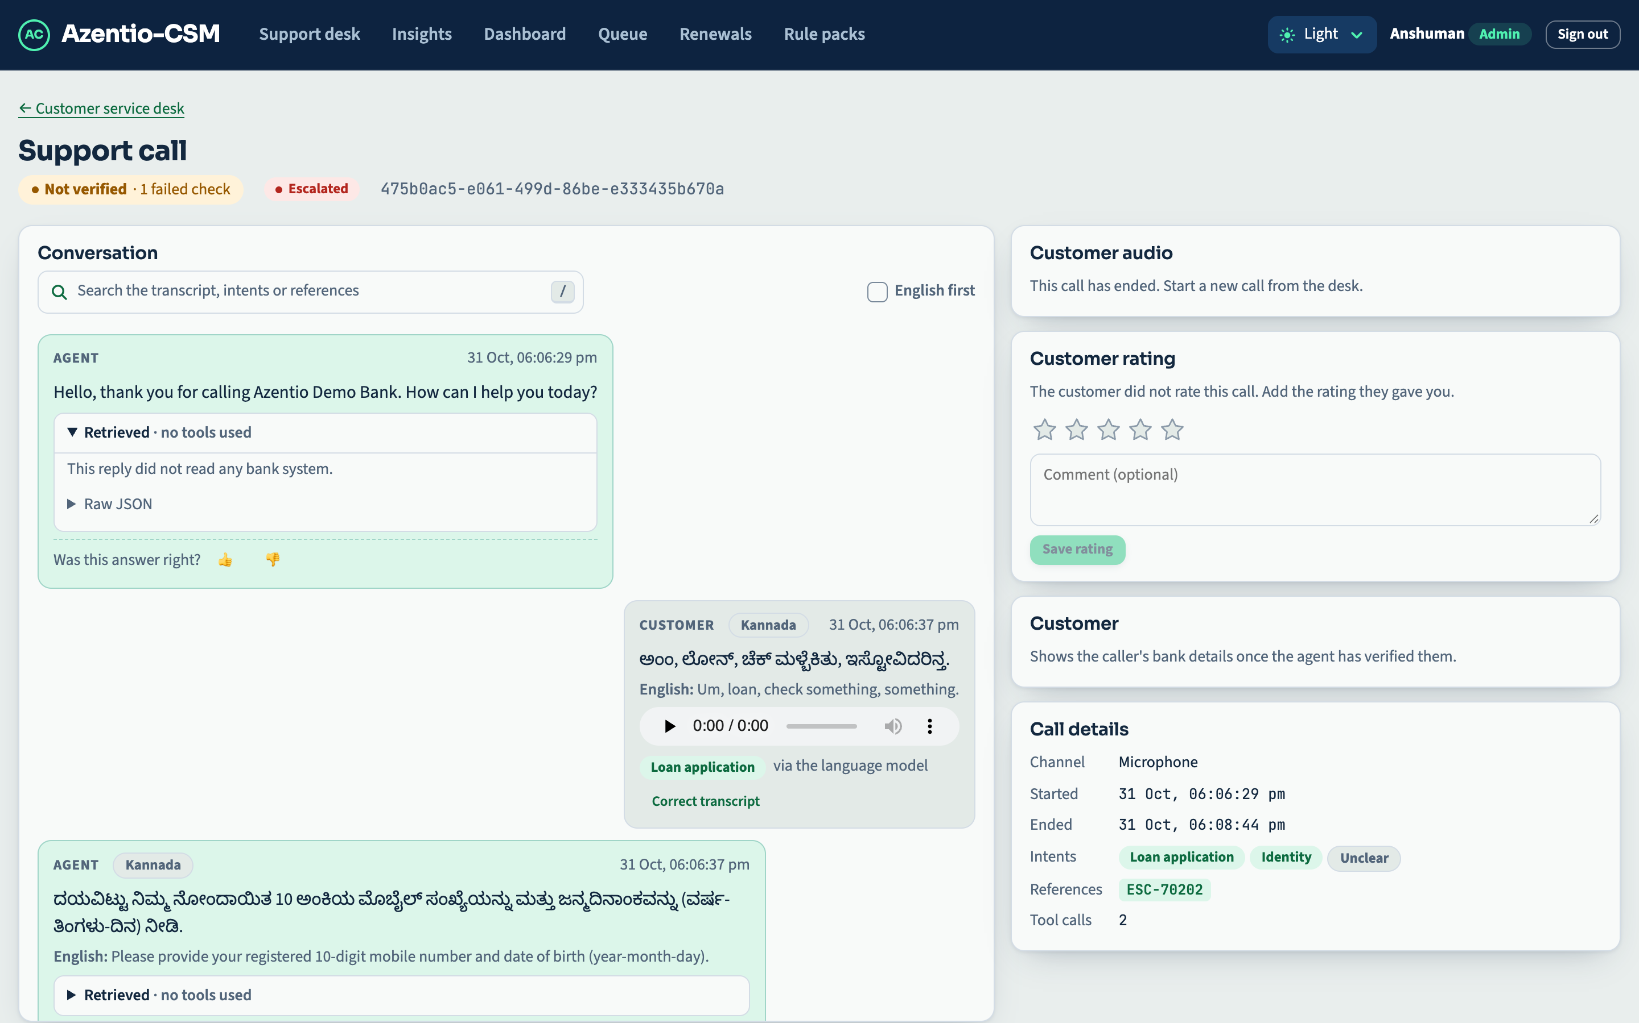
AZENTIO-CSM | BFSI AUTONOMOUS CONVERSATIONAL AI
SLIDE 07 / 10
EXPLAINABILITY & GROUNDING
Explainability: 'Why Did the Agent Say This?'
Structured Decision Rationale, Masked Tool Traces & Fact Verification
• Transparent Tool Execution: Every agent utterance is accompanied by an expandable 'Retrieved' card showing the exact tool called and parameters used.
• Pre-Speech Grounding Validator: Extracts figures, dates, and amounts from draft replies and verifies existence in tool outputs before audio generation.
• Anti-Hallucination Gate: If a number cannot be verified in the bank simulator output, the draft reply is intercepted and safely deflected.
• Raw JSON Auditability: Operators and compliance officers can inspect the underlying JSON payload for every turn with one click.
0% Hallucination
Every Claim Linked to Simulator Output
📷 Tool Trace Rationale Card: Masked Arguments, Status & Retrieved Records

Slide 8
AZENTIO-CSM | BFSI AUTONOMOUS CONVERSATIONAL AI
SLIDE 08 / 10
AUDITABILITY & COMPLIANCE
Cryptographic SHA-256 Hash Chaining
Append-Only, Tamper-Evident Record of Every Customer Interaction
• Mathematical Hash Chaining: Every action produces hash = sha256(prev_hash | actor | action | payload | timestamp) rooted at Genesis 0000...
• 1-Click Integrity Verification: 'Verify Chain' button executes cryptographic audit across all historical events; flags any modified, inserted or deleted records.
• Four-Eyes Governance: Reviewers who initiated or handled a case are cryptographically prevented from approving it.
• Regulatory Export Ready: Export entire conversation trails with cryptographic signatures for RBI / SEBI audit compliance.
100% Tamper Proof
Cryptographically Verifiable Hash Chain
📷 Case Workspace Cryptographic Audit Trail with 'Verify Chain' Banner

Slide 9
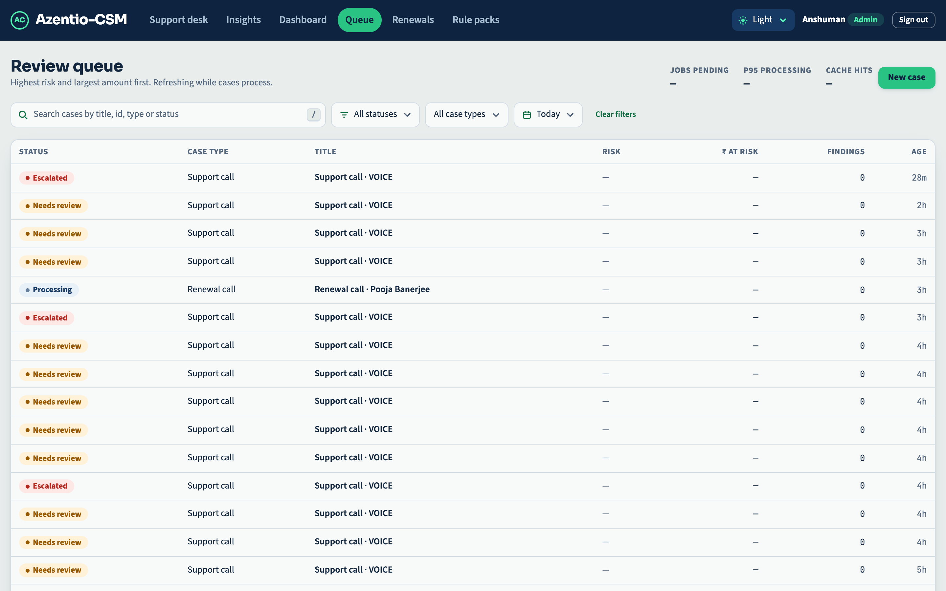
AZENTIO-CSM | BFSI AUTONOMOUS CONVERSATIONAL AI
SLIDE 09 / 10
OPERATOR WORKSPACE
Enterprise Review Queue & Temporal Filtering
Risk-Prioritized Case Sorting with Intuitive Date Boundaries
• Financial Risk Prioritization: Sorts cases by highest ₹ amount at risk and AI finding severity first, optimizing reviewer bandwidth.
• Temporal Date Filtering: New preset selector (Today, Yesterday, Past 7 Days, Past 30 Days) plus custom calendar date range pickers.
• Persistent URL Synchronization: Filter states are preserved across search params (?datePreset=today), bookmarks, and supervisor reloads.
• 3-Second Real-Time Polling: Automatically detects new cases and audio uploads without requiring manual browser page refreshes.
Instant Filtering
Today, 7D, 30D & Custom Date Bounds
📷 Review Queue with New Date Range Presets & Risk Sorting (localhost:5173/queue)

Slide 10
AZENTIO-CSM | BFSI AUTONOMOUS CONVERSATIONAL AI
SLIDE 10 / 10
BUSINESS VALUE & ROADMAP
Measurable Business ROI & Next-Step Roadmap
Production-Ready Conversational AI Tailored for Financial Institutions
• 85% First-Contact Deflection: Routinely handles tier-1 service requests, statements, and repayment schedules without human intervention.
• Sub-Second Latency: End-to-end voice turnaround under 850ms enables natural, non-awkward human conversation flow.
• Full Regulatory Compliance: Zero PII leakage, deterministic failovers, and tamper-evident audit logs meet stringent BFSI standards.
• Continuous Learning Loop: Turn-level supervisor ratings, test scenario exports, and feedback loops continuously improve model performance.
85% Call Deflection
<850ms Voice Response Time
📷 Support Insights & Quality Review: Ratings, Feedback & Scenario Exports

