Slide 1
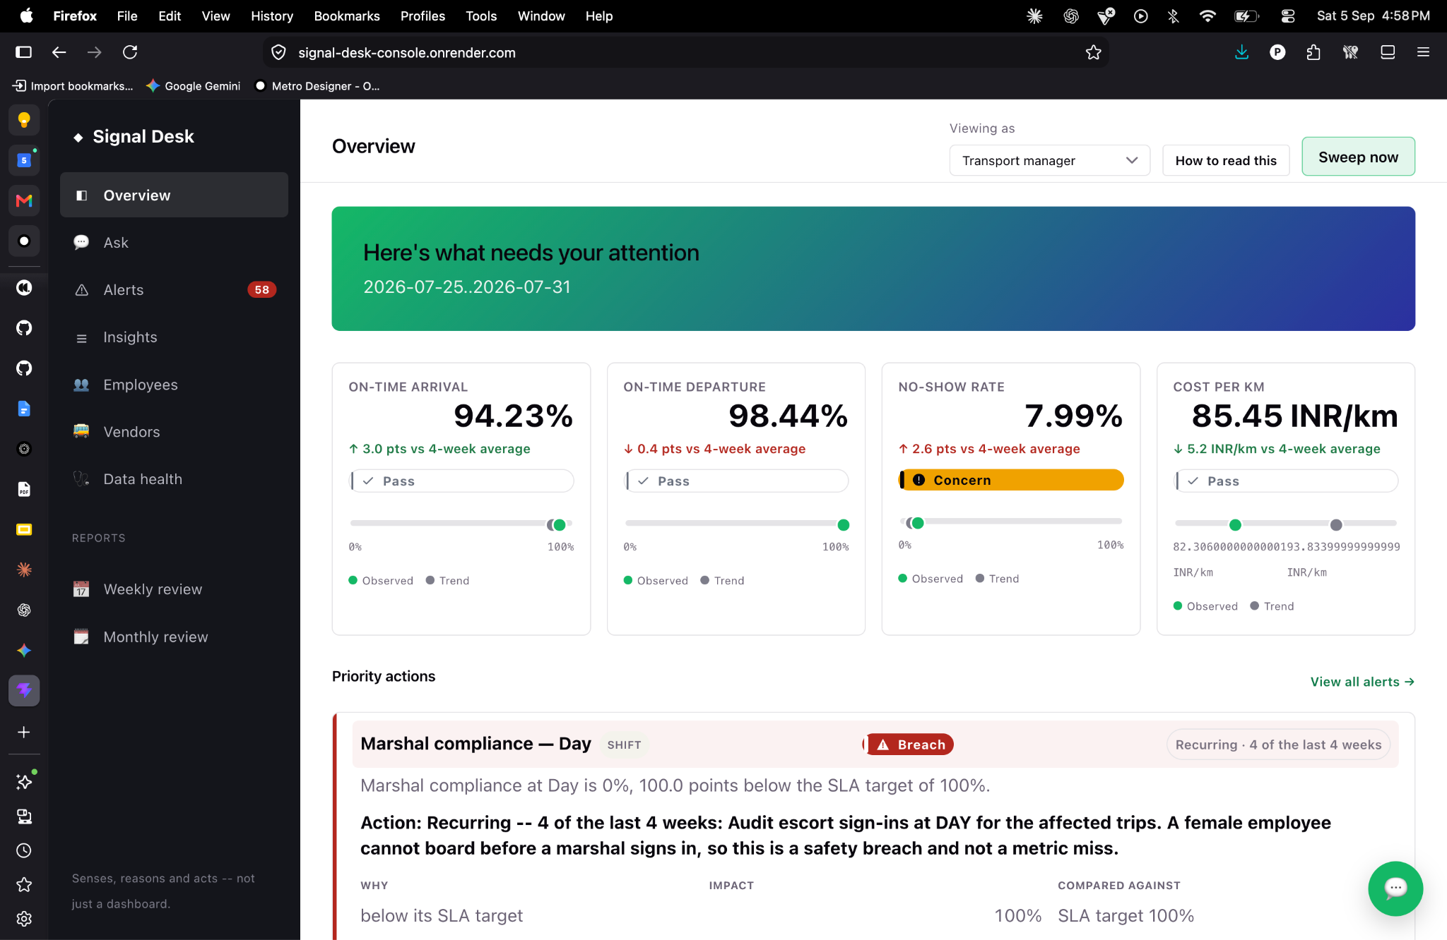
f
MoveInSync Intelligence Layer
From “what happened?” to
“what should I do next?”
An agentic intelligence & reporting layer that senses operational change, explains the business impact, recommends action, and closes the loop.
MOVEINSYNC

Slide 2
01 — THE PROBLEM
Mobility teams have data everywhere — but decisions nowhere.
The signal is rich. The insight is missing. The action is manual.
TODAY
THE SHIFT WE WANT
A metric arrives without context.
78% becomes
a decision.
“OTA is 78%.”
The manager still has to answer:
• Is that better or worse than last month?
• Which vendor caused the gap?
• Which routes are recurring offenders?
• How many employees were impacted?
• What should I do next?
“OTA fell from 85% to 78%, below the 90% SLA. Two vendors explain 81% of the gap, affecting 146 employees. Intervene on 3 morning routes.”
CONTEXT
CAUSE
IMPACT
ACTION

Slide 3
02 — WHO WINS
Two personas. One shared source of operational truth.
↗
TRANSPORT MANAGER
◈
FACILITIES HEAD
Run the day
Run the business
Needs fast answers: what changed, what is urgent, which vendor/route is driving it, and who to contact.
Needs a coherent cost + SLA + experience story without assembling weekly leadership packs by hand.
Their question
Their question
What needs my attention now?
Where is value/risk moving?

Slide 4
03 — EXPERIENCE DESIGN
Replace the reporting loop with an action loop.
TODAY
01
→
02
→
03
→
04
→
05
→
06
Open report
Find metric
Export data
Investigate
Call / email
Wait + recheck
WITH MOVEINSYNC INTELLIGENCE
01
02
03
04
05
06
Sense change
→
Explain why
→
Show impact
→
Recommend action
→
Communicate
→
Prove outcome
Core product promise:
Every important signal ends in a clear decision, owner, or next step.

Slide 5
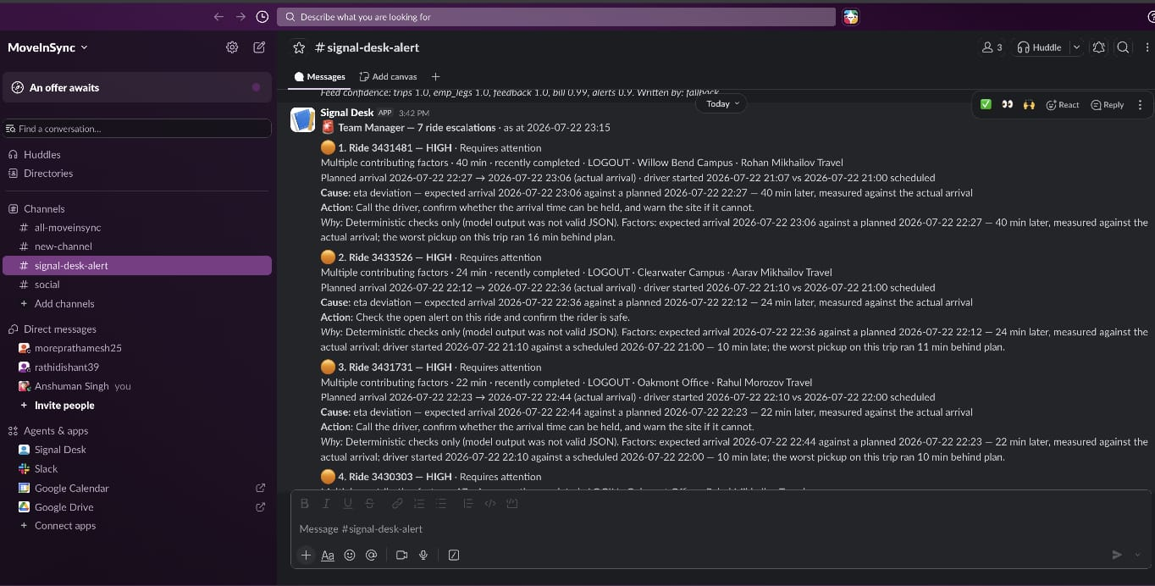
04 — AGENTS
↗
TRANSPORT MANAGER
Delay Management Agent
Transport Manager’s Daily headache of calling & confirming on delays are sorted!
Their question
What needs my attention now?

Slide 6
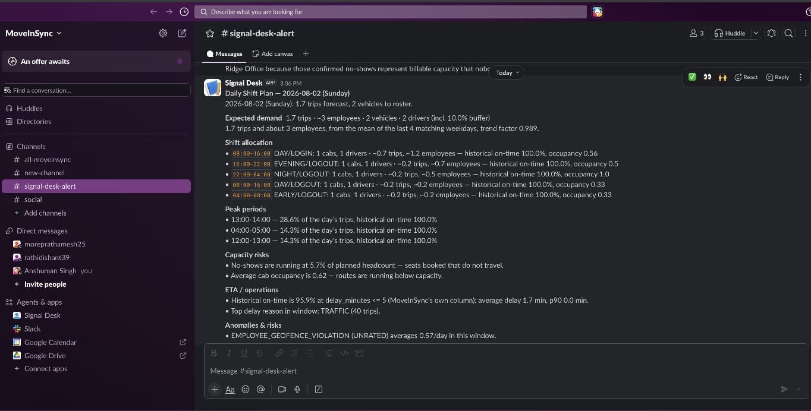
04 — AGENTS
↗
TRANSPORT MANAGER
Shift Planning Agent
No Manual ShiftPlanning now, It’s al automated with everyday data.

Slide 7
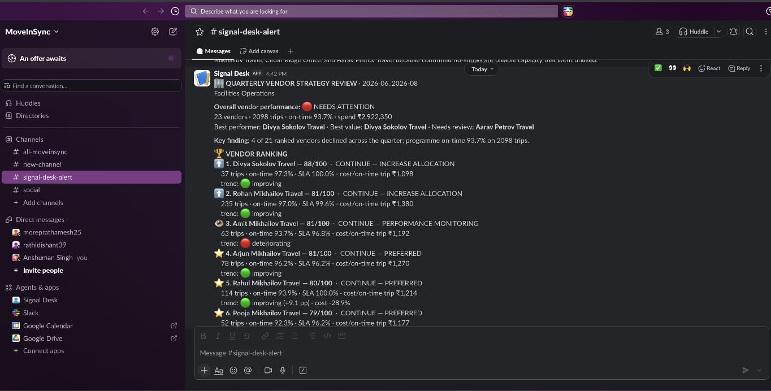
04 — AGENTS
◈
FACILITIES HEAD
Strategy Agent
Facility Head is now sorted to make their strategy. Daily, Weekly & Quarterly. Save Big Money & Serve Bigger Purpose.
Their quetion

Slide 8
11 — THE CLOSE
Don’t build another dashboard.
Build the decision layer.
MoveInSync Intelligence turns mobility data into prioritized action — for the person who needs to act, at the moment they need to act.
SENSE
→
UNDERSTAND
01
Business-first
02
Persona-aware
Connects metrics to SLA, impact, and commercial consequence.
One event becomes the right decision for each stakeholder.
ACT
→
PROVE
From operational data
to measurable outcomes.
03
Action-oriented
04
Closed-loop
Every priority ends with a recommended owner / next move.
Measures whether the intervention actually improved outcomes.
MOVEINSYNC INTELLIGENCE
Thank you

