Slide 1
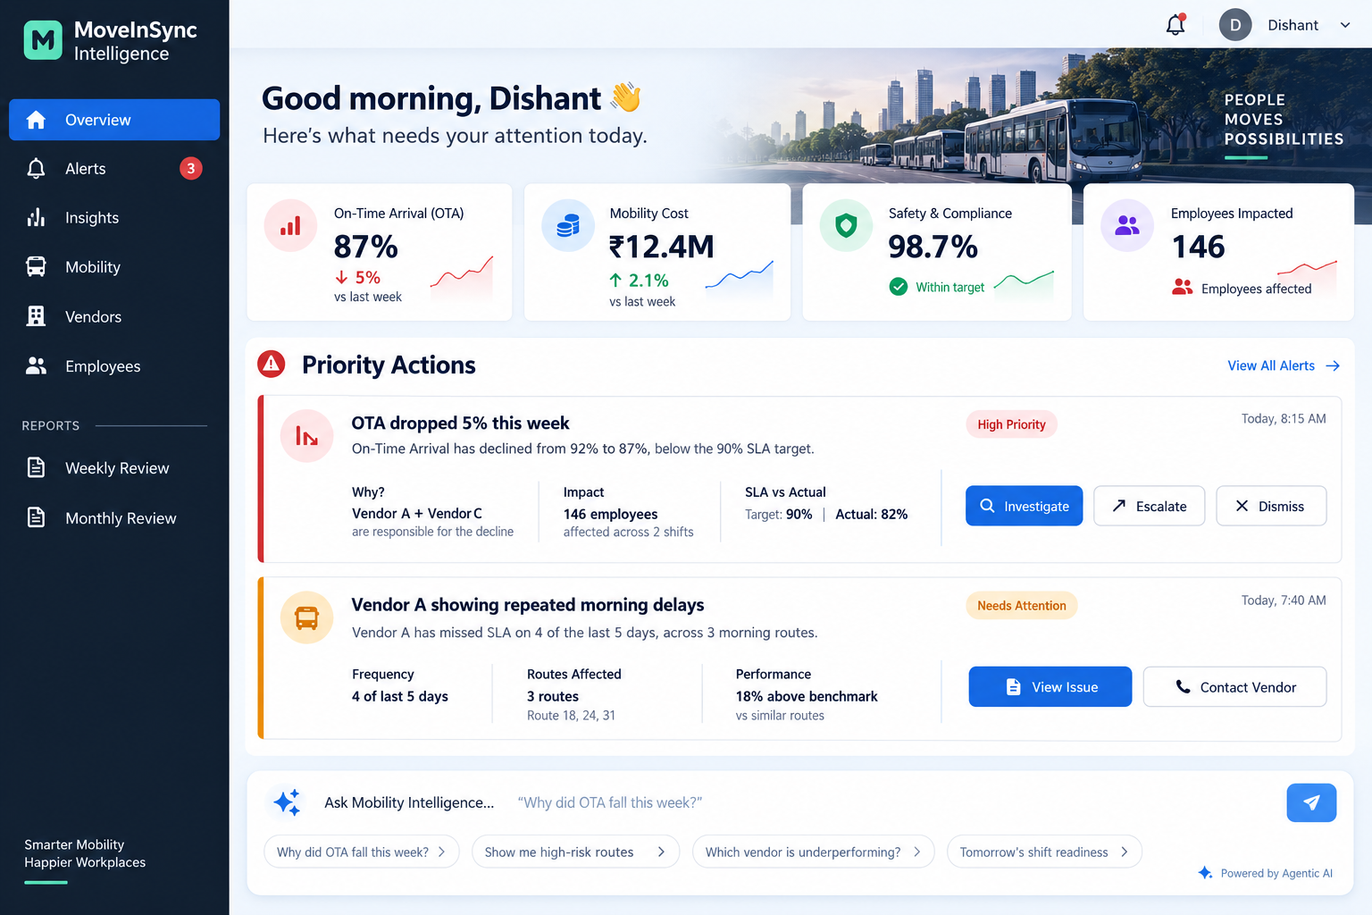
AGENTIC AI • ENTERPRISE MOBILITY
MoveInSync
Intelligence
From “what happened?” to
“what should I do next?”
Signal Desk — a working agent on the provided dataset. It sweeps on a clock tick, ranks what changed against trend and peers, and sends the brief with the SQL attached.
Hackathon build | 5 September 2026 | 12 slides
MOVEINSYNC

Slide 2
01 — THE PROBLEM
Mobility teams have data everywhere — but decisions nowhere.
The signal is rich. The insight is missing. The action is manual.
TODAY
THE SHIFT WE WANT
A metric arrives without context.
78% becomes
a decision.
“OTA is 78%.”
The manager still has to answer:
• Is that better or worse than last month?
• Which vendor caused the gap?
• Which routes are recurring offenders?
• How many employees were impacted?
• What should I do next?
“OTA fell from 85% to 78%, below the 90% SLA. Two vendors explain 81% of the gap, affecting 146 employees. Intervene on 3 morning routes.”
CONTEXT
CAUSE
IMPACT
ACTION

Slide 3
02 — WHO WINS
Two personas. One shared source of operational truth.
↗
TRANSPORT MANAGER
◈
FACILITIES HEAD
Run the day
Run the business
Needs fast answers: what changed, what is urgent, which vendor or route is driving it, and who to contact. Signal Desk sends each BREACH and CONCERN as it is found, naming the vendor, the site and the reference it fell short of.
Needs a coherent cost + SLA + experience story without assembling weekly leadership packs by hand. The same sweep writes a brief addressed to this audience, forwardable without rework.
Their question
Their question
What needs my attention now?
Where is value/risk moving?

Slide 4
03 — THE LOOP, AS BUILT
Six manual steps become one unprompted sweep.
TODAY — THE MANAGER DOES THIS
01
→
02
→
03
→
04
→
05
→
06
Open report
Find metric
Export data
Investigate
Call / email
Wait + recheck
SIGNAL DESK — ONE SWEEP, NO PROMPT
01
02
03
04
05
06
Load the feeds
→
Score metrics
→
Rank findings
→
Write the brief
→
Slack + email
→
Log the SQL
The one rule:
The model never computes a number and never writes SQL — a test enforces it.

Slide 5
04 — ARCHITECTURE
One process, four stages, one hard seam.
Python 3.12 · FastAPI · embedded DuckDB 1.5 · Sarvam sarvam-105b · React 19 console — one stateless process, no queue, no backing database.
01
02
03
04
SENSE
→
REASON
→
COMPOSE
→
ACT
Load + measure
Pure rules
Language only
Route + log
DuckDB in-process • the provided feeds • SQL lives here
Trend + peer + target • four tiers • no I/O, no model
Sarvam sarvam-105b • one call • every figure validated
Slack + SES by tier • dispatch log with finding ids
SQL lives in exactly two modules; the model sees only settled findings.
THERE IS NO run_sql TOOL
ONE PROCESS
SQL IN TWO MODULES
AN INJECTED CLOCK
ONE DATA SEAM
FastAPI + uvicorn; the console is a thin HTTP client.
ingest.py and registry.py — a grep test enforces it.
Same data + same clock → identical findings.
source_for(): a local dir today, s3:// tomorrow.

Slide 6
05 — LIVE DEMO
What you will see in three minutes.
01
Boot
“sweep run_id=run-… findings=…”
It sweeps on startup. No prompt, no human in the loop.
DEPLOYED
02
Replay
The dataset plays out at a day per second
Live on
a public
URL
The replay clock drives the same loop production runs on.
03
Evidence
Expand any finding → the exact SQL
Paste it into DuckDB against the same data and the number matches.
04
Brief
A brief written for a named audience
Render blueprint in the repo — API + console. The public URL runs the committed sample; the demo runs the full dataset.
Sarvam writes prose; every figure is checked against the findings.
05
Dispatch
BREACH → Slack + email, and logged
The dispatch record carries the finding ids it was built from.
SAME CODE

Slide 7
06 — PRODUCT EXPERIENCE
The home screen answers: “What needs my attention today?”
PRIORITY FIRST
Four KPIs, then the actions that matter — the shipped console ranks the same way.

Slide 8
07 — A FINDING DEFENDS ITSELF
Every number on screen carries its own SQL.
BREACH
Why you can
trust the number
On-time arrival, one site
Below its own 4-week average and behind its peer median for the window — a ranked BREACH, not an isolated reading.
1
Counted
rejects quarantined, not lost
WHY
RANK
ACTION
2
Capped
low confidence caps severity
PEER_LAGGARD
Tier, then gap
Sent to TM + Facilities
cause, assigned by rule
ordinal, never summed
3
Anchored
no metric is shown alone
4
Ordinal
a WATCH never beats a BREACH
EVIDENCE SQL
TREND
PEERS
5
Checked
unknown figure → template
EVIDENCE SQL, VERBATIM
SELECT 100.0 * sum(on_time) / nullif(count(*), 0) FROM trips
WHERE scheduled_at >= ? AND scheduled_at < ? AND site_id = ?

Slide 9
08 — RIGHT MESSAGE, RIGHT PERSON
One sweep. Each audience gets only what it can act on.
TRANSPORT MANAGER
What do I need to do?
The vendor and site behind the week’s worst on-time gap, with the corrective action to take before tomorrow’s peak. Slack and email.
ONE SWEEP
FACILITIES HEAD
What does this mean for the business?
On-time, no-show, cost per km and marshal compliance — each against its own 4-week trend and its peers.
ONE SWEEP
How it routes:
BREACH and CONCERN go to Slack and email · WATCH to Slack · PASS is not sent at all.

Slide 10
09 — COST & SCALE
Cost is flat in data volume, by construction.
ONE SWEEP, STEP BY STEP
BY DESIGN
01
02
03
04
05
Cost does not grow with the data
Load
→
Measure
→
Reference
→
Rank
→
Compose
One model call per brief, taken over settled findings.
the feeds land in DuckDB
every metric, every slice
4-week trend + peer median
4 tiers, lexicographic
one model call per brief
THE MODEL NEVER SEES
THE MODEL SEES
Rows
Findings
Flat in scale
The model sees findings, never rows — never the data itself.
The prompt carries a handful of settled findings and no data. That is why the bill does not move when the client does — and why no figure in the brief can be invented.

Slide 11
10 — BUSINESS IMPACT
The value case is measurable: less manual work, less leakage, better service.
•
MANAGER TIME
•
COST OPPORTUNITY
•
SLA IMPROVEMENT
•
EMPLOYEE IMPACT
2–3 hrs/day
2–5%
↑
↓
Potential time recovered per manager
Illustrative mobility optimization range
Earlier intervention before breach
Fewer late / disrupted arrivals
WHERE THE MONEY COMES FROM
WHO BENEFITS?
•
Productivity
less report-building + manual investigation
Transport
less firefighting
•
Cost control
route, vendor, and capacity inefficiency exposed
Facilities
clearer budget + vendor story
•
Risk
earlier SLA / safety intervention
Operations
better shift readiness
•
Experience
fewer employee disruptions
HR / Employees
better experience
Assumptions are intentionally illustrative; the enterprise pilot would baseline actual savings and service improvements.

Slide 12
11 — THE CLOSE
Don’t build another dashboard.
Build the decision layer.
Signal Desk runs on the provided dataset today: it senses on a clock tick, reasons in rules, and every number traces to its SQL.
SENSE
→
REASON
01
Unprompted
02
Explainable
Sweeps on a clock tick and sends without being asked.
Every figure carries the SQL that produced it.
COMPOSE
→
ACT
From raw feeds
to one brief.
03
Persona-aware
04
Honest about cost
One sweep, routed to the audience that can act.
Flat in data volume, by construction.
MOVEINSYNC INTELLIGENCE
Thank you

