Slide 1

Development of Nanobiosensors to detect viral diseases
Under Prof. Dheerendra Singh
By:
Deepanshu Jain
2022B2A81582P

Slide 2
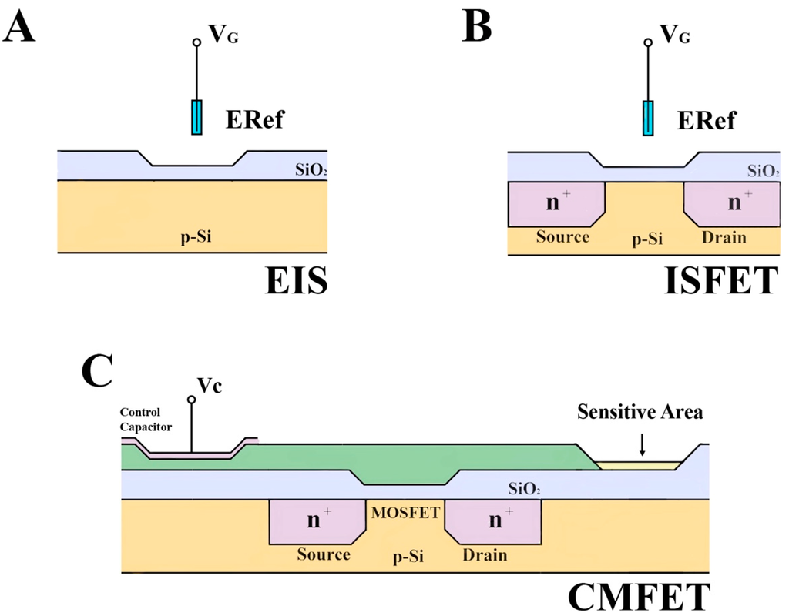
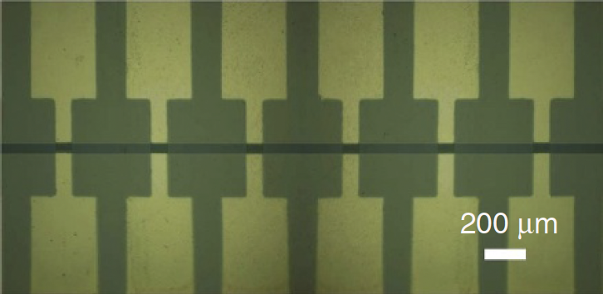
Studying about G-FET
Getting to know about the different FETs, and how GFET is the most desired device for our purpose
How using graphene can increasing the sensitivity of the device
How multi-channel graphene increases the efficiency and the LOD
Distinguishing single base mutation, probe density, efficiency, and getting the maximum response
Minimizing the leakage currents (< 5 nA)
Usage of such devices to monitor the kinetics of oligonucleotide binding and un-binding by Real Time-recording of electric signals, hence getting the rate constants of such reactions.
Veigas, B.; Fortunato, E.; Baptista, P.V. Field Effect Sensors for Nucleic Acid Detection: Recent Advances and Future Perspectives. Sensors 2015, 15, 10380-10398.
Xu, S., Zhan, J., Man, B. et al. Real-time reliable determination of binding kinetics of DNA hybridization using a multi-channel graphene biosensor. Nat Commun 8, 14902 (2017). https://doi.org/10.1038/ncomms14902

Slide 3
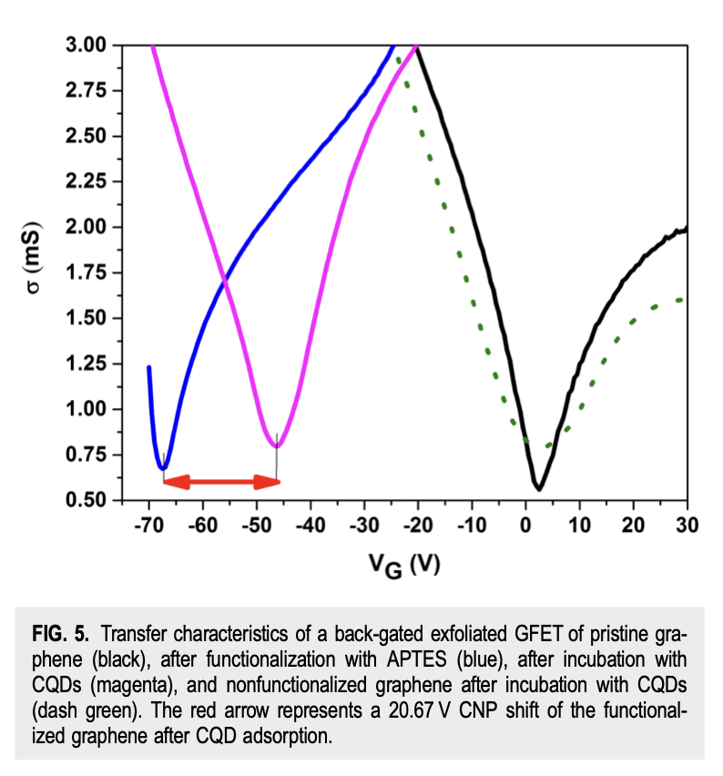
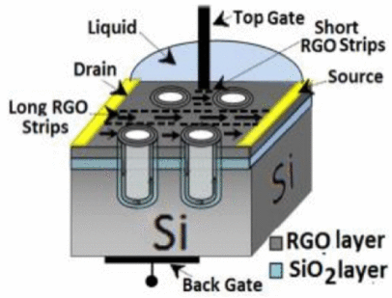
To increase the FET Limit of Detection
The ultrasensitivity is achieved through smooth and reliable graphene nanogrids, which enhance quantum dot-like transport behavior and improve biomolecule interaction within nanopores​.
Functionalization of graphene channels with APTES increases graphene's affinity for carbon quantum dots, enabling ultrasensitive detection through shifts in the charge neutrality point​
Enhanced sensitivity in graphene-based FET biosensors is attributed to strong coupling effects between the graphene interface and adsorbates, tailored for virus detection​

Slide 4
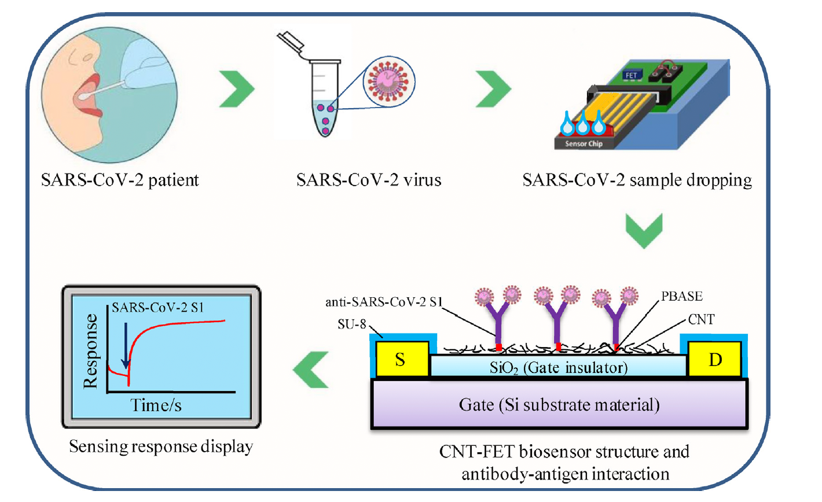
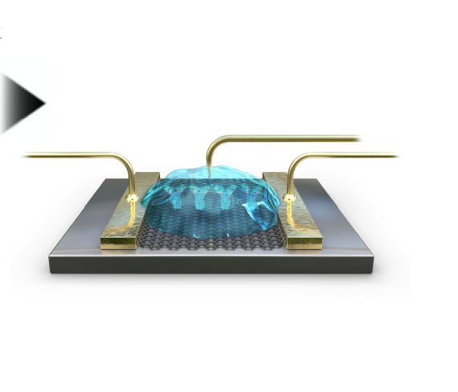
Diseases and their detectability
Developed an In₂O₃ nanoribbon field-effect transistor biosensor for detecting SARS-CoV-2 spike protein and IgG antibodies.
Disease Targeted: COVID-19 (SARS-CoV-2).
Limit of Detection: 100 femtograms per milliliter (fg/mL) for spike protein and 1 picogram per milliliter (pg/mL) for IgG antibodies​
Introduced a graphene-based FET biosensor functionalized with SARS-CoV-2 spike antibodies for rapid detection in clinical samples.
Disease Targeted: COVID-19 (SARS-CoV-2).
Limit of Detection: 1 femtogram per milliliter (fg/mL) in phosphate-buffered saline (PBS) and 100 fg/mL in clinical transport medium​
Designed a carbon nanotube FET-based biosensor for rapid detection of the SARS-CoV-2 spike protein in saliva samples.
Disease Targeted: COVID-19 (SARS-CoV-2).
Limit of Detection: 4.12 femtograms per milliliter (fg/mL)​
Designed a graphene FET-based biosensor for quantitative detection of imatinib interactions with the Abl1 kinase, targeting chronic myeloid leukemia (CML).
Disease Targeted: Chronic Myeloid Leukemia (CML).
Limit of Detection: 15.5 femtomolar (fM)​​

Slide 5
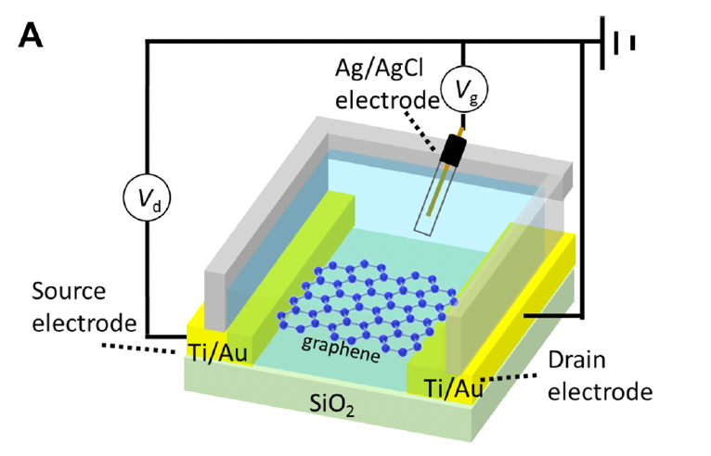
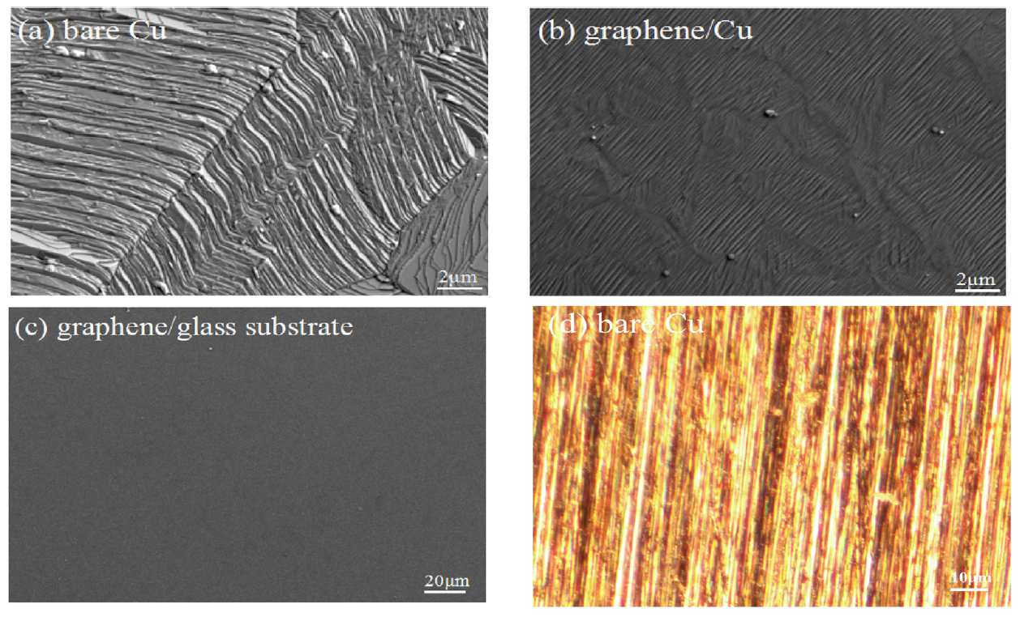
Diseases and their detectability
Designed a graphene FET-based immunosensor for ultrasensitive noncompetitive detection of the small antigen peptide BGP-C7, a marker for bone diseases.
Disease Targeted: Bone-related conditions.
Limit of Detection: 10 femtograms per milliliter (fg/mL)
Designed a graphene field-effect transistor (G-FET) biosensor using peptide nucleic acid (PNA) and DNA probes for the detection of RNA, with a high specificity and ultrasensitive detection limit.
Disease Targeted: RNA-related conditions in clinical diagnostics.
Limit of Detection: 0.1 attomolar (aM) for PNA-modified G-FET sensor​​

Slide 6
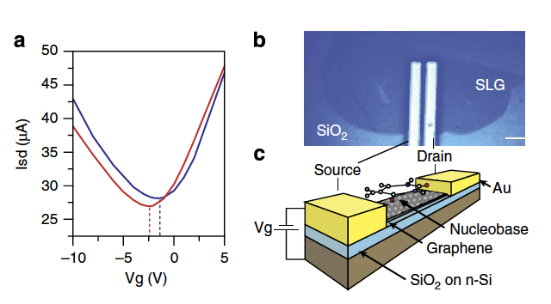
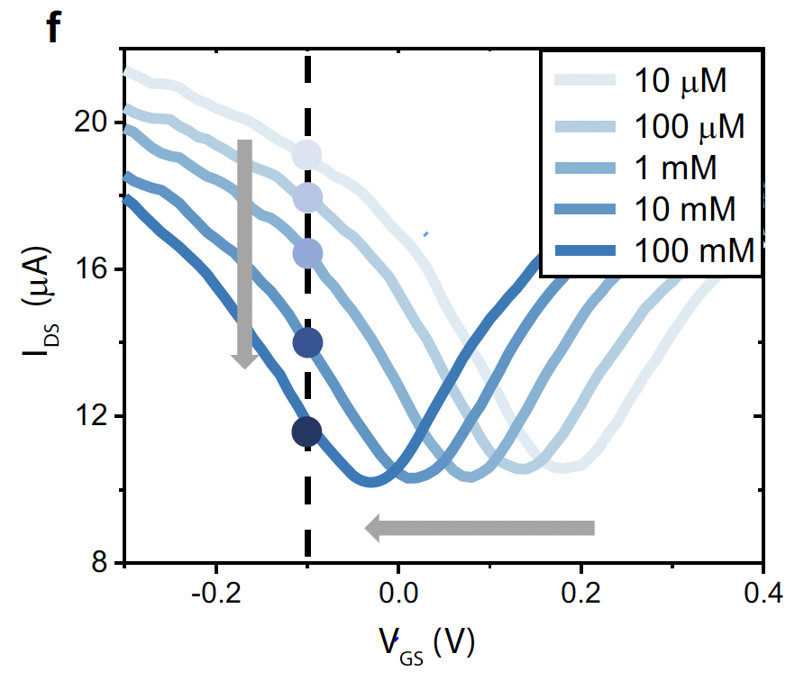
Researching Papers for Referral Dimensions
1. Graphene FET for DNA Nucleobases
The study explores graphene field-effect transistors (GFETs) as highly sensitive devices for detecting DNA nucleobases (adenine, guanine, cytosine, thymine) by adsorbing them directly onto the graphene surface. The interaction alters the electronic properties of graphene, enabling molecular recognition.
Sensitivity: The device can detect distinct conductance changes due to adsorption of individual nucleobases. Extrapolated calculations predict a charge carrier density shift (Δn) of 106−108 e/cm2 for single nucleobase detection, indicating high sensitivity even at the nanoscale.
Device dimensions: The GFET was fabricated using single-layer graphene channels sized 50μm×50μm - 200μm on a silicon substrate with 90 nm thick SiO2​ dielectric.
2. Graphene Transistor Arrays for Ion Sensing
This work presents a platform with 256 graphene-based field-effect transistors arranged in a 16×16array to detect physiologically important ions like potassium (K+), sodium (Na+), and calcium (Ca2+) in real time.
Sensitivity and Limit of Detection (LOD):
The sensors demonstrate near-ideal Nernstian sensitivity, with average slopes of:
K+: −54.7±2.9mV/decade
Na+: −56.8±5.9mV/decade
Ca2+: −30.1±1.9mV/decade
Detection range extends from 10μM to 100mM for these ions, making it suitable for diagnostic fluids like blood, urine, and sweat.
Device dimensions: Each sensor unit consists of a 30μm×30μm30μm graphene channel with two Ti/Au electrodes (5 nm/150 nm thickness). The full platform is fabricated on a 4-inch, 200 μm thick glass wafer.
6:6563 | DOI: 10.1038/ncomms7563 | www.nature.com/naturecommunications
https://doi.org/10.1038/s41467-022-32749-4 | ( 2022) 13:5064

Slide 7
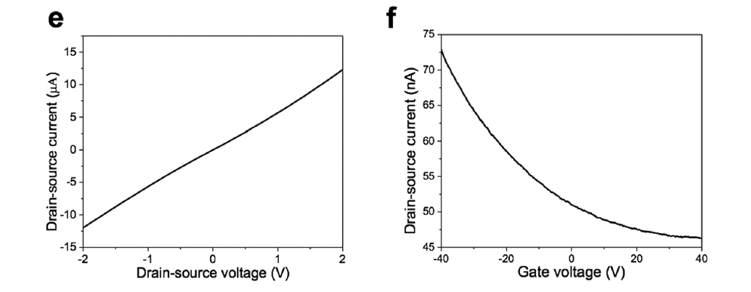
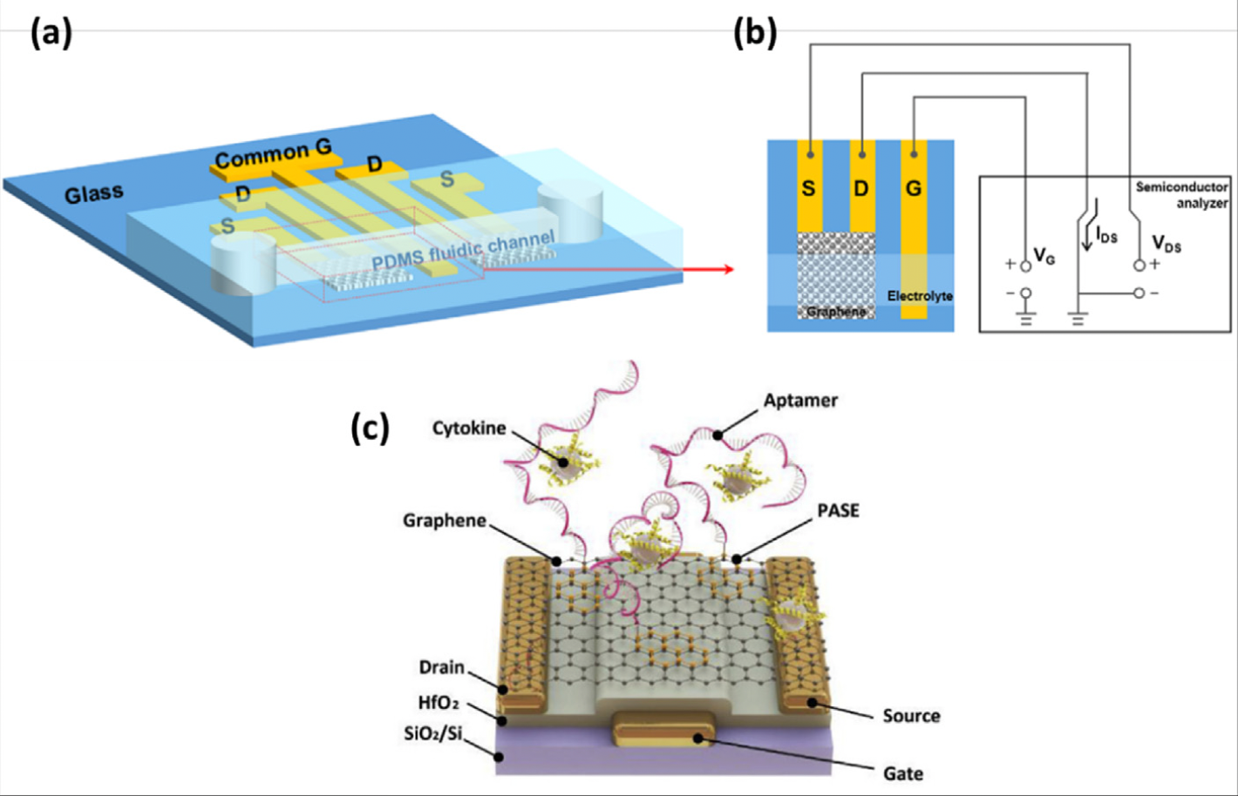
Researching Papers for Referral Dimensions
3. Reduced Graphene Oxide FET for Ebola Antigen
The paper details a reduced graphene oxide (rGO)-based FET biosensor designed for rapid and highly sensitive detection of the Ebola glycoprotein (EGP), a key antigen for diagnosing Ebola virus disease (EVD).
Thickness: The rGO channel has a measured thickness of ~2 nm, indicating a few-layer graphene structure. The monolayer thickness is ~0.34 nm, suggesting that the rGO sheet consists of approximately six layers.
Device fabrication: Gold nanoparticles (5 nm) are electrosprayed onto the rGO for conjugation with Ebola-specific antibodies. This ensures high selectivity for the target antigen while minimizing false positives.
4. Reduced Graphene Oxide FET for Breast Cancer Detection
The paper discusses the use of reduced graphene oxide (rGO) and pristine graphene-based FET biosensors for breast cancer (BC) biomarker detection. Various biosensors target genes, antigens, and proteins associated with BC, focusing on high sensitivity and selective detection.
Thickness: The reported graphene layers range from monolayer to multilayer, often dependent on the fabrication technique. Specific examples include crumpled graphene with high mobility (~4150 cm²/V·s).
Device Fabrication: Techniques include chemical vapor deposition (CVD) and reduction of graphene oxide. Functionalization often employs linkers like PBASE or aptamers for target specificity. Some devices achieve LODs of 33 particles/mL (exosome detection) using rGO/PASE channels.
Mobility: Channel mobilities range between ~14 cm²/V·s (for radicals) and ~9000 cm²/V·s (DNA sensing), influenced by factors like substrate effects, fabrication methods, and structural modifications.
Scientific Reports | 7: 10974 | DOI:10.1038/s41598-017-11387-7
https://doi.org/10.1016/j.carbon.2020.10.048 | 0008-6223/© 2020 Elsevier Ltd. All rights reserved

Slide 8
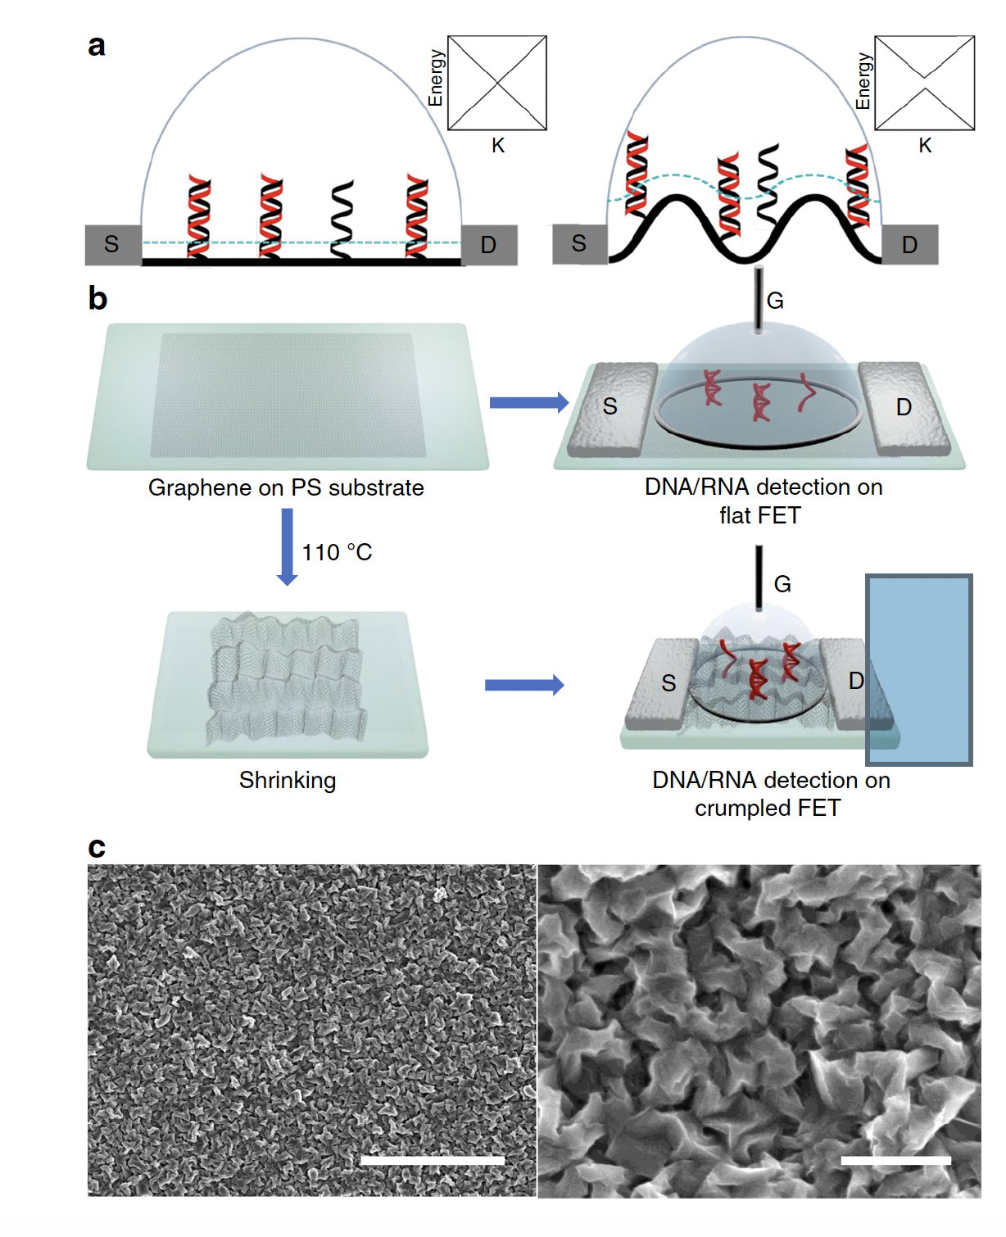
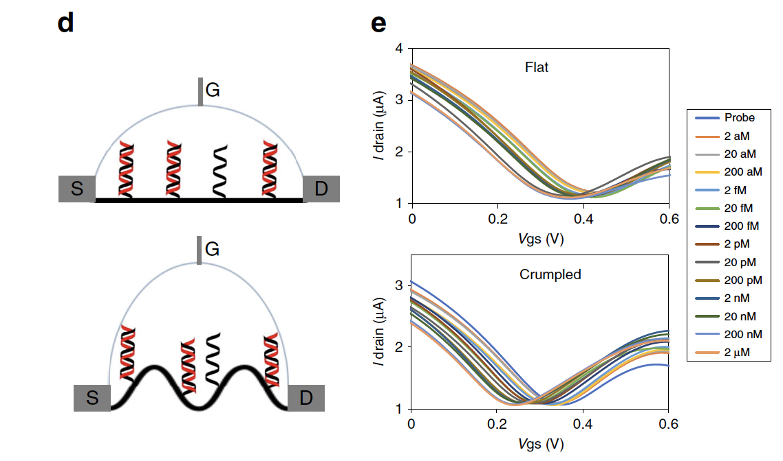
A Visit to CEERI and the Next Step
The paper introduces deformed (crumpled) graphene FET biosensors that achieve unprecedented sensitivity for DNA/RNA detection, leveraging nanoscale deformations to create "electrical hot spots" that enhance biomolecular detection at ultralow concentrations.
Noise Reduction: Noise is minimized by modulating the Debye length at concave regions of the graphene surface. These nanoscale curvatures exclude counter ions, reducing charge screening and allowing for higher sensitivity in physiological solutions.
Sensitivity Statistics: The biosensor demonstrates detection limits of 600 zM (equivalent to ~18 molecules) in buffer and 20 aM in undiluted human serum for DNA/RNA, making it one of the most sensitive electronic biosensors reported to date.
Material Innovation: The crumpled graphene introduces a bandgap that exponentially amplifies source-drain currents with minimal charge interaction, a feature absent in flat graphene structures.
Diagnostic Potential: The biosensor can detect microRNA (e.g., let-7b) directly in complex biological fluids like serum without amplification or purification, making it a practical tool for non-invasive diagnostics and liquid biopsy applications.
Hwang, M.T., Heiranian, M., Kim, Y. et al. Ultrasensitive detection of nucleic acids using deformed graphene channel field effect biosensors. Nat Commun 11, 1543 (2020). https://doi.org/10.1038/s41467-020-15330-9

Slide 9
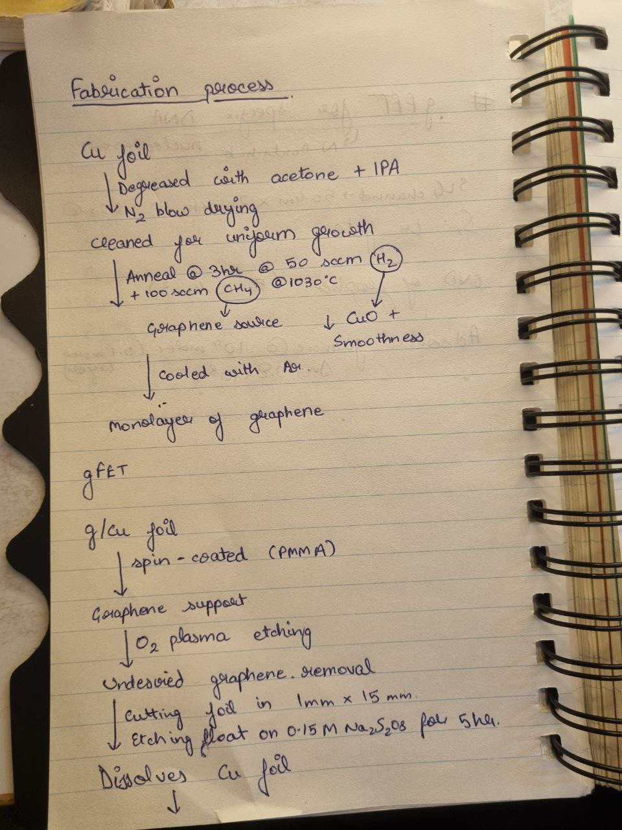
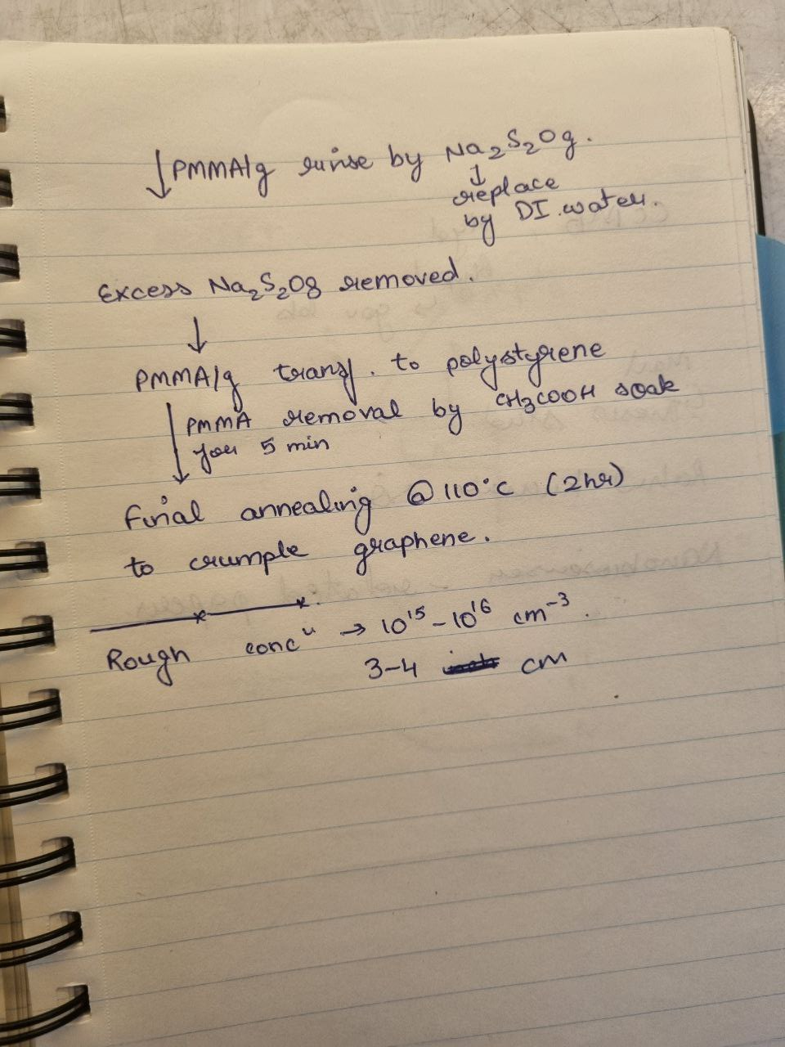
Deducing a Fabrication Process
Hwang, M.T., Heiranian, M., Kim, Y. et al. Ultrasensitive detection of nucleic acids using deformed graphene channel field effect biosensors. Nat Commun 11, 1543 (2020). https://doi.org/10.1038/s41467-020-15330-9

Slide 10
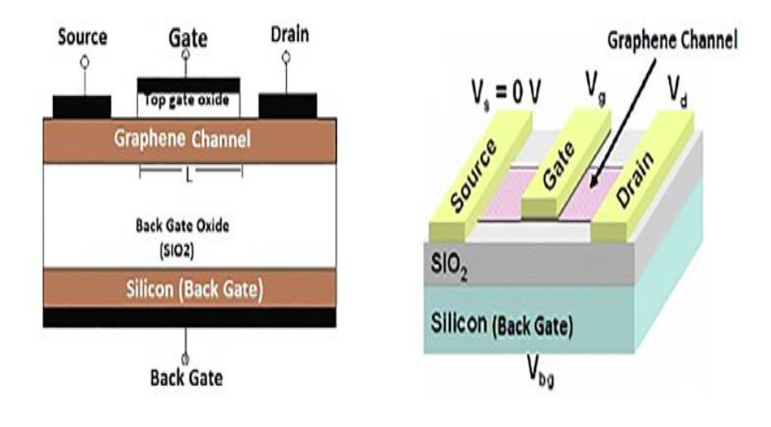
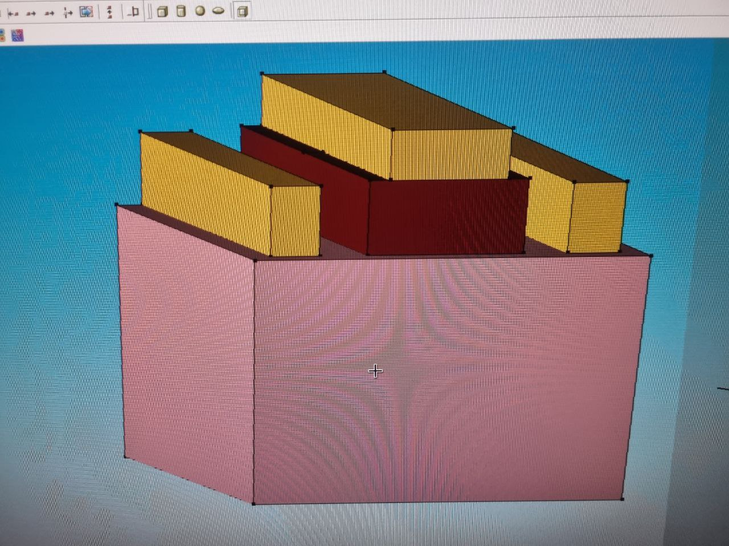
A Step Forward
Introduction to TCAD Sentaurus: Guided to learn the Sentaurus TCAD software for simulations. Utilized a combination of online resources, including YouTube tutorials and official Sentaurus documentation, to become proficient in its usage.
Setup and Familiarization: Installed the necessary Linux environment and configured the tools required to work seamlessly with Sentaurus TCAD.
Model Replication Task: Assigned the task of replicating a draft model presented in the IRJET research paper to align the project with published research and establish a baseline for further development.
Practical Implementation: Applied the theoretical knowledge and newly acquired software skills to successfully replicate the assigned model. This phase marked my transition from learning to practical implementation and paved the way for subsequent advancements.
https://www.irjet.net/archives/V10/i8/IRJET-V10I826.pdf

Slide 11
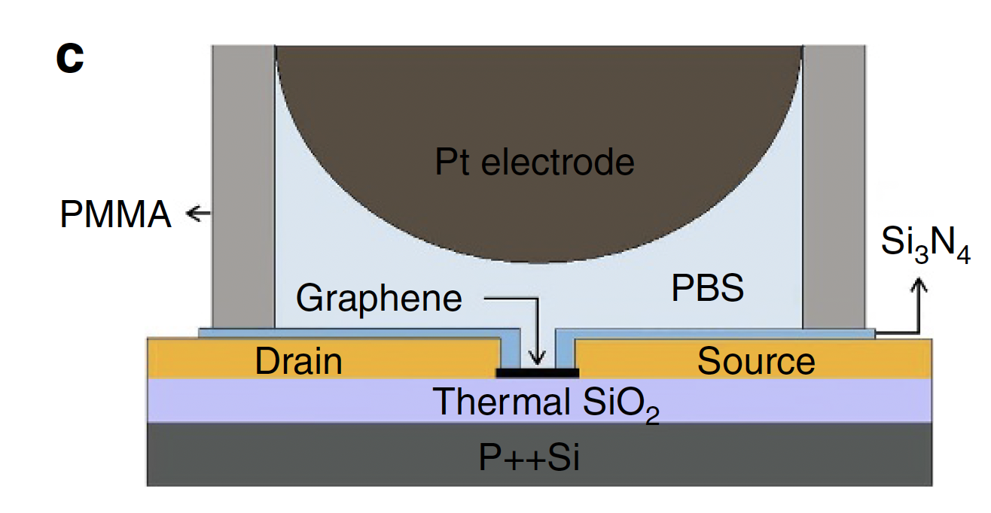
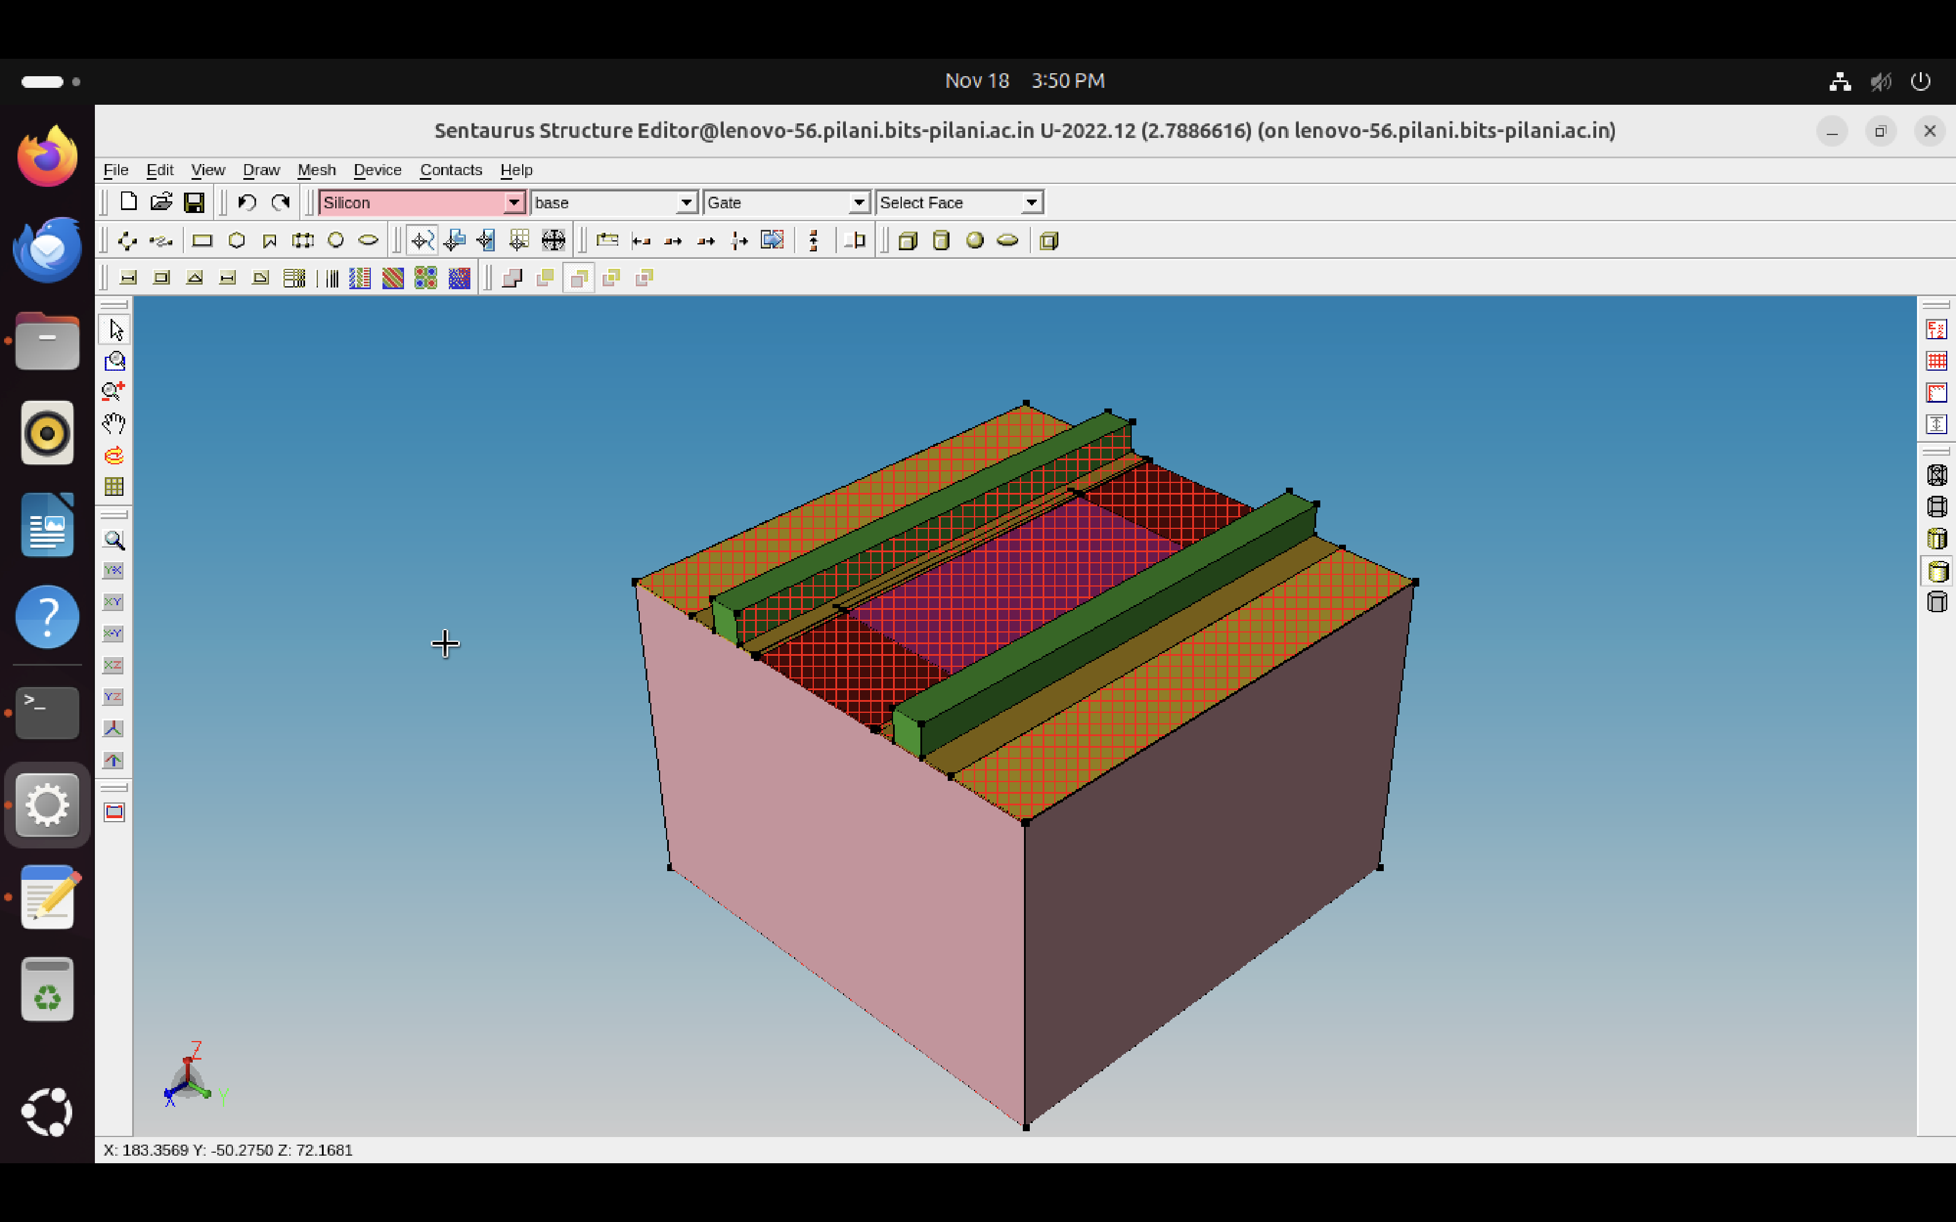
Final Model Fabrication on TCAD
This study develops a graphene-based field-effect transistor (G-FET) biosensor to measure DNA hybridization kinetics, binding affinities, and single-base mismatches in real time. The sensor offers high sensitivity (detection limit of 10 pM) and reproducibility, surpassing optical sensors and previous nanowire FETs.
Device and Fabrication Details:
The sensor consists of six graphene single-crystal domains fabricated into parallel G-FET channels. Each channel is 45 µm long and 90 µm wide, with graphene channel spacings of 400 µm. A microfluidic channel integrated with the device allows controlled reagent delivery.
Performance Metrics:
Sensitivity: Detects DNA concentrations as low as 10 pM.
Voltage Characteristics: Shows a significant charge-neutrality voltage shift (e.g., ~0.22V with DNA probe attachment and ~0.203V with target DNA hybridization).
Comparison with Existing Technologies:
The G-FET achieves a 10 pM detection limit, which is 3 orders of magnitude lower than the 10 nM detection limit of standard optical methods. The sensor can reliably regenerate for over 50 cycles without significant performance degradation, demonstrating high durability.
The G-FET leverages the intrinsic properties of graphene, such as ultra-high carrier mobility and surface sensitivity. Unlike nanowire-based sensors, it eliminates issues like high device variability and fabrication complexity. The integration of chemical vapor deposition (CVD)-grown graphene and precise fabrication techniques makes the device scalable, cost-effective, and suitable for high-throughput applications.
NATURE COMMUNICATIONS | 8:14902 | DOI: 10.1038/ncomms14902 |www.nature.com/naturecommunications

Slide 12
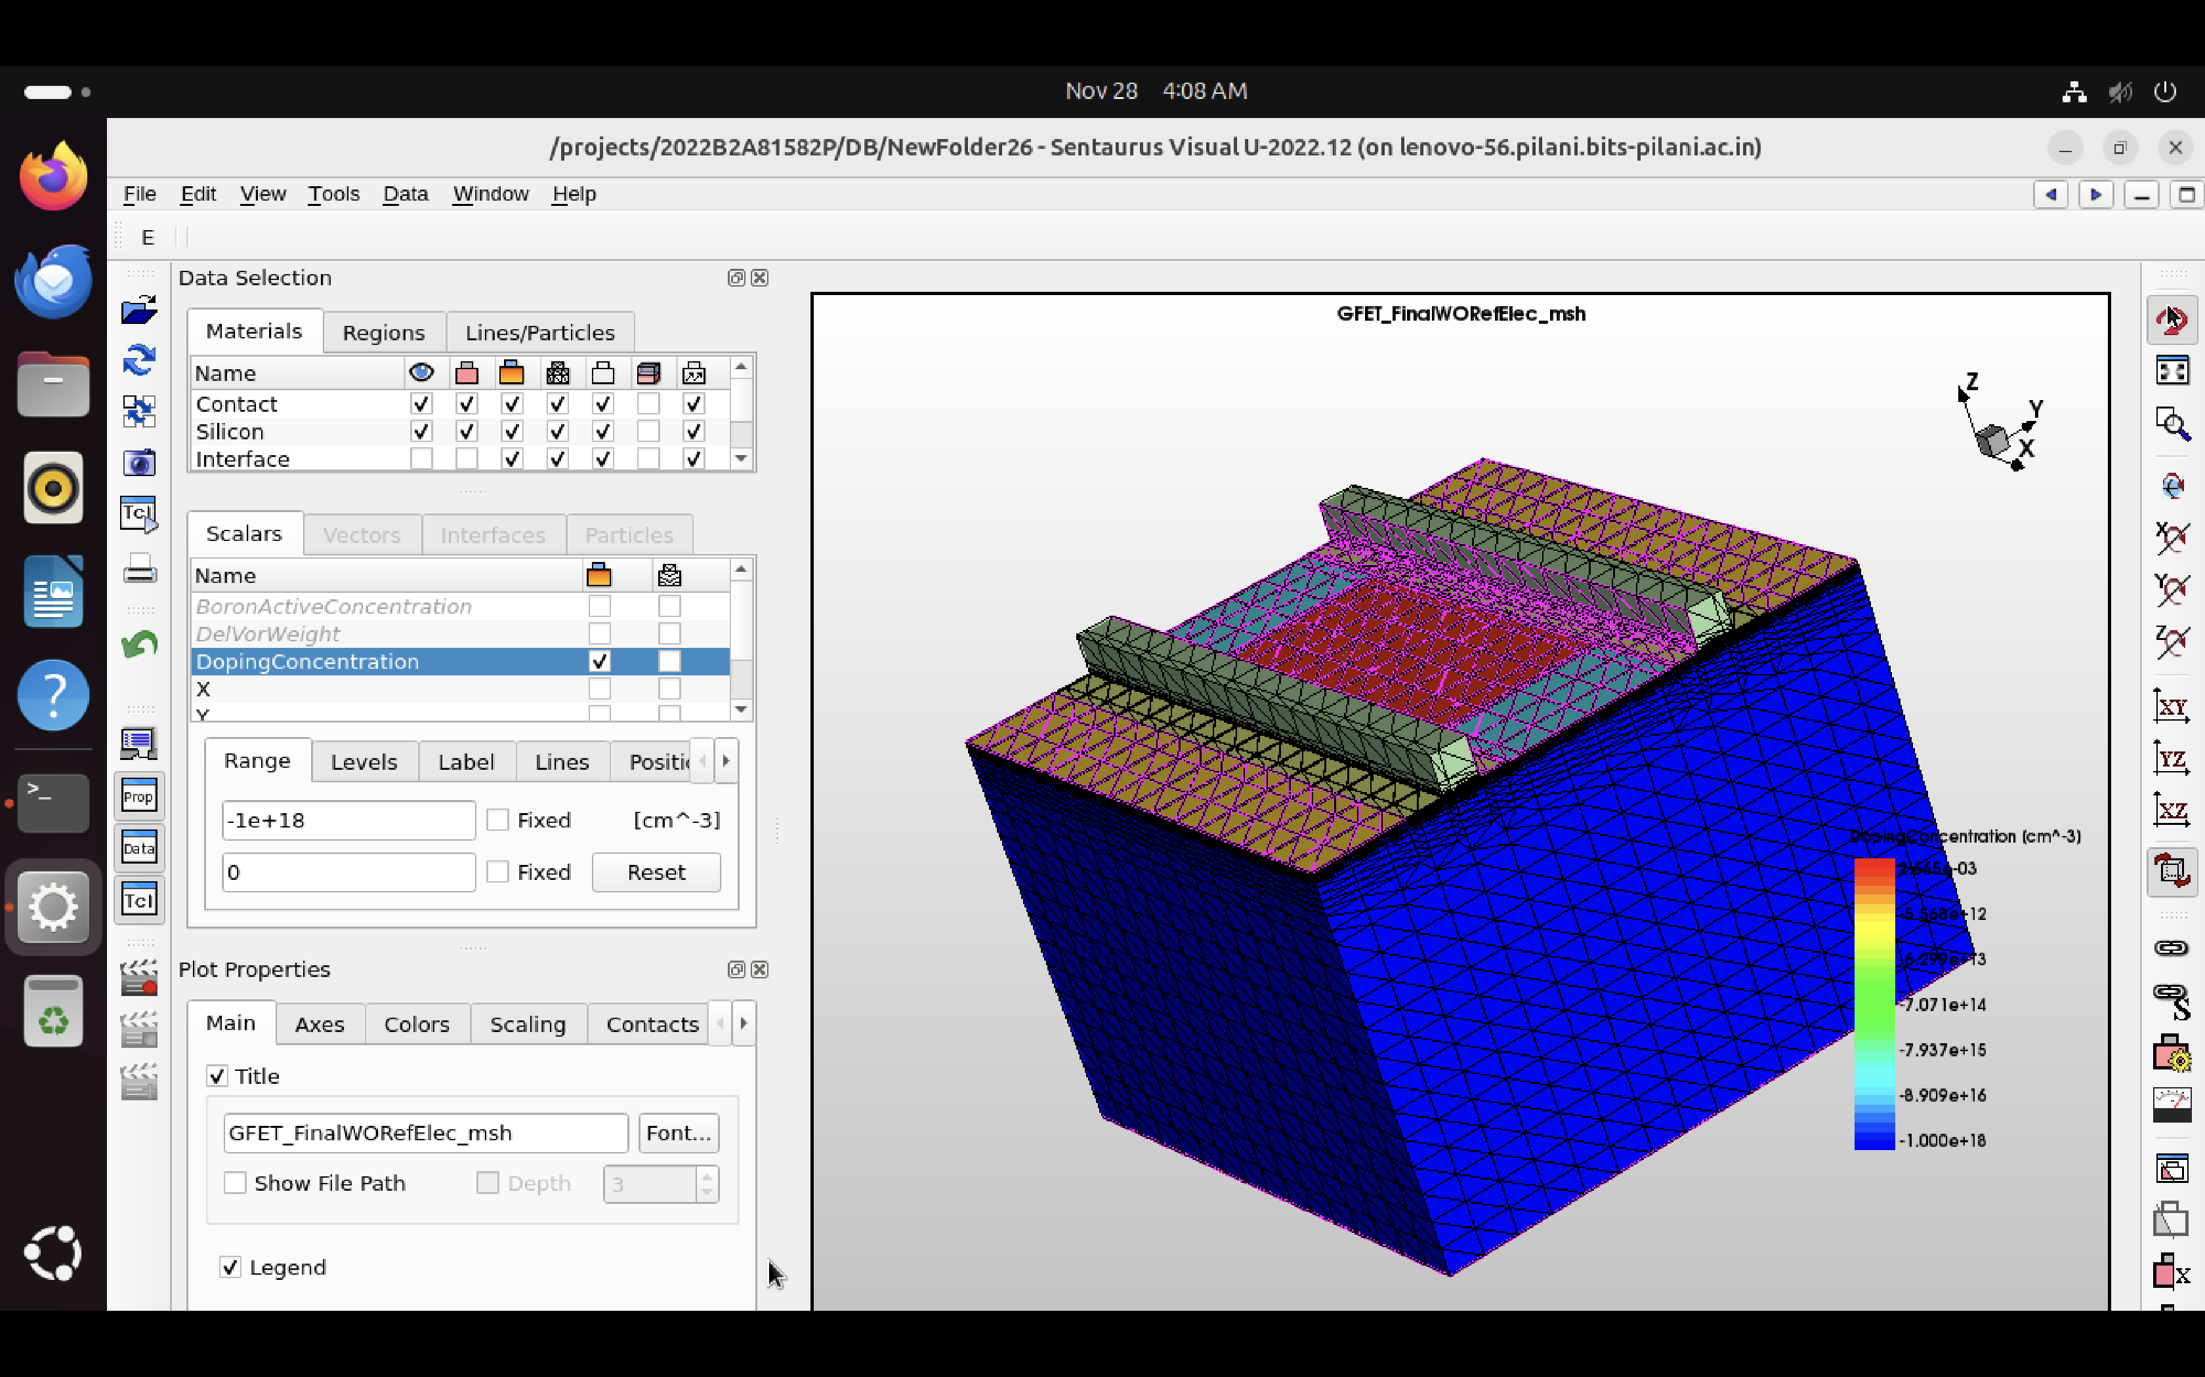
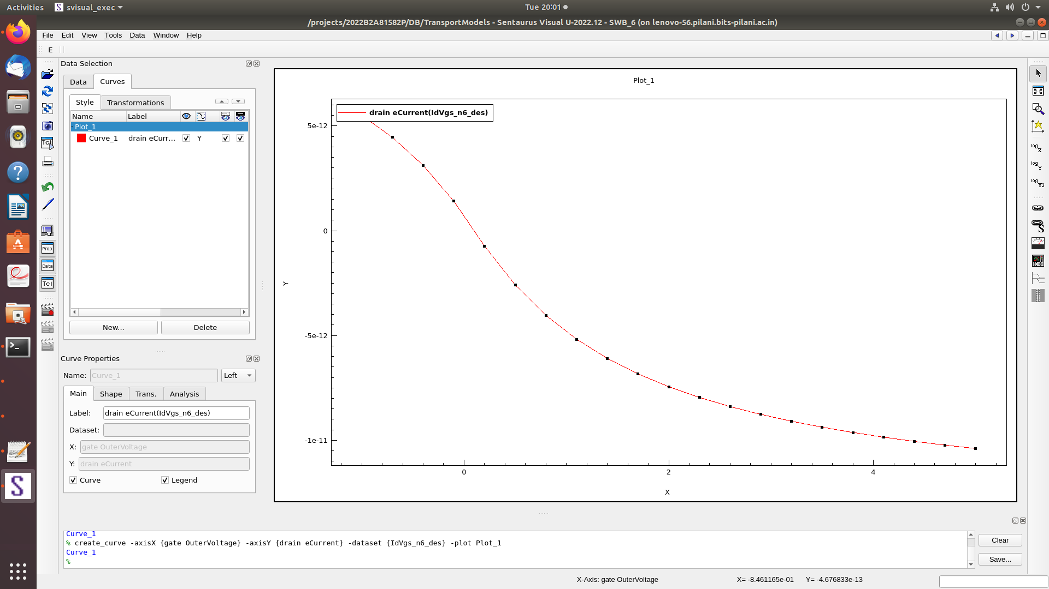
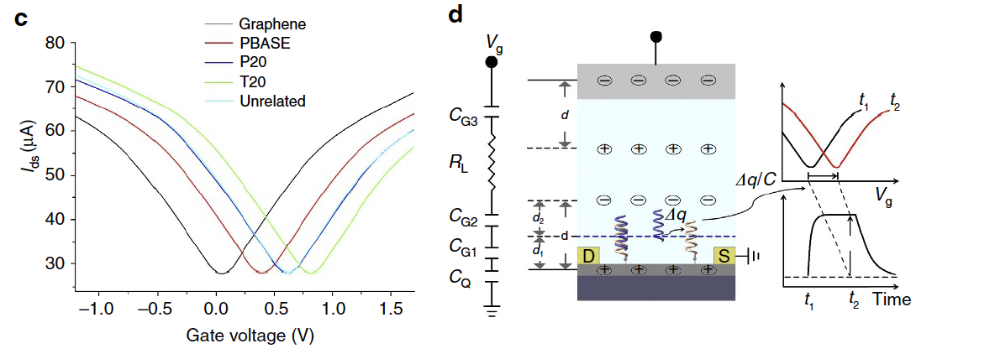
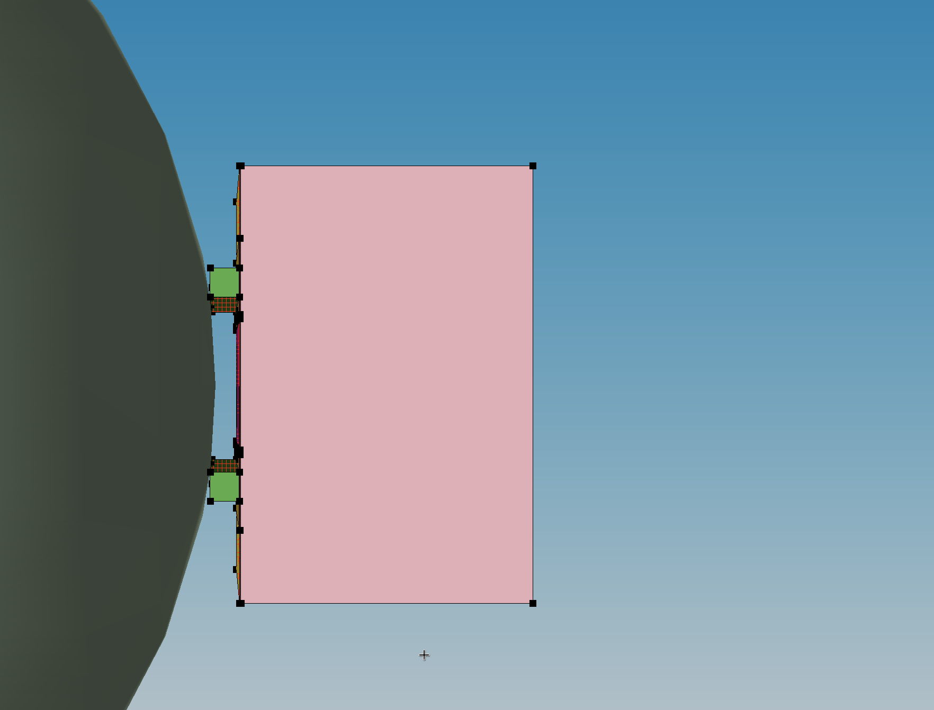
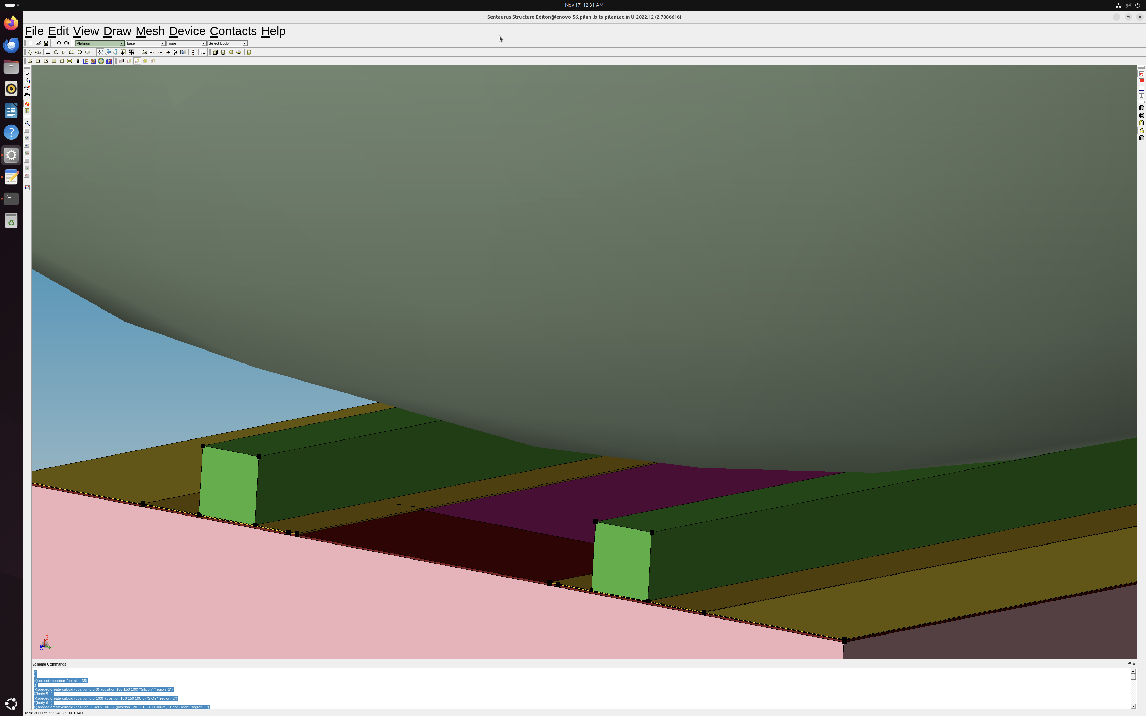
Final Model Fabrication on TCAD
Actual Graph
Expected Graph

Slide 13
Graph Analysis
Possible Causes:
Mismatch in Graphene Parameters:
Graphene has unique properties like zero bandgap, high carrier mobility, and a linear energy dispersion relationship. If these are not properly modelled, the simulation will not capture its behaviour.
Parameters such as mobility, work function, and Fermi level should be carefully selected from experimental data.
Incorrect Inclusion of Defects:
Defects like grain boundaries or impurities can reduce the current dramatically. If these are modelled improperly, the simulation may underestimate current levels.
Improper Layer Thickness or Geometry:
Graphene is atomically thin, and any deviation from this assumption in the simulation (e.g., a thicker layer or 3D assumptions) can result in incorrect behaviour.
Misalignment in the source, drain, or gate contacts could also change current flow.
Doping Profile:
Doping levels and gradients play a significant role in determining the device’s response to gate voltage. Improper doping (or lack of it) can lead to insufficient carriers for conduction, resulting in picoampere-level currents.
Contact Properties:
The Schottky barrier height, contact resistance, and work function differences between the metal and graphene need to be accurately modelled. Improper values can suppress current significantly.
Gate Voltage Application:
Ensure the gate terminal voltage sweep matches the expected conditions. If the gate-source potential is not properly applied, the device may not operate in the desired region.
Physical Models:
If the simulation does not include graphene-specific effects (e.g., ballistic transport, quantum tunnelling), the output will differ. For low-dimensional materials like graphene, traditional drift-diffusion models may be insufficient.

Slide 14
Graph Analysis
Steps to Align Results:
Verifying the Simulation Setup:
Cross-check the physical models enabled in Sentaurus.
Enable graphene-specific models, such as ballistic transport, quantum corrections, or non-parabolic energy bands, if available.
Use the drift-diffusion model cautiously. For graphene devices, advanced models like Monte Carlo simulations or quantum transport may be necessary.
Confirm that the voltage sweep (gate voltage) matches the range and resolution of the expected graph.
Graphene Mobility:
Use literature values for graphene’s intrinsic mobility (up to 105 cm2) unless there are reasons to include defects or impurities.
Work Function:
Ensure the work function of the gate material and graphene are consistent with experimental setups.
Doping Concentrations:
Use lightly or undoped graphene for typical ambipolar behaviour. If doped, verify the doping concentration aligns with experimental conditions.
Analyse Current Levels
Compare the absolute current levels. A current level mismatch may suggest:
Excessive resistance in the simulation setup.
Improper material properties (e.g., mobility too low).
Missing effects like tunnelling or contact injection.
Adjust Voltage Sweep
Confirm that the voltage sweep is symmetric (e.g., from −1.0 V−1.0V to 1.5 V1.5V) to capture the ambipolar behaviour observed in the expected graph.

Slide 15
Biomolecule Approach
IgG Charge: Practical and Biological Implications
Field Effect Transistor Biosensor Using Antigen Binding Fragment for Detecting Tumor Marker in Human Serum
At physiological pH (pH = 7.4), the charge of most IgGs transitioned to weakly anionic states. For instance, IgG1 showed a ZDHHZDHH​ of -5.6 ± 0.1, while IgG4Pro exhibited a more negative charge of -13 ± 0.3.
An IgG4 molecule with ZDHH = −10.6ZDHH​= −10.6 to −13−13 corresponds to a charge of approximately −1.6×10−18 C−1.6×10−18C per molecule. When distributed across the sensor surface, this creates a measurable electrostatic potential, causing a shift in the GFET's Dirac point.
Based on the paper's data, a single layer of IgG molecules could induce voltage shifts in the range of 10–50 mV .
When exposed to 1 μg/mL AFP, the Fab-immobilized FET exhibited a ΔVg of 111 mV, significantly greater than the 51 mV shift observed with the antibody-immobilized FET.
The Fab-immobilized FET achieved a detection limit of 100 pg/mL, a tenfold improvement over the 10 ng/mL detection limit of antibody-immobilized FETs.
This represents a significant advancement, with detection completed within 60 minutes, far surpassing the time required for ELISA (approximately 3 hours).
https://doi.org/10.3390/antib8010024
https://doi.org/10.3390/ma7042490

Slide 16
THANK YOU

