Slide 1
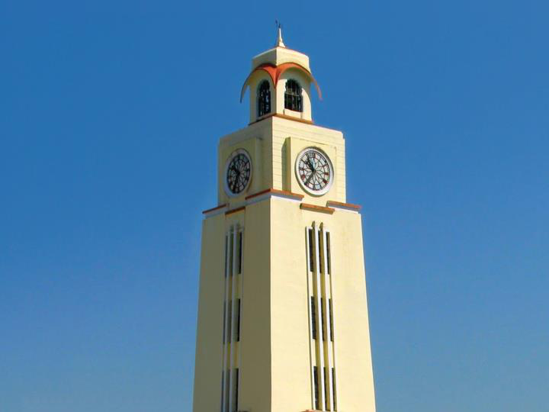

Vital Wristband: TinyML Fall Detection and Vital-Sign Monitoring on ESP32
Course No: BITS F312 · Neural Networks & Fuzzy Logic
BITS Pilani
Course Instructor: Dr. V. Kalaichelvi, Associate Professor/EEE
Dubai Campus
Presented by: [Student name (ID)], [Student name (ID)], [Student name (ID)]
November 2026
Notes:
Our project is the Vital Wristband: a low-cost ESP32 wristband that detects falls with an on-device neural network, monitors heart rate, blood oxygen and breathing rate, reminds the wearer to take medication and alerts a caregiver dashboard. The software is complete and verified; the hardware build is planned for completion by 10 December 2026.

Slide 2

OUTLINE
Outline
1
Introduction
5
Experiments
Why falls and vitals need watching
Baselines, ablation, cross-validation
2
Problem statement
6
Results
The gap we close
Software results, hardware feasibility
3
Literature review
7
Future work
Market wristbands and research
Hardware plan to 10 Dec 2026
4
Design and implementation
Hardware, firmware, ML, dashboard
2
BITS Pilani, Dubai Campus
Notes:
Seven parts, in the order of the brief. Sections 4 to 6 carry most of the work.

Slide 3
1 · INTRODUCTION
Falls are common; lying unnoticed is the danger
684,000
Our wristband in one sentence
An ESP32 band that detects falls on the device with a 14 KB neural network, tracks heart rate, SpO₂ and breathing rate, rings for medication and alerts a caregiver dashboard over WiFi.
deaths from falls worldwide each year, the second leading cause of unintentional injury death
37.3 million
Fall detection
Vital signs
falls a year severe enough to need medical attention; adults over 60 suffer most
state machine + TinyML
PPG signal processing
Medication
Caregiver view
Source: World Health Organization, “Falls” fact sheet, 26 April 2021.
RTC alarms, escalation
live web dashboard
3
BITS Pilani, Dubai Campus
Notes:
According to the WHO about 684,000 people die from falls each year and 37.3 million falls need medical attention. For older people living alone, lying on the floor for hours without help makes outcomes far worse. Our wristband detects the fall, lets the wearer cancel a false alarm, and otherwise alerts a caregiver within seconds. It also watches heart rate, blood oxygen and breathing, and reminds the wearer to take medication.

Slide 4
2 · PROBLEM STATEMENT
Reliable fall alerts cost too much or need the cloud
Design a low-cost wristband that detects falls on the device with few false alarms, monitors HR, SpO₂ and respiratory rate, enforces medication adherence and alerts a caregiver, within the memory and battery budget of an ESP32.
Cost and subscriptions
False alarms
Missing pieces
Smartwatches with fall detection cost US$300–400; medical-alert services add a monthly fee.
Threshold-only detectors fire on jumps, sit-downs and wrist slaps, so people stop wearing them.
Budget bands have no fall detection and no caregiver escalation for missed doses.
Engineering constraints
520 KB SRAM · 4 MB flash
50 Hz IMU: 20 ms per sample
LiPo battery, radio mostly off
Works offline, no cloud inference
Objectives
Detect falls with ≥ 95 % recall on people the model has never seen, with few false alarms
Estimate HR, SpO₂ and breathing rate with motion rejection and persistence checks
Run fully in simulation now, and on a ≈ US$30 wristband by 10 December 2026
4
BITS Pilani, Dubai Campus
Notes:
Build a low-cost wristband that detects falls on the device with few false alarms, monitors heart rate, SpO2 and breathing rate, enforces medication adherence and alerts a caregiver, within an ESP32's memory and battery budget. Three gaps motivate it: cost, false alarms and missing features.

Slide 5
3 · LITERATURE REVIEW: WRISTBANDS ON THE MARKET
How existing wristbands compare with ours
Product | Approx. price | Fall detection | SpO₂ | Breathing rate | Missed dose → caregiver | Monthly fee
Apple Watch Series 10 | from US$399 | Yes | Yes¹ | Sleep only | No | No
Samsung Galaxy Watch7 | from US$299 | Yes | Yes | Sleep only | No | No
Google Pixel Watch 3 | from US$349 | Yes | Yes | Sleep only | No | Optional
Fitbit Charge 6 | US$160 | No | Yes | Sleep only | No | Optional
Medical-alert watch² | US$100–200 | Paid add-on | Varies | No | No | US$30–45
Budget band (Noise, boAt) | US$20–50 | No | Spot check | No | No | No
Vital Wristband (ours) | ≈ US$30 parts | On-device CNN | Yes | Continuous | Yes, after 5 min | No
Cost
Features
Open
about one tenth of a fall-detecting smartwatch, no subscription
only option with falls, breathing rate and missed-dose escalation
on-device inference, open-source firmware, self-hosted dashboard
Prices: approximate US launch prices of 2023–24 models; check before citing. ¹ Availability varies by region. ² e.g. Medical Guardian, Bay Alarm Medical; monitoring fees are a typical range.
5
BITS Pilani, Dubai Campus
Notes:
Premium smartwatches detect falls but cost 300 to 400 dollars, measure breathing only during sleep and none escalate a missed dose to a caregiver. Fitness and budget bands have no fall detection. Medical-alert watches charge a monthly fee. Our parts cost about 30 dollars with no subscription.

Slide 6
3 · LITERATURE REVIEW: RESEARCH
What earlier work did, and what it left open
Work | Sensors / placement | Method | Gap for a wristband
Bourke et al., Gait & Posture, 2007 | Accelerometers, trunk and thigh | Fixed thresholds | Fires on hard daily activities
Özdemir & Barshan, Sensors, 2014 | 6 Xsens units incl. wrist (UCI data) | k-NN, SVM, ANN offline | PC-side, six sensors, no vitals
Sucerquia et al., Sensors, 2017 | Waist device, 38 subjects (SisFall) | Threshold features | Waist, not wrist; no learned model
Musci et al., IEEE TETC, 2021 | Waist IMU (SisFall) | LSTM, online | Recurrent nets costly on MCUs
Charlton et al., IEEE RBME, 2018 | PPG and ECG | Review: breathing rate | Basis of our 0.1–0.5 Hz filter
David et al., MLSys, 2021 | Microcontrollers | TensorFlow Lite Micro | The runtime we deploy on
This project | 1 wrist IMU + PPG on ESP32 | Trigger + int8 1D-CNN + DSP | Tested on unseen wrist subjects
Most published detectors are waist-worn or run off-device. We pair a cheap trigger with a CNN that fits in 14 KB and test it on people it never saw.
6
BITS Pilani, Dubai Campus
Notes:
Early detectors used fixed thresholds. The UCI dataset compared classifiers offline with six sensors. SisFall, our main dataset, is waist-worn. Recurrent networks are heavy for a microcontroller. Charlton's review underpins our breathing-rate filter, and TensorFlow Lite Micro is our runtime.

Slide 7
4 · DESIGN AND IMPLEMENTATION
System architecture
Sensors
ESP32 · FreeRTOS
Caregiver side
MPU6050 IMU, 50 Hz
MAX30102 PPG, 25 Hz
DS3231 RTC + EEPROM
Buttons A and B
Battery voltage (ADC)
motion_task: fall trigger + int8 CNN
vitals_task: HR, SpO₂, RR
reminder_task: RTC alarms
alert_task: queues → WiFi
Buzzer, vibration, watchdog
server.py: FastAPI webhook + SQLite
app.py: Gradio dashboard
Alerts, trends, acknowledge
WiFi
JSON
I²C
Inference on the device
Radio off by default
Simulation mode
Raw motion data never leaves the band; only events and vitals are sent.
WiFi wakes at once for a fall or SOS, otherwise every 5 minutes.
Every sensor has a realistic mock, so all software runs without hardware.
7
BITS Pilani, Dubai Campus
Notes:
Sensors share one I2C bus. The ESP32 runs four FreeRTOS tasks. A Python webhook receiver stores events in SQLite and a Gradio dashboard shows them. Inference happens on the device, the radio stays off except to send, and every sensor has a simulated version.

Slide 8
4 · DESIGN AND IMPLEMENTATION: HARDWARE
Hardware required: about US$30 of parts
Component | Role | Interface / ESP32 pin | ≈ US$
ESP32-WROOM-32 dev board | Dual-core MCU, WiFi | I²C SDA 21, SCL 22 | 6
MPU6050 (GY-521) | Accel + gyro: fall detection | I²C 0x69 · INT GPIO27 | 2
MAX30102 | Red/IR PPG: HR, SpO₂, RR | I²C 0x57 · INT GPIO32 | 3
DS3231 + AT24C32 | Dose alarms, event log | I²C 0x68 / 0x50 · INT GPIO33 | 3
2 tactile buttons | Cancel / SOS, confirm dose | GPIO4, GPIO13 | 0.5
Active buzzer + vibration motor, 2 NPN | Local alarm | GPIO25, GPIO26 | 2
3.7 V LiPo 500 mAh + TP4056 charger | Battery, USB charging | 100k/100k divider → GPIO34 | 6
Perfboard, 3D-printed case, strap | Wearable enclosure | n/a | 7
Total | ≈ AED 110 |  | ≈ 30
Address clash fixed in design: the DS3231 module’s EEPROM ships at 0x57, the same as the MAX30102, so we bridge its A0–A2 pads to move it to 0x50. Prices are approximate online retail.
8
BITS Pilani, Dubai Campus
Notes:
Everything needed to build the wristband for about 30 US dollars. One detail caught in design: the RTC module's EEPROM defaults to 0x57, which clashes with the oximeter, so we move it to 0x50.

Slide 9
4 · DESIGN AND IMPLEMENTATION: FIRMWARE
Four FreeRTOS tasks on two cores
Task | Core | Prio | Period | Job
motion | 1 | 5 | 20 ms | Read IMU, fall trigger, TFLite Micro inference, PPG motion gate
vitals | 1 | 4 | 40 ms | Drain MAX30102 FIFO; HR / SpO₂ / RR every second; 30 s persistence
reminder | 0 | 3 | 250 ms | DS3231 alarm interrupt, nag pattern, MED_TAKEN or MED_MISSED
alert | 0 | 2 | event | Queue set (HIGH first); WiFi on → JSON POST → WiFi off; retries
loop | 1 | 1 | 20 ms | Buttons, SOS long-press, battery monitor, stack and heap stats
Queues
Event group
Safety
Build modes
HIGH and LOW alert queues in a queue set; vitals in a 1-slot mailbox
Motion gate, button presses, fall-alarm and dose-pending flags
I²C mutex, task watchdog reboot, model self-test at boot
Simulation, real hardware, and a wrist data-logger
C++17 on Arduino-ESP32 2.0.17 (ESP-IDF 4.4) under PlatformIO; libraries: TensorFlowLite_ESP32, Adafruit MPU6050, SparkFun MAX3010x, RTClib, ArduinoJson 7.
9
BITS Pilani, Dubai Campus
Notes:
Sensing runs on core 1 at the highest priorities, so a slow WiFi connection never delays fall detection. Tasks communicate through priority queues, a mailbox and an event group. For hardware readiness we added an I2C mutex, a task watchdog, a model self-test at boot and a data-logger build.

Slide 10
4 · DESIGN AND IMPLEMENTATION: FALL DETECTION
A cheap trigger, then the CNN decides
Trigger
Stillness
CNN
Countdown
Alert
free fall then > 2.7 g, OR impact > 2.0 g
low motion for 2.5 s after the impact
int8 1D-CNN, p(fall) ≥ 0.5
15 s buzz: any button cancels
FALL event to the dashboard
Why two trigger paths? Measured on held-out falls:
Trigger rule | Falls triggered: SisFall | Falls triggered: real wrist
Free fall < 0.5 g for 60 ms, then impact > 2.7 g (original spec) | 42.9 % | 44.0 %
Spec path OR impact > 2.0 g without free fall (deployed) | 99.2 % | 99.3 %
Real falls often lack a clean free-fall phase: people grab furniture, slide or faint.
The extra path costs nothing: jumps, slaps and jogging fail the stillness check or the CNN.
The window is 128 samples (2.56 s at 50 Hz) with the impact at sample 64, exactly as in training.
10
BITS Pilani, Dubai Campus
Notes:
Every 20 ms sample goes through a cheap trigger. Our original specification required a free-fall valley below 0.5 g followed by an impact above 2.7 g, but on real held-out falls that path fires for only about 43 percent of them, because people grab, slide or faint. We kept it and added a second path: any impact above 2.0 g. Together they fire for about 99 percent of falls. The stillness check and the CNN then reject the extra triggers from jumps and slaps.

Slide 11
4 · DESIGN AND IMPLEMENTATION: THE MODEL
A 1D-CNN small enough for a microcontroller
Layer | Output | Params
Input: 128 samples × 6 axes (g, °/s ÷ 500) | 128 × 6 | 0
Conv 8 @ 7, ReLU, max-pool 2 | 64 × 8 | 344
Conv 16 @ 5, ReLU, max-pool 2 | 32 × 16 | 656
Conv 24 @ 5, ReLU, max-pool 2 | 16 × 24 | 1,944
Conv 32 @ 3, ReLU, global average | 32 | 2,336
Dropout 0.2, Dense 16 ReLU, Dense 1 sigmoid | 1 | 545
5,825
parameters
183 k
multiply-adds per window
13.8 KB
full-int8 TFLite model
Conv1D written as Conv2D with k×1 kernels, so the graph uses only six TFLite Micro ops: CONV_2D, FULLY_CONNECTED, LOGISTIC, MAX_POOL_2D, MEAN, RESHAPE.
Full-integer int8 post-training quantization; float vs int8 decisions agree on 99.65 % of test windows.
Two reference windows are embedded in the firmware and scored at every boot as a self-test.
11
BITS Pilani, Dubai Campus
Notes:
Four convolution blocks and a small dense head: 5,825 parameters, 183 thousand multiply-adds and a 14 KB int8 model. Writing 1D convolutions as 2D keeps the model to six operators that TensorFlow Lite Micro supports. The firmware scores two reference windows at boot to prove the interpreter works.

Slide 12
4 · DESIGN AND IMPLEMENTATION: VITAL SIGNS
Three vital signs from one optical sensor
Vital | Signal chain (MAX30102 at 25 Hz) | Alarm
Heart rate | IR → band-pass 0.5–4 Hz → adaptive peak detector → median beat interval | < 40 or > 130 bpm
SpO₂ | Ratio of ratios R = (AC/DC)red ÷ (AC/DC)IR; SpO₂ = 110 − 25·R | < 90 %
Breathing rate | IR baseline, decimate 25 → 5 Hz, band-pass 0.1–0.5 Hz, count breaths | < 8 or > 28 /min
Motion gate
30-second persistence
When the IMU sees movement (std of |a| > 0.06 g or gyro > 35 °/s), PPG samples are discarded and filters re-arm, so arm swing never becomes a fake heartbeat.
An alert goes out only after a vital stays abnormal for 30 consecutive valid seconds; it re-arms after 2 minutes.
Filters: 4th-order Butterworth band-passes from cascaded biquads, initialised to steady state so the large PPG DC level causes no start-up transient.
12
BITS Pilani, Dubai Campus
Notes:
Heart rate uses a 0.5 to 4 hertz band-pass and peak detection. SpO2 uses the ratio of ratios. Breathing rate uses the 0.1 to 0.5 hertz band-pass from the brief on the decimated PPG baseline. The motion gate and 30-second persistence keep false alarms down.

Slide 13
4 · DESIGN AND IMPLEMENTATION: DATA
Three datasets, 75 people, 37,966 windows
Dataset | Sensor and placement | People | Trials → windows | Role
SisFall (Sucerquia et al., 2017) | ADXL345 + ITG3200, waist, 200 Hz | 38 (15 aged 60+) | 4,505 → 18,469 | Train / validate / test
UCI Simulated Falls & ADL (Özdemir & Barshan, 2014) | Xsens MTw, right wrist, 25 Hz | 17 | 3,326 → 14,497 | 12 train, 5 unseen test
Synthetic wrist (our generator) | Physics model of wrist falls and daily activities | 20 virtual | → 5,000 | Augmentation
Why each one
SisFall: the largest public fall set, 15 falls and 19 daily activities, including older adults.
UCI wrist: real right-wrist recordings, the placement we build; 5 volunteers are never trained on.
Synthetic: covers wrist-specific motion SisFall lacks: arm swing, table slaps, jumps, sit-downs.
13
BITS Pilani, Dubai Campus
Notes:
We trained on three sources. SisFall is the largest public fall dataset with 38 people including 15 older adults, but it is waist-worn. The UCI dataset gives real right-wrist recordings from 17 volunteers; we train on 12 and keep 5 as an unseen test. Our synthetic generator adds wrist-specific motions.

Slide 14
4 · DESIGN AND IMPLEMENTATION: DATA PREPARATION
From raw recordings to model-ready windows
1
Parse
2
Convert units
3
Resample to 50 Hz
4
Window
SisFall text files; UCI Xsens exports (wrist sensor only)
ADC counts, m/s², rad/s → g and °/s
SisFall 200 Hz block-average; UCI 25 Hz interpolation
128 samples with the impact at sample 64, ±10 jitter
5
Hard negatives
6
Subject-wise split
7
Augment
8
Balance
ADL windows centred on each trial’s 3 strongest peaks
no person in both train and test
random 3-D rotation, gain 0.9–1.1, noise σ 0.02
class weights; int8 calibration on 1,000 windows
14
BITS Pilani, Dubai Campus
Notes:
Eight preparation steps. Each trial is parsed and converted to g and degrees per second, resampled to 50 hertz, and cut into 2.56-second windows with the impact at sample 64, the same alignment the firmware uses. Daily-activity windows are centred on their strongest peaks, because those are the hard cases the trigger hands to the model. Splits are by person, never by window. Training adds random rotations so the model does not depend on how the sensor sits in the strap. The chart shows a waist fall, a wrist fall and a jump.

Slide 15
4 · DESIGN AND IMPLEMENTATION: TRAINING
Training procedure
Setting | Value
Training windows | 24,558 (validation: separate subjects)
Optimiser | Adam, learning rate 2 × 10⁻³, batch 64
Learning-rate schedule | × 0.5 when validation loss plateaus for 4 epochs
Early stopping | patience 8; best epoch kept (25 of 40 run)
Loss | binary cross-entropy with balanced class weights
Augmentation | rotation ± 180°, gain 0.9–1.1, Gaussian noise σ 0.02
Deployment | int8 post-training quantization, calibrated on 1,000 windows
15
BITS Pilani, Dubai Campus
Notes:
The deployed model trains with Adam, a plateau learning-rate schedule and early stopping on a validation set of separate people. Augmentation with random rotations, gain and noise makes it robust to sensor mounting and tolerance. Training and validation curves track each other closely, so the model is not over-fitting.

Slide 16
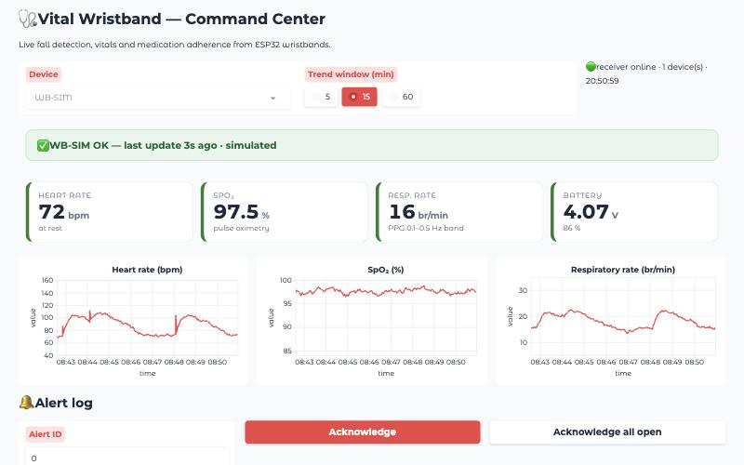
4 · DASHBOARD: CAREGIVER VIEW (GRADIO)
Scenario 1: normal monitoring
Everything normal
Green banner; live heart rate, SpO₂, breathing rate and battery; 15-minute trends built from the telemetry heartbeat.
16
BITS Pilani, Dubai Campus
Notes:
The Gradio dashboard during normal monitoring. Vitals arrive with each telemetry heartbeat and the trends show the last 15 minutes.

Slide 17
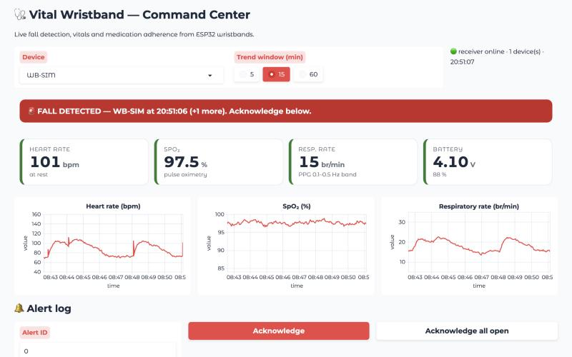
4 · DASHBOARD: CAREGIVER VIEW (GRADIO)
Scenario 2: fall detected
FALL alert
The wearer did not cancel within 15 s: a flashing red banner stays until a caregiver acknowledges it.
17
BITS Pilani, Dubai Campus
Notes:
A fall has been confirmed. The band sent a FALL event with the model probability and impact strength; the banner flashes until acknowledged.

Slide 18
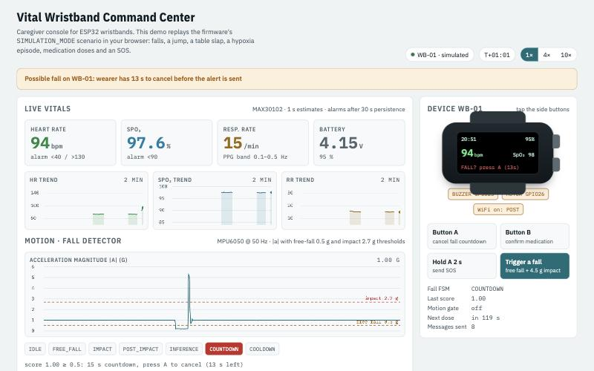
4 · DASHBOARD: WHAT THE BAND SEES (LIVE DEMO)
Scenario 3: fall and countdown
Free fall, 5 g impact, stillness → CNN → countdown
The trace shows the free-fall dip and impact spike; the band buzzes “FALL? press A” for 15 s.
18
BITS Pilani, Dubai Campus
Notes:
From the live demo, which runs the firmware scenario in the browser. The acceleration trace shows the free-fall dip and the impact; the wearer lies still, the model scores it and the countdown starts.

Slide 19
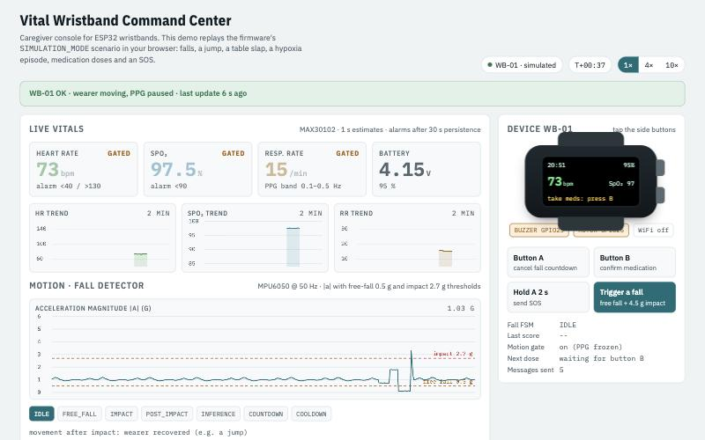
4 · DASHBOARD: WHAT THE BAND SEES (LIVE DEMO)
Scenario 4: a jump is not a fall
Jump rejected: “wearer recovered”
A real free fall and a 3.8 g landing, but the wearer keeps walking, so the stillness check stops it. PPG readings are gated while moving.
19
BITS Pilani, Dubai Campus
Notes:
A jump passes the free-fall and impact checks, but the wearer keeps moving, so it is rejected before the model even runs. The vitals cards show GATED because the arm is moving.

Slide 20
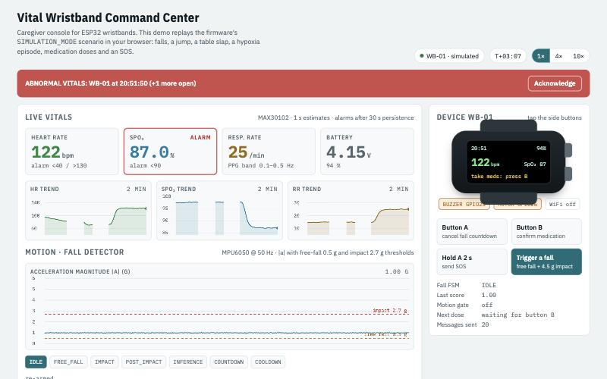
4 · DASHBOARD: VITAL SIGNS
Scenario 5: low blood oxygen
VITALS_ABNORMAL after 30 s
SpO₂ 87 %, heart rate 122, breathing rate 25 for over 30 consecutive seconds; the band shows the alarm too.
20
BITS Pilani, Dubai Campus
Notes:
A simulated hypoxia episode. After 30 consecutive seconds below 90 percent the band sends VITALS_ABNORMAL and the banner turns red.

Slide 21
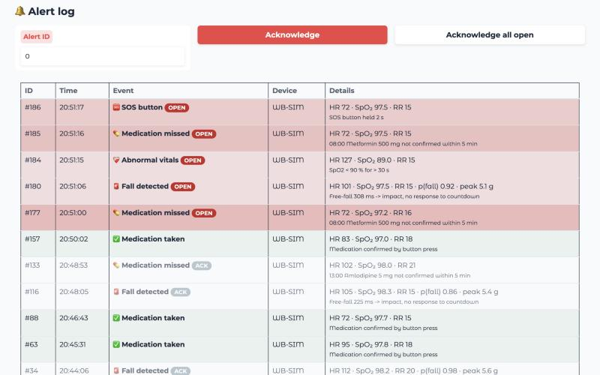
4 · DASHBOARD: CAREGIVER VIEW (GRADIO)
Scenario 6: SOS and missed medication
Alert log
SOS (button A held 2 s), missed doses after the confirm window, abnormal vitals and falls stay open until acknowledged.
21
BITS Pilani, Dubai Campus
Notes:
The caregiver's alert log. Critical events stay highlighted until acknowledged; confirmed doses show in green; each row carries the vitals at the moment of the event.

Slide 22
5 · EXPERIMENTS
Seven experiments, all on unseen people
# | Experiment | Question it answers
E1 | Baselines: threshold rules, rule-based score, Random Forest, CNN | Is a neural network needed at all?
E2 | Ablation: 5 training recipes | Which data and augmentation help on a real wrist?
E3 | 5-fold subject-wise cross-validation | Is the result stable across people?
E4 | Decision-threshold sweep | Where should p(fall) be cut?
E5 | Per-activity errors | Which falls are missed, which activities false-alarm?
E6 | Firmware simulation, 80 simulated minutes | Does the whole pipeline work end to end?
E7 | Trigger analysis | Does the threshold trigger let real falls through?
Test sets: 4,767 windows from 12 held-out SisFall and synthetic subjects, and 4,285 windows from 5 held-out UCI wrist volunteers. No test person appears in any training set.
22
BITS Pilani, Dubai Campus
Notes:
Seven experiments, each answering one question. The key rule: every test uses people the model never saw in training, so the numbers estimate performance on a new wearer.

Slide 23
5 · EXPERIMENTS · E1
Baselines: the CNN wins, and stays small
Method | Size
Threshold rules | ~10 comparisons
Rule-based score | ~1k FLOPs
Random Forest | 117,620 tree nodes (~1.4 MB)
CNN float32 | 27.6 KB
CNN int8 (deployed) | 13.9 KB
Threshold rules alone miss most falls.
Random Forest is close on SisFall but drops on the real wrist and needs ~1.4 MB.
The int8 CNN matches float accuracy at 14 KB.
23
BITS Pilani, Dubai Campus
Notes:
Threshold rules alone score an F1 around 0.25, because most real falls do not show the textbook pattern. A Random Forest on 42 hand-crafted features does well on SisFall but drops on the real wrist and would need about 1.4 megabytes. The CNN is the most accurate and fits in 14 KB after int8 quantization.

Slide 24
5 · EXPERIMENTS · E2
Ablation: what made the real-wrist score jump
Rotation augmentation alone lifts real-wrist recall from 80.2 % to 97.3 %: the model stops depending on how the sensor is mounted.
Adding real wrist data and rotation together gives the best wrist recall (98.4 %) with SisFall performance unchanged. This recipe is deployed.
24
BITS Pilani, Dubai Campus
Notes:
Five training recipes, same test people. Training on SisFall alone generalises poorly to the wrist. Random rotation augmentation is the single biggest gain, because it removes the dependence on sensor orientation. Adding real wrist data from 12 UCI volunteers plus rotation gives the best result, so that is the deployed model.

Slide 25
5 · EXPERIMENTS · E3
Five-fold cross-validation across 75 people
Metric | Mean ± std
Accuracy | 98.91 ± 0.22 %
Precision | 99.30 ± 0.07 %
Recall | 98.69 ± 0.38 %
F1 | 98.99 ± 0.21 %
Specificity | 99.18 ± 0.06 %
ROC AUC | 0.9987 ± 0.0008
Folds split by person (GroupKFold); each fold trains a fresh model with the deployed recipe.
25
BITS Pilani, Dubai Campus
Notes:
To check the result is not luck of one split, we re-trained the deployed recipe five times with different held-out people. Accuracy stays around 99 percent with a standard deviation of a few tenths of a percent.

Slide 26
5 · EXPERIMENTS · E7
Trigger analysis changed the firmware
Trigger rule | Triggered falls SisFall | Triggered falls wrist | System recall SisFall | System recall wrist
Free fall then > 2.7 g (spec) | 42.9 % | 44.0 % | 41.4 % | 43.8 %
Free fall < 0.6 g then > 2.0 g | 80.5 % | 72.7 % | 78.2 % | 71.9 %
Impact > 2.7 g only | 93.1 % | 90.9 % | 90.9 % | 89.9 %
Spec OR impact > 2.0 g (deployed) | 99.2 % | 99.3 % | 96.4 % | 97.8 %
System recall = trigger × CNN. The spec trigger alone would cap recall near 44 %.
With the second path, recall reaches 96.4 % (SisFall) and 97.8 % (wrist).
False alarms on the hardest daily-activity windows stay at 0.6 %–1.1 %, before the stillness check.
26
BITS Pilani, Dubai Campus
Notes:
This experiment found a real design flaw before we built hardware. The CNN only runs when the threshold trigger fires. The original free-fall-then-impact rule fires for fewer than half of real falls, so the system would have missed most falls despite an excellent model. Adding an impact-only path lifts system recall to about 96 to 98 percent while false alarms stay around one percent of the hardest daily activity windows.

Slide 27
6 · RESULTS
The deployed model on 17 people it never saw
98.3 %
98.9 %
97.9 %
0.995
accuracy
precision
recall
ROC AUC
Test set (int8 model) | Windows | Accuracy | Precision | Recall | F1
SisFall, 12 held-out subjects | 4,267 | 98.1 % | 98.5 % | 97.1 % | 0.978
UCI real wrist, 5 held-out volunteers | 4,285 | 98.4 % | 99.1 % | 98.4 % | 0.987
Synthetic wrist | 500 | 99.6 % | 99.6 % | 99.6 % | 0.996
All test windows | 9,052 | 98.3 % | 98.9 % | 97.9 % | 0.984
Cross-validated: 98.9 ± 0.2 % accuracy. Model 13.8 KB; float and int8 agree on 99.65 % of decisions.
27
BITS Pilani, Dubai Campus
Notes:
Headline results of the deployed int8 model on 9,052 windows from 17 people it never saw: about 98 percent accuracy, precision and recall, with an AUC of 0.995. Real-wrist performance is as good as SisFall.

Slide 28
6 · RESULTS: ERROR ANALYSIS
Where the remaining errors are
Hardest falls (SisFall) | Detected
F05 trip while jogging | 72.0 %
F06 vertical faint | 96.0 %
F11 backward, sitting down | 96.0 %
F12 lateral, sitting down | 96.0 %
Activities that false-alarm most | False alarms
D18 stumble while walking | 5.7 %
D11 collapse into a chair | 3.7 %
D05 stairs, slowly | 3.6 %
D17 getting in/out of a car | 3.1 %
Trip-while-jogging falls look like running until the impact; more wrist data is the fix.
Car entry and stumbles produce real impacts; the stillness check removes most of these on the device.
Threshold 0.5 sits on a flat part of the curve, so small calibration shifts on hardware will not hurt.
28
BITS Pilani, Dubai Campus
Notes:
The few remaining misses are mostly trips while jogging, which look like running until the impact. The activities that occasionally false-alarm, like getting into a car or stumbling, involve real impacts; the stillness check removes most of these. The threshold sweep shows a flat optimum around 0.5.

Slide 29
6 · RESULTS: FIRMWARE
The firmware pipeline, end to end, in simulation
20/20
0/40
15/15
scripted falls detected
false alerts from jumps and slaps
unit tests passing
Vital sign (vs scenario ground truth) | Mean abs. error | RMSE
Heart rate | 3.4 bpm | 7.4 bpm
SpO₂ | 1.1 % | 2.2 %
Breathing rate | 2.4 /min | 4.7 /min
80 simulated minutes (20 scenario cycles) through the real C++ firmware modules on a PC.
Every fall window scored p = 0.996 by the int8 model.
RMSE is higher than MAE because estimates lag sudden step changes by a few seconds.
Build: ESP32 firmware compiles in simulation, hardware, data-logger and hardware-with-WiFi modes (flash 1.08 MB of 1.9 MB, static RAM 86 KB of 320 KB).
29
BITS Pilani, Dubai Campus
Notes:
We compiled the actual firmware modules on a PC and replayed the simulation scenario for 80 minutes. Every scripted fall was detected, no jump or table slap caused an alert, and vital signs tracked ground truth within a few units. All unit tests pass and the firmware compiles for the ESP32 in all build modes.

Slide 30
6 · RESULTS: HARDWARE FEASIBILITY
Does the software fit the hardware?
Resource | Budget | Needed | Status
App flash | 1.9 MB slot | 1.08 MB (55 %) | Fits (measured)
Static RAM | 320 KB | 86 KB (26 %) | Fits (measured)
Model + tensor arena | — | 13.8 KB + 24 KB | Fits; usage logged at boot
Inference time | < 20 ms (one sample) | 183 k MACs ≈ 5–15 ms (est.) | To measure on device
Battery, 500 mAh | ≥ 24 h target | ≈ 40–55 mA → 9–12 h (est.) | Needs power work
Radio | Off when idle | ≈ 2 s per 5 min + events | Implemented
Measured: compiled firmware size and memory for the ESP32.
Estimated: inference time from the multiply-add count; current from datasheet typicals (ESP32 active ≈ 30–50 mA, MPU6050 ≈ 4 mA, MAX30102 ≈ 1–2 mA).
The firmware prints real inference time, arena use and stack margins at boot, so week 1 of the build replaces every estimate with a measurement.
30
BITS Pilani, Dubai Campus
Notes:
Memory is comfortably within budget: about half the flash slot and a quarter of RAM. Inference time and battery life are estimates; the firmware logs the real numbers at boot so we can confirm them in the first week of the hardware build. Battery life is the main open risk.

Slide 31
6 · RESULTS
Is the software ready for the hardware?
Done and verified
Changed for hardware
Needs the hardware
Firmware compiles in all 3 build modes
15 unit tests pass
20/20 falls, 0 false alerts in simulation
Model: 98 % on 17 unseen people
Dashboard + webhook tested end to end
Impact-only trigger path (recall 43 % → 97 %)
Rotation-trained model with real wrist data
Task watchdog and I²C bus scan
IMU axis remap, wrist LED current
Data-logger build + recorder script
Inference time and arena on ESP32
Sensor orientation on the wrist
PPG quality vs a reference oximeter
Battery life, WiFi range
Fine-tuning on our own wrist data
Verdict: the software is complete and ready to flash; what remains can only be measured on the physical wristband.
31
BITS Pilani, Dubai Campus
Notes:
The software is complete. Before building hardware we made five changes: the extra trigger path, a rotation-trained model with real wrist data, a watchdog and bus scan, an axis remap and LED setting for the wrist, and a data-logger build. What remains can only be measured on the real device.

Slide 32
7 · FUTURE WORK: PLAN OF ACTION
From software to a working wristband by 10 December
Week (2026) | Tasks | Exit criterion
1 · 12–18 Nov | Order parts; breadboard ESP32 + MPU6050 + MAX30102 + DS3231; flash the hardware build | I²C scan finds all 4 chips; self-test passes; inference time logged
2 · 19–25 Nov | Data-logger build: record wrist trials from 5 volunteers (falls onto crash mats); set IMU axis map; tune PPG LED vs a reference oximeter | ≥ 300 labelled trials; SpO₂ within ± 2 % of reference
3 · 26 Nov–2 Dec | Fine-tune the CNN on our wrist data; solder the board; 3D-print case and strap; fit battery; measure current | Wearable prototype v1; model re-validated
4 · 3–9 Dec | System tests: 50 mat falls, 2-hour wear test, vitals vs references, battery run-down, dashboard alerts | Recall ≥ 95 %, ≤ 1 false alarm per 2 h; test report
10 Dec | Final demonstration and report submission | Working wristband alerting the dashboard
Falls are performed only by healthy volunteers onto crash mats. Task owners: [team member names].
32
BITS Pilani, Dubai Campus
Notes:
Week one: parts and breadboard; the I2C scan and self-test confirm the hardware. Week two: record real wrist data and calibrate. Week three: fine-tune the model and build the wearable. Week four: formal tests with clear pass criteria. Final demonstration on 10 December.

Slide 33
7 · FUTURE WORK: RISKS AND NEXT STEPS
Risks we expect, and what comes after
Risk | Mitigation
Battery life (est. 9–12 h) | CPU at 80 MHz, light sleep, MPU FIFO batching; ≥ 24 h
Wrist PPG is noisier than a fingertip | LED tuning, motion gate, report only valid readings
Sensor mounted at another angle | Rotation-trained model + IMU_AXIS_MAP
Dev board too large to wear | ESP32-S3 mini module on a custom PCB
Realistic fall data is scarce | Volunteers on crash mats; data-logger ready
After 10 December
BLE link and a phone app for caregivers
LTE-M or phone tethering for alerts outdoors
Over-the-air firmware updates
TLS and per-device keys on the webhook
Longer trials with older adults, with ethics approval
33
BITS Pilani, Dubai Campus
Notes:
Battery life is the biggest risk; we plan to lower the clock, sleep between samples and batch IMU readings. After the course: a phone app, outdoor connectivity, OTA updates, encryption and properly approved trials with older adults.

Slide 34
Thank you
Questions are welcome.
BITS Pilani
Live demo: huggingface.co/spaces/kkshik/vital-wristband
Source code: github.com/f20230104-dotcom/Vital-armband
Dubai Campus
Notes:
Thank you. The live demo is on Hugging Face and all source code is on GitHub.

